Slide 1
Points of Dispensing and
ESSENCE
Creating a Template for Implementation

Slide 2
What is a point of dispensing (POD)?
Community locations where public health agencies dispense medical counter measures (MCM) during a public health emergency
  Vaccines
  Antiviral drugs
  Antibiotics
  Antitoxins
  Chemical antidotes
Source: https://www.cdc.gov/cpr/readiness/healthcare/closedpodtoolkit/factsheet-mcm.htm

Slide 3
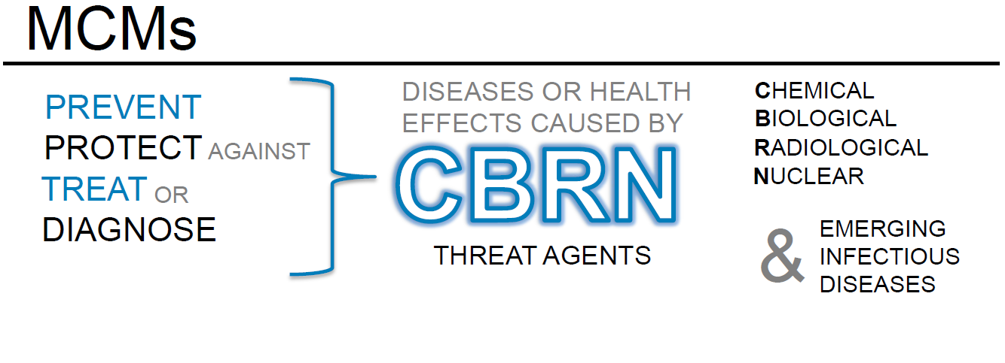
Source: https://www.fda.gov/emergency-preparedness-and-response/about-mcmi/what-are-medical-countermeasures

Slide 4
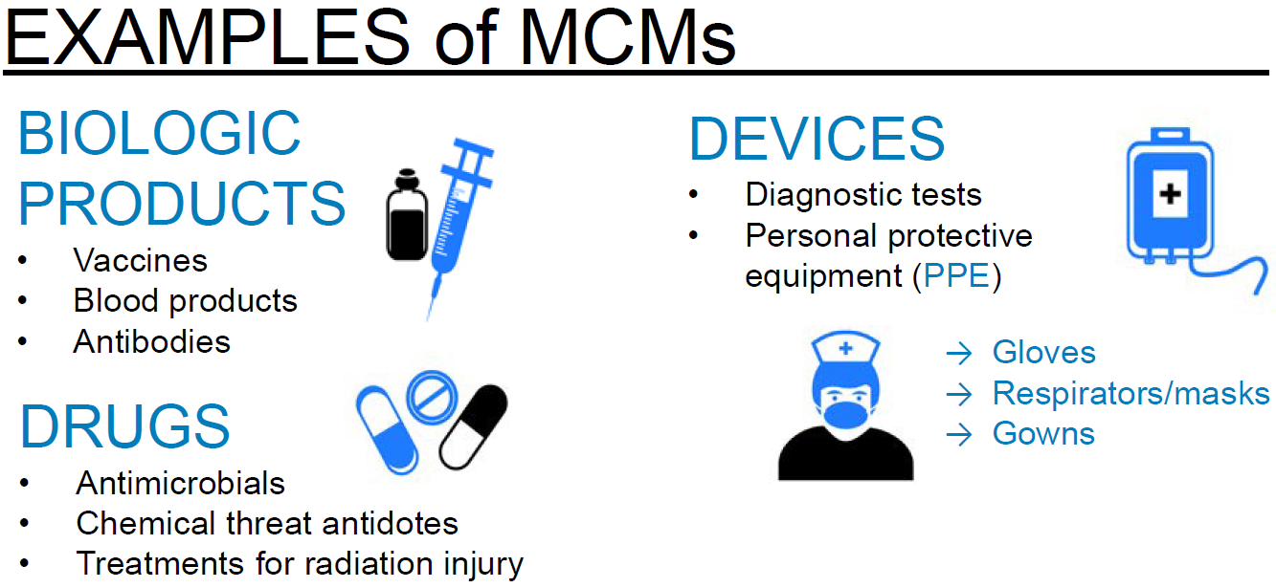
Source: https://www.fda.gov/emergency-preparedness-and-response/about-mcmi/what-are-medical-countermeasures

Slide 5
However…..
Mass distribution of medical countermeasures means there is a small risk of the occurrence of an adverse event
  “Any undesirable experience associated with the use of a medical product in a patient.”
Source: https://www.fda.gov/safety/medwatch/howtoreport/ucm053087.htm
Notes:
Similar to ongoing adverse event surveillance for vaccines, but we need to have a more active method of looking for adverse events during mass vaccination or mass medication events

Slide 6
How can ESSENCE help?
Existing surveillance system that is easily adapted to public health needs as they arise
Free text fields and diagnosis codes allow for flexibility in search parameters
Dashboard capabilities that allow us to set up a skeleton query that can be adapted and activated as needed
Alert subscriptions can be set up to notify public health when there is a visit matching the query

Slide 7
POD Adverse Event Query
Purpose:
Identify hospital visits that may be related to an adverse event associated with a POD for further investigation

Slide 8
POD Adverse Event Query
Basic structure:
(,^point of dispens^
,or,(,^[ ;.,/]pod[ ;.,/]^,andnot,^podiat^,)
,or,(,^drive[ -]thru^,or,^drive[ -]through^,)
,andnot,(,^mcdonald^,or,^burger king^,or,^taco bell^,or,^tacobell^,),)

Slide 9
POD Adverse Event Query
Exclusions:
(,^point of dispens^
,or,(,^[ ;.,/]pod[ ;.,/]^,andnot,^podiat^,)
,or,(,^drive[ -]thru^,or,^drive[ -]through^,)
,andnot,(,^mcdonald^,or,^burger king^,or,^taco bell^,or,^tacobell^,),)
Notes:
A few things to highlight here:
Exclusion terms like podiatry and names of some fast food restaurants were included
There is still some noise on drive through restaurants (7 in a 90 day period), but not much and it probably isn’t worth spending the time to exclude those when they can easily be ruled out in a manual review

Slide 10
POD Adverse Event Query
Adaptability:
(,^point of dispens^
,or,(,^[ ;.,/]pod[ ;.,/]^,andnot,^podiat^,)
,or,(,^drive[ -]thru^,or,^drive[ -]through^,)
,andnot,(,^mcdonald^,or,^burger king^,or,^taco bell^,or,^tacobell^,),)
Notes:
There are parenthesis included around these query terms so that more specific query elements can be added

Slide 11
What can be added*
Name/location where the exposure occurred
  County name where exposure occurred
Name of medication being dispensed
Reference to the county health department
Name of the disease-causing agent
ICD-10-CM code for the disease or any of the symptoms it causes
*not an exhaustive list

Slide 12
Where to look
CCDD
Triage Notes
Admit Reason
Clinical Impression
Notes:
Always look in CCDD, the other fields will depend on county/facility
For example, the largest hospital system in the state does not contain triage notes in ESSENCE records
However, the CCDD field for the largest or only hospitals in some counties are relatively less text rich but the triage notes or other fields are much more text rich

Slide 13
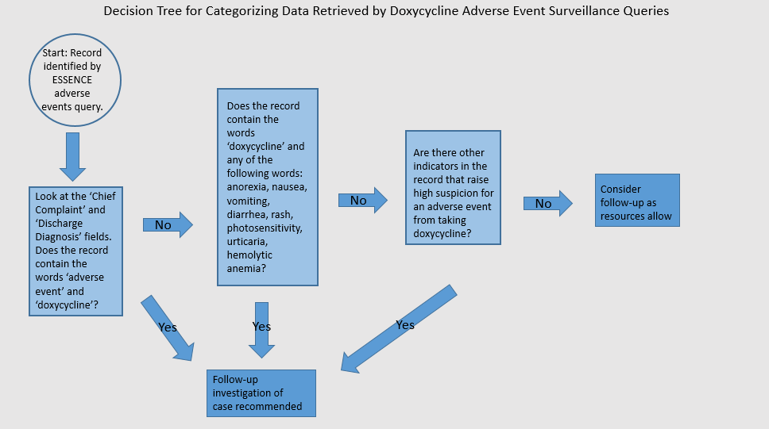
Notes:
This is an example of a decision tree for a POD that dispensed doxycycline

Slide 14
Room for Improvement
Add location of exposure to the list of additional query elements
Add names of the exposure agent/event
Include reporting to VAERS (Vaccine Adverse Reporting System) in the decision tree
Notes:
This was the first iteration of the protocol, so there will be things that can and should improve on as we get more feedback from more partners
There are a few things we should add to the “suggestion” list for what to include in the query. Even though it’s not an exhaustive list, we want to make sure that we’re giving public health users good suggestions for what to include.
Names: both official names and how they media may be referring to the event
Reporting to VAERS in a situation like this is required in the PHEP grant

Slide 15
Next Steps
Other events this template could be adapted to?
Coordinating with other jurisdictions?
Opportunities to practice implementation?

Slide 16
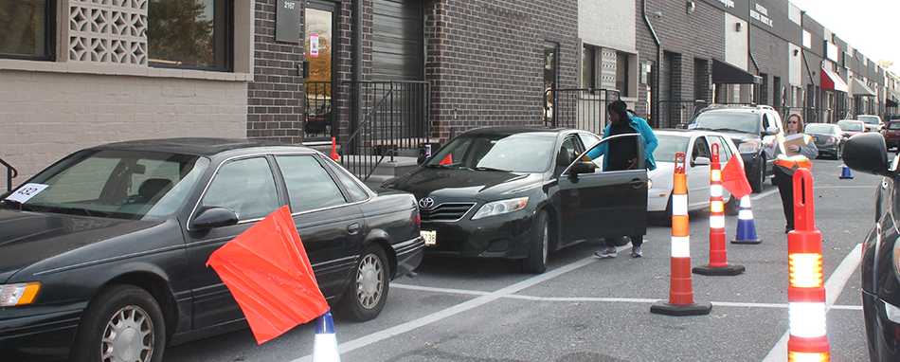
Thank you!
syndromicsurveillance@azdhs.gov
sara.chronister@maricopa.gov
Notes:
This image is from a POD exercise in Baltimore called “Operation Shortbread” where the county of Baltimore partners with the local Girl Scouts chapter to simulate bulk dispensing for a POD. Instead of pills or vaccines, however, they distributed Girl Scout cookies to troop leaders. It turns out that Girl Scout cookies are an almost perfect substitute for what would be distributed during an actual POD event, and in addition to flooding the area with delicious cookies, gave public health emergency preparedness an opportunity to learn and improve how they would respond during an emergency that would require a POD.

