Slide 1

Strategy 3: Surveillance- Illicit Drug Supply

Slide 2
Major Strategy for OD2A is contracted through a substance abuse treatment organization, Gateway, to expand their Project Save Lives (PSL) program, established November 2017.
PSL places Peer Navigators in six area Emergency Departments to engage overdose survivors once stabilized and before they leave the hospital.
Part of PSL protocol is to secure a sample of the urines from OD survivors to analyze in an independent lab, Premier Bio-tech.

Slide 3
Findings from those urines are presented monthly to the OD2A Partner meeting and when appropriate to other venues where the OD2A surveillance data is presented such as:
  Monthly Drug Epidemiology Network (DENS) meetings
  Quarterly stakeholder meetings
  Innovative Strategy Projects meetings
Data may direct us to a side of town or show an emerging trend which will inform our prevention efforts.

Slide 4
Data reported is from urine samples from those who consent to participate in PSL.
The Premier Bio-Tech consultant with OD2A works regularly with the hospitals to collect the samples.
Some hospitals do not see the value in collecting the urine when the patient has already told them that they overdosed and what substances they took.

Slide 5
However
  The patients are not always the best historians
  and
  many times, they do not know what has been added to the substance they ingested before they received it.
Ongoing education and training with the hospitals is provided.

Slide 6


Slide 7
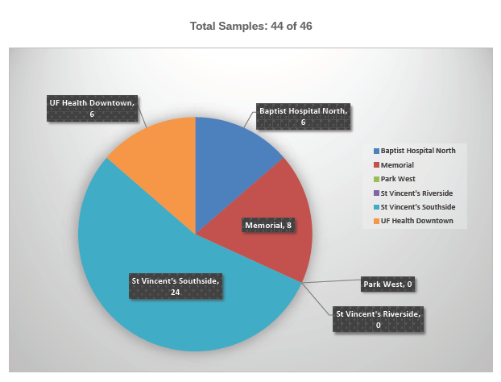

Slide 8
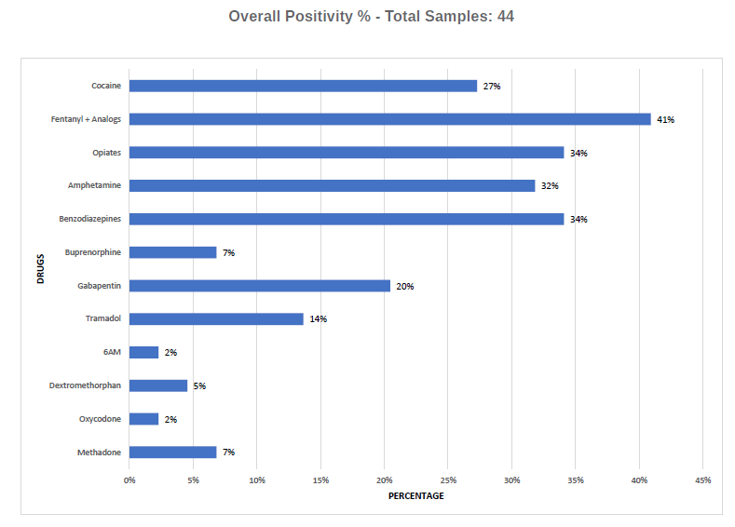
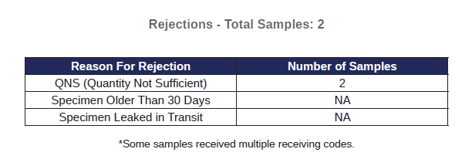

Slide 9
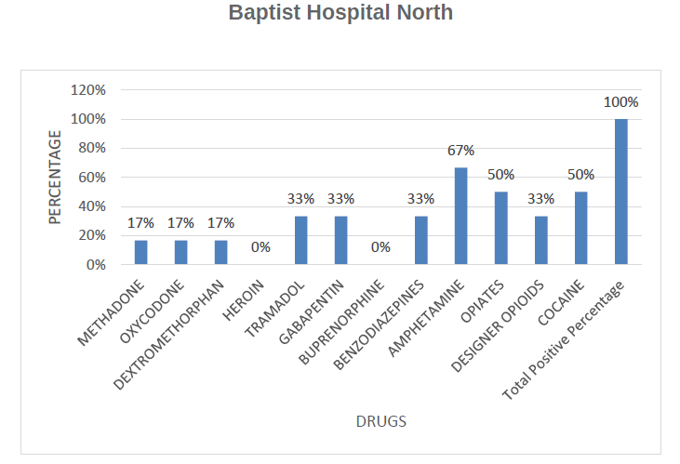

Slide 10
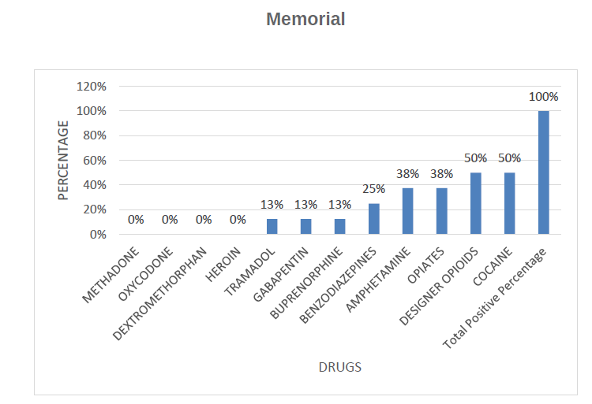

Slide 11
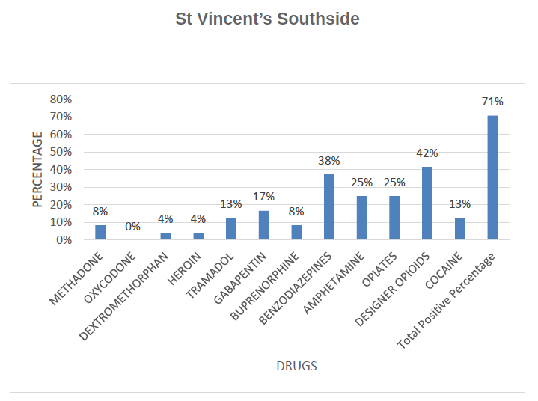

Slide 12
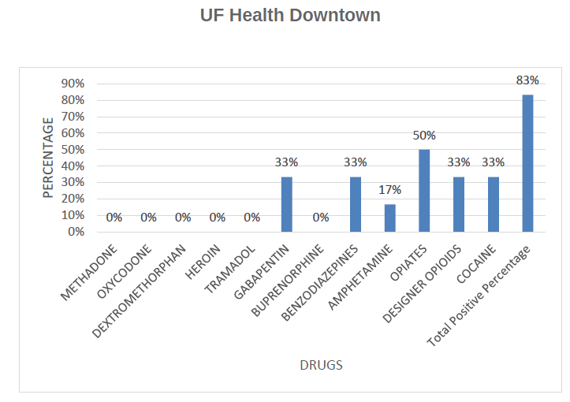

Slide 13
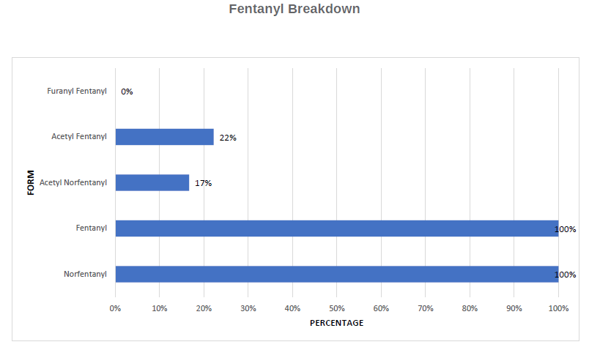

Slide 14
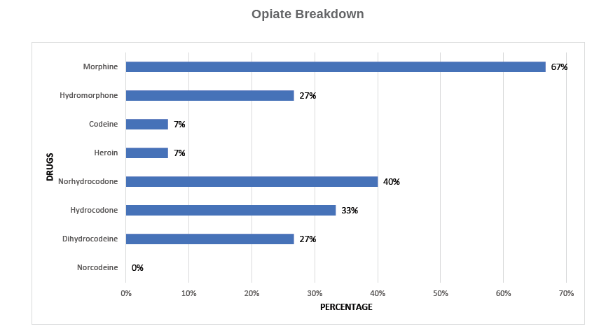

Slide 15
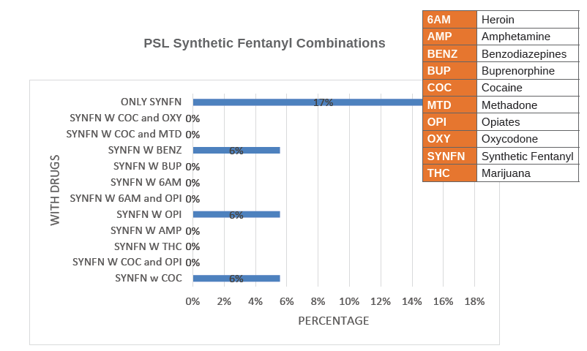

Slide 16
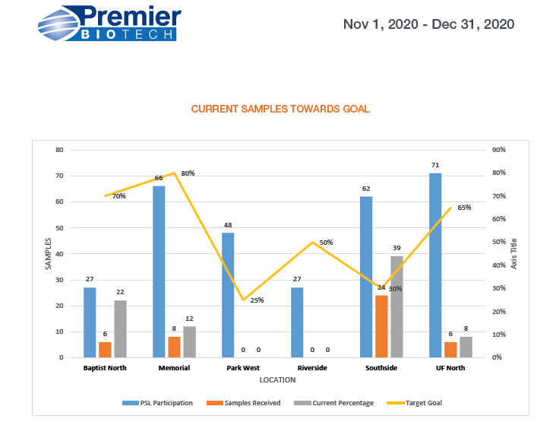

Slide 17
Contact information:
  Carolyn Arnister, Program Manager
  Carolyn.Arnister@flhealth.gov
  Erin Green, Epidemiologist
  Erin.Green@flhealth.gov
  Karen Tozzi, Principle Investigator
  Karen.Tozzi@flhealth.gov

