Slide 1
CSTE OH Spring Planning Meeting
11/03/2022

Slide 2
OH and Climate Change Spring Planning (11/3/2022)
Review draft agenda – add in times (see previous year agenda)
Decide meeting objectives
Identify potential speakers
Plan sessions
  Requires some materials in advance of meeting
    Summary of survey results?

Slide 3
OLD Draft Agenda (1 ½ day meeting)
8 – 8:15 AM: Welcome and Introductions
8:15 AM – 9:15 AM: Working Meeting Background Info
  Why is this important for occupational health?
  Guest speakers???
    Wonder if there is someone we can bring in that’s an expert on climate change and it’s effects on worker health (like Schulte)???
  NIOSH (goals/priorities, what are they currently doing) – ask Marie??
  Survey responses we get from the survey
Group and breakout group discussions??? – rest of first day and second day??
As group, come back together to discuss ideas and narrow down focus
Wrap-up/Next steps

Slide 4
New Draft Agenda (1 ½ day meeting) – Day 1
9 – 9:15 AM: Welcome and Introductions
9:15 – 10:15 AM: Working Meeting Background Info
  Objectives: Why is this important for occupational health?
  Background: Guest speakers???
    Wonder if there is someone we can bring in that’s an expert on climate change and it’s effects on worker health (like Schulte)???
10:15 – 12:30 PM: Breakout group discussions??? – rest of first day and second day??
12:30 – 1:30 PM: Lunch
1:30 – 3PM: Breakout Session #2 - As group, come back together to discuss ideas and narrow down focus
3 – 3:15 PM: Break
3:15 PM –4 PM: Report Back/Final Comments

Slide 5
New Draft Agenda (1 ½ day meeting) – Day 2
9 – 9:15 AM: Regroup
9:15 – 9:45 AM:
  Guest speakers???
9:45 AM – 10:45 AM: Breakout #3
10:45 AM – 12 PM: Discussion/Wrap-up

Slide 6
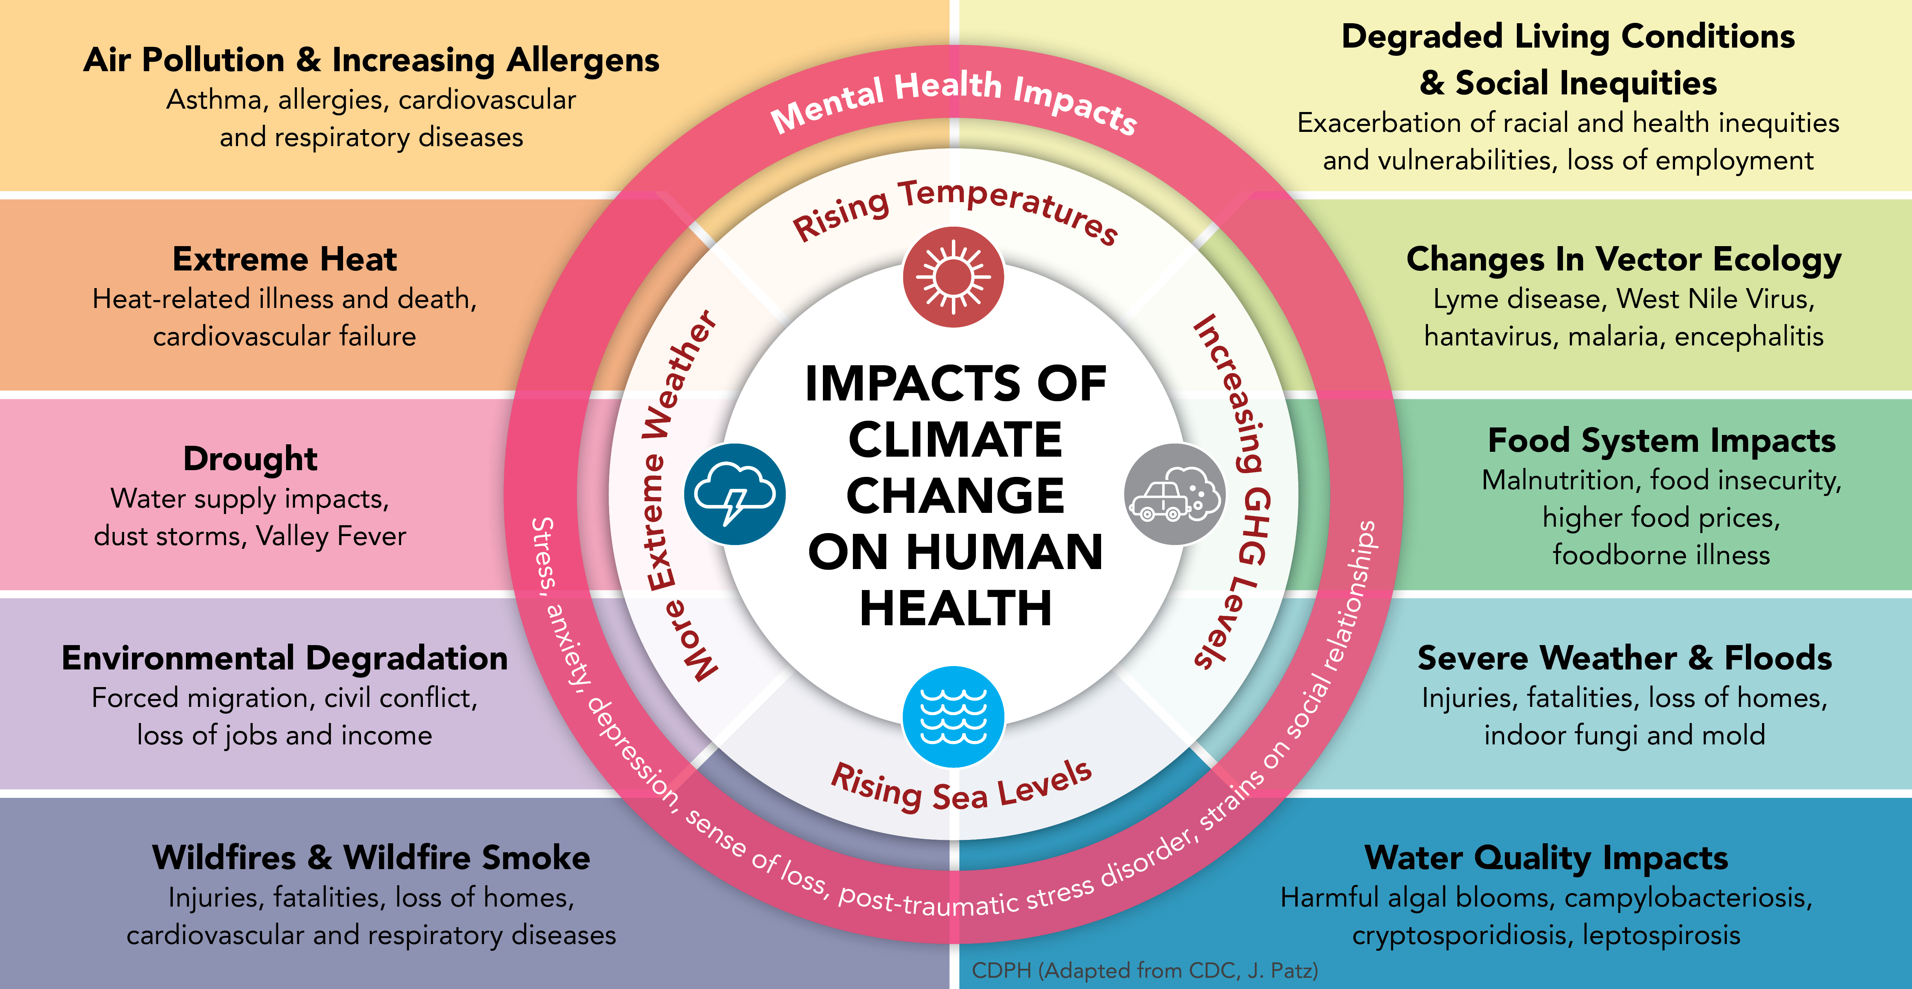
Environmental Health Equity Approach
Background

Slide 7
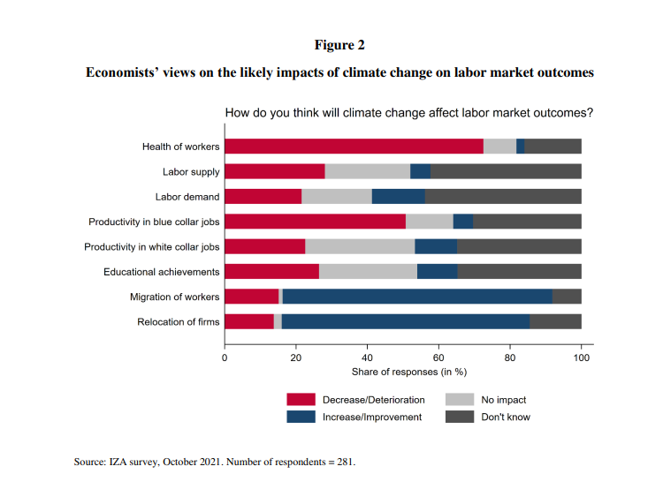
Background
More than 70% economists surveyed think the health of workers will decrease/deteriorate
IZA Institute of Labor Economics. 2021. Why Do Relatively Few Economists Work on Climate Change? A Survey. Discussion Paper Series. IZA DP No. 14885

Slide 8
How Does Surveillance Help?
Background

Slide 9
21st Century OSH Surveillance Objectives
Background
Guide immediate action to control threats to occupational health and safety;
Measure the health and economic burden of work-related injuries or illnesses and monitor trends over time and space;
Identify industries, occupations, and worksites as well as populations defined by sociodemographic characteristics and work arrangements at high risk for work-related injury, illness, or hazardous exposures;
Detect and respond to new or emerging workplace hazards or facilitate the investigation of new diseases linked to occupational exposures;
Guide the planning, implementation, and evaluation of programs and policies intended to prevent and control work-related injuries, illnesses, and hazardous workplace exposures; and
Generate hypotheses and make pertinent data available for research.
National Academies of Sciences, Engineering, and Medicine. A smarter national surveillance system for occupational safety and health in the 21st century. National Academies Press, 2018.

Slide 10
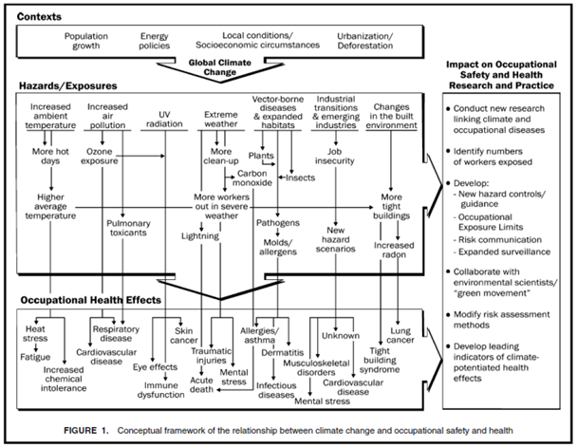
Occupational Lens
Background
Pandemics
Respiratory effects
Neurologic effects
Climate Change and Occupational Safety and Health | Blogs | CDC

Slide 11
Objectives
Background
Identify new data sources and reassess data capacities since pandemic
  Age of digital modernization
Capture approaches to surveillance for climate change and occupational health using guiding principles from disaster epidemiology surveillance:
  Flexibility
  Information needs, population impacts and resource availability
  Capture of work, industry and/or occupation – changing nature of work
  Establish stakeholder relationships
  Dissemination of results
  Security and confidentiality
Document case examples from jurisdictions

Slide 12
Potential External Speaker Ideas
Background
National level
  National Institute of Health
    Climate Change and Health Initiative: Environmental Factor - January 2022: Climate change spurs big new plan for health research (nih.gov)
  NIOSH (goals/priorities, what are they currently doing)
    Paul Schulte?
  National Environmental Health Tracking?
    National Environmental Public Health Tracking Network Data Explorer (cdc.gov)
  Fifth National Climate Assessment | GlobalChange.gov
    Version 5 is set for completion in 2023 – Contact Mary Hayden Chapter Lead on Human Health?
State level
  Maybe can ask a few states who have done work so far to discuss their efforts and working with the data (successes/challenges) and any outreach
    LA (heat – ED discharge data and syndromics); WA (heat – workers’ comp); OR (severe weather – syndromics)
    IL contact at UIC Lee Friedman via Linda Forst

Slide 13
Break Out Session #1 - Heat – Mock Up
Breakouts
Select two data sources to represent state capacity for injury or illnesses – current and future (flexibility)
  Syndromic surveillance – few states
  Electronic health records
  Death certificates – most states
Identify data sources for potential linkages (resource availability)
  Environmental public health tracking data?
Case studies on stakeholders working in the domain
  Health equity groups
  Worker advocacy groups

Slide 14
Break Out Session #2 - Flood – Mock Up
Breakouts
Select two data sources to represent state capacity for injury or illnesses – current and future (flexibility)
  ???
Identify data sources for potential linkages (resource availability)
  ???
Case studies on stakeholders working in the domain
  ???

Slide 15
Break Out Session #3 - Wildfires – Mock Up
Breakouts
Select two data sources to represent state capacity for injury or illnesses – current and future (flexibility)
  Syndromic surveillance
  Electronic health records
  Death certificates
Identify data sources for potential linkages (resource availability)
  National Oceanic and Atmospheric Administration: NOAA Data Discovery Portal
  Bureau of Labor Statistics
Case studies on stakeholders working in the domain
  Health equity groups
  Worker advocacy groups

Slide 16
Next Steps
Action Plan
Identify who to invite
Develop materials for participants
  Background
  Aims for the breakout rooms
  Questions
  Assign roles?
In-person or virtual?
  If virtual how can we ensure retention through the day?

Slide 17
Additional Supporting Slides
Information Only

Slide 18
Climate Change
Long-term change in average weather patterns that have come to define Earth’s local, regional and global climates.
  Global Warming vs. Climate Change | Facts – Climate Change: Vital Signs of the Planet (nasa.gov)

Slide 19
Future Effects of Global Climate Change on the U.S.
Sea level rise (1-8 feet) by 2100
Climate changes will continue through this century and beyond
Hurricanes will be stronger and more intense
More droughts and heat waves
Longer wildfire seasons
Change in precipitation
Frost-free season will lengthen
Global temperatiures will continue to rise
Arctic is very likely to become ice-free
Effects | Facts – Climate Change: Vital Signs of the Planet (nasa.gov)

Slide 20
U.S. Regional Effects
Northeast.
Northwest
Heat waves, heavy downpours, and sea level rise pose increasing challenges to many aspects of life in the Northeast. Infrastructure, agriculture, fisheries, and ecosystems will be increasingly compromised. Farmers can explore new crop options, but these adaptations are not cost- or risk-free. Moreover, adaptive capacity, which varies throughout the region, could be overwhelmed by a changing climate. Many states and cities are beginning to incorporate climate change into their planning.
Changes in the timing of peak flows in rivers and streams are reducing water supplies and worsening competing demands for water. Sea level rise, erosion, flooding, risks to infrastructure, and increasing ocean acidity pose major threats. Increasing wildfire incidence and severity, heat waves, insect outbreaks, and tree diseases are causing widespread forest die-off.
Effects | Facts – Climate Change: Vital Signs of the Planet (nasa.gov)

Slide 21
U.S. Regional Effects
Southeast.
Midwest.
Sea level rise poses widespread and continuing threats to the region’s economy and environment. Extreme heat will affect health, energy, agriculture, and more. Decreased water availability will have economic and environmental impacts.
Extreme heat, heavy downpours, and flooding will affect infrastructure, health, agriculture, forestry, transportation, air and water quality, and more. Climate change will also worsen a range of risks to the Great Lakes.
Effects | Facts – Climate Change: Vital Signs of the Planet (nasa.gov)

Slide 22
U.S. Regional Effects
Southwest.
Climate change has caused increased heat, drought, and insect outbreaks. In turn, these changes have made wildfires more numerous and severe. The warming climate has also caused a decline in water supplies, reduced agricultural yields, and triggered heat-related health impacts in cities. In coastal areas, flooding and erosion are additional concerns.
Effects | Facts – Climate Change: Vital Signs of the Planet (nasa.gov)

Slide 23
Disaster Epi Notes
Successful disaster surveillance activities:
  Need for flexible disaster surveillance response plans
  Have key partnerships established
  Train staff
  Ready to support surveillance activities before an event.
In simple terms, disaster epidemiology is the use of epidemiology to investigate the short- and long-term health effects of disasters and to predict the health consequences of future disasters.

Slide 24
Disaster Epi Questions
Are Yours Systems Flexible? Can You Adapt?
  Choose surveillance strategy - Any existing systems that meet your needs?
      Yes and modify
      No – create a flexible system that can have extended life.
  Public Health Assessment and Surveillance | Natural Disasters and Severe Weather | CDC
What are the start/stop triggers?
  Information needs (e.g., suspected outbreaks of infectious disease, reports of high rates of mental illness, controlling rumors)
  Impact on the population (e.g., displaced or in shelters?)
  Resource availability (e.g., status of PH and health care infrastructure, capacity to conduct surveillance)
  Opening of multiple or long-term evacuation shelters

Slide 25
Additional Disaster Epi Questions
Can existing surveillance forms capture disaster-relatedness?
  Population displacement flags
  Guidance may be needed for EDRS
Who are the relevant stakeholders?
How is the surveillance information going to be used?
What information do you have about the affected population?
What issues of security and confidentiality need to be considered?
What phase of the disaster is it?
  Drives length of data collection and complexity

