Slide 1
CSTE OH: OSH Surveillance x Climate change PRE-WORKSHOP webinar
February 28, 2023

Slide 2
CSTE Oh: OSH Surveillance X climate change
Identify new data sources
Capture approaches to surveillance for climate change and occupational health using guiding principles from disaster epidemiology surveillance:
  Flexibility
  Information needs, population impacts and resource availability
  Capture of work, industry and/or occupation
  Establish stakeholder relationships

Slide 3
PARTICIPANT PACKETS
Participant worksheet (.xlsx)
Primers
Useful resources (.pptx)
  Exposure data sources by climate change issue
  New exposure assessment tools
  Crosscutting tools
Caveats: we may not know what to ask or what the answers are
Explore – jump in
Few have assessed
Trust in your OSH experience
Be open
Think crowdsourcing

Slide 4
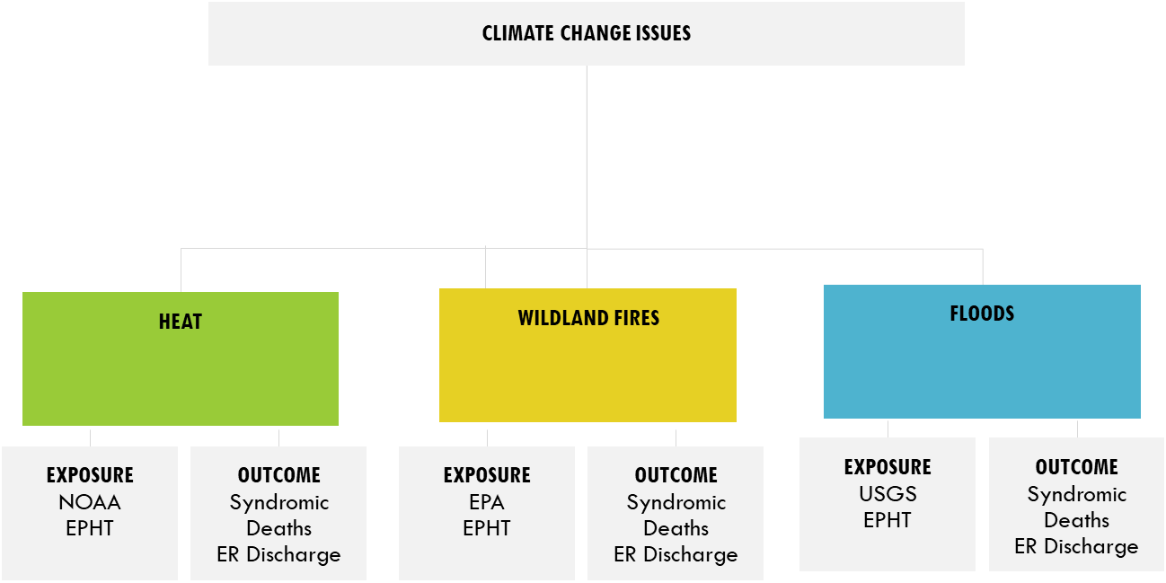
WORKSHEETS
  Aim to assess two outcome and exposure data sources each climate change topic, by ease:
    Easy to access
    Aspirational, complex

Slide 5
SURVEILLANCE DATA SOURCES
CLIMATE CHANGE ISSUES
HEAT
WILDLAND FIRES
FLOODS
EXPOSURE
NOAA
EPHT
OUTCOME
Syndromic
Deaths
ER Discharge
EXPOSURE
EPA
EPHT
OUTCOME
Syndromic
Deaths
ER Discharge
EXPOSURE
USGS
EPHT
OUTCOME
Syndromic
Deaths
ER Discharge
NOAA: National Oceanic and Atmospheric Administration
EPHT: Environmental Public Health Tracking
EPA: US Environmental Protection Agency
USGS: US Geological Survey

Slide 6
WORKSHEET EXAMPLE: Heat
OUTCOME
EXPOSURE
Data source url: if none N/A
Do you currently work with the data source? Y/N
Which state, tribe, local or territory do you work? State/Tribe/County or City
Which states currently doing or can access?
Work variables (e.g. WC Payer, I and O
What are the condn. definitions?
How are data pulled?
What are the potential disease or injury conditions to focus on?
Other important demos? R|E, Sex, Age, tenure
Smallest geographic level unit available? Spatial scale
Geocoded? Y/N
Injury site? Employer? Residential address?
Allow annual counts or estimates?
Years Available
Allows for clustering? If so how?
Allows for case F/U
Availability – real-time or lag?
Pros
Cons
Data source url:
Do you currently work with the data source? Y/N
Which state, tribe, local or territory do you work? State/Tribe/County or City
How many or which states currently?
Measurement variable e.g. temperature or WBGT or modeled surface temperature
Smallest geographic level unit available? Spatial scale
Temporal scale
Geocoded?
Allow for linkage? At which unit level?
Time period availability
Allows for clustering? If so how?
Accessibility – freely available?
Outputs files as txt or csv? Y/N
Pros
Cons

Slide 7
PRE-WORKSHOP REQUESTS
Work on populating tables (.xlsx) for all endpoints
  Fill in as much as possible
  Add questions – add brief comments
Send your populated tables into a single point of contact at CSTE OH Subcommittee planning group by 04/06/23
Be ready to discuss any of the topics at the workshop
Notes:
(Rationale: To engage all for the entirety of the work and will lead to fruitful discussion at the end of Day 1 and Day 2)

Slide 8
Questions?

Slide 9
THANK YOU
Join our March TBD office hours if you have questions!

Slide 10
FEDERAL AGENCIES
DEPARTMENT OF LABOR
HEALTH AND HUMAN SERVICES
OCCUPATIONAL SAFETY & HEALTH ADMINISTRATION
MINING SAFETY & HEALTH ADMINISTRATION
BUREAU OF LABOR STATISTICS
AGENCY FOR HEALTHCARE RESEARCH AND QUALITY
CENTERS FOR DISEASE CONTROL AND PREVENTION
OFFICE OF NATIONAL COORDINATOR
VARIOUS DATA SOURCES FOR EACH ORGANIZATION
National Institute for Occupational Safety and Health (NIOSH) – Adult Blood Lead Epidemiology and Surveillance
Integrated Management Information System – Inspection Data
…
STATE-BASED SURVEILLANCE SYSTEMS
STATE, TRIBAL, LOCAL AND TERRITORIAL AGENCIES

