Slide 1
Spotted Fever Rickettsiosis Position Statement
Abelardo Moncayo, PhD (Submitting and Presenting Author)
and the SFR Core Group

Slide 2
Spotted Fever Rickettsiosis Surveillance Background
1920s: Rocky Mountain spotted fever (RMSF) became nationally notifiable
Between 1990 and 2010, there have five case definition iterations relating to RMSF
2010: category changed to Spotted Fever Rickettsiosis (SFR)
  Change reflects the inability to differentiate between spotted fever group Rickettsia (SFGR) species using commonly available serologic tests
  New category captures cases of RMSF, R. parkeri rickettsiosis, Pacific Coast tick fever, rickettsialpox, and others
Notes:
While CSTE case definitions are for surveillance purposes only and not intended for clinical use, surveillance data provides useful information about risk and disease trends.

Slide 3
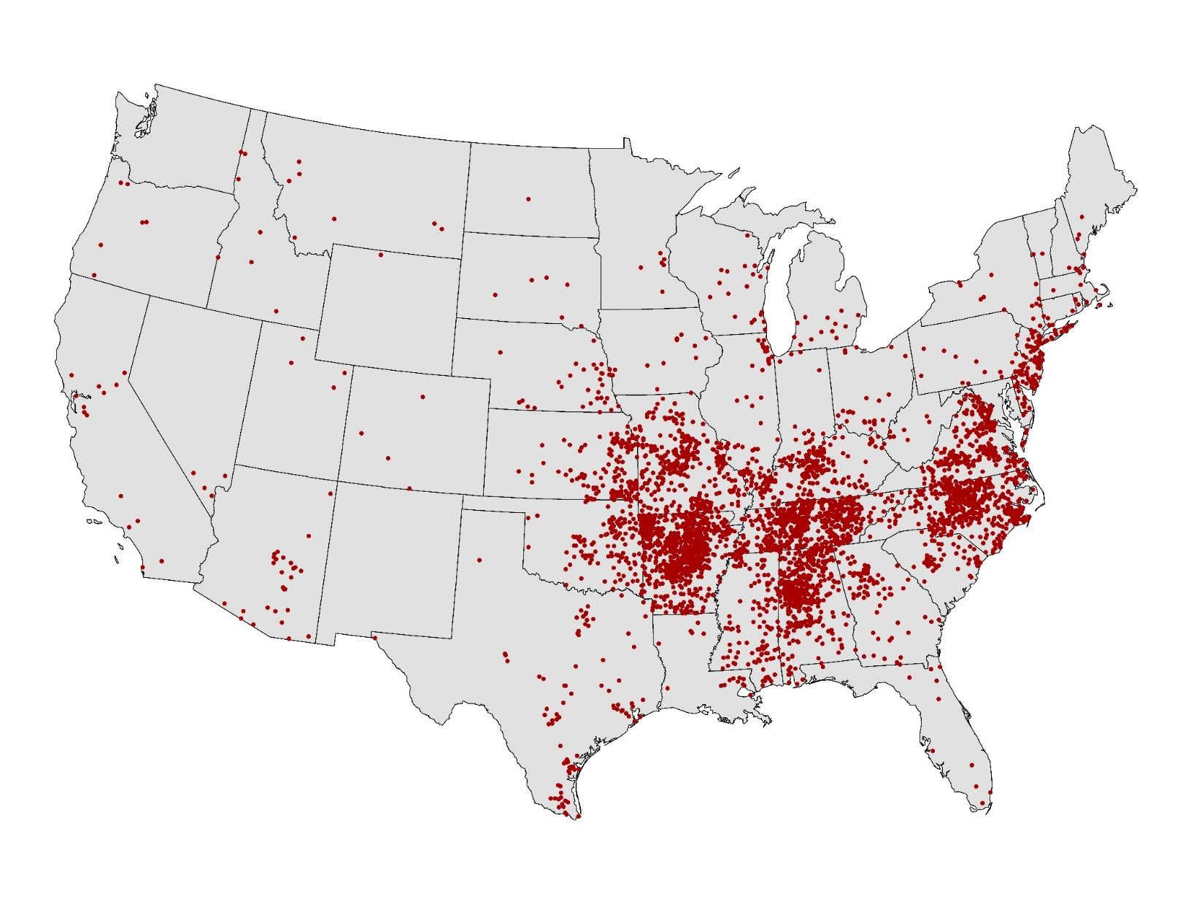
Spotted Fever Rickettsiosis, 2016
NOTE: Each dot represents one case. Cases are reported from the infected person’s county of residence, not necessarily the place where they were infected.

Slide 4
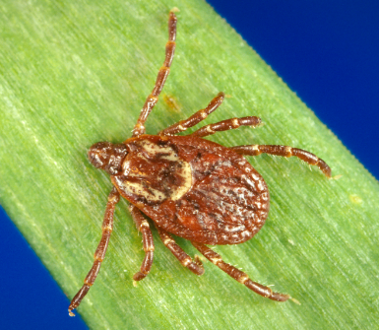
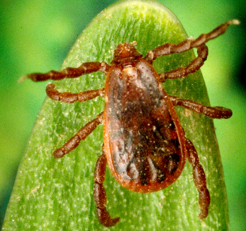
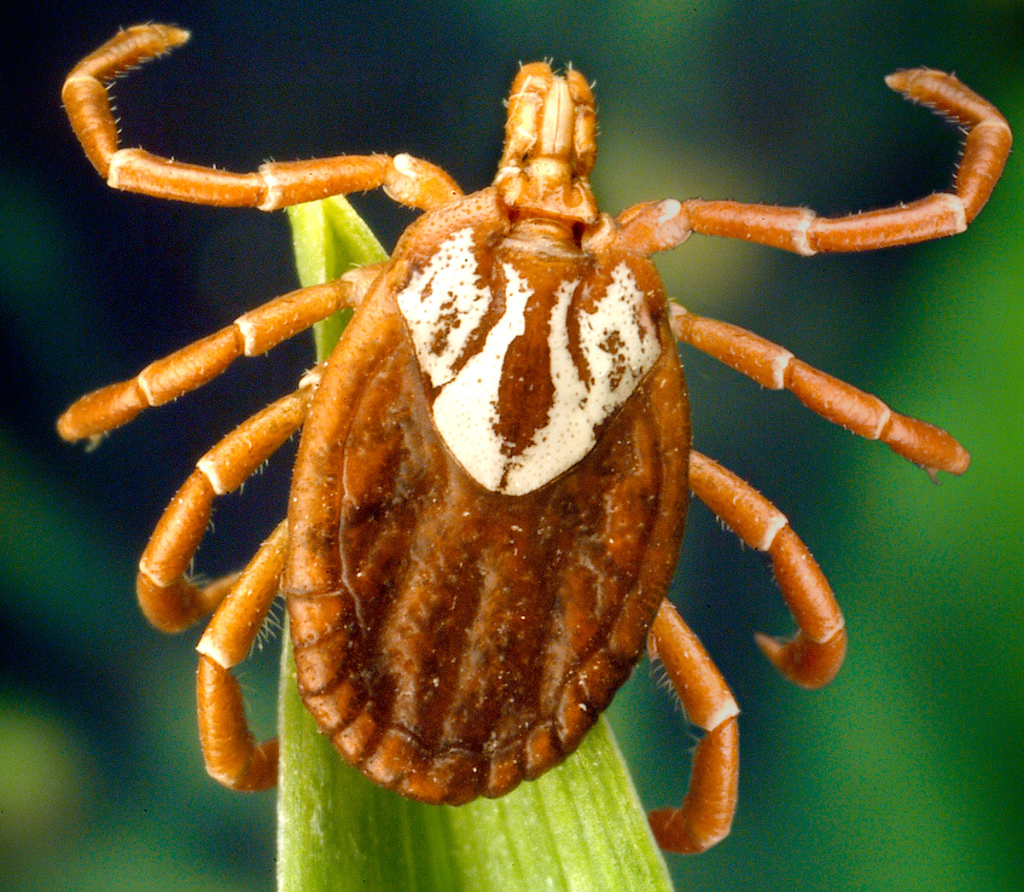
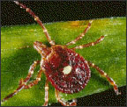
Spotted Fever Rickettsiosis
In 2017, reported cases through NNDSS increased 46% compared to 2016
  From 4,269 cases to 6,248 cases
Annual incidence increased from 2010–2017
  From 6.4 to 19.2 cases per million persons
However, the proportion of confirmed cases decreased to only 3% in 2017

Slide 5
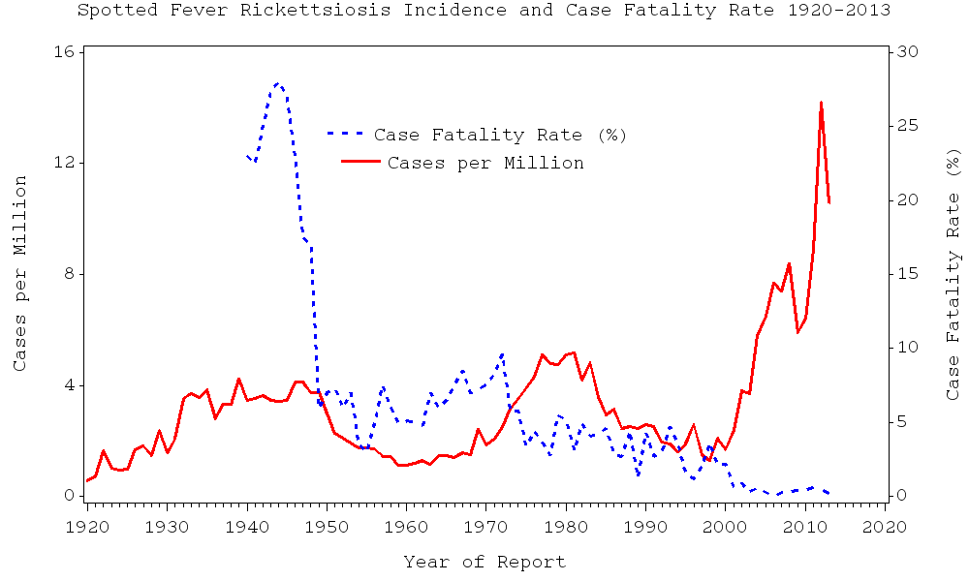
What we don’t know about spotted fevers in the U.S.
How much is R. rickettsii vs. other spotted fever rickettsiosis?
  Historical case fatality rates (CFR) for RMSF 25%
  Surveillance CFR (<1%)
  Very few SFR cases confirmed
  Most data come from single titers

Slide 6
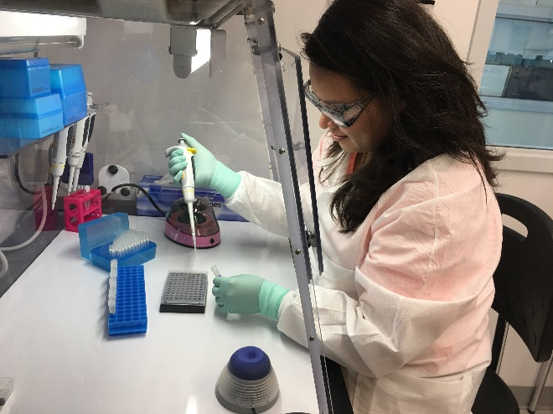
Rickettsia species Real Time-PCR Assay
FDA 510(k)-cleared
Available to certain state and local health departments through Laboratory Response Network (LRN)
Whole blood samples should be collected while patients are symptomatic
Image courtesy of Cecilia Kato and Ida Chung

Slide 7
PCR assays for SFGR
Limitations of PCR in diagnosis of spotted fever rickettsiosis
  Rickettsiae are found in the endothelial cells
  Decreased sensitivity may occur following doxycycline administration
Although a positive PCR result is helpful, a negative result does not rule out the diagnosis
Always collect paired serum specimens for serologic testing, in addition to whole blood, for full diagnostic options
Treatment should never be withheld pending laboratory results

Slide 8
Authors
Abelardo C. Moncayo, Ph.D.
Tennessee Department of Health
Sally Slavinski, DVM, MPH, Dipl ACVPM
NY City Department of Health and Mental Hygiene
Kelly Orejuela, MPH
Tennessee Department of Health
Carl Williams, DVM
North Carolina Division of Public Health
Hayley D. Yaglom, MS, MPH
Arizona Department of Health Services
Kristen Nichols Heitman, MPH
CDC
Shawna Stuck, MPH
Georgia Department of Public Health

Slide 9
Subject Matter Expert (SME) Consultants
CDC Rickettsial Zoonoses Branch
Paige A. Armstrong, MD MHS
Cecilia Y. Kato, PhD
Naomi A. Drexler, MPH
Gilbert J. Kersh, PhD
Christopher Davis Paddock, MD MPHTM
William L. Nicholson, PhD MS
Amy E. Peterson, DVM, PhD

Slide 10
Synopsis
This position statement updates the case definition for Spotted Fever Rickettsiosis (previous position statement 09-ID-16) through changes to the laboratory criteria.

Slide 11
Statement of the Problem
Concerns for accuracy of current surveillance data because of limitations with current serologic assays
  Current laboratory evidence for SFR case definition includes two unreliable tests;
    Positive immunoglobulin M (IgM) serologic assay, and;
    Single positive immunoglobulin G (IgG) serologic assay,
  Neither is reliable for definitively diagnosing acute illness because of potential for inaccurate interpretation
    Recognition of multiple SFR that may cause background low level sero-positivity
    Persistence of IgG over time
    High number of false positive IgMs
Due to these limitations we propose updating the current lab criteria used to classify SFR.
We also propose that final SFR case numbers are omitted from the weekly MMWR surveillance tables, and only included in the MMWR annual surveillance reports.

Slide 12
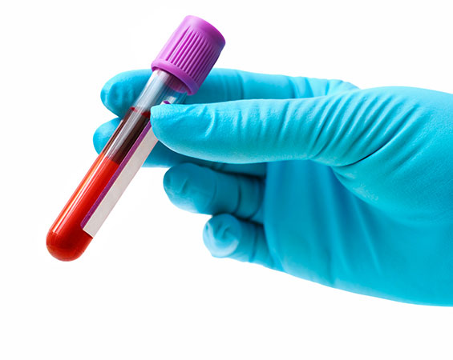
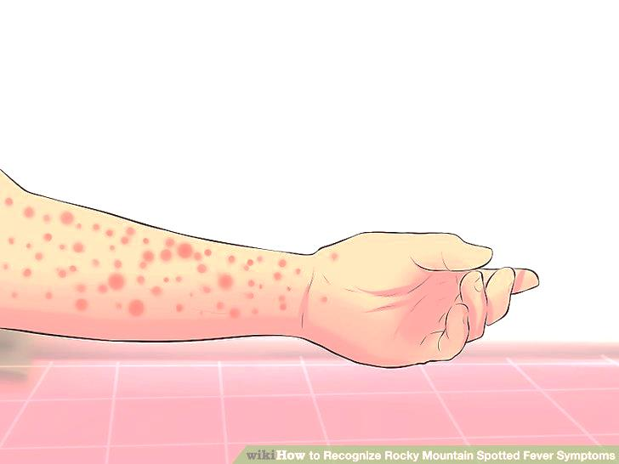
Clinical Criteria for Reporting
Criteria for Case Ascertainment
Laboratory Criteria for Reporting
A person whose healthcare record contains a diagnosis of Spotted Fever Rickettsiosis (including Rocky Mountain spotted fever).
A person whose death certificate lists Spotted Fever Rickettsiosis (including Rocky Mountain spotted fever) as a cause of death or a significant condition contributing to death.
Serologic evidence of a fourfold increase in immunoglobulin G (IgG)-specific antibody titer reactive with spotted fever group Rickettsia, including R. rickettsii, antigen by indirect immunofluorescence assay (IFA) between paired serum specimens, or
Elevated IgG antibody titer reactive with R. rickettsii or other spotted fever group antigen by IFA, or
Detection of spotted fever group Rickettsia, including R. rickettsii, DNA in a clinical specimen via amplification of a species-specific target by PCR assays, or
Demonstration of spotted fever group antigen in a biopsy or autopsy specimen by IHC, or
Isolation of spotted fever group Rickettsia, including R. rickettsii, from a clinical specimen in cell culture and molecular confirmation (e.g., PCR or sequence).

Slide 13
Case Definition for Case Classification
Clinical Criteria
Any reported fever , AND one or more of the following: rash, eschar, headache, myalgia, anemia, thrombocytopenia, or any hepatic transaminase elevation.
Laboratory Criteria
Confirmatory laboratory evidence:
  Serological evidence of a fourfold increase in immunoglobulin G (IgG)-specific antibody titer reactive with spotted fever group Rickettsia, including R. rickettsii, antigen by indirect immunofluorescence assay (IFA) between paired serum specimens (one taken in the first week of illness and a second 2-4 weeks later), or
  Detection of spotted fever group Rickettsia, including R. rickettsii, DNA in a clinical specimen via amplification of a species-specific target by PCR assay, or
  Demonstration of spotted fever group antigen in a biopsy or autopsy specimen by IHC, or
  Isolation of spotted fever group Rickettsia, including R. rickettsii, from a clinical specimen in cell culture.
Supportive laboratory evidence:
  Has serologic evidence of elevated IgG or IgM antibody reactive with spotted fever group Rickettsia, including R. rickettsii, antigen by IFA, enzyme-linked immunosorbent assay (ELISA), dot-ELISA, or latex agglutination.
Epidemiologic Linkage
None required for case classification.

Slide 14
Case Definition for Case Classification
Clinical Criteria
Any reported fever , AND one or more of the following: rash, eschar, headache, myalgia, anemia, thrombocytopenia, or any hepatic transaminase elevation.
Laboratory Criteria
Confirmatory laboratory evidence:
  Serological evidence of a fourfold increase in immunoglobulin G (IgG)-specific antibody titer reactive with spotted fever group Rickettsia, including R. rickettsii, antigen by indirect immunofluorescence assay (IFA) between paired serum specimens (one taken in the first week of illness and a second 2-4 weeks later), or
  Detection of spotted fever group Rickettsia, including R. rickettsii, DNA in a clinical specimen via amplification of a species-specific target by PCR assay, or
  Demonstration of spotted fever group antigen in a biopsy or autopsy specimen by IHC, or
  Isolation of spotted fever group Rickettsia, including R. rickettsii, from a clinical specimen in cell culture.
Supportive laboratory evidence:
  Has serologic evidence of elevated IgG or IgM antibody reactive with spotted fever group Rickettsia, including R. rickettsii, antigen by IFA, enzyme-linked immunosorbent assay (ELISA), dot-ELISA, or latex agglutination.
Epidemiologic Linkage
None required for case classification.

Slide 15
Case Definition for Case Classification
Clinical Criteria
Fever as reported by the patient or a healthcare provider, AND one or more of the following: rash, eschar, headache, myalgia, anemia, thrombocytopenia, or any hepatic transaminase elevation.
Laboratory Criteria
Confirmatory laboratory evidence:
  Serological evidence of a fourfold increase in immunoglobulin G (IgG)-specific antibody titer reactive with spotted fever group Rickettsia, including R. rickettsii, antigen by indirect immunofluorescence assay (IFA) between paired serum specimens (one taken in the first two weeks of illness and a second 2–6 weeks later), or
  Detection of spotted fever group Rickettsia, including R. rickettsii, DNA in a clinical specimen via amplification of a species-specific target by PCR assay, or
  Demonstration of spotted fever group antigen in a biopsy or autopsy specimen by IHC, or
  Isolation of spotted fever group Rickettsia, including R. rickettsii, from a clinical specimen in cell culture and molecular confirmation (e.g., PCR or sequence).
Presumptive laboratory evidence:
  Has serologic evidence of elevated IgG antibody at a titer ≥1:128 reactive with spotted fever group Rickettsia, including R. rickettsii, antigen by IFA in a sample taken within 60 days of illness onset.
Supportive laboratory evidence:
  Has serologic evidence of elevated IgG antibody at a titer ≥1:64 reactive with spotted fever group Rickettsia, including R. rickettsii, antigen by IFA in a sample taken within 60 days of illness onset.
Epidemiologic Linkage
None required for case classification.

Slide 16
Case Definition for Case Classification
Clinical Criteria
Fever as reported by the patient or a healthcare provider, AND one or more of the following: rash, eschar, headache, myalgia, anemia, thrombocytopenia, or any hepatic transaminase elevation.
Laboratory Criteria
Confirmatory laboratory evidence:
  Serological evidence of a fourfold increase in immunoglobulin G (IgG)-specific antibody titer reactive with spotted fever group Rickettsia, including R. rickettsii, antigen by indirect immunofluorescence assay (IFA) between paired serum specimens (one taken in the first two weeks of illness and a second 2–6 weeks later), or
  Detection of spotted fever group Rickettsia, including R. rickettsii, DNA in a clinical specimen via amplification of a species-specific target by PCR assay, or
  Demonstration of spotted fever group antigen in a biopsy or autopsy specimen by IHC, or
  Isolation of spotted fever group Rickettsia, including R. rickettsii, from a clinical specimen in cell culture and molecular confirmation (e.g., PCR or sequence).
Presumptive laboratory evidence:
  Has serologic evidence of elevated IgG antibody at a titer ≥1:128 reactive with spotted fever group Rickettsia, including R. rickettsii, antigen by IFA in a sample taken within 60 days of illness onset.
Supportive laboratory evidence:
  Has serologic evidence of elevated IgG antibody at a titer ≥1:64 reactive with spotted fever group Rickettsia, including R. rickettsii, antigen by IFA in a sample taken within 60 days of illness onset.
Epidemiologic Linkage
None required for case classification.

Slide 17
Case Classifications
Confirmed: A clinically compatible case (meets clinical evidence criteria) that is laboratory confirmed.
Probable: A clinically compatible case (meets clinical evidence criteria) that has presumptive laboratory evidence.
Suspect: A case with laboratory evidence of past or present infection but no clinical information available (e.g., a laboratory report) or a clinically compatible case that has supportive laboratory evidence.

Slide 18
Table of criteria to determine whether a case should be reported to public health authorities
Notes:
S = This criterion alone is SUFFICIENT to report a case.
N = All “N” criteria in the same column are NECESSARY to report a case.
O = At least one of these “O” (ONE OR MORE) criteria in each category (categories=clinical evidence, laboratory evidence, and epidemiological evidence) in the same column—in conjunction with all “N” criteria in the same column—is required to report a case.

Slide 19
Classification Table: Criteria for defining a case of Spotted Fever Rickettsiosis
Notes:
S = This criterion alone is SUFFICIENT to report a case.
N = All “N” criteria in the same column are NECESSARY to report a case.
O = At least one of these “O” (ONE OR MORE) criteria in each category (categories=clinical evidence, laboratory evidence, and epidemiological evidence) in the same column—in conjunction with all “N” criteria in the same column—is required to report a case.

