Slide 1
Statistics / Dataset Presentation
Tsuro Consulting
Notes:
Good day, my name is Jordan Larson and joining me is Cody Custis and we are here as Tsuro Consulting, a public health firm working with CSTE to provide technical consulting on jurisdiction CDC Opioid Vulnerability Assessments. Today, we will be presenting on Jurisdiction VA indicators and index calculations, along with a focus case study of a state-level analysis in Texas.

Slide 2
Datasets
Income (American Community Survey, 2013-2017)
Unemployment (ACS, 2013-2017)
Drug Overdose Mortality (CDC Wonder, 2013-2017)
Opioid Prescription (IQVIA Xponent, 2017)
Drug Arrests (Uniform Crime Reporting Program Data, 2016)
Buprenorphine Waivers (SAMHSA, 2019)

Slide 3
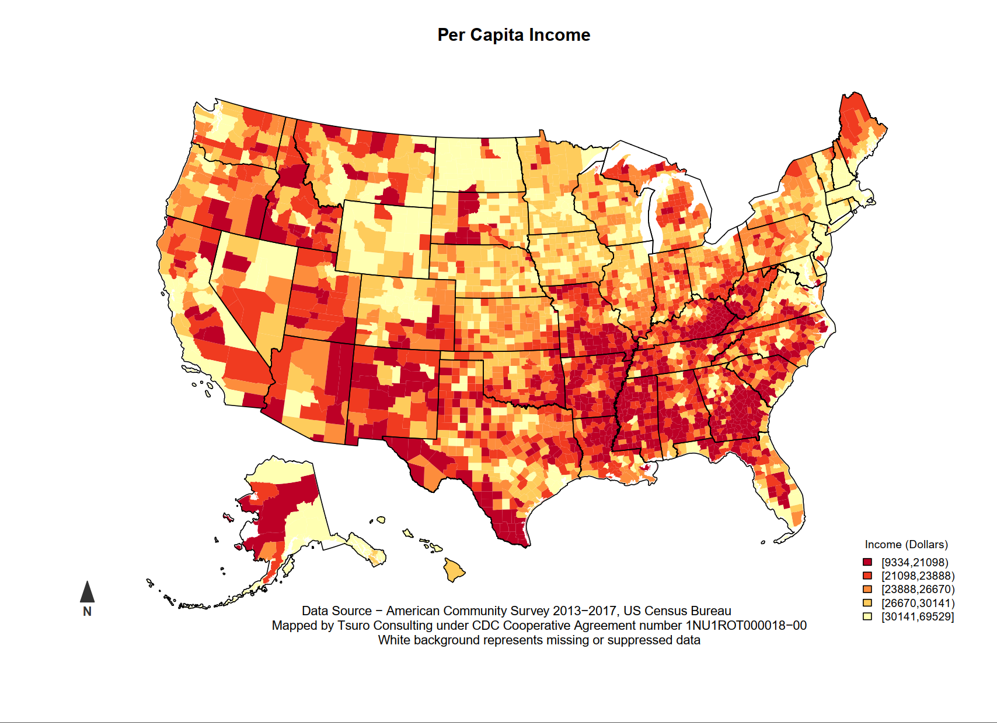
Datasets

Slide 4
Datasets
Per Capita Income
  American Community Survey (2013-2017)
  Five year estimates (all counties / census tracts)
  Three year estimates (some counties / census tracts)
  One year estimates (few counties / census tracts)
Statistical Question?
  Jenks breaks – industry standard / handles skewed data
  Quantile breaks – easier to explain / assumes symmetry

Slide 5
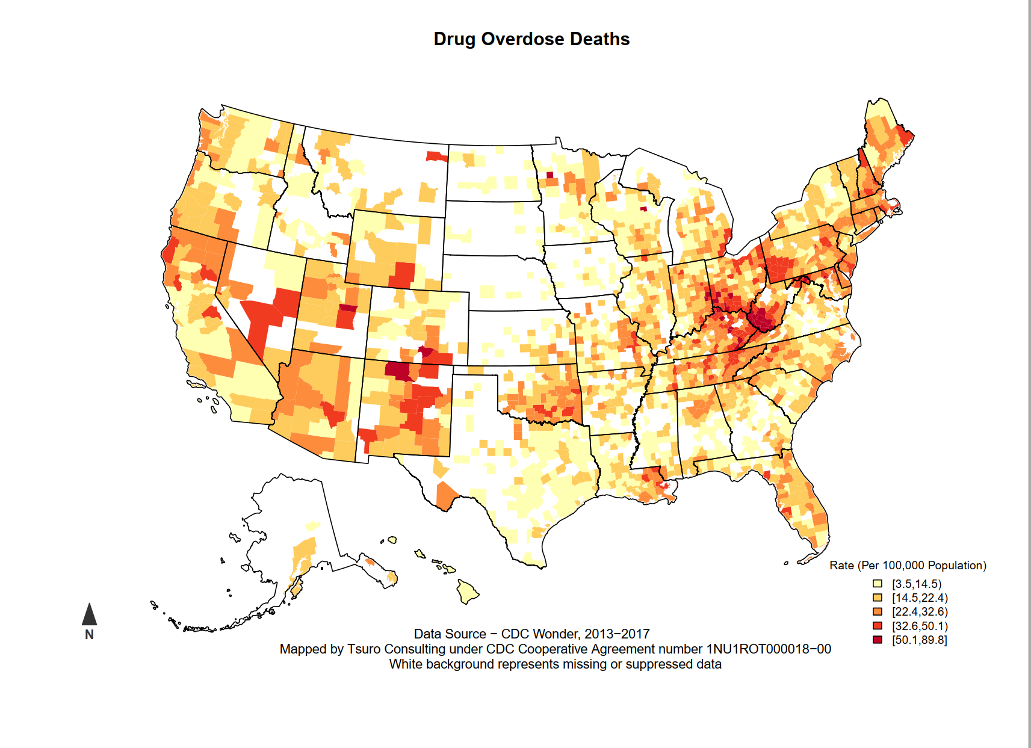
Datasets

Slide 6
Datasets
Drug Overdose Deaths
  CDC Wonder (2013-3017)
  Based on ICD-10 coded cause of death
Statistical Questions
  Imputation methods (median / mean, spatial imputation)
  Statistically reliable rates
Notes:
For statistically reliable rates, a number of states (Montana, Utah, New Mexico) all use the following guidelines, at least five events for numbers and at least twenty events for rates. Statistical reliability of a rate depends on the numerator, not the denominator. We’ve found that using calculating rates based on smaller numbers works for jurisdictional vulnerability index and Poisson regression methods, since the indicator is one of many.

Slide 7
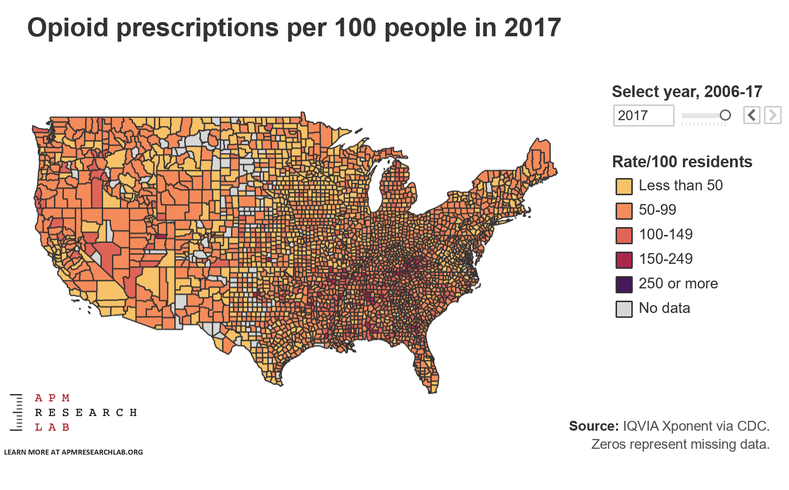
Dataset
Notes:
You’ll notice that this map looks different than the others. Independently, American Public Media used the same dataset in reporting on the opioid epidemic. It was also a featured map in the Tableau gallery. Yes, many counties have more opioid prescriptions than people.
https://www.apmresearchlab.org/stories/2019/04/09/prescription-opioids-county-state-national-trends

Slide 8
Datasets
Opioid Prescriptions
  IQVIA Xponent (2017)
  Per capita opioid prescriptions
Statistical Questions
  Variable selection methods
  Poisson regression

Slide 9
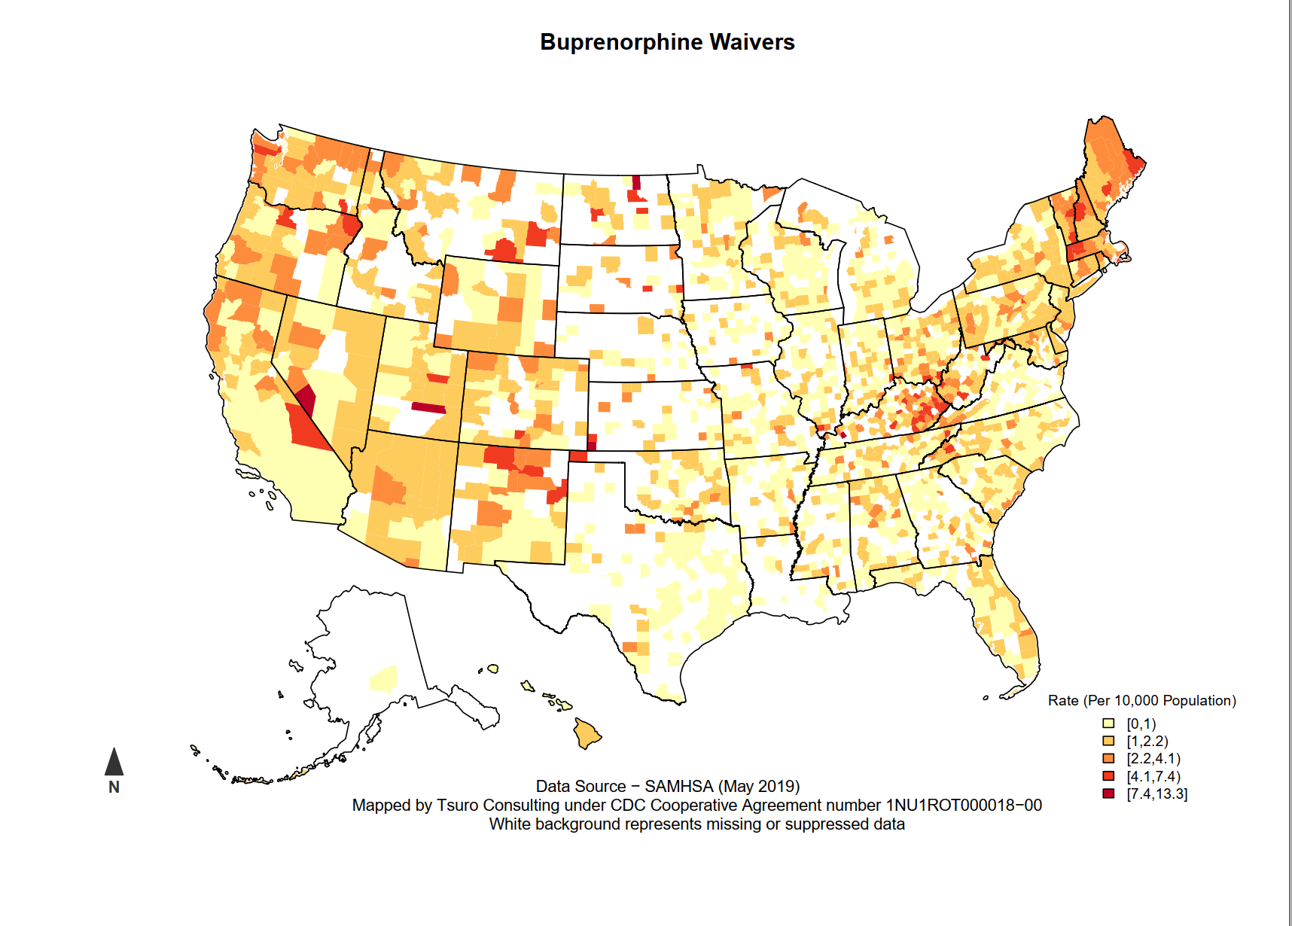
Datasets

Slide 10
Datasets
Buprenorphine Waivers
  SAMHSA (May 2019)
  Prescribers with a waiver (unit level with name and address)
Statistical Questions
  Imputing zip code / county
Notes:
Because buprenorphine is unit level data, it sometimes only has zip code. In cases where it has zip code, we apply a HUD crosswalk to assign county. If county is still missing after applying the crosswalk, we use a geolocator provided by Texas A&M. In less than .1% of cases, it’s still missing, so we exclude them from further analysis.

Slide 11
Funding by Cooperative Agreement number 1NU1ROT000018-00. The conclusions in this presentation are those of the authors and do not necessarily represent the official position of the Centers for Disease Control and Prevention.
CSTE National Office
2635 Century Parkway NE, Suite 700
Atlanta, Georgia 30345
770.458.3811
770.458.8516
jarieh@cste.org
Notes:
Thank you for your time, we are now opening up the call for questions. If anyone is hoping to get ahold of us after the call, we can be reached through contacting CSTE.

