Slide 1
Statistics / Dataset Presentation
Tsuro Consulting
Notes:
Jordan: Hello, I am Jordan Larson and joining me is Cody Custis and we are here as Tsuro Consulting, a public health firm working with CSTE to provide technical consulting on jurisdiction CDC Opioid Vulnerability Assessments. Today, we will be presenting on statistical questions, along with consultants from ThoughtBridge. Let’s do brief, one sentence introductions:
(Introductions).
Cody: As a bit of housekeeping, if you have any questions, please enter them in the chat box and Cailyn will direct them as appropriate. If we cannot answer right away, we’ll get back in an e-mail.

Slide 2
Datasets
Income (American Community Survey, 2013-2017)
Unemployment (ACS, 2013-2017)
Drug Overdose Mortality (CDC Wonder, 2013-2017)
Opioid Prescription (IQVIA Xponent, 2017)
Drug Arrests (Uniform Crime Reporting Program Data, 2016)
Buprenorphine Waivers (SAMHSA, 2019)
Notes:
Cody: we’ve got a few datasets we’re going to focus on for statistical questions. It seems better to introduce concepts with examples.
Jordan: we’ve worked with these datasets with a few different states. We have county level maps available for all states.

Slide 3
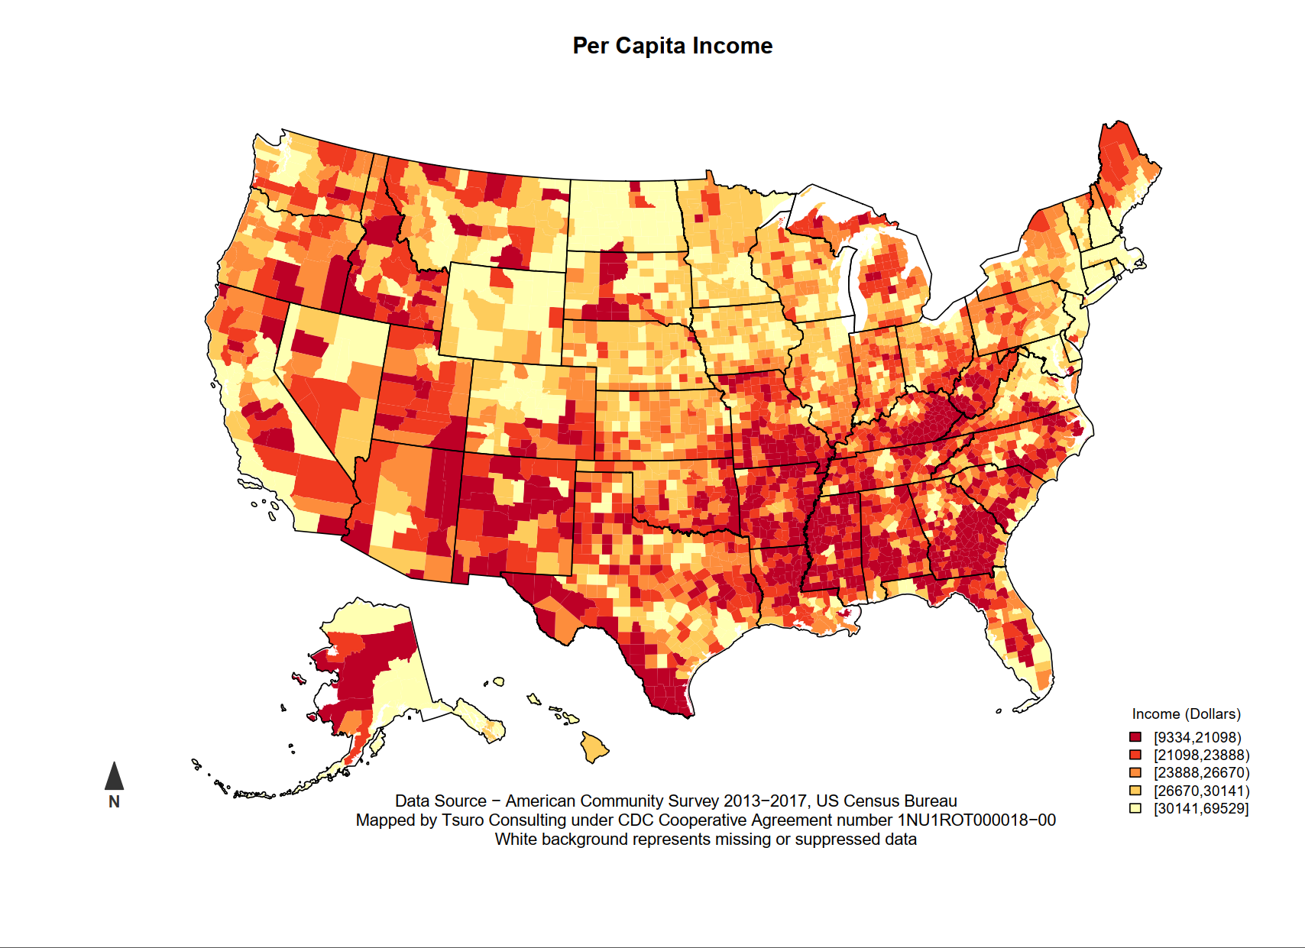
Datasets
Notes:
Jordan: Per-capita income comes from the American Community Survey. We commonly “reverse” per capita income, as lower per capita income represents higher vulnerability.

Slide 4
Datasets
Per Capita Income
  American Community Survey (2013-2017)
  Five year estimates (all counties / census tracts)
  Three year estimates (some counties / census tracts)
  One year estimates (few counties / census tracts)
Statistical Question?
  Jenks breaks – industry standard / handles skewed data
  Quantile breaks – easier to explain / assumes symmetry
Notes:
Cody: As Jordan said, per capita income is one of the variables in the American Community Survey. One important concept is that five year estimates are available for all counties / census tracts. On the other hand, one year estimates are only available for large counties. More years of data means more estimates.
Jordan: One of the questions that we get asked is what kind of breaks to use. The two most common styles in public health are Jenks and Quantile breaks. Jenks breaks have a lot of theory as to classification; they’re also the default in most applications (ESRI / ArcGIS). Jenks breaks also make no assumptions about data. Quantile breaks are easy to understand and explain, especially for audiences without a statistical background, but may give unexpected results for highly skewed data, like income.

Slide 5
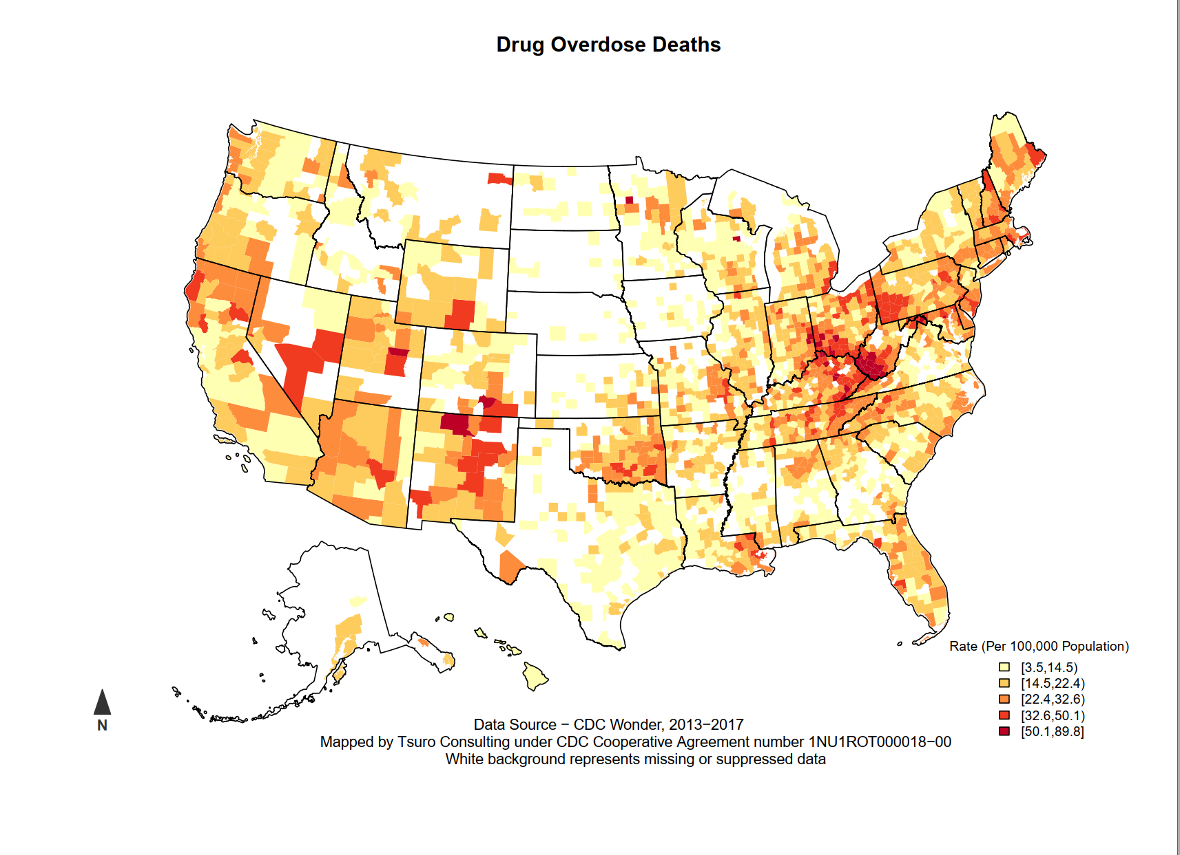
Datasets
Notes:
Cody: Drug overdose deaths are available in CDC Wonder. One thing you’ll notice about this map is that there are a lot of suppressed counties, particularly in the Great Plains.

Slide 6
Datasets
Drug Overdose Deaths
  CDC Wonder (2013-3017)
  Based on ICD-10 coded cause of death
Statistical Questions
  Imputation methods (median / mean, spatial imputation)
  Statistically reliable rates
Notes:
Jordan: Deaths from CDC Wonder allow the user to select multiple years. Even with 2013-2017 (five years), many counties have missing values. CDC Wonder only uses the ICD-10 coded cause of death; this may give different numbers than sources such as the National Violent Death Reporting System or coroner / medical examiner confirmed drug overdose mortality.
Cody: For statistically reliable rates, a number of states (Montana, Utah, New Mexico) all use the following guidelines, at least five events for numbers and at least twenty events for rates. Statistical reliability of a rate depends on the numerator, not the denominator. We’ve found that using calculating rates based on smaller numbers works for jurisdictional vulnerability index and Poisson regression methods, since the indicator is one of many.

Slide 7
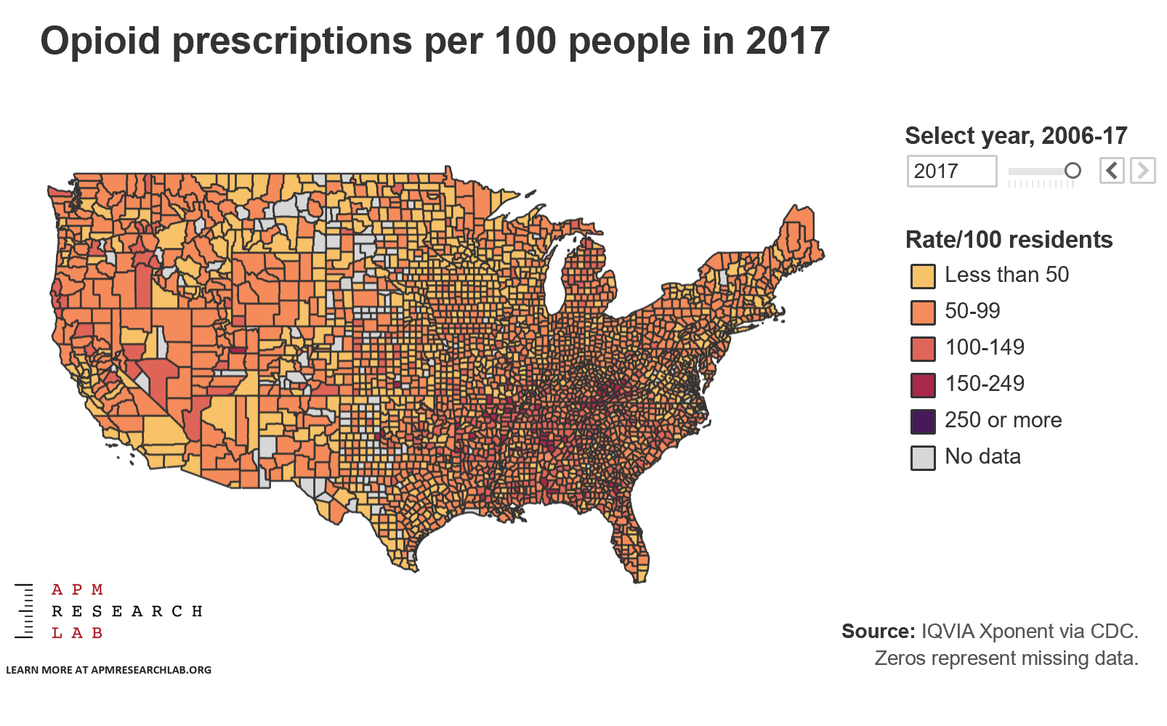
Dataset
Notes:
Jordan: You’ll notice that this map looks different than the others. Independently, American Public Media used the same dataset in reporting on the opioid epidemic. It was also a featured map in the Tableau gallery. Yes, many counties have more opioid prescriptions than people. Also, American Public Media chose to use logical breaks, where 100 per 100 residents represents unity.
https://www.apmresearchlab.org/stories/2019/04/09/prescription-opioids-county-state-national-trends

Slide 8
Datasets
Opioid Prescriptions
  IQVIA Xponent (2017)
  Per capita opioid prescriptions
Statistical Questions
  Dataset selection methods
Notes:
Jordan: Although the data is available through the CDC, IQVIA is the company that produces opioid prescription data. The current dataset is opioid prescriptions per capita, based on a survey of pharmacies.
Cody: The original Van Handel paper used DEA Arcos data, which has more detailed information on specific prescriptions. However, the dataset would have required a lot more manipulation. There’s a recent article in the Washington Post (“76 billion opioid pills: Newly released federal data”), which examines prescription based sources. Many states were able to use data from state prescription drug monitoring programs for their project. When choosing a dataset, one wants to tradeoff completeness, number of suppressed geographies, ease of manipulation, and timeliness.

Slide 9
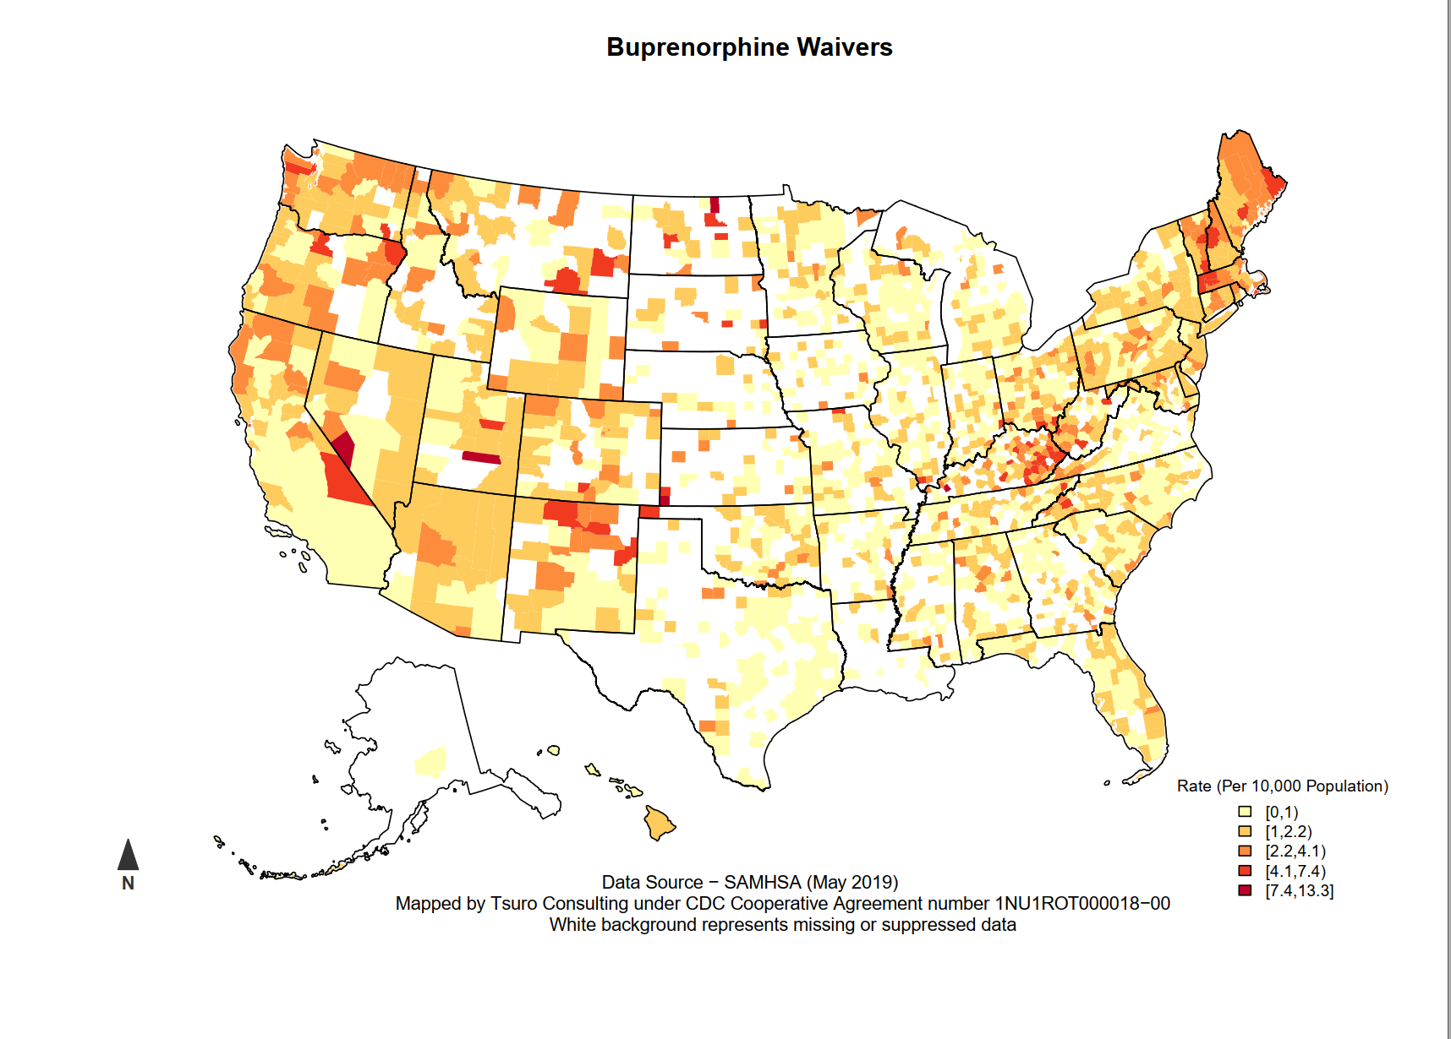
Datasets
Notes:
Cody: the last dataset that we’ll talk about is buprenorphine waivers. For this dataset, I downloaded a complete list of all providers with buprenorphine waivers from the SAMHSA website.

Slide 10
Datasets
Buprenorphine Waivers
  SAMHSA (May 2019)
  Prescribers with a waiver (unit level with name and address)
Statistical Questions
  Imputing zip code / county
Notes:
Cody: Because of the source, the dataset is unit level. There was a decent amount of manipulation needed to get county level waiver rates from unit level data.
Jordan: Because buprenorphine is unit level data, it sometimes only has zip code. In cases where it has zip code, we apply a HUD crosswalk to assign county. If county is still missing after applying the crosswalk, we use a geolocator provided by Texas A&M. In less than .1% of cases, it’s still missing, so we exclude them from further analysis.

Slide 11
Funding by Cooperative Agreement number 1NU1ROT000018-00. The conclusions in this presentation are those of the authors and do not necessarily represent the official position of the Centers for Disease Control and Prevention.
CSTE National Office
2635 Century Parkway NE, Suite 700
Atlanta, Georgia 30345
770.458.3811
770.458.8516
jarieh@cste.org
Notes:
Thank you for your time, we are now opening up the call for questions. If anyone is hoping to get ahold of us after the call, we can be reached through contacting CSTE.

