Slide 1
Jurisdiction Vulnerability Index Models
Tsuro Consulting
Notes:
Good day, my name is Jordan Larson and joining me is Cody Custis and we are here as Tsuro Consulting, a public health firm working with CSTE to provide technical consulting on jurisdiction CDC Opioid Vulnerability Assessments. Today, we will be presenting on Jurisdiction VA indicators and index calculations, along with a focus case study of a state-level analysis in Texas.

Slide 2
Example: Texas
Indicator categories
  Socioeconomics: Per Capita Income (2013-2017 American Community Survey)
  Crime: Drug Arrest Rate (Uniform Crime Reporting Program Data, 2016)
  Prescriptions: IQVIA Xponent (Per 100 Capita Prescriptions, 2017)
  Mortality: Drug Overdose Rate (CDC Wonder, 2013-2017)
Notes:
Jumping into our second presentation segment today, we are going to review a ranking average index calculation for the state of Texas. The indicator categories that we are looking at for our Texas model include the above list. Notice we have narrowed the model down to one variable from each data category, to inform the index.

Slide 3
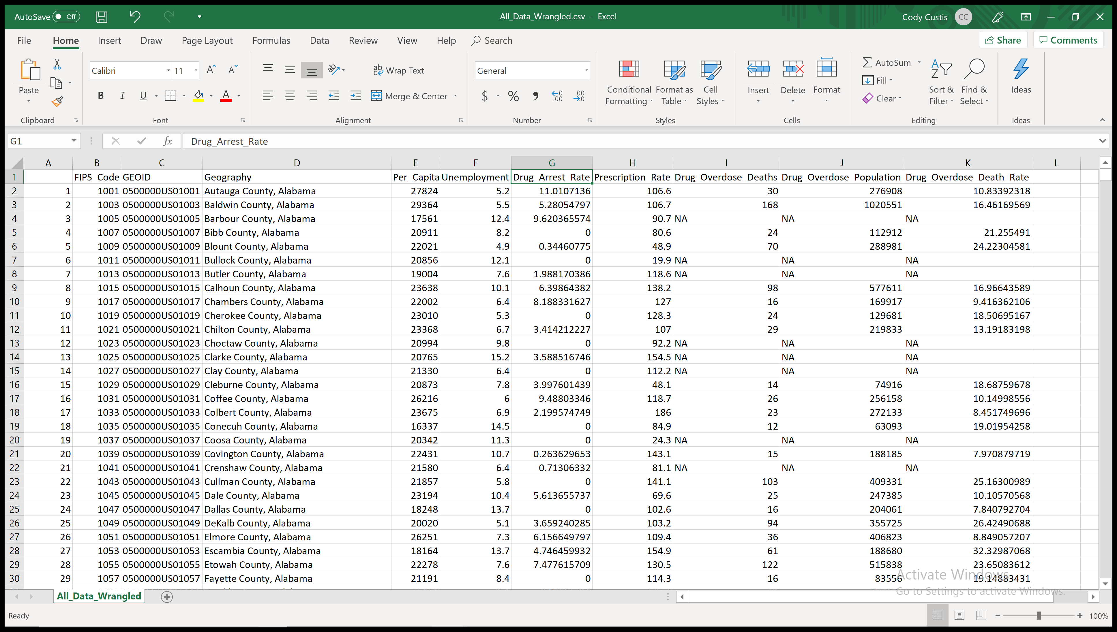
Example: Texas
Notes:
The raw data can be viewed in a spreadsheet, and looks like this.

Slide 4
Example: Texas
Missing Data
  Assume that zero reflects zero events
  Assign N/A values to statewide median
Geography | State | Per_Capita_Income | Unemployment | Drug_Arrest_Rate | Prescription_Rate | Drug_Overdose_Death_Rate | Arrests_Imputed | Prescriptions_Imputed | Deaths_Imputed
Anderson County, Texas | Texas | 17466 | 4.3 | 45.15486574 | 62.2 | 14.89848243 | 45.15486574 | 62.2 | 14.89848
Andrews County, Texas | Texas | 29903 | 4.5 | 53.84351014 | 52.5 | NA | 53.84351014 | 52.5 | 10.88959
Angelina County, Texas | Texas | 21974 | 7.6 | 41.94725982 | 88.7 | 10.47735752 | 41.94725982 | 88.7 | 10.47736
Aransas County, Texas | Texas | 29999 | 6.7 | 141.5818974 | 83 | 20.63967104 | 141.5818974 | 83 | 20.63967
Archer County, Texas | Texas | 31103 | 3 | 53.16689783 | NA | 25.16068529 | 53.16689783 | 56.9 | 25.16069
Notes:
The first thing we need to do in terms of managing data quality is to treat missing or zero data so it does not influence our statistical measurements. One reasonable and simple approach is to assign N/A values to the statewide median.

Slide 5
Example: Texas
For each county
  Rank each predictor
  Take the mean of the ranks
FIPS_Code | GEOID | Geography | State | Per_Capita_Income | Unemployment | Drug_Arrest_Rate | Prescription_Rate | Drug_Overdose_Death_Rate | Arrests_Imputed | Prescriptions_Imputed | Deaths_Imputed | Income_Rank | Death_Rank | Arrest_Rank | Prescription_Rank | Rank_Average | ST_Income_Rank | ST_Death_Rank | ST_Arrest_Rank | ST_Prescription_Rank | ST_Rank_Average
48001 | 0500000US48001 | Anderson County, Texas | Texas | 17466 | 4.3 | 45.15486574 | 62.2 | 14.89848243 | 45.15486574 | 62.2 | 14.89848 | 3015 | 1439 | 2014 | 1535 | 2000.75 | 239 | 227 | 110 | 168 | 186
48003 | 0500000US48003 | Andrews County, Texas | Texas | 29903 | 4.5 | 53.84351014 | 52.5 | NA | 53.84351014 | 52.5 | 10.88959 | 661 | 597 | 2320 | 1078 | 1164 | 40 | 62 | 140 | 96 | 84.5
48005 | 0500000US48005 | Angelina County, Texas | Texas | 21974 | 7.6 | 41.94725982 | 88.7 | 10.47735752 | 41.94725982 | 88.7 | 10.47736 | 2321 | 558 | 1900 | 2408 | 1796.75 | 182 | 53 | 91 | 233 | 139.75
48007 | 0500000US48007 | Aransas County, Texas | Texas | 29999 | 6.7 | 141.5818974 | 83 | 20.63967104 | 141.5818974 | 83 | 20.63967 | 646 | 2310 | 3107 | 2242 | 2076.25 | 36 | 250 | 248 | 222 | 189
48009 | 0500000US48009 | Archer County, Texas | Texas | 31103 | 3 | 53.16689783 | NA | 25.16068529 | 53.16689783 | 56.9 | 25.16069 | 520 | 2671 | 2298 | 1254 | 1685.75 | 29 | 253 | 139 | 109 | 132.5
Notes:
Next we create the rank for each indicator (predictor), and then simply aggregate the ranks by taking a mean of all ranks for each administrative unit in the dataset. For context, there are 254 counties in Texas, so 239, for example, would represent relatively high vulnerability.

Slide 6
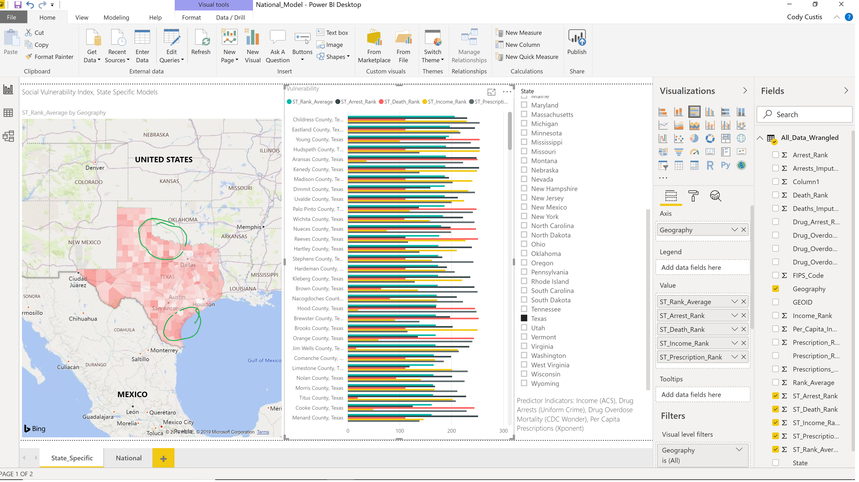
Example: Texas
Notes:
The process will yield some interesting results that can be observed geographically, as well as via a histogram; showing the rank average index, and the individual indicator ranks by county, respectively. Childress, circled in this slide, ranks highest among counties in the state.

Slide 7
Example: Texas
Childress County
  High vulnerability: Arrests, Income, Prescriptions
  Median vulnerability: Drug Overdose (Missing Data)
Notes:
Zooming in on one particular unit, Childress County appears as a county of concern because of high vulnerability observations for arrests, income, prescriptions and drug overdoes. Upon investigation, it has a missing value of drug overdose deaths.

Slide 8
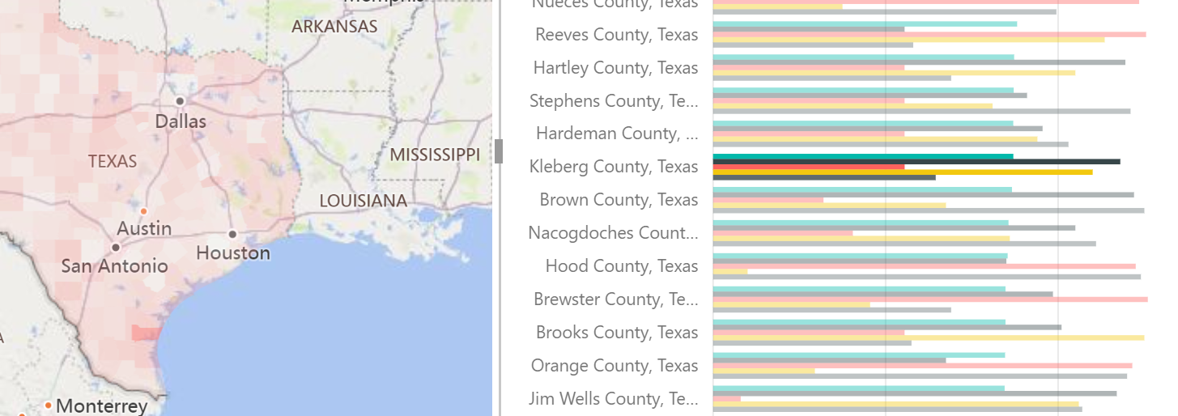
Example: Texas
Kleberg
  High vulnerability: Arrests and income
  Median: Prescriptions
Notes:
Zooming in on another unit, Kleberg County (red and south of San Antonio) appears also as a region of concern because of high and medium vulnerability observations for arrests, income, and prescriptions.

Slide 9
Example: Texas
Index is built using Excel (can provide file for your state)
Mapped using linked Power BI Desktop (can map in other software)
Notes:
Index methods can be built using widely available spreadsheet tools, such as Microsoft Excel. The maps in this presentation we made using Microsoft Power BI, which, as we remember from our presentation on software, is free for use and display of public data.

Slide 10
Example: Texas
Outcome – HIV Diagnoses (https://www.cdc.gov/nchhstp/atlas/index.htm)
Notes:
HIV incidence is a bit different than Hep C, or overdose. In this next part of the Texas case study, we will be looking at results for HIV diagnoses data.

Slide 11
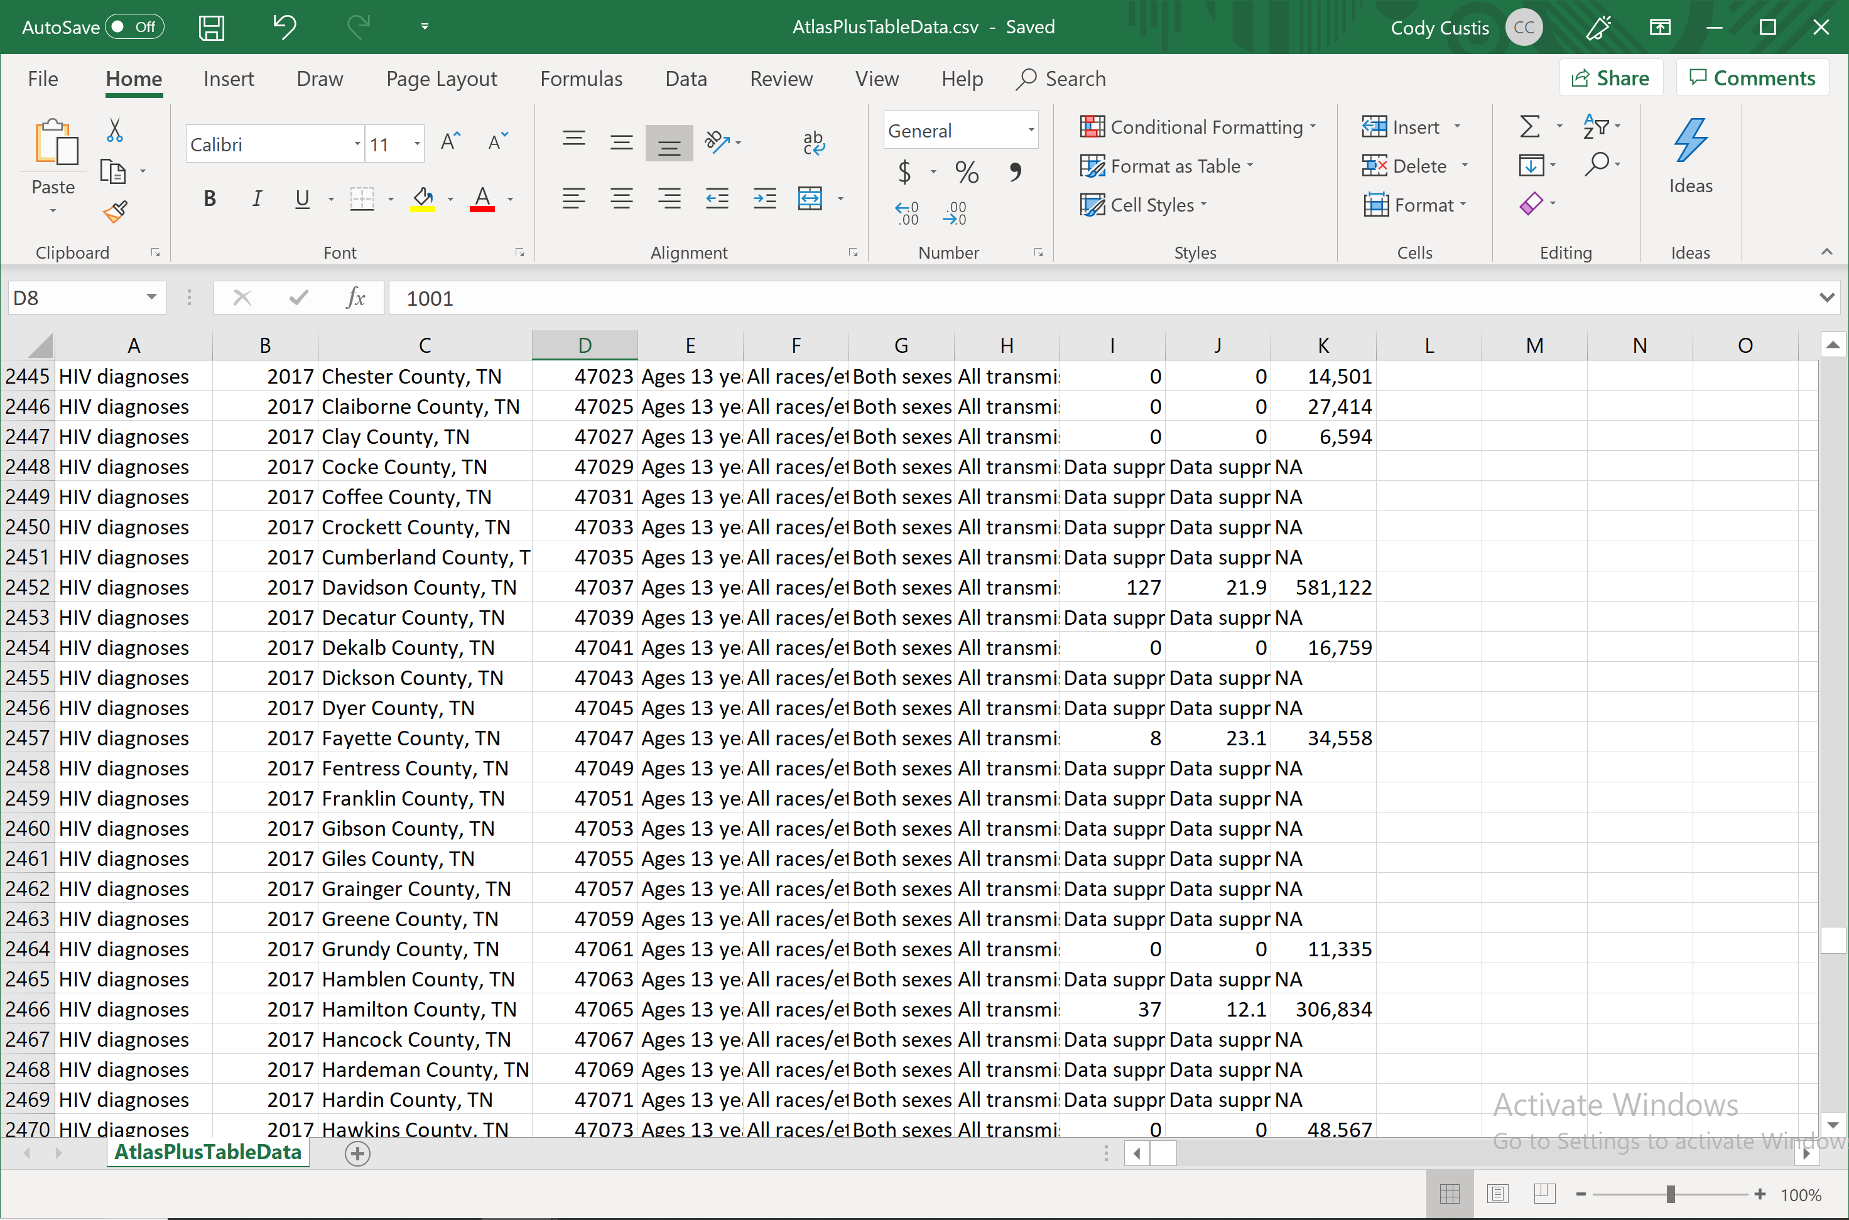
Example: Texas
Notes:
Again, the county-level data can be reviewed in a spreadsheet format. Note that many counties have suppressed (but non-zero) rates. The data source suppresses data with counts between 1 and 4.

Slide 12
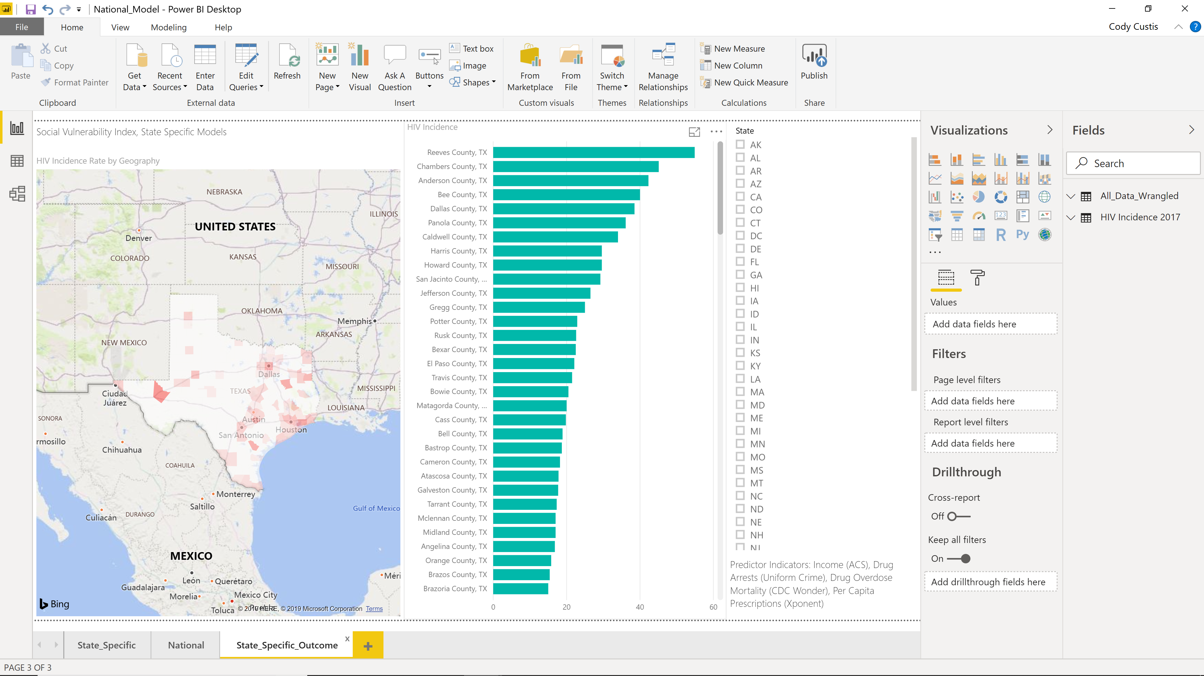
Example: Texas
Notes:
Mapping and graphing the results, we see some areas with higher HIV infection, the outcome metric.

Slide 13
Funding by Cooperative Agreement number 1NU1ROT000018-00. The conclusions in this presentation are those of the authors and do not necessarily represent the official position of the Centers for Disease Control and Prevention.
CSTE National Office
2635 Century Parkway NE, Suite 700
Atlanta, Georgia 30345
770.458.3811
770.458.8516
jarieh@cste.org
Notes:
Thank you for your time, we are now opening up the call for questions. If anyone is hoping to get ahold of Jordan or myself, after the call, Tsuro Consulting can be reached through contacting CSTE. Thank you again.

