Slide 1
Power BI Demo
Cody Custis, Technical Consultant, Tsuro Consulting
CDC Opioid Vulnerability Assessment

Slide 2
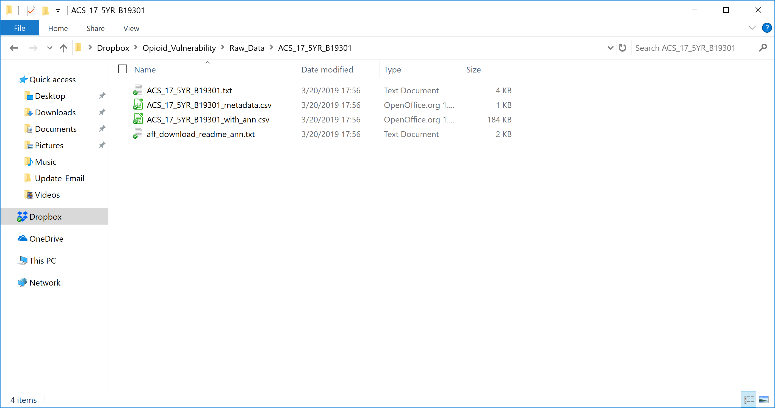
Data Source
N

Slide 3
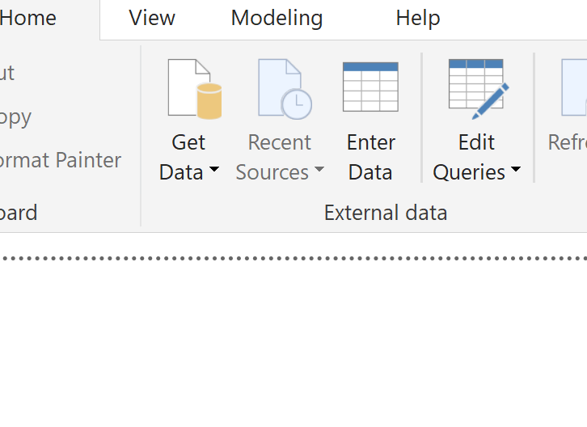
Data Source

Slide 4
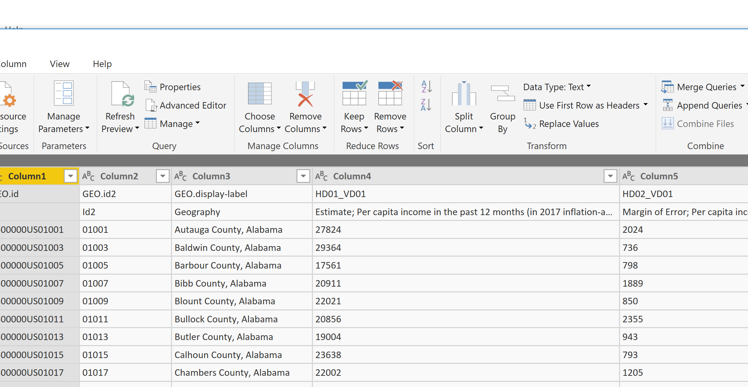
Data Wrangling
Step 1: Remove top row

Slide 5
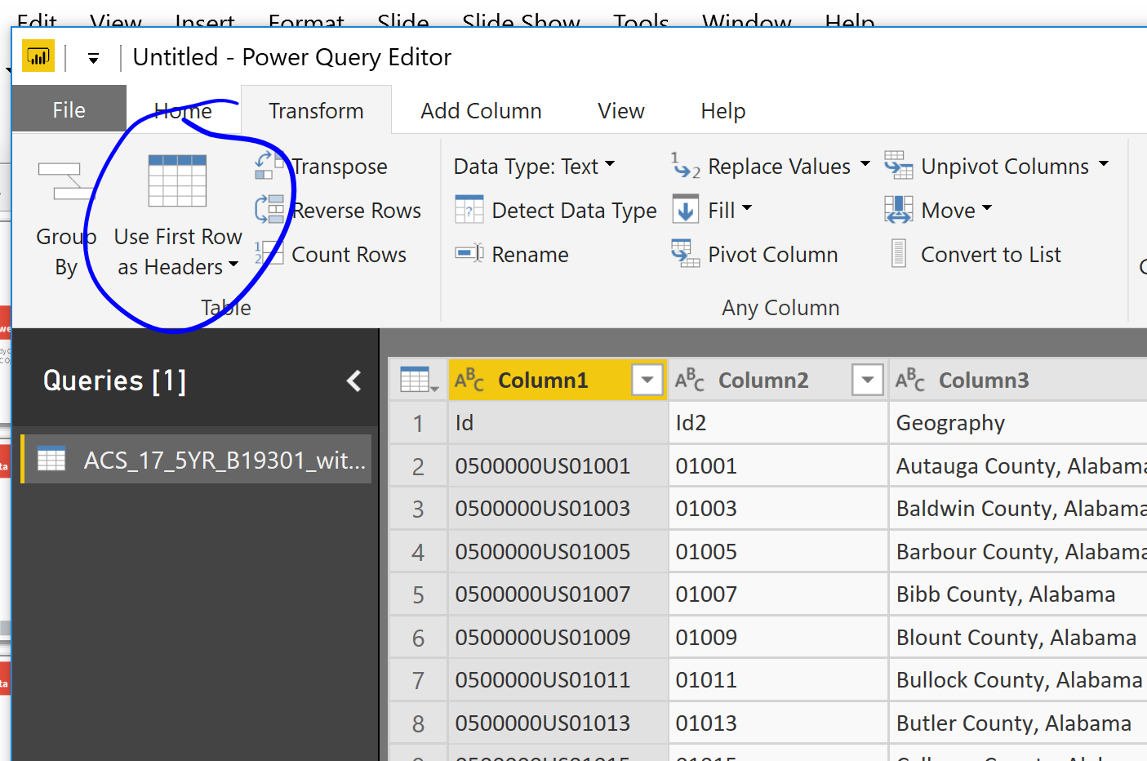
Data Wrangling
Step 2: Advance Headers

Slide 6
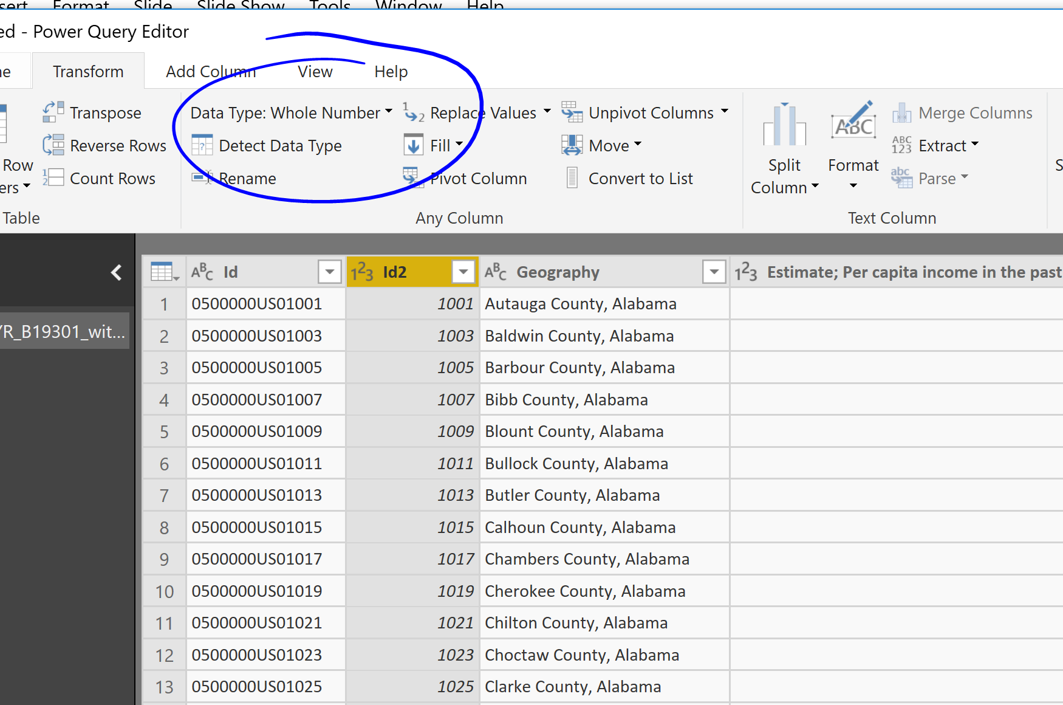
Data Wrangling
Step 3: Convert ID to character

Slide 7
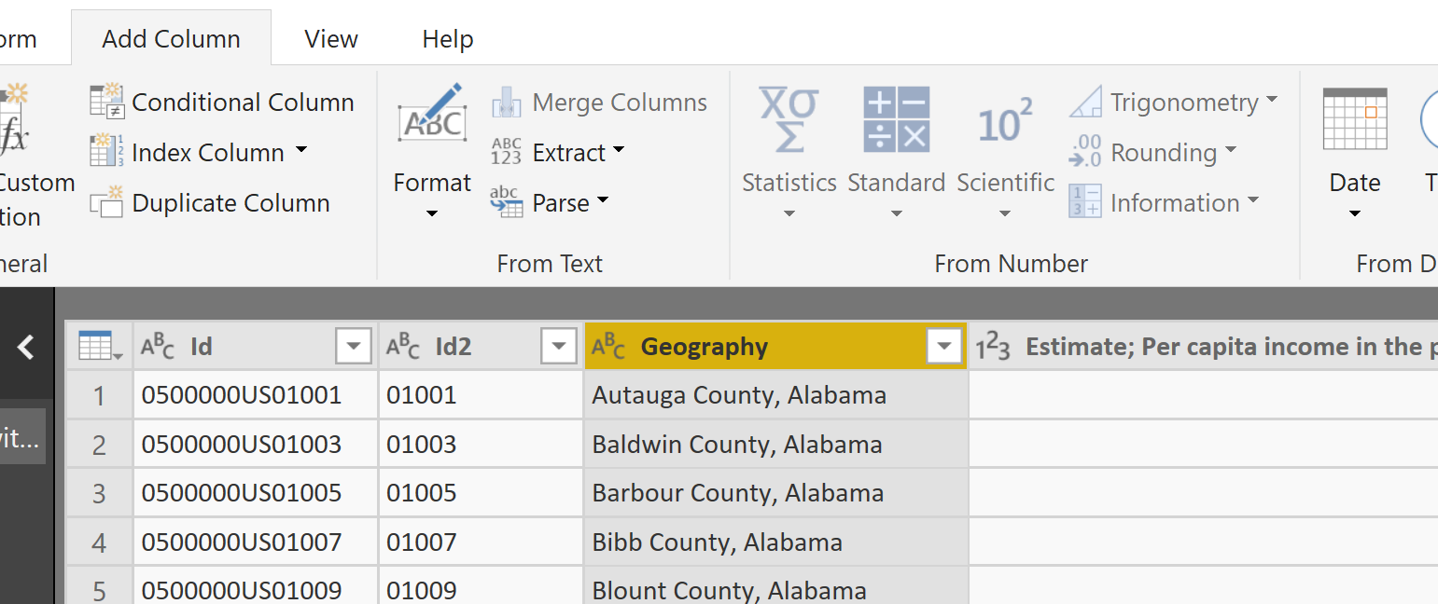
Data Wrangling
Step 4: Convert county name to state

Slide 8
Data Wrangling
Woohoo finished!

Slide 9
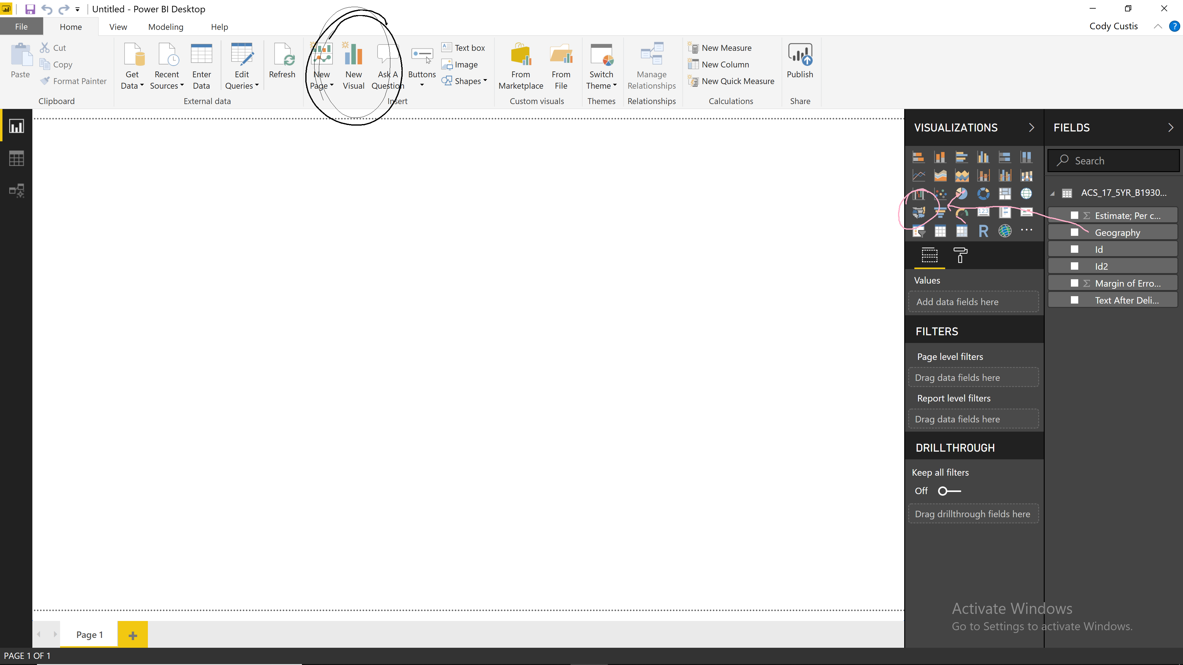
Desktop
First visual:

Slide 10
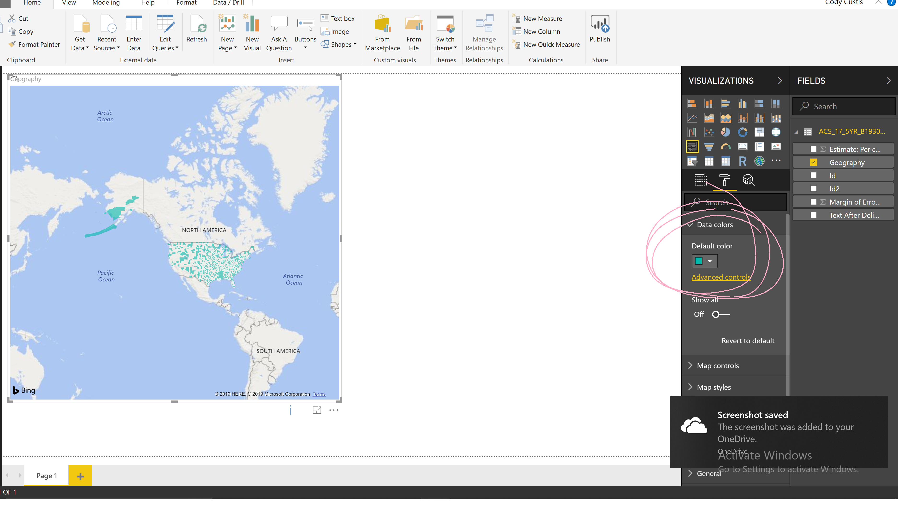
Desktop
First visual:

Slide 11
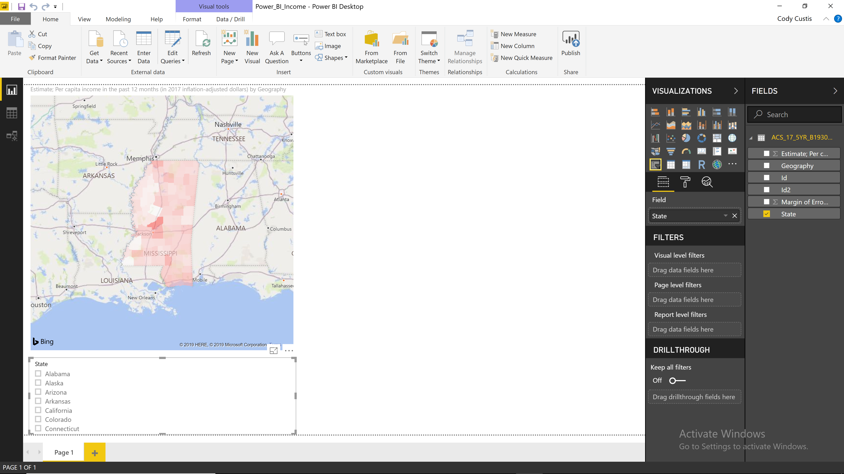
Desktop
Add slicer:

Slide 12
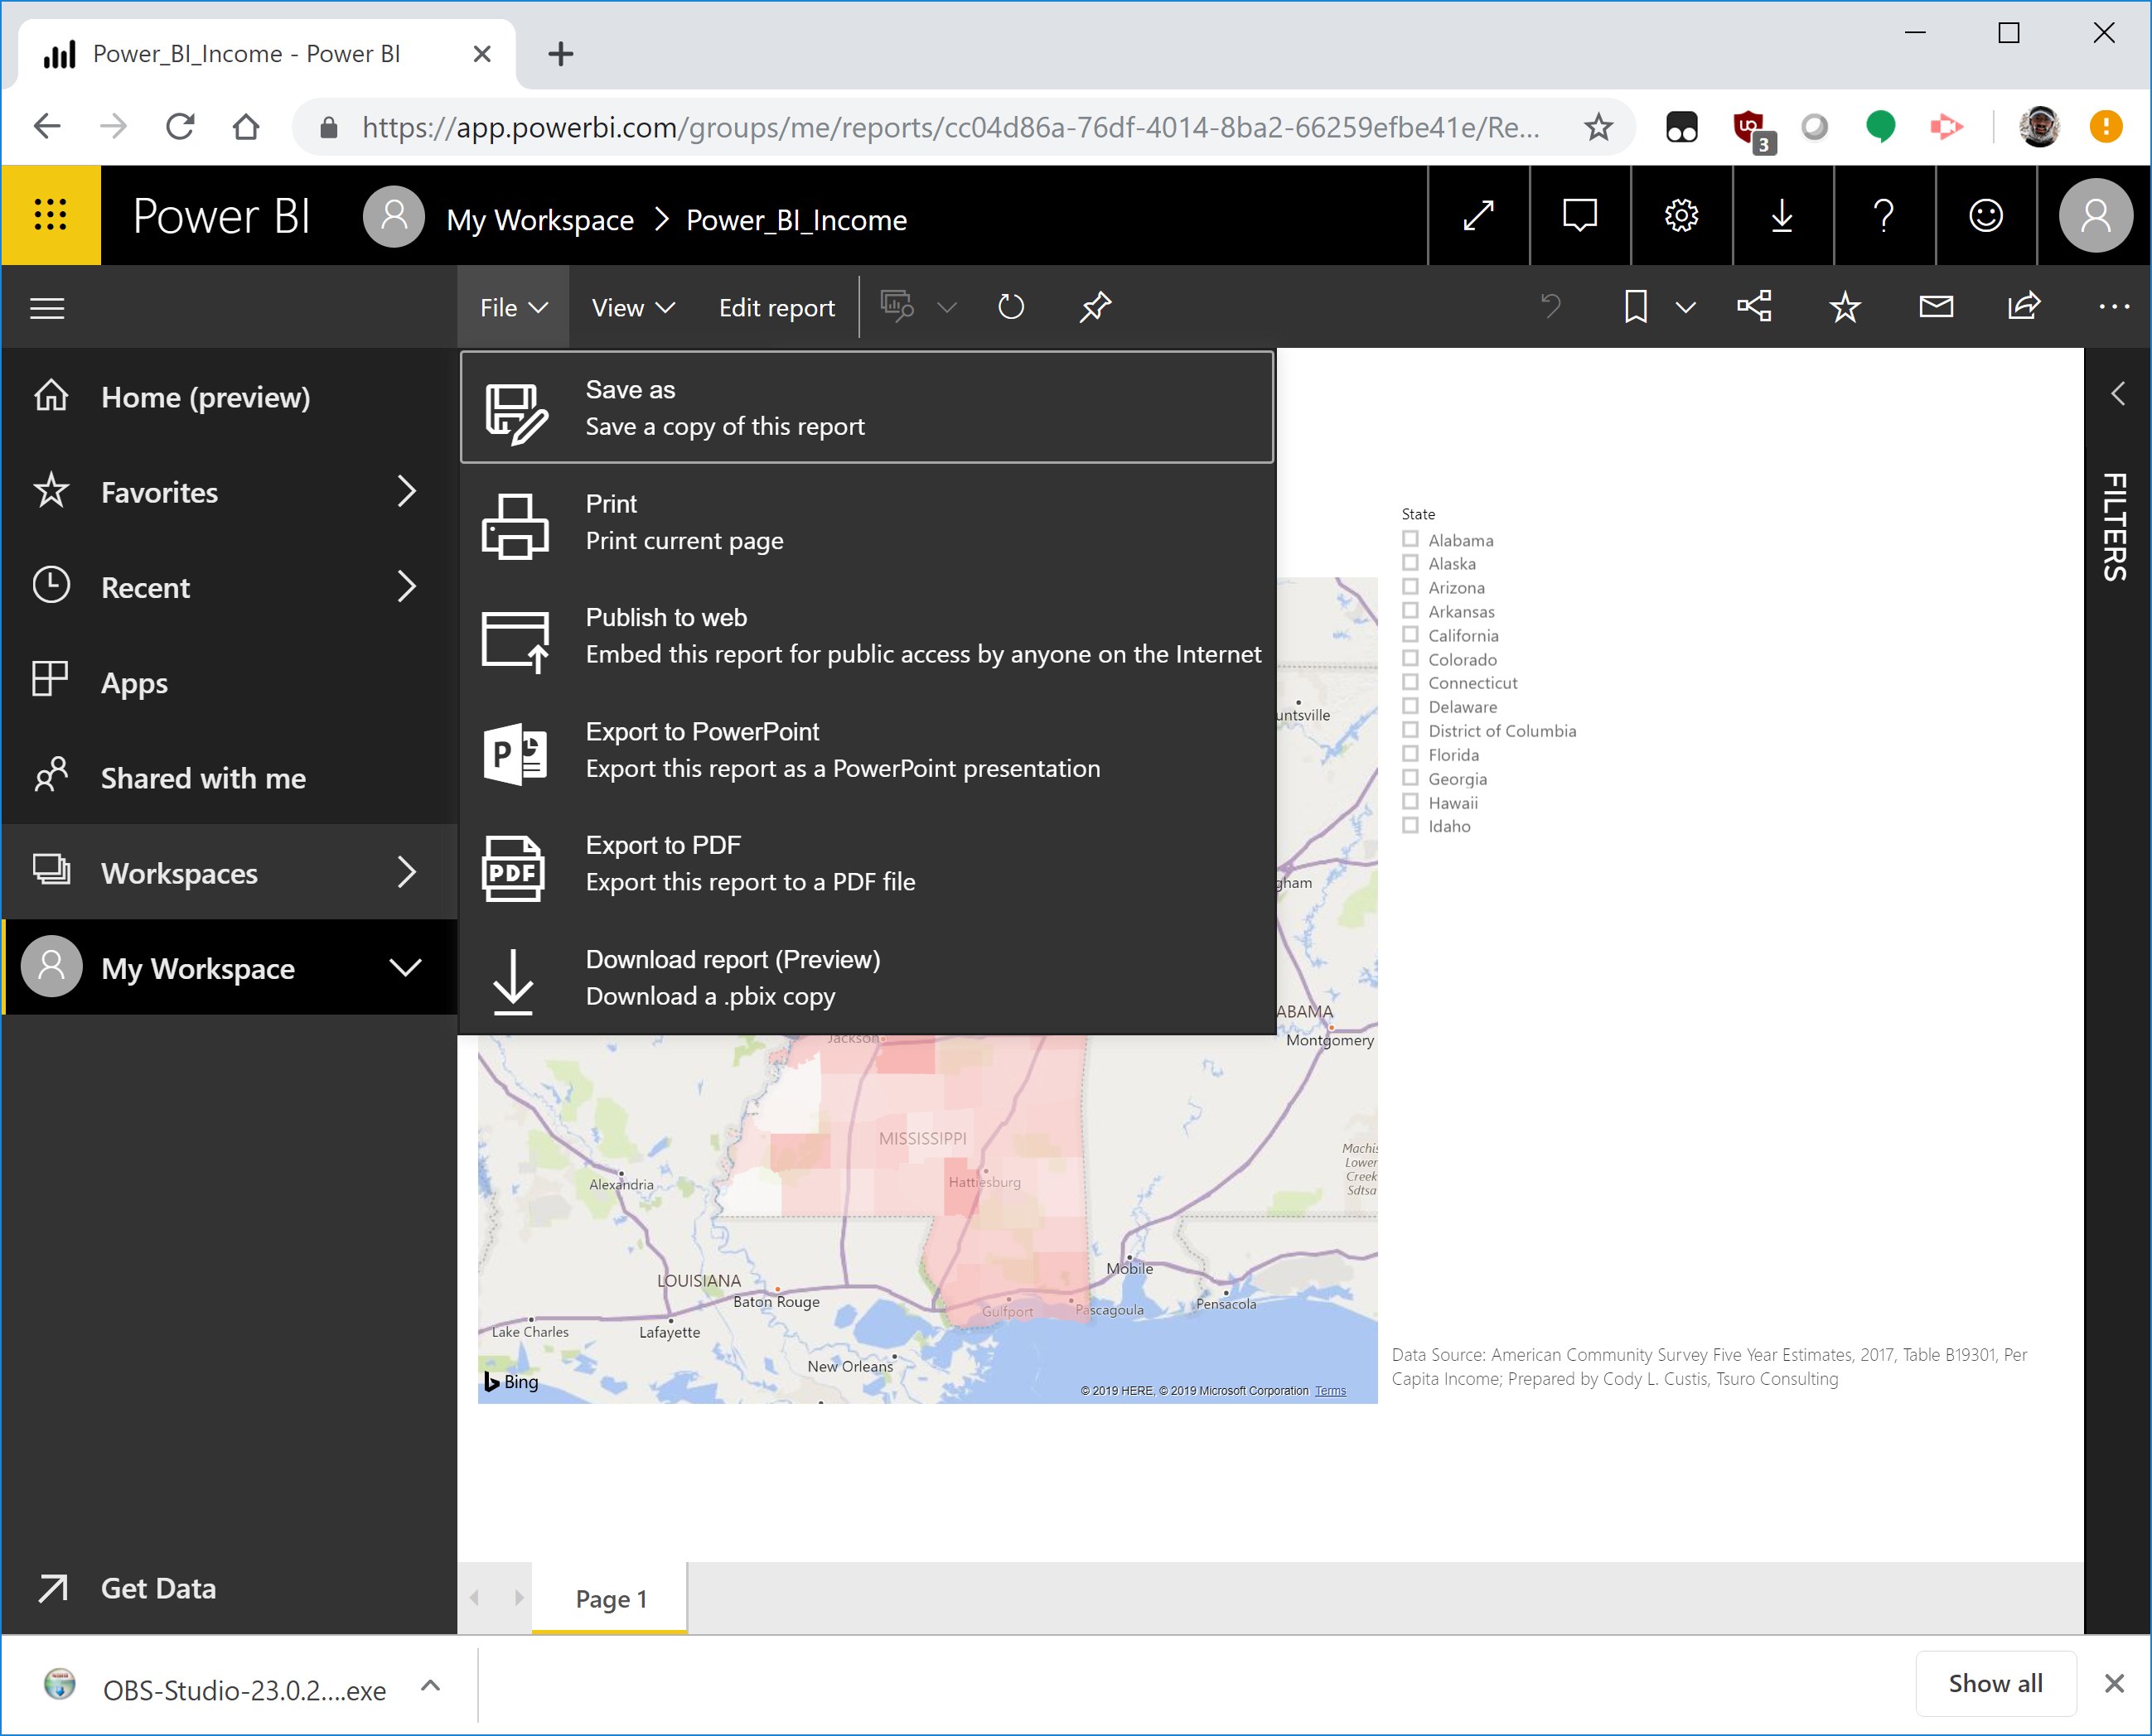
Deploy!

Slide 13
Deploy
https://app.powerbi.com/view?r=eyJrIjoiOTA0ODRiY2YtOGY4ZC00MjI2LWIyNjctNzkyYWQzMjFlOGMyIiwidCI6IjcxZjNhYTMyLTg2NTYtNGU4Yi1iMTUxLTBkNWEwYjBkMjhiMCJ9

