Slide 1
Introduction to GIS and mapping software for public health applications
Tsuro Consulting
Jordan Larson and Cody Custis
Technical Consultants with CDC Opioid Vulnerability Assessment

Slide 2
Content
Notes:
Good day, my name is Jordan Larson and joining me is Cody Custis and we are Tsuro Consulting, a small firm working with CSTE to provide technical consulting on state CDC Opioid Vulnerability Assessments. Today, we will be presenting on an introduction to GIS and mapping software for use in public health applications.

Slide 3
Topics for Today
Summarize commonly available GIS and mapping software and applications that can help with any health assessment work
Take a closer look at ESRI products
Produce a quick map with ArcGIS using ACS data
Produce a quick map with Power BI using ACS data
Notes:
Topics for today include those listed and the following learning objectives:
1. Identify common GIS and mapping software platform and products, for different sized organizations.
Identify ESRI products for different sized organizations.
Independently produce a basic layered map in an ArcGIS environment and export to a useable file format for reporting purposes.
Independently produce a basic layered map in the Power BI/3D Maps environment and export to a useable file format for reporting purposes.
Independently produce a basic layered map in the Power Maps environment and export to a useable file format for reporting purposes.

Slide 4
Software

Slide 5
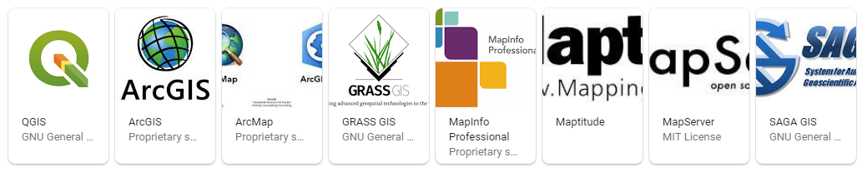
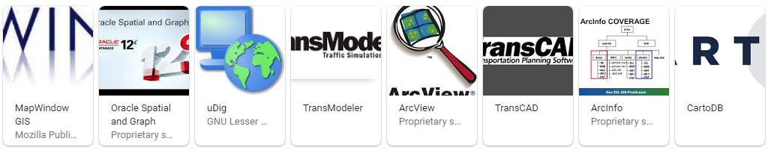

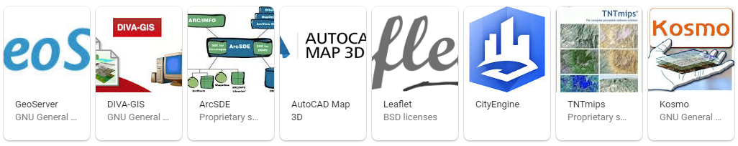
Independent GIS Software
Notes:
If you are starting from the ground floor, shopping the market for independent GIS, or mapping software can look overwhelming. Here you see about half of all independent, mainstream GIS software titles. In addition to these titles you have customizable mapping applications and visualization tools built into major platforms including those we all know (Google, Amazon, Microsoft, Apple, Oracle, Facebook, etc.) and some programming platforms we might be less familiar with (R, Python, Java, etc.). The reality is, most of the independent titles have niche industries they cater too, and for the major platforms have generalized their data processes and visualization such that they have become easy to use, and can get teams through very simple tasks in almost any industry. In the public health space, we will be pointing out some of the best options across a range of needs.

Slide 6

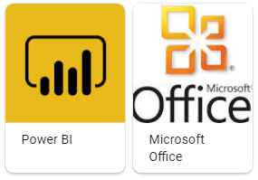
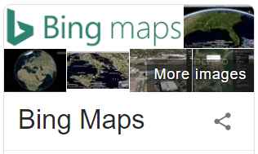
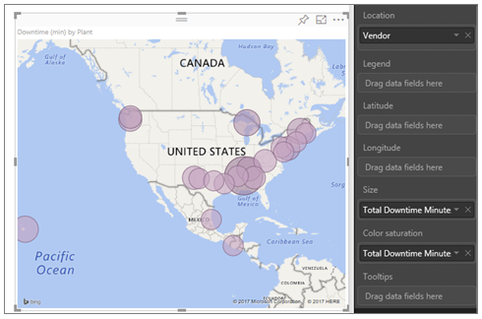
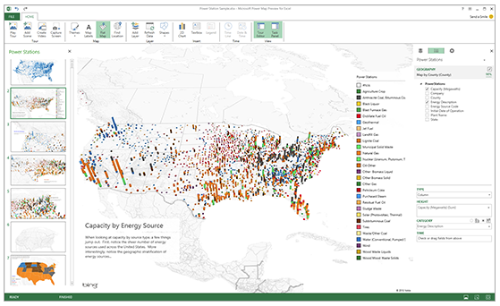
Microsoft Mapping
Notes:
In the world of software giants, companies like Google, Microsoft, Apple, and Oracle have their versions of mapping software services, which are different from full, independent GIS software options. Among leaders in this space, Microsoft has internally competing products it offers in it’s business and personal class software. Power BI, and 3D Maps (also known as Power Maps) offered through Microsoft Office, represent two mapping visualization services running on top of Bing Maps. Power BI provides a web-based dashboard environment with a moderate level of map customization and visualization options. Power BI is designed to work easily with data formats that are common to structured databases.
Alternatively, 3D maps was developed in stages to offer some unique visualization options for consumers using Microsoft Office products. 3D maps is now fully integrated into Office 365 Excel. Visualization options in 3D maps are extremely fast and powerful, but extremely limited in customizable options. For quick and easy visualization of county-level health data, very few options beat the ease of use of Power Maps, or the deploy-ability of Power BI. The Tsuro team highly recommends getting familiar with, at the very least, the consumer side of Microsoft mapping services, because of the confidence it can give any team with simple mapping tasks, and in an environment as familiar as power point! On the downside, Microsoft mapping services have fairly canned visualization functions, and it becomes difficult to develop mapping protocols across an entire organization, if the Azure stack isn’t backing things up. There are definitely downsides to Microsoft, and so we also don’t want to oversell, or encourage a team to become over reliant on these products. One downfall, is lack of GIS technical knowhow. Much like learning a language, if you always work off of a translator, though convenient, you might never take the time to learn the language.

Slide 7
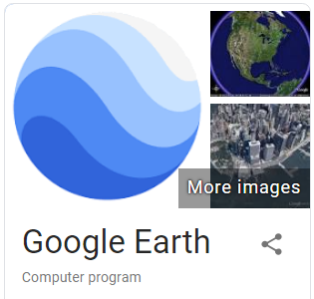

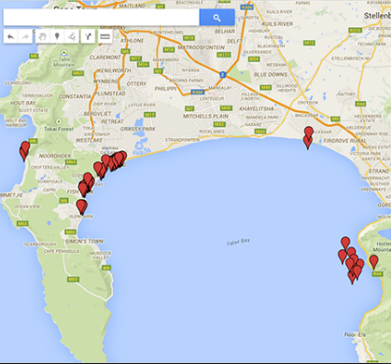
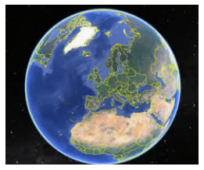
Google Mapping
Notes:
We won’t spend much time looking at google, although it’s worth mentioning that google is also a leader in certain applications for mapping software. Mainly, Google Earth has proven most useful in research applications, more so than in private applications or published “add-ons” for general analytical and dashboard uses. On the consumer side, perhaps the most familiar product in the market today, google maps, provides visualization that is really geared towards simple tasks and ease of use for general geographic needs. Google has a clear domination in the space of big data, and tying this in with research specialization, they could be, arguably, the most powerful mapping platform in the world. This being said, we don’t think it works well for conversion to public health applications, and google has not yet fully entered into government services, or large organizations, the way Microsoft has. I’m sure there are some successful public health teams out there using google products, but we aren’t generally recommending it, if you’re starting from scratch.

Slide 8
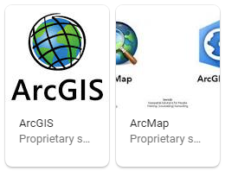

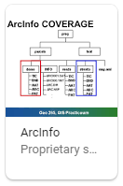
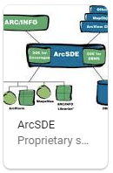
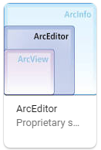


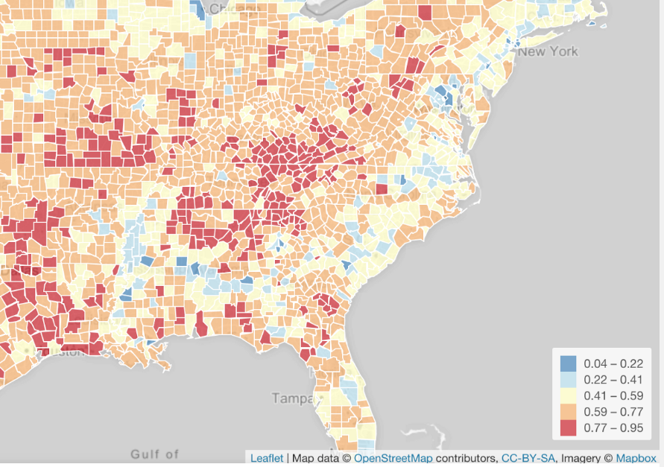

[Slide Header]
Notes:
Finally, In the race for independent GIS software, the ESRI platform, which represents about 43% of market share, is an established leader. ESRI’s famous ArcGIS includes many GIS software applications bundled into its platform: ArcMap, ArcView, ArcInfo, ArcSDE, ArcEditor, etc. ESRI, today, is considered the global leader in GIS and mapping software, and has been sold to and through many large institutions private, and public. For production of government, or large organization, maps, with consisten data management and archiving, ESRI is a strong candidate for a software platform, and mapping solution.
There are still, a few other titles worth mentioning today. QGIS has grown substantially over the last 5 years as a leader for open source GIS software, and has allowed, smaller, more technical groups to cut down on the institutional costs of ESRI products. Another significant, and historical, open source platform is GRASS GIS. Finally, Leaflet, a java application, has become a popular software package for use in other platforms including in concert with R.
Now across all of these options, there are reasons why an public health organization, large or small, might be interested in a particular software package, of more simple mapping service. It’s fairly straight forward to have guessed that ESRI software is really built for the institution, and the more complex of customers…but within ESRI’s product line, there are also some lighter tool sets, including ESRI online, and their mobile apps. These might be quite suitable for a smaller task, or a smaller organization with simple mapping needs.
On the flipside, Cody and I want to tell you that there are some other great options out there, especially for smaller organizations with a limited budget, or perhaps organizations flexible enough to become highly technical and invest in customized business information systems. For groups low on funds, but with a deep bench of GIS skill sets, QGIS or Grass GIS might be a great option. If you find that some of your staff skill sets include R, often transferring over from academic days, leaflet might be a great option as well. Leaflet can be executed inside an R script, and combined, they can generate some of the most powerful, elegant, and customized visualizations on the market. These kinds of tools will really require more of an artisan craft, and someone capable of discerning and writing simple programming code. That being said, the process control, the quality of Leaflet maps, the endless optioning of R code, dynamic web publishing, and all while remaining mostly free of cost… put it all together and it becomes clear to see why R mapping is so popular in academic and independent groups with technical skill sets.

Slide 9
ESRI

Slide 10





Notes:
Because ESRI is so popular for production in the business world and in government agencies…we want to take a closer, more in depth look at the ESRI product space.
The ESRI platform, is broken up into multiple market segments;
1) ArcGIS desktop is a bundle of their traditional applications and currently available in version 10.7. This bundle is really available for legacy clients and is their core software.
2) ArcGIS pro delivers the ArcGIS desktop experience in a “next generation” cloud computer environment.
3) ArcGIS online delivers limited forms of ArcGIS applications through a web interface
4) ArcGIS enterprise is really a full stack service software for large organizations and data managing firms.
5) Finally, ESRI applications deliver specific functions available for use in mobile computing and otherwise.
As far as public health data management, and mapping, ESRI will have a solution for almost everything, and at spectrum of prices. Chances are, if you’re in the government, you might already have access to enterprise licensing, but if not, you can make a great case to purchase ESRI, when you consider how many sister agencies are likely using it. At State governments, sometimes administration offices manage enterprise licenses across multiple agencies, it’s worth checking with administrative IT offices to clarify the opportunities your team might have to access the software.

Slide 11
ArcMap Demo

Slide 12
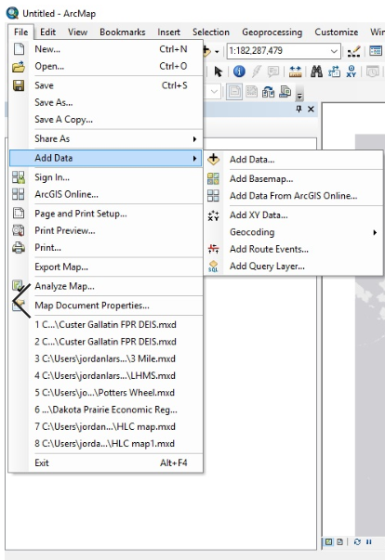
Add Data
Notes:
Once the ArcMap environment is open, and you’ve started a blank new map, the canvas of a globe will appear blank. ESRI will require you to load a basemap onto your work space before anything is visualized. Some users may choose to not immediately load a basemap, which can be resource intensive as they carry the extent of the entire globe. In this case, a user may want to start by simply adding their custom data. In any case, the best place to get started in constructing a map in ESRI is to select Add Data in the File menu. Here you’ll see a list of options that will start forming the visual orientation of your map.

Slide 13
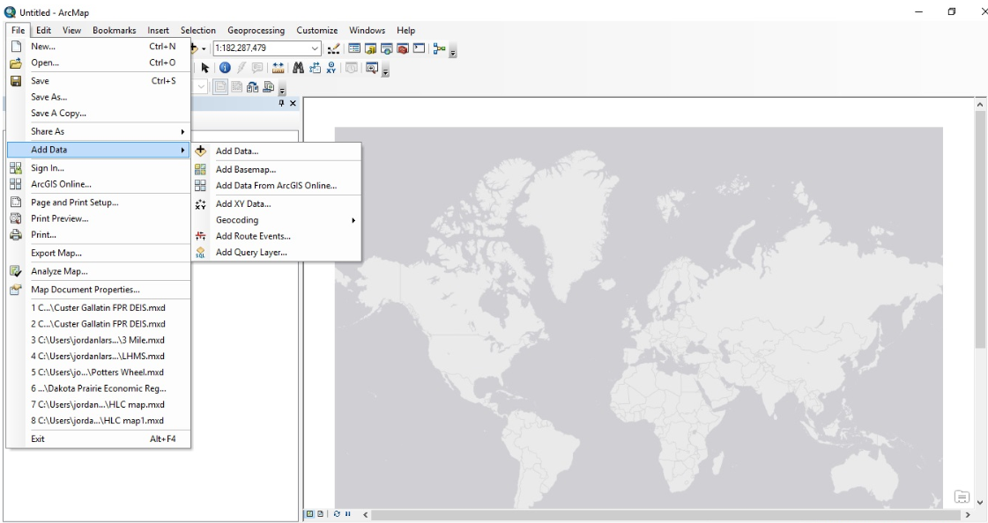
Basemap
Notes:
Here I’ve selected a generic World Light Gray Canvas Base from the ESRI provided options. These options were selected by simply going to the Add Basemap option just below the Add Data selection.

Slide 14
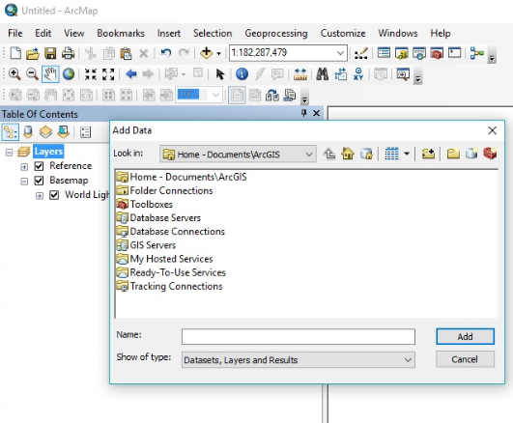
Data options
Notes:
Next I want to add my own data to begin customizing my map. Navigating back to the same Add Data function, I select Add Data, and a window pops up which asks where the user would like to find this data. This window begins to show the complexity of options in the ArcGIS environment. Data can be loaded up manually, or from GIS servers and other applications running in the ESRI platform, or 3rd party software, or databases. For this demonstration, I am simply going to select a local file, that I downloaded from ESRI’s website, that contains the administrative boundaries of Counties in the united states. When I downloaded this file, called a shape file, I stored it in my local ArcGIS file folder found in my documents folder. This way ESRI was already pointing me in the right direction, via the top selection on this menu.

Slide 15
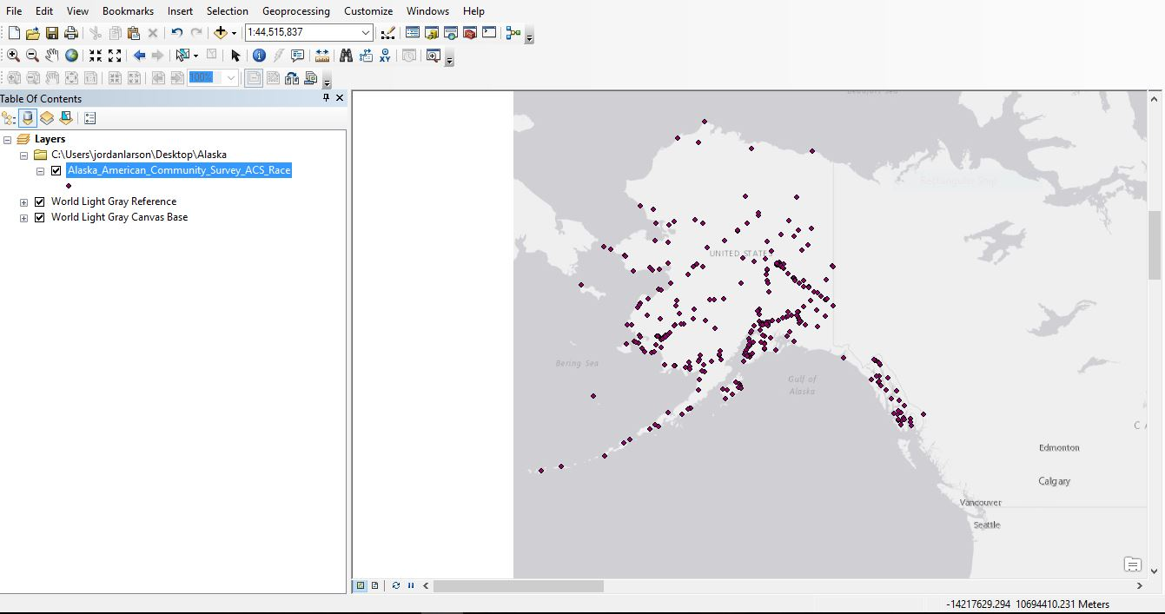
Basic point data layer

Slide 16
Basic point data layer

Slide 17
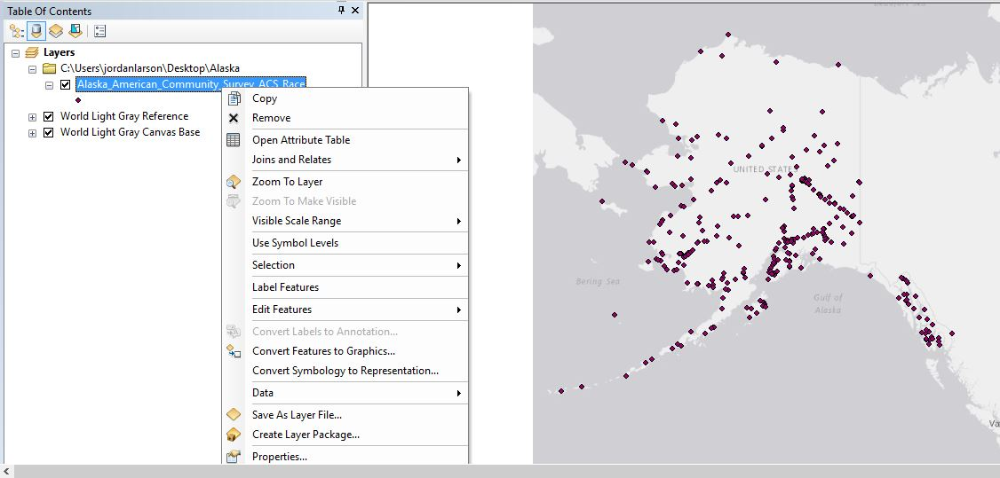
Data Properties

Slide 18
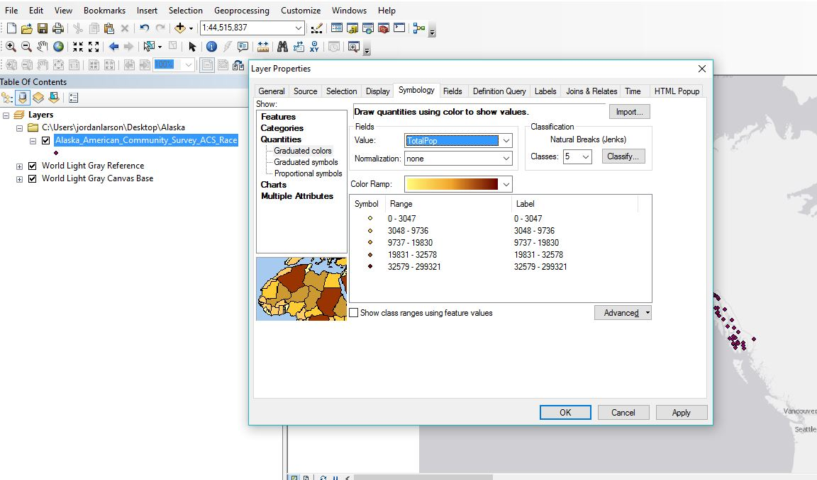
Data Properties

Slide 19
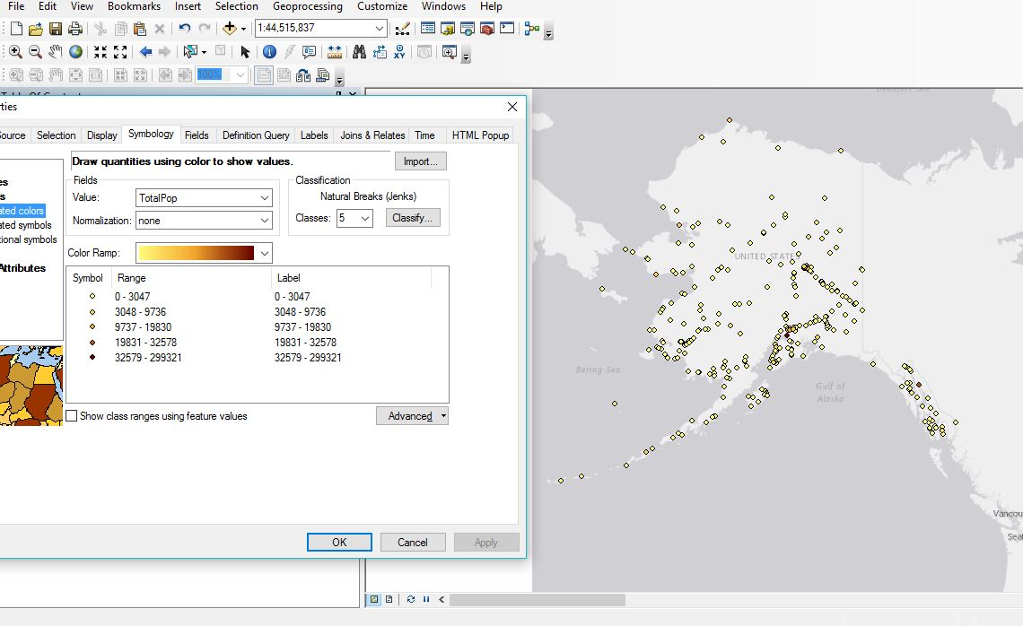
Data Properties

Slide 20
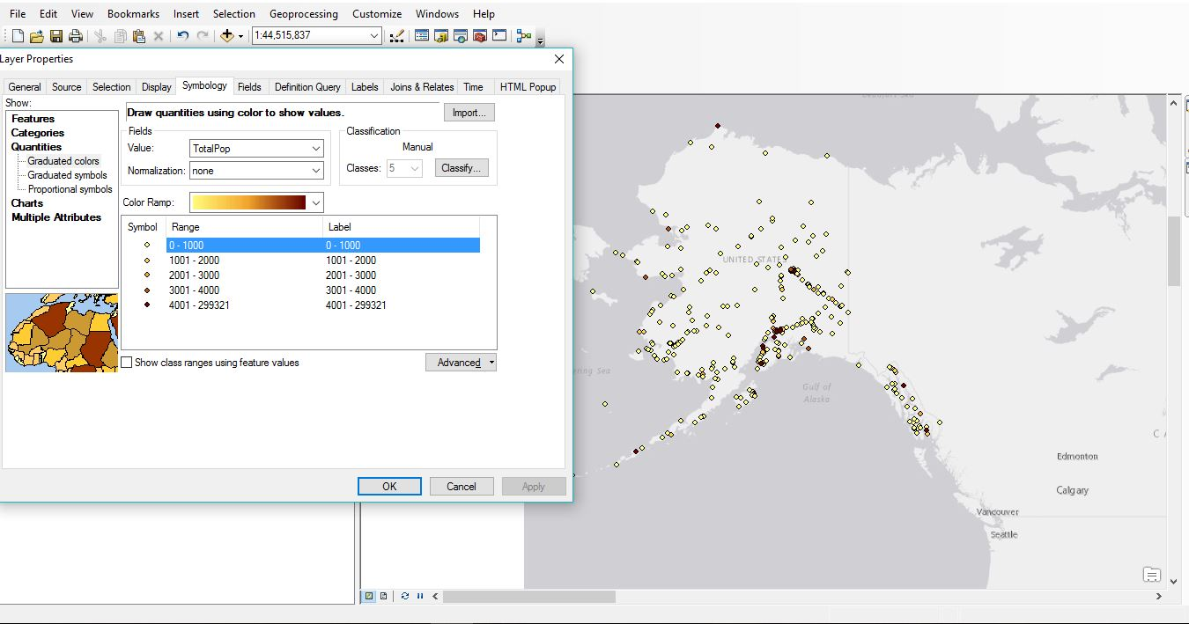
Data Properties

Slide 21
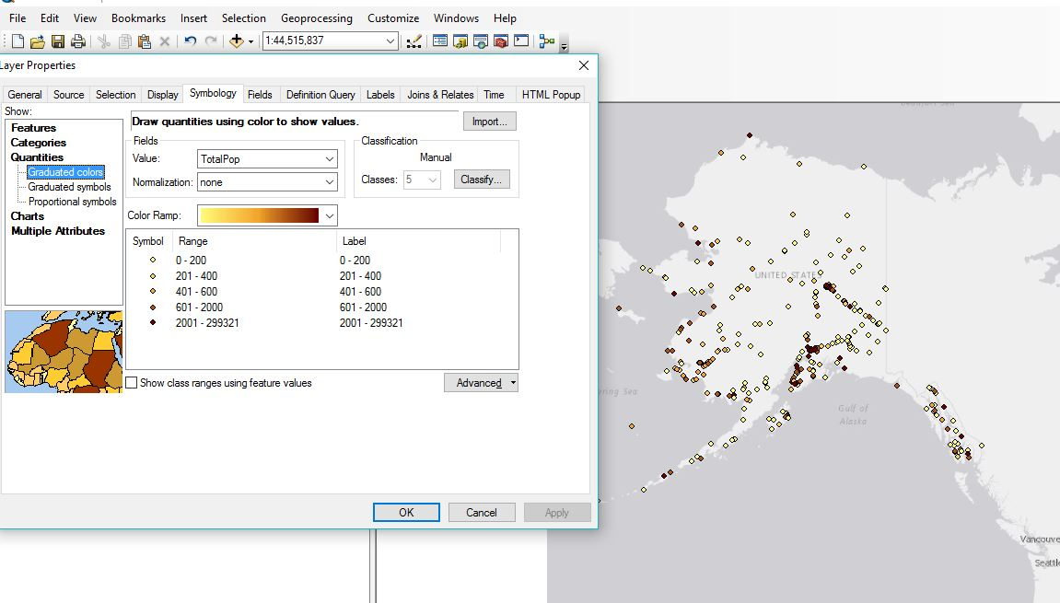
Data Properties

Slide 22
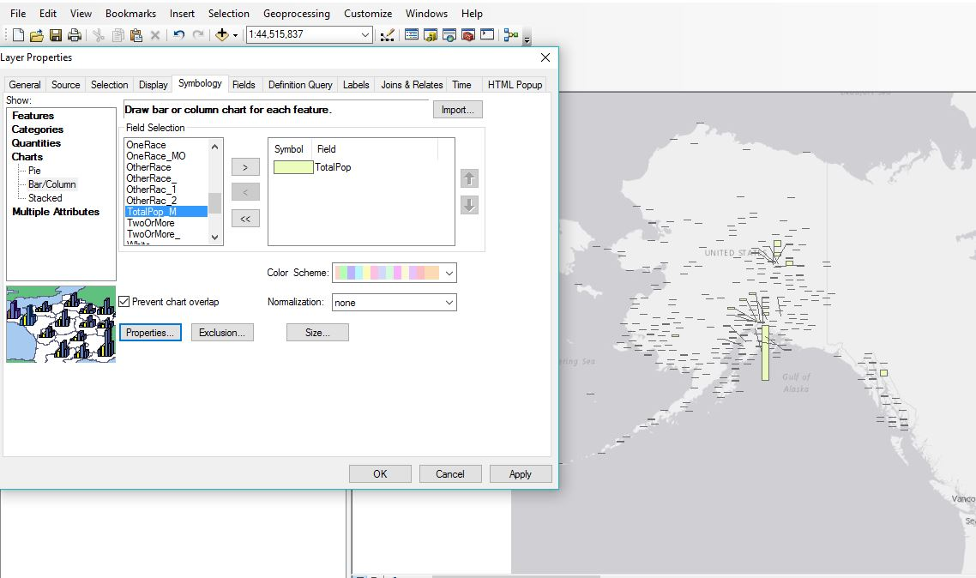
Data Properties

Slide 23
Power BI Demo
Notes:
Again, joining us is Cody Custis and he will be helping us in the presentation with a quick data task, and mapping visualization with Power BI, out of the Microsoft services package.

Slide 24
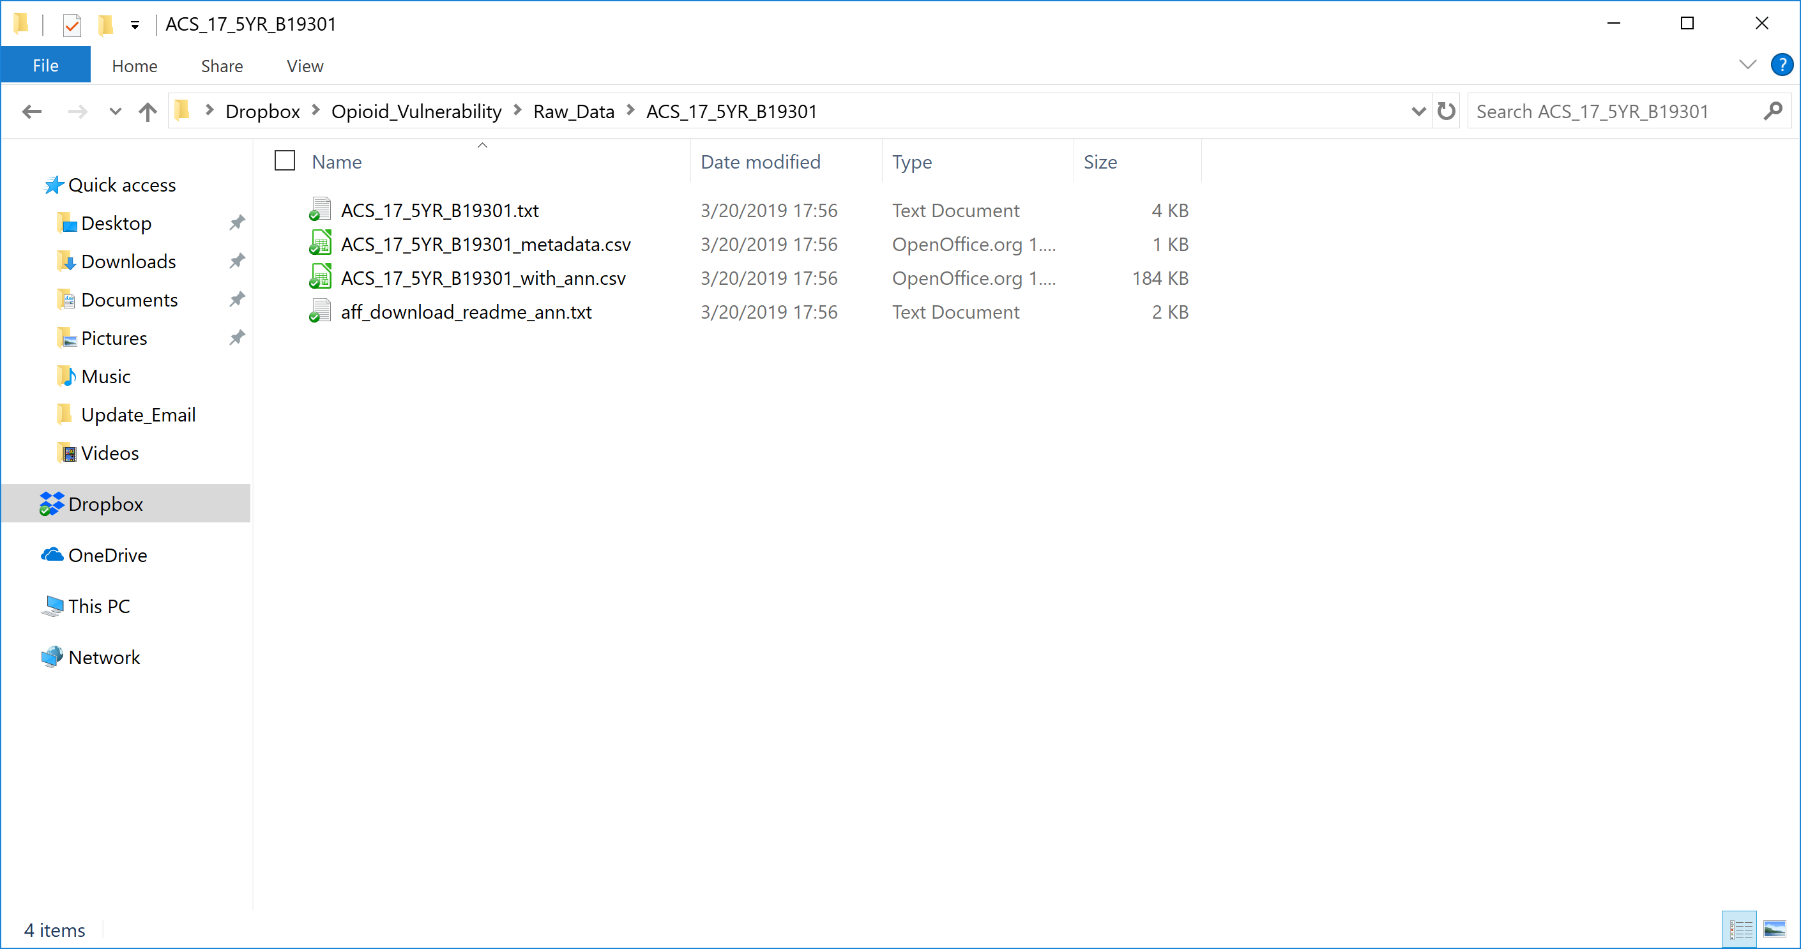
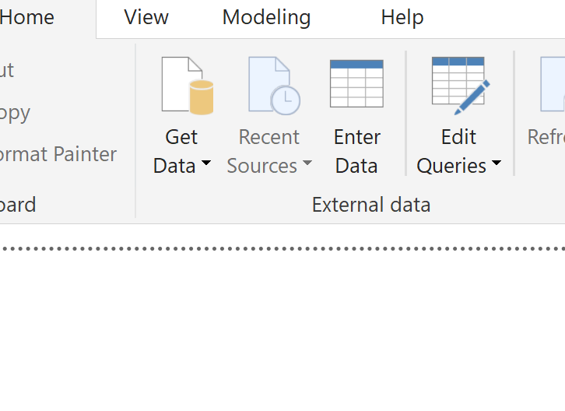
Data Source
N

Slide 25
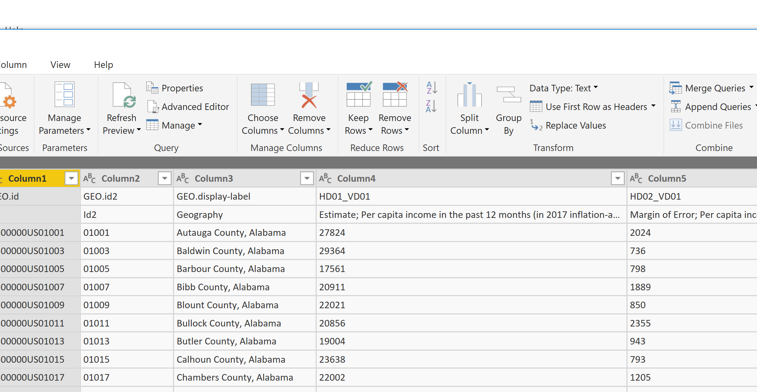
Data Wrangling
Step 1: Remove top row

Slide 26
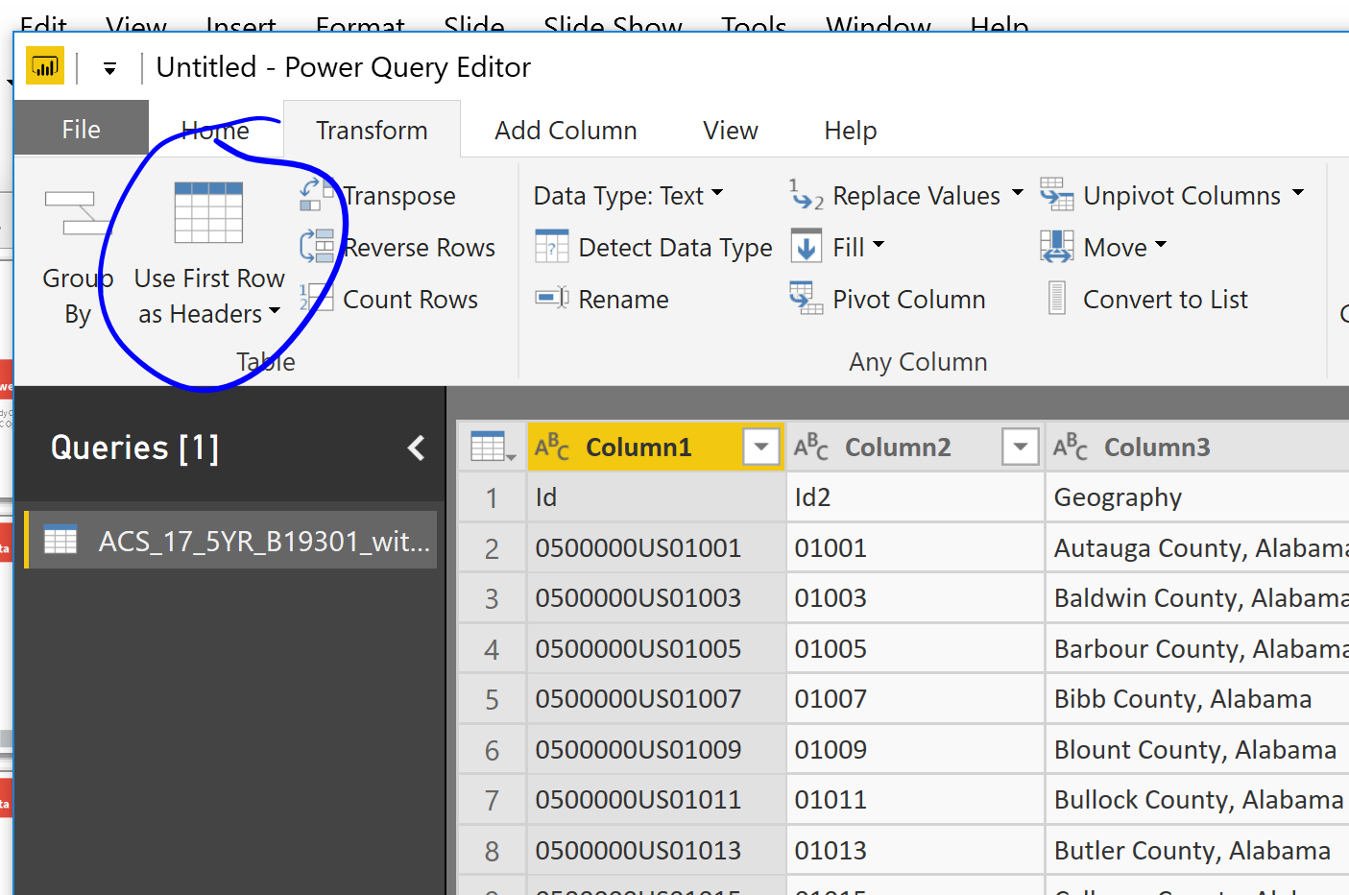
Data Wrangling
Step 2: Advance Headers

Slide 27
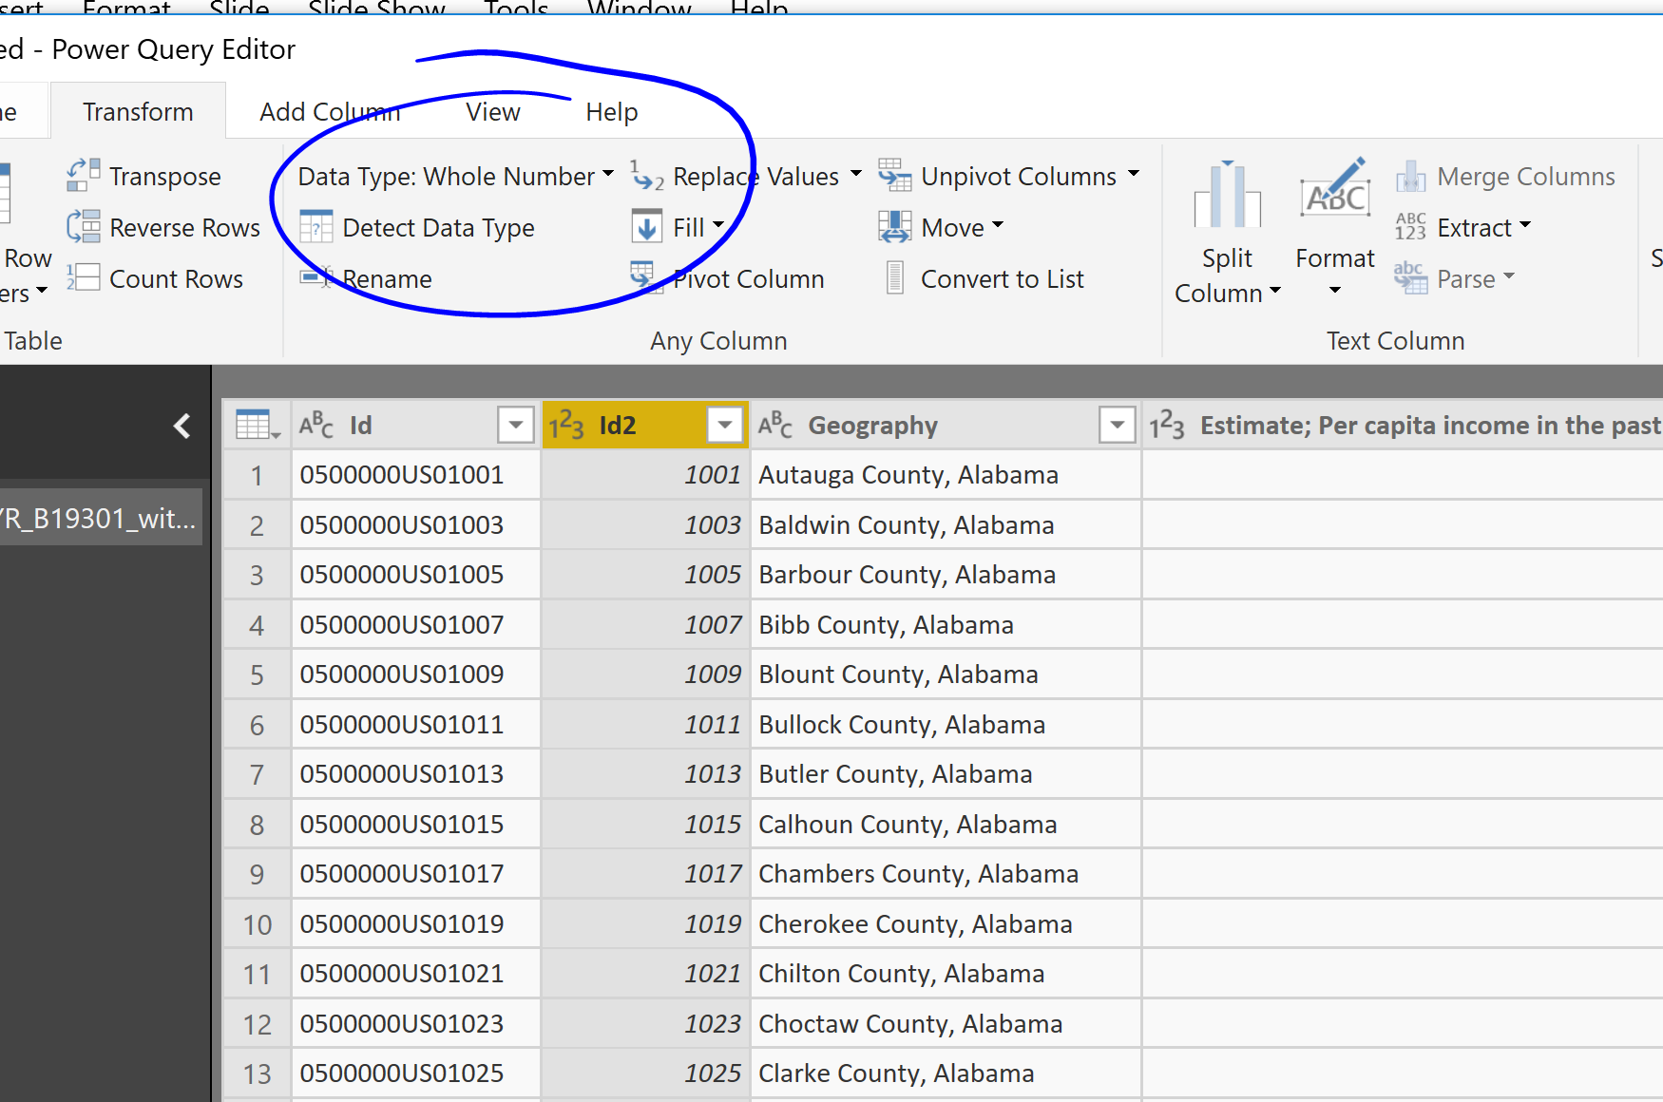
Data Wrangling
Step 3: Convert ID to character

Slide 28
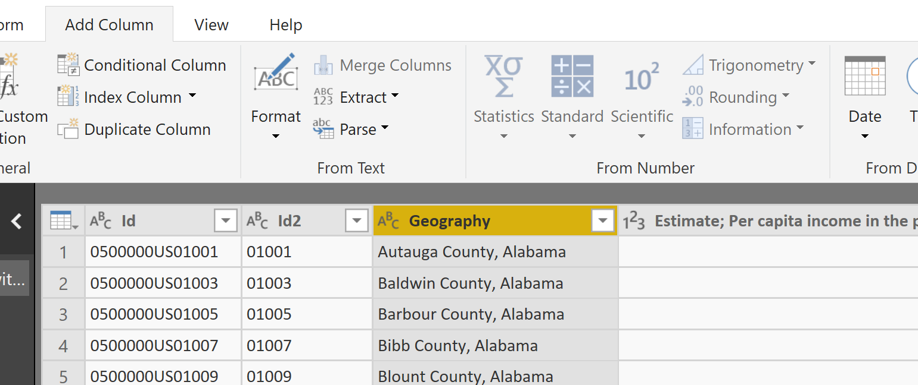
Data Wrangling
Step 4: Convert county name to state

Slide 29
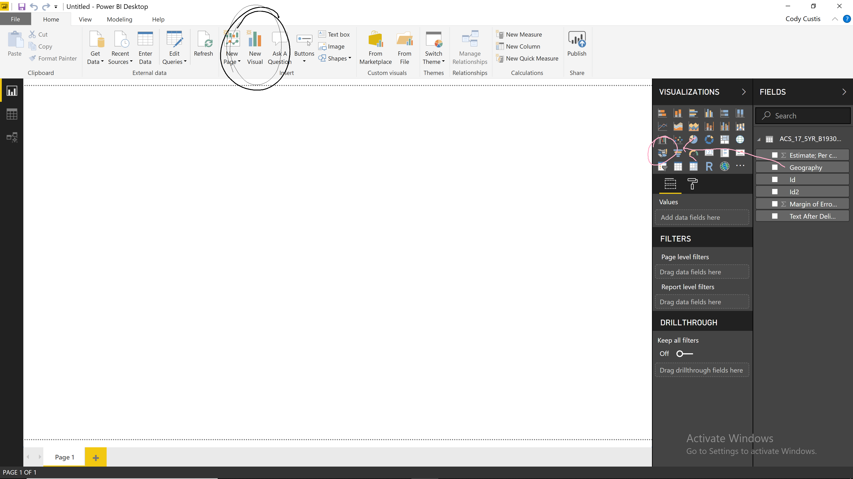
Data Visualization
First visual: name to state

Slide 30
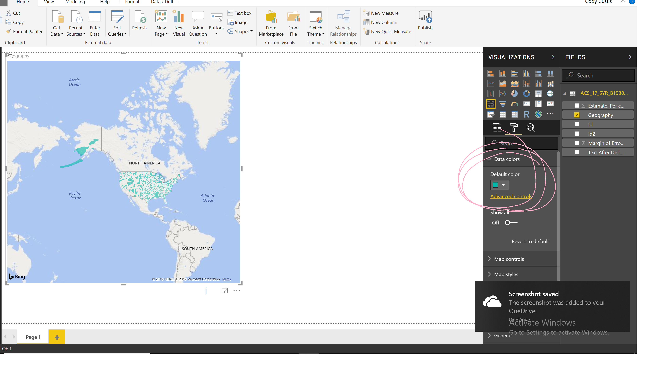
Data Visualization
First visual:

Slide 31
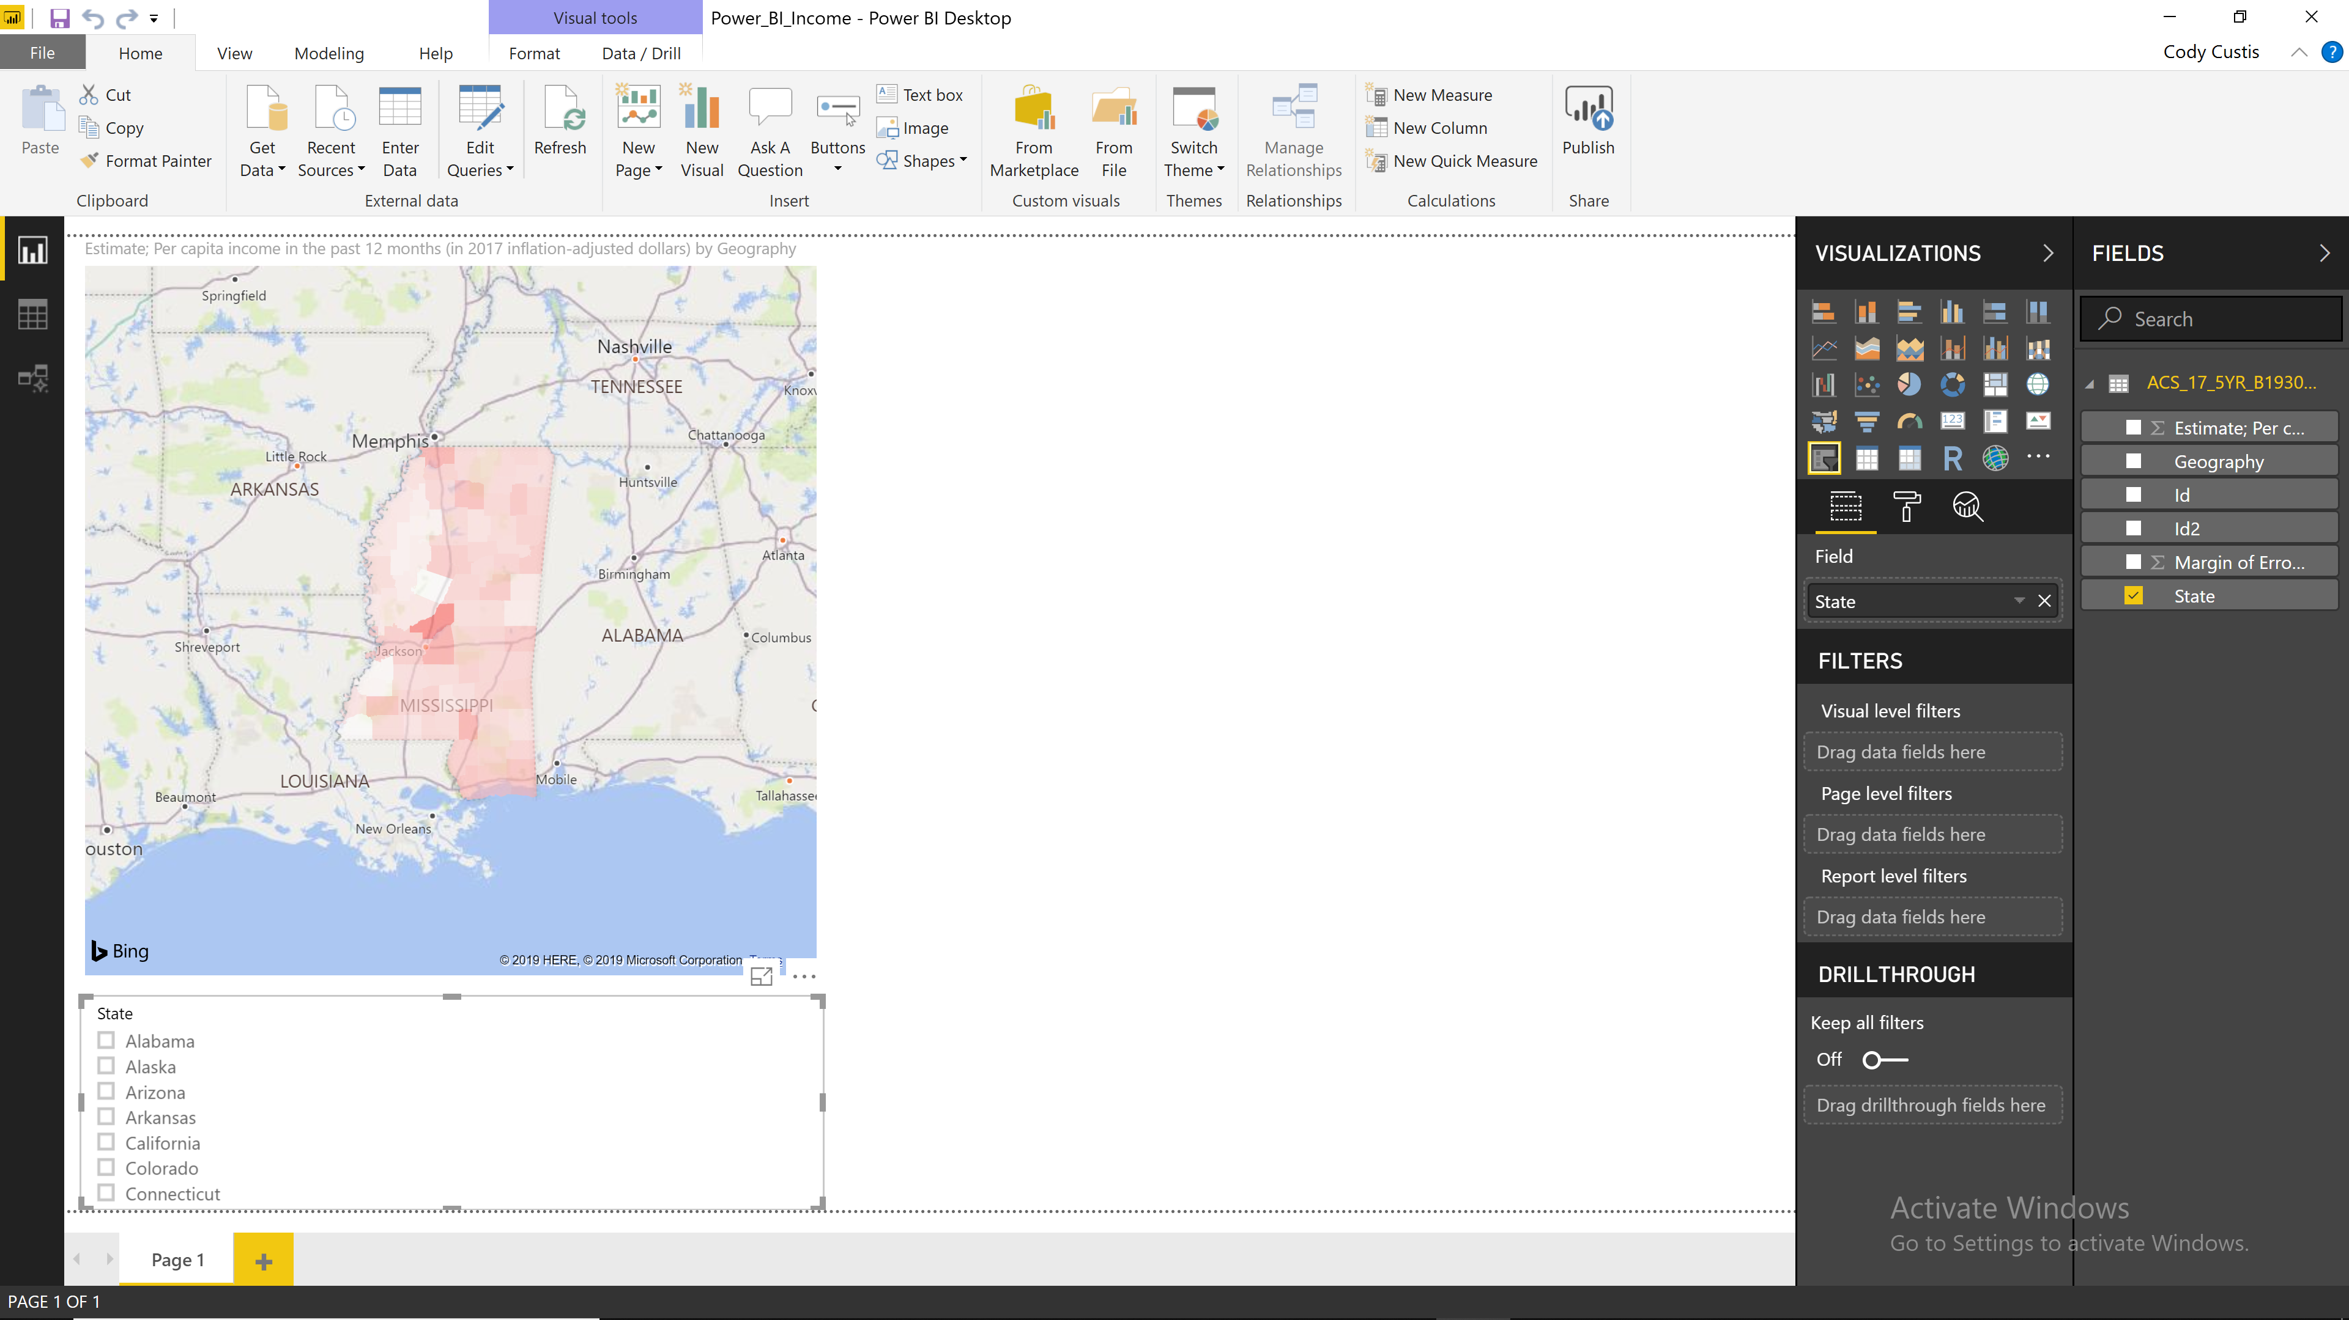
Data Visualization
Add slicer:

Slide 32
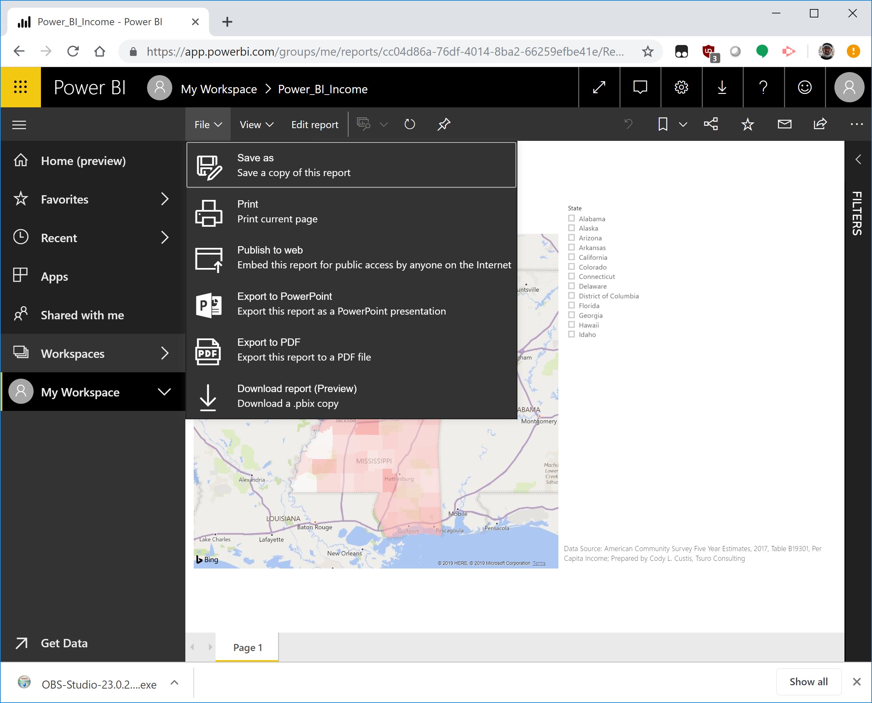
Data Visualization
Deploy:

Slide 33
Data Visualization
Deploy:

Slide 34
Data Visualization
Deploy:
https://app.powerbi.com/view?r=eyJrIjoiOTA0ODRiY2YtOGY4ZC00MjI2LWIyNjctNzkyYWQzMjFlOGMyIiwidCI6IjcxZjNhYTMyLTg2NTYtNGU4Yi1iMTUxLTBkNWEwYjBkMjhiMCJ9

Slide 35
Funding by Cooperative Agreement number 1NU1ROT000018-00. The conclusions in this presentation are those of the authors and do not necessarily represent the official position of the Centers for Disease Control and Prevention.
CSTE National Office
2635 Century Parkway NE, Suite 700
Atlanta, Georgia 30345
770.458.3811
770.458.8516
jarieh@cste.org

