Slide 1
Introduction to GIS and mapping software for public health applications
Tsuro Consulting
Jordan Larson and Cody Custis
Technical Consultants with CDC Opioid Vulnerability Assessment

Slide 2
Content
Notes:
Good day, my name is Jordan Larson and joining me is Cody Custis and we are Tsuro Consulting, a small firm working with CSTE to provide technical consulting on jurisdiction CDC Opioid Vulnerability Assessments. Today, we will be presenting on an introduction to GIS and mapping software for use in public health applications.

Slide 3
Topics for Today
Summarize commonly available GIS and mapping software and applications that can help with any health assessment work
Take a closer look at ESRI products
Produce a quick map with ArcGIS using ACS data
Produce a quick map with Power BI using ACS data
Notes:
Topics for today include those listed and the following learning objectives:
1. Identify common GIS and mapping software platform and products, for different sized organizations.
Identify ESRI products for different sized organizations.
Independently produce a basic layered map in an ArcGIS environment and export to a useable file format for reporting purposes.
Independently produce a basic layered map in the Power BI/3D Maps environment and export to a useable file format for reporting purposes.
Independently produce a basic layered map in the Power Maps environment and export to a useable file format for reporting purposes.

Slide 4
Software

Slide 5

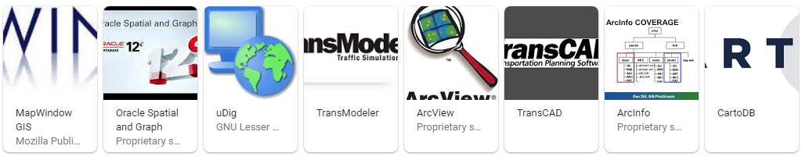

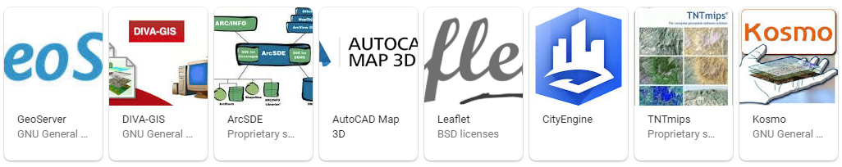
Independent GIS Software
Notes:
If you are starting from the ground floor, shopping the market for independent GIS, or mapping software can look overwhelming. Here you see about half of all independent, mainstream GIS software titles. In addition to these titles you have customizable mapping applications and visualization tools built into major platforms including those we all know (Google, Amazon, Microsoft, Apple, Oracle, Facebook, etc.) and some programming platforms we might be less familiar with (R Studio, Python, Java, etc.). The reality is, most of the independent titles have niche industries they cater to and so not all products out there would be useful in public health. The major platforms have also pushed further and further into this market, and have improved basic functions such that they have become competitive just in how easy they are to use. Some jurisdictions may want to stick with major platforms to complete very simple maps and to share their data quickly. As the presentation proceeds, we will be keying in on products, both independent and corporate, that we feel suit vulnerability assessment work for the various jurisdictions.

Slide 6

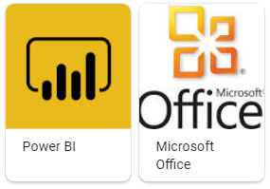
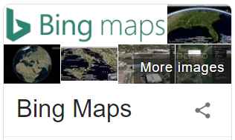
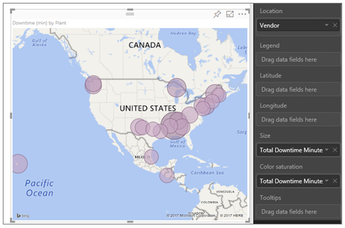
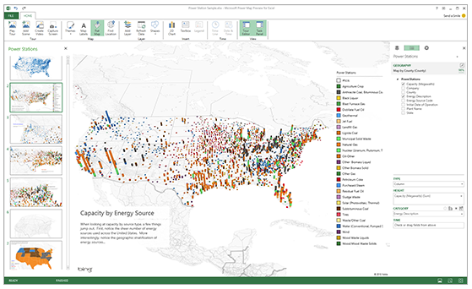
Microsoft Mapping
Notes:
In the world of software giants, companies like Google, Microsoft, Apple, and Oracle have their versions of mapping software services, which are different from full, independent GIS software options. Among leaders in this space, Microsoft has internally competing products it offers in it’s business and personal class software. Power BI, and 3D Maps (also known as Power Maps) offered through Microsoft Office, represent two mapping visualization services running on top of Bing Maps. Power BI provides a web-based dashboard environment with a moderate level of map customization and visualization options. Power BI is designed to work easily with data formats that are common to structured databases.
Alternatively, 3D maps was developed in stages to offer some unique visualization options for consumers using Microsoft Office products. 3D maps is now fully integrated into Office 365 Excel. Visualization options in 3D maps are extremely fast and powerful, but extremely limited in customizable options. For quick and easy visualization of county-level health data, very few options beat the ease of use of Power Maps, or the deploy-ability of Power BI. The Tsuro team highly recommends getting familiar with, at the very least, the consumer side of Microsoft mapping services, because of the confidence it can give any team with simple mapping tasks, and in an environment as familiar as power point! On the downside, Microsoft mapping services have fairly canned visualization functions, and it becomes difficult to develop mapping protocols across an entire organization, if the Azure stack isn’t backing things up. There are definitely downsides to Microsoft, and so we also don’t want to oversell, or encourage a team to become over reliant on these products. One downfall, is the lack of GIS technical knowhow necessary to work with some of Microsoft tools. Much like traveling to a foreign country, if you always rely on a translator, though convenient, you might be missing a deeper cultural experience.
As far as the requirements to complete an Opioid Vulnerability Assessment, it is possible, and quite easy, to do everything in one of Microsoft’s mapping services, but is that the finished product a jurisdiction would really want?

Slide 7


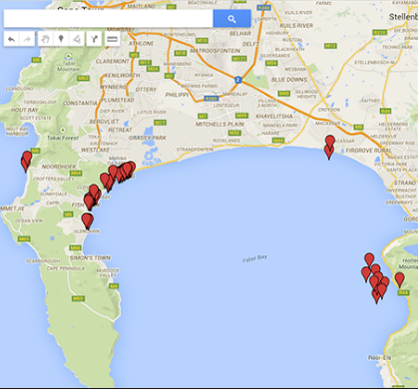

Google Mapping
Notes:
We won’t spend much time looking at google, although it’s worth mentioning that google is also a leader in certain applications for mapping software. Mainly, Google Earth has proven most useful in research applications, more so than in private applications or published “add-ons” for general analytical and dashboard uses. On the consumer side, perhaps the most familiar product in the market today, google maps, provides visualization that is really geared towards simple tasks and ease of use for general geographic needs. Google has a clear domination in the space of big data, and tying this in with research specialization, they could be, arguably, the most powerful mapping platform in the world. This being said, we don’t think it works well for conversion to public health applications, and google has not yet fully entered into government services, or large organizations, the way Microsoft has. I’m sure there are some successful public health teams out there using google products, but we aren’t generally recommending it, if you’re starting from scratch.

Slide 8
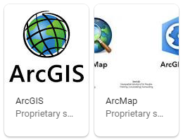

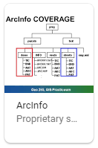
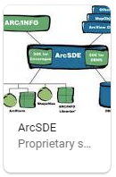
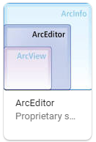


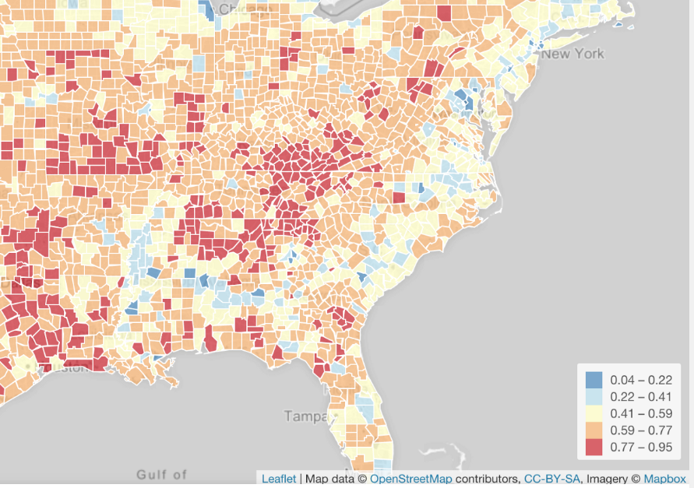

Independent GIS Software
Notes:
Finally, In the race for independent GIS software, the ESRI platform, which represents about 43% of market share, is an established leader. ESRI’s famous ArcGIS includes many GIS software applications bundled into its platform: ArcMap, ArcView, ArcInfo, ArcSDE, ArcEditor, etc. ESRI, today, is considered the global leader in GIS and mapping software, and has been sold to and through many large institutions private, and public. For production of government, or large organization, maps, with consisten data management and archiving, ESRI is a strong candidate for a software platform, and mapping solution.
There are still, a few other titles worth mentioning today. QGIS has grown substantially over the last 5 years as a leader for open source GIS software, and has allowed, smaller, more technical groups to cut down on the institutional costs of ESRI products. Another significant, and historical, open source platform is GRASS GIS. Finally, Leaflet, a java application, has become a popular software package for use in other platforms including in concert with R studio.
Now across all of these options, there are reasons why an public health organization/jurisdiction might be interested in a particular software package, of more simple mapping service. It’s fairly straight forward to have guessed that ESRI software is really built for the institution, and the more complex of customers…but within ESRI’s product line, there are also some lighter tool sets, including ESRI online, and their mobile apps. These might be quite suitable for a smaller task, or a smaller organization with simple mapping needs.
On the flipside, Cody and I want to tell you that there are some other great options out there, especially for smaller jurisdictional units with a limited budget, or perhaps organizations flexible enough to become highly technical and invest in customized business information systems. For groups low on financial resources, but with a deep bench of GIS skill sets, QGIS or Grass GIS might be a great option. If you find that some of your staff skill sets include R coding, often transferring over from academic experience, library packages like leaflet might be a great option as well. Leaflet can be executed inside an R script, and combined, they can generate some of the most powerful, elegant, and customized visualizations on the market. These kinds of tools will really require more of an artisan craft, and someone capable of discerning and writing simple programming code. That being said, the process control, the quality of Leaflet maps, the endless optioning of R code, dynamic web publishing, and all while remaining mostly free of cost… put it all together and it becomes clear to see why R mapping is so popular in academic and independent groups with technical skill sets. Cody is now going to show us a short demonstration on using R Studio to publish maps, and what that might look like for a jurisdiction.

Slide 9
R Studio Demo

Slide 10
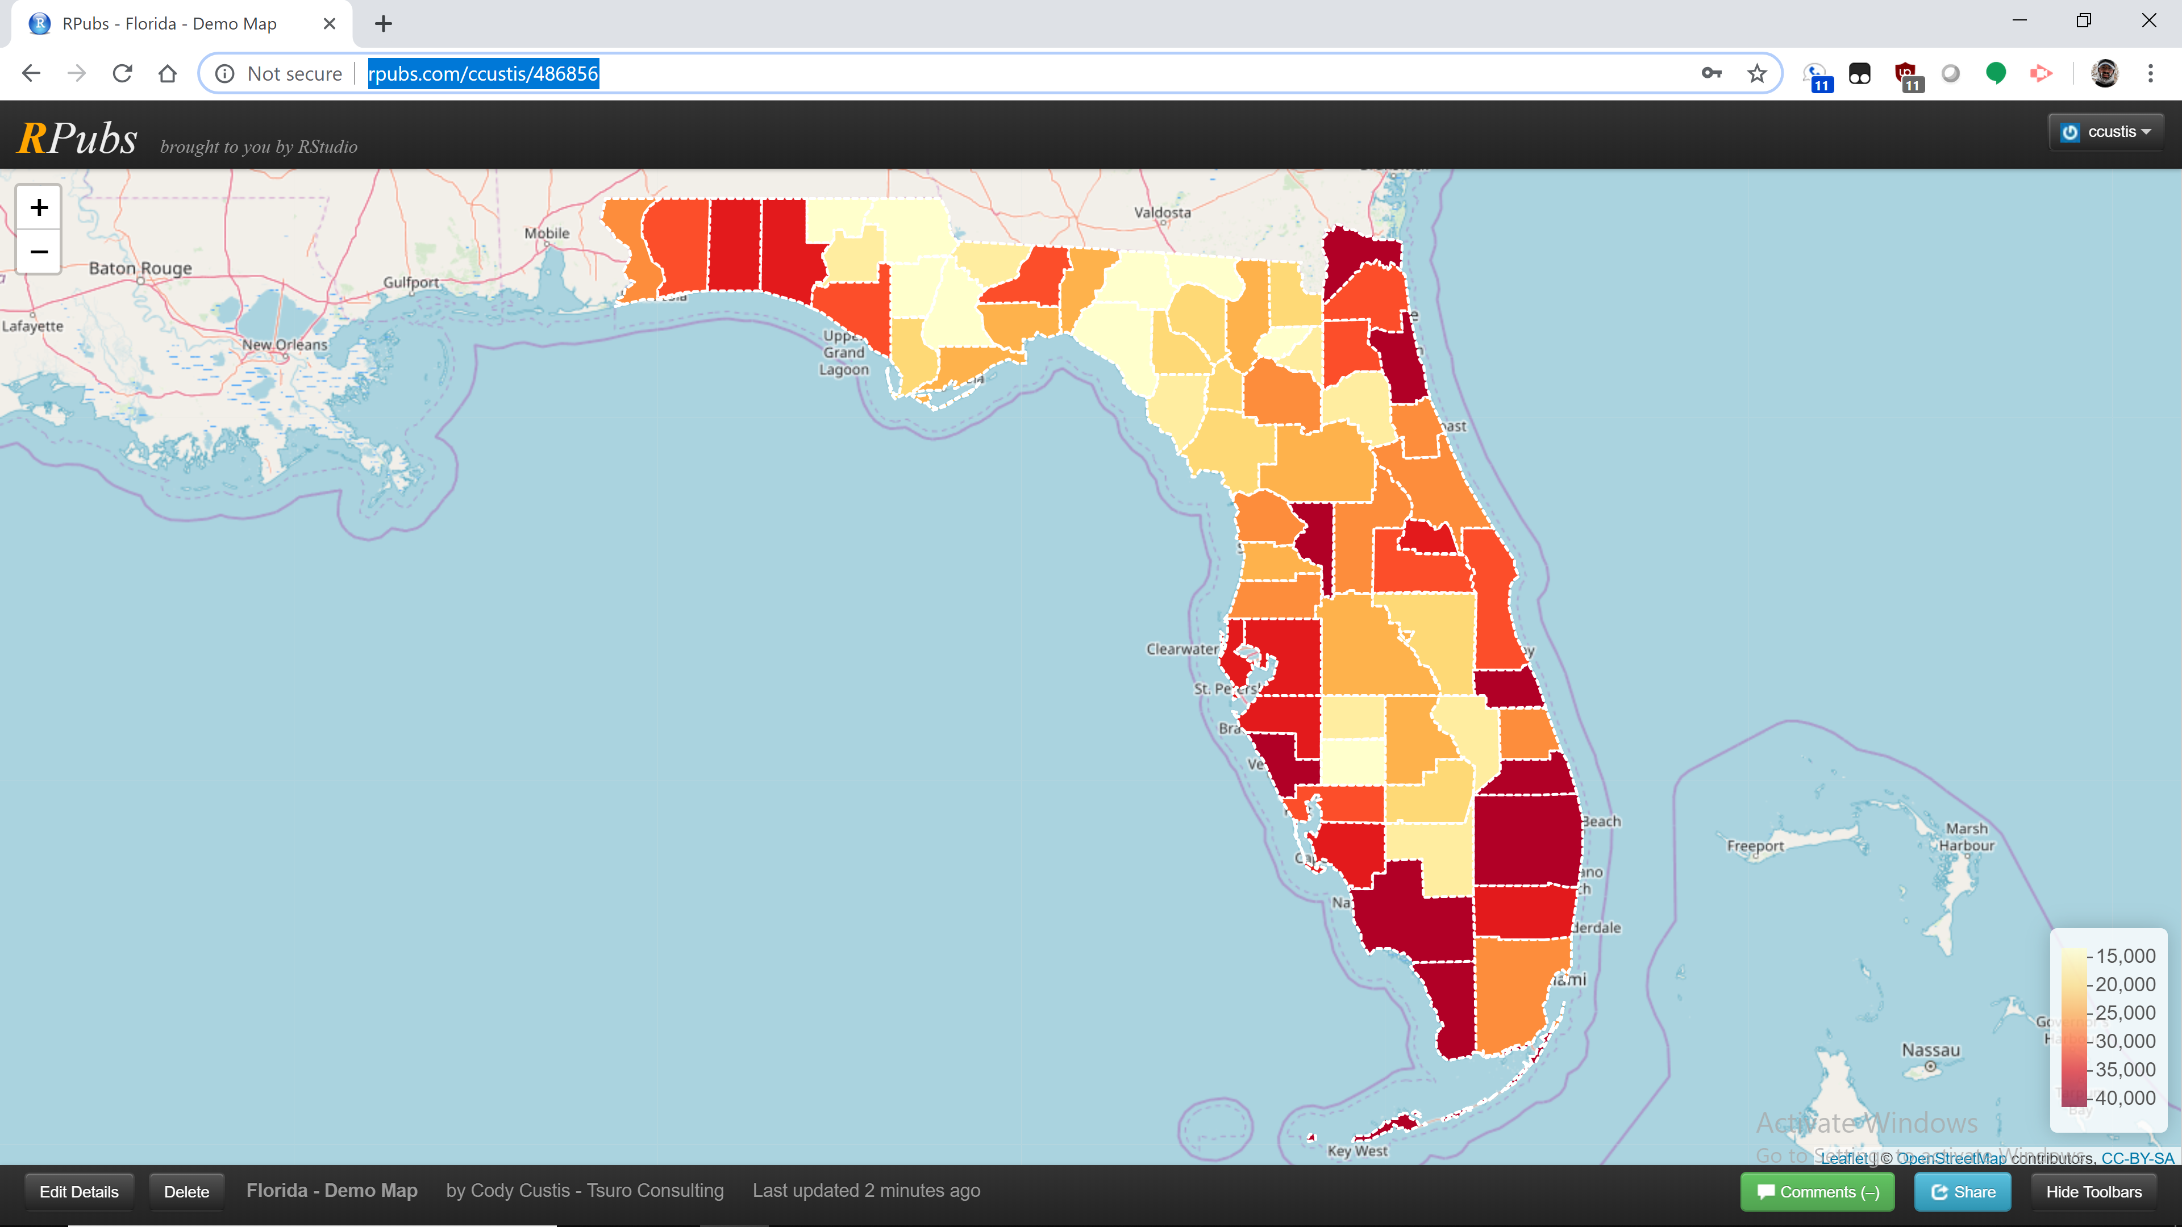
R – Demonstration
Notes:
http://rpubs.com/ccustis/486856
Advantages: Capable of both modeling, mapping, deployment
Disadvantage: Programming language, learning curve
The solution that we’ll talk about, in addition to Power BI and ArcGIS, is R. R has a lot of packages that do much of the heavy lifting and a great interface, Rstudio. The map that you just saw is per capita income for Florida, using the Leaflet package. Now that the map is created, we can (and will) recycle a lot of code to make maps for other indicators. And, for those with a GIS background, that is a Leaflet object. Leaflet is important, because it’s a standard GIS object. Leaflets can also be embedded in other applications.

Slide 11
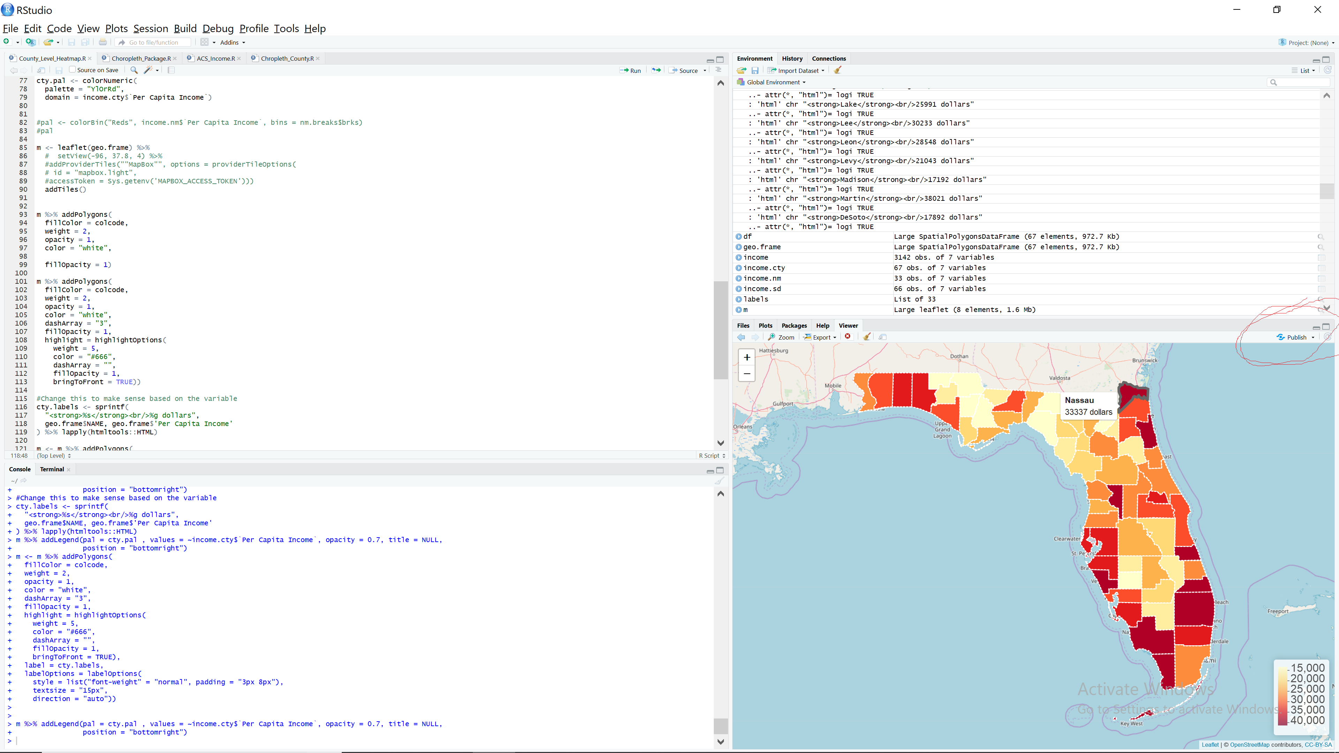
R – Demonstration
Notes:
I hit Publish from the web interface, and the map just uploaded to the public Internet after I made an account. It took me roughly three minutes to get the map published to the web.

Slide 12
R – Demonstration
Notes:
The map has tooltips. It’s possible to switch up the base layers, add points.
The challenge is that R can be really, really steep to work with. For example, I had an error about missing a color ramp function; the real error was that I renamed one of my objects. We’ll make all the R code for this project (though not necessarily private jurisdiction data) available to the public, using Basecamp and ideally Github. Some of the other packages that make maps are ggplot or cartography. Syntax is not consistent from package to package, so we’ll try to stick to one or two packages. We’ll do a little bit with Rshiny, which allows users to make slider based dashboards using R.
http://rpubs.com/ccustis/486856

Slide 13
ESRI

Slide 14





Notes:
Because ESRI is so popular for production in the business world and in government agencies…we want to take a closer, more in depth look at the ESRI product space.
The ESRI platform, is broken up into multiple market segments;
1) ArcGIS desktop is a bundle of their traditional applications and currently available in version 10.7. This bundle is really available for legacy clients and is their core software.
2) ArcGIS pro delivers the ArcGIS desktop experience in a “next generation” cloud computer environment.
3) ArcGIS online delivers limited forms of ArcGIS applications through a web interface
4) ArcGIS enterprise is really a full stack service software for large organizations and data managing firms.
5) Finally, ESRI applications deliver specific functions available for use in mobile computing and otherwise.
As far as public health data management, and mapping, ESRI will have a solution for almost everything, and at spectrum of prices. Chances are, if you’re in the government, you might already have access to enterprise licensing, but if not, you can make a great case to purchase ESRI, when you consider how many sister agencies are likely using it. At State governments, sometimes administration offices manage enterprise licenses across multiple agencies, it’s worth checking with administrative IT offices to clarify the opportunities your team might have to access the software.

Slide 15
ArcMap Demo

Slide 16
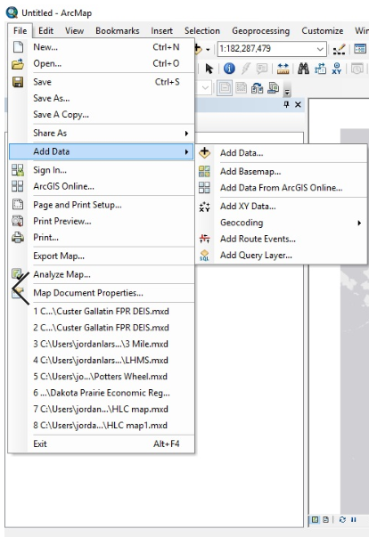
Add Data
Notes:
Once the ArcMap environment is open, and you’ve started a blank new map, the canvas of a globe will appear blank. ESRI will require you to load a basemap onto your work space before anything is visualized. Some users may choose to not immediately load a basemap, which can be resource intensive as they carry the extent of the entire globe. In this case, a user may want to start by simply adding their custom data. In any case, the best place to get started in constructing a map in ESRI is to select Add Data in the File menu. Here you’ll see a list of options that will start forming the visual orientation of your map.

Slide 17
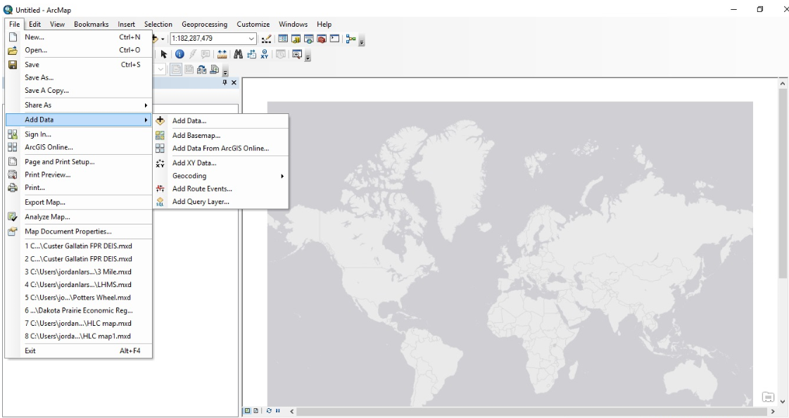
Basemap
Notes:
Here I’ve selected a generic World Light Gray Canvas Base from the ESRI provided options. These options were selected by simply going to the Add Basemap option just below the Add Data selection.

Slide 18
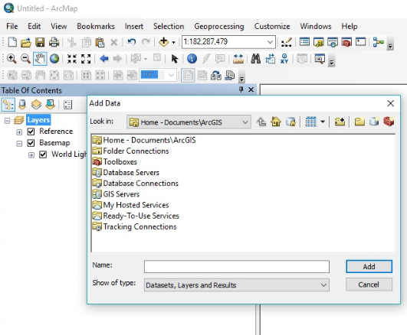
Data options
Notes:
Next I want to add my own data to begin customizing my map. Navigating back to the same Add Data function, I select Add Data, and a window pops up which asks where the user would like to find this data. This window begins to show the complexity of options in the ArcGIS environment. Data can be loaded up manually, or from GIS servers and other applications running in the ESRI platform, or 3rd party software, or databases. For this demonstration, I am simply going to select a local file, that I downloaded from ESRI’s website, that contains the administrative boundaries of Counties in the united states. When I downloaded this file, called a shape file, I stored it in my local ArcGIS file folder found in my documents folder. This way ESRI was already pointing me in the right direction, via the top selection on this menu.

Slide 19
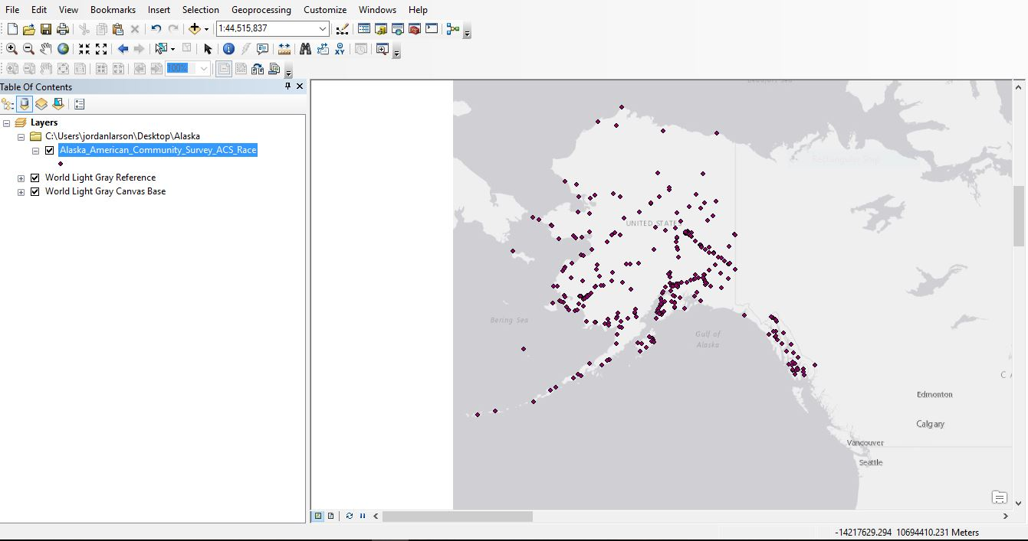
Basic point data layer

Slide 20
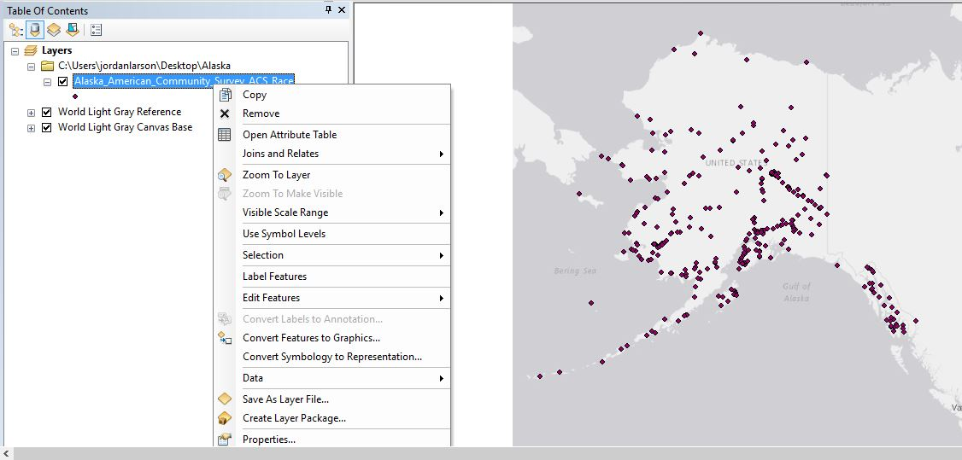
Data Properties

Slide 21
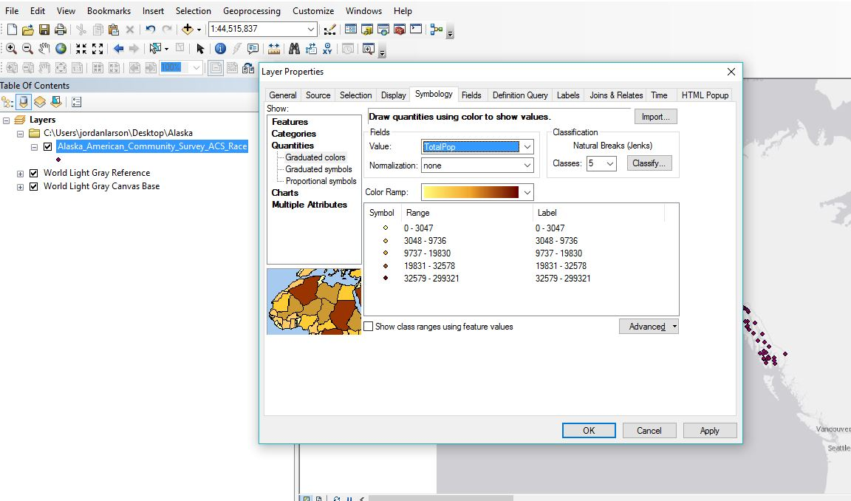
Data Properties

Slide 22
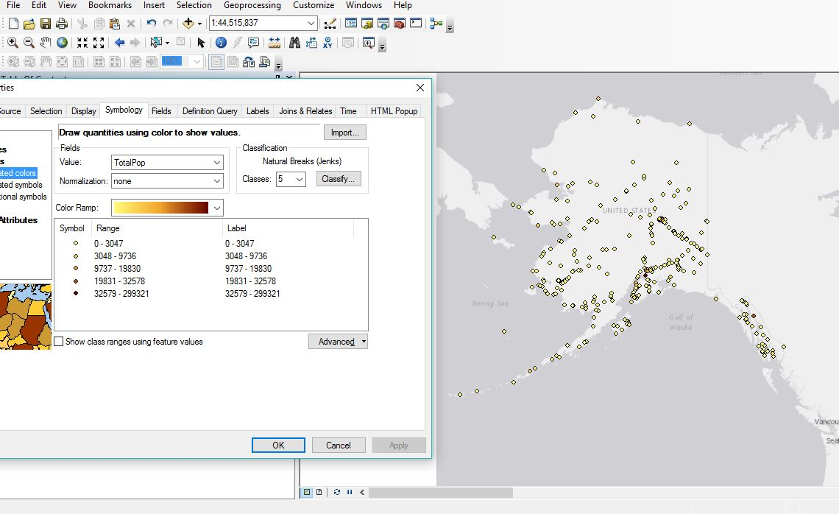
Data Properties

Slide 23
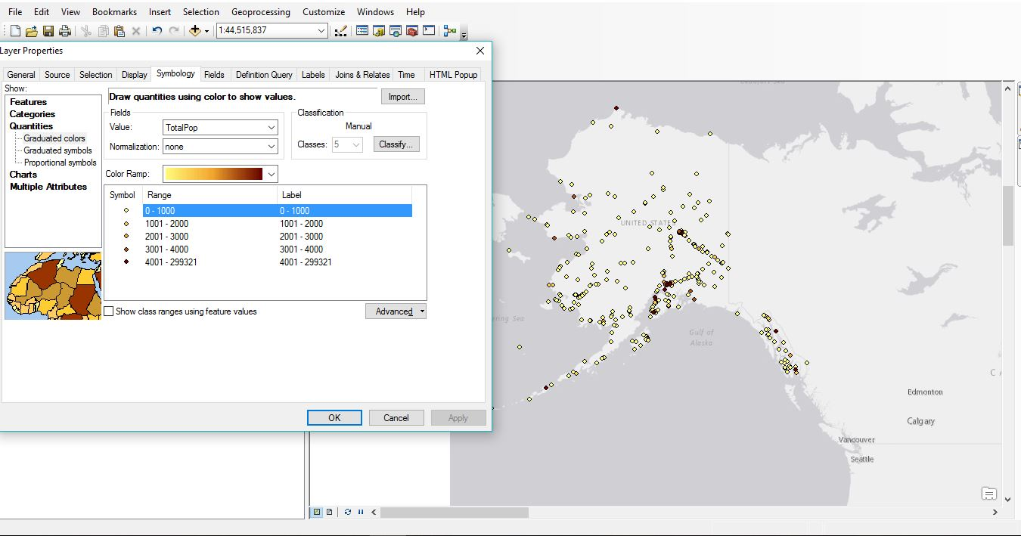
Data Properties

Slide 24
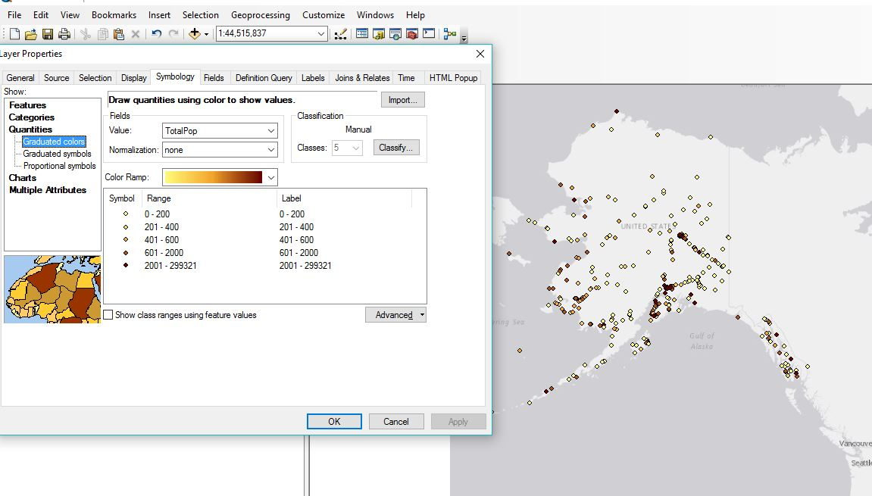
Data Properties

Slide 25
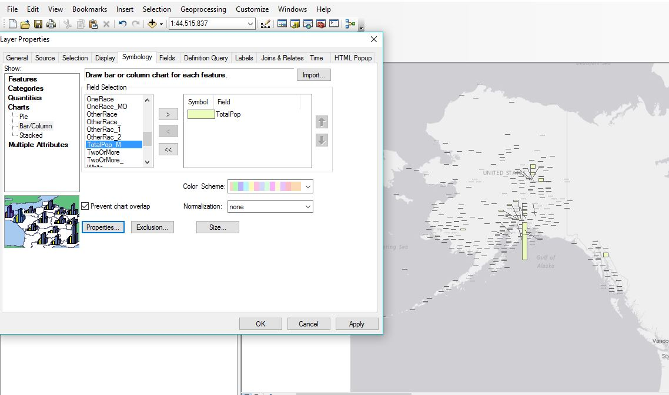
Data Properties

Slide 26
Power BI Demo
Notes:
Again, joining us is Cody Custis and he will be helping us in the presentation with a quick data task, and mapping visualization with Power BI, out of the Microsoft services package.

Slide 27
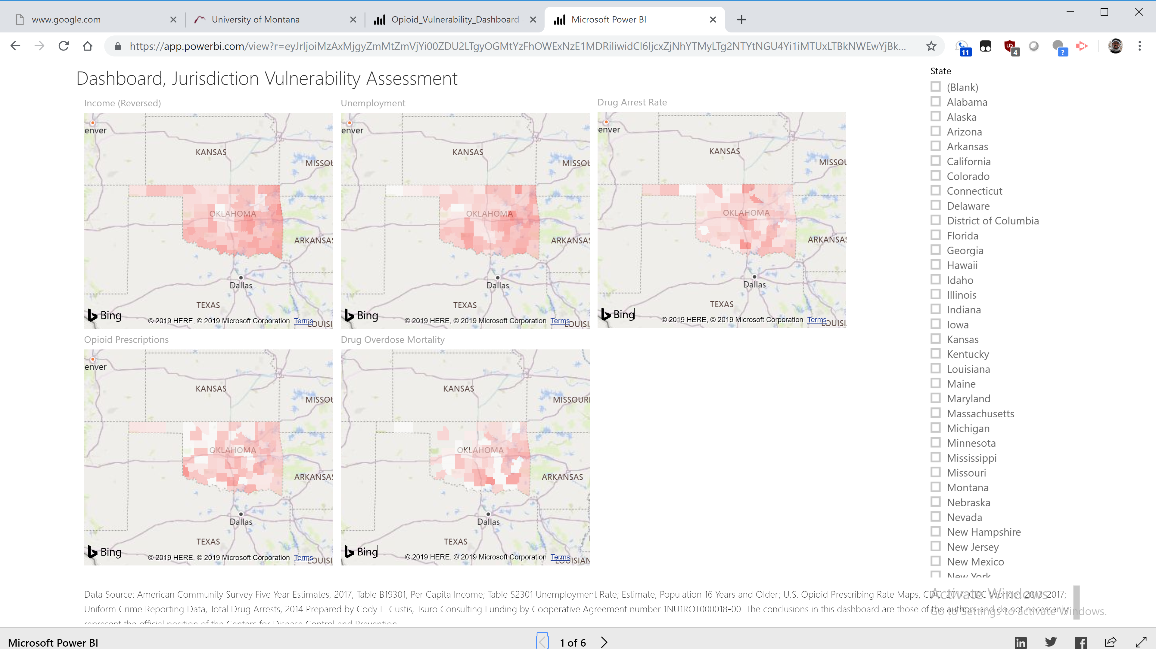
Power BI - Demonstration
Notes:
Now, we’re going to look at some of the indicators from the American Community Survey and other data sources using a deployed Microsoft Power BI project. We’ve got a video that goes how to deploy one of these indicators; we’ll make another video that shows some more of the dashboard construction. Today, I want to focus on the content that Power BI creates, specifically indicators for the jurisdiction vulnerability assessment. What you’re looking at on this page is a live, public dashboard, on the World Wide Web.

Slide 28
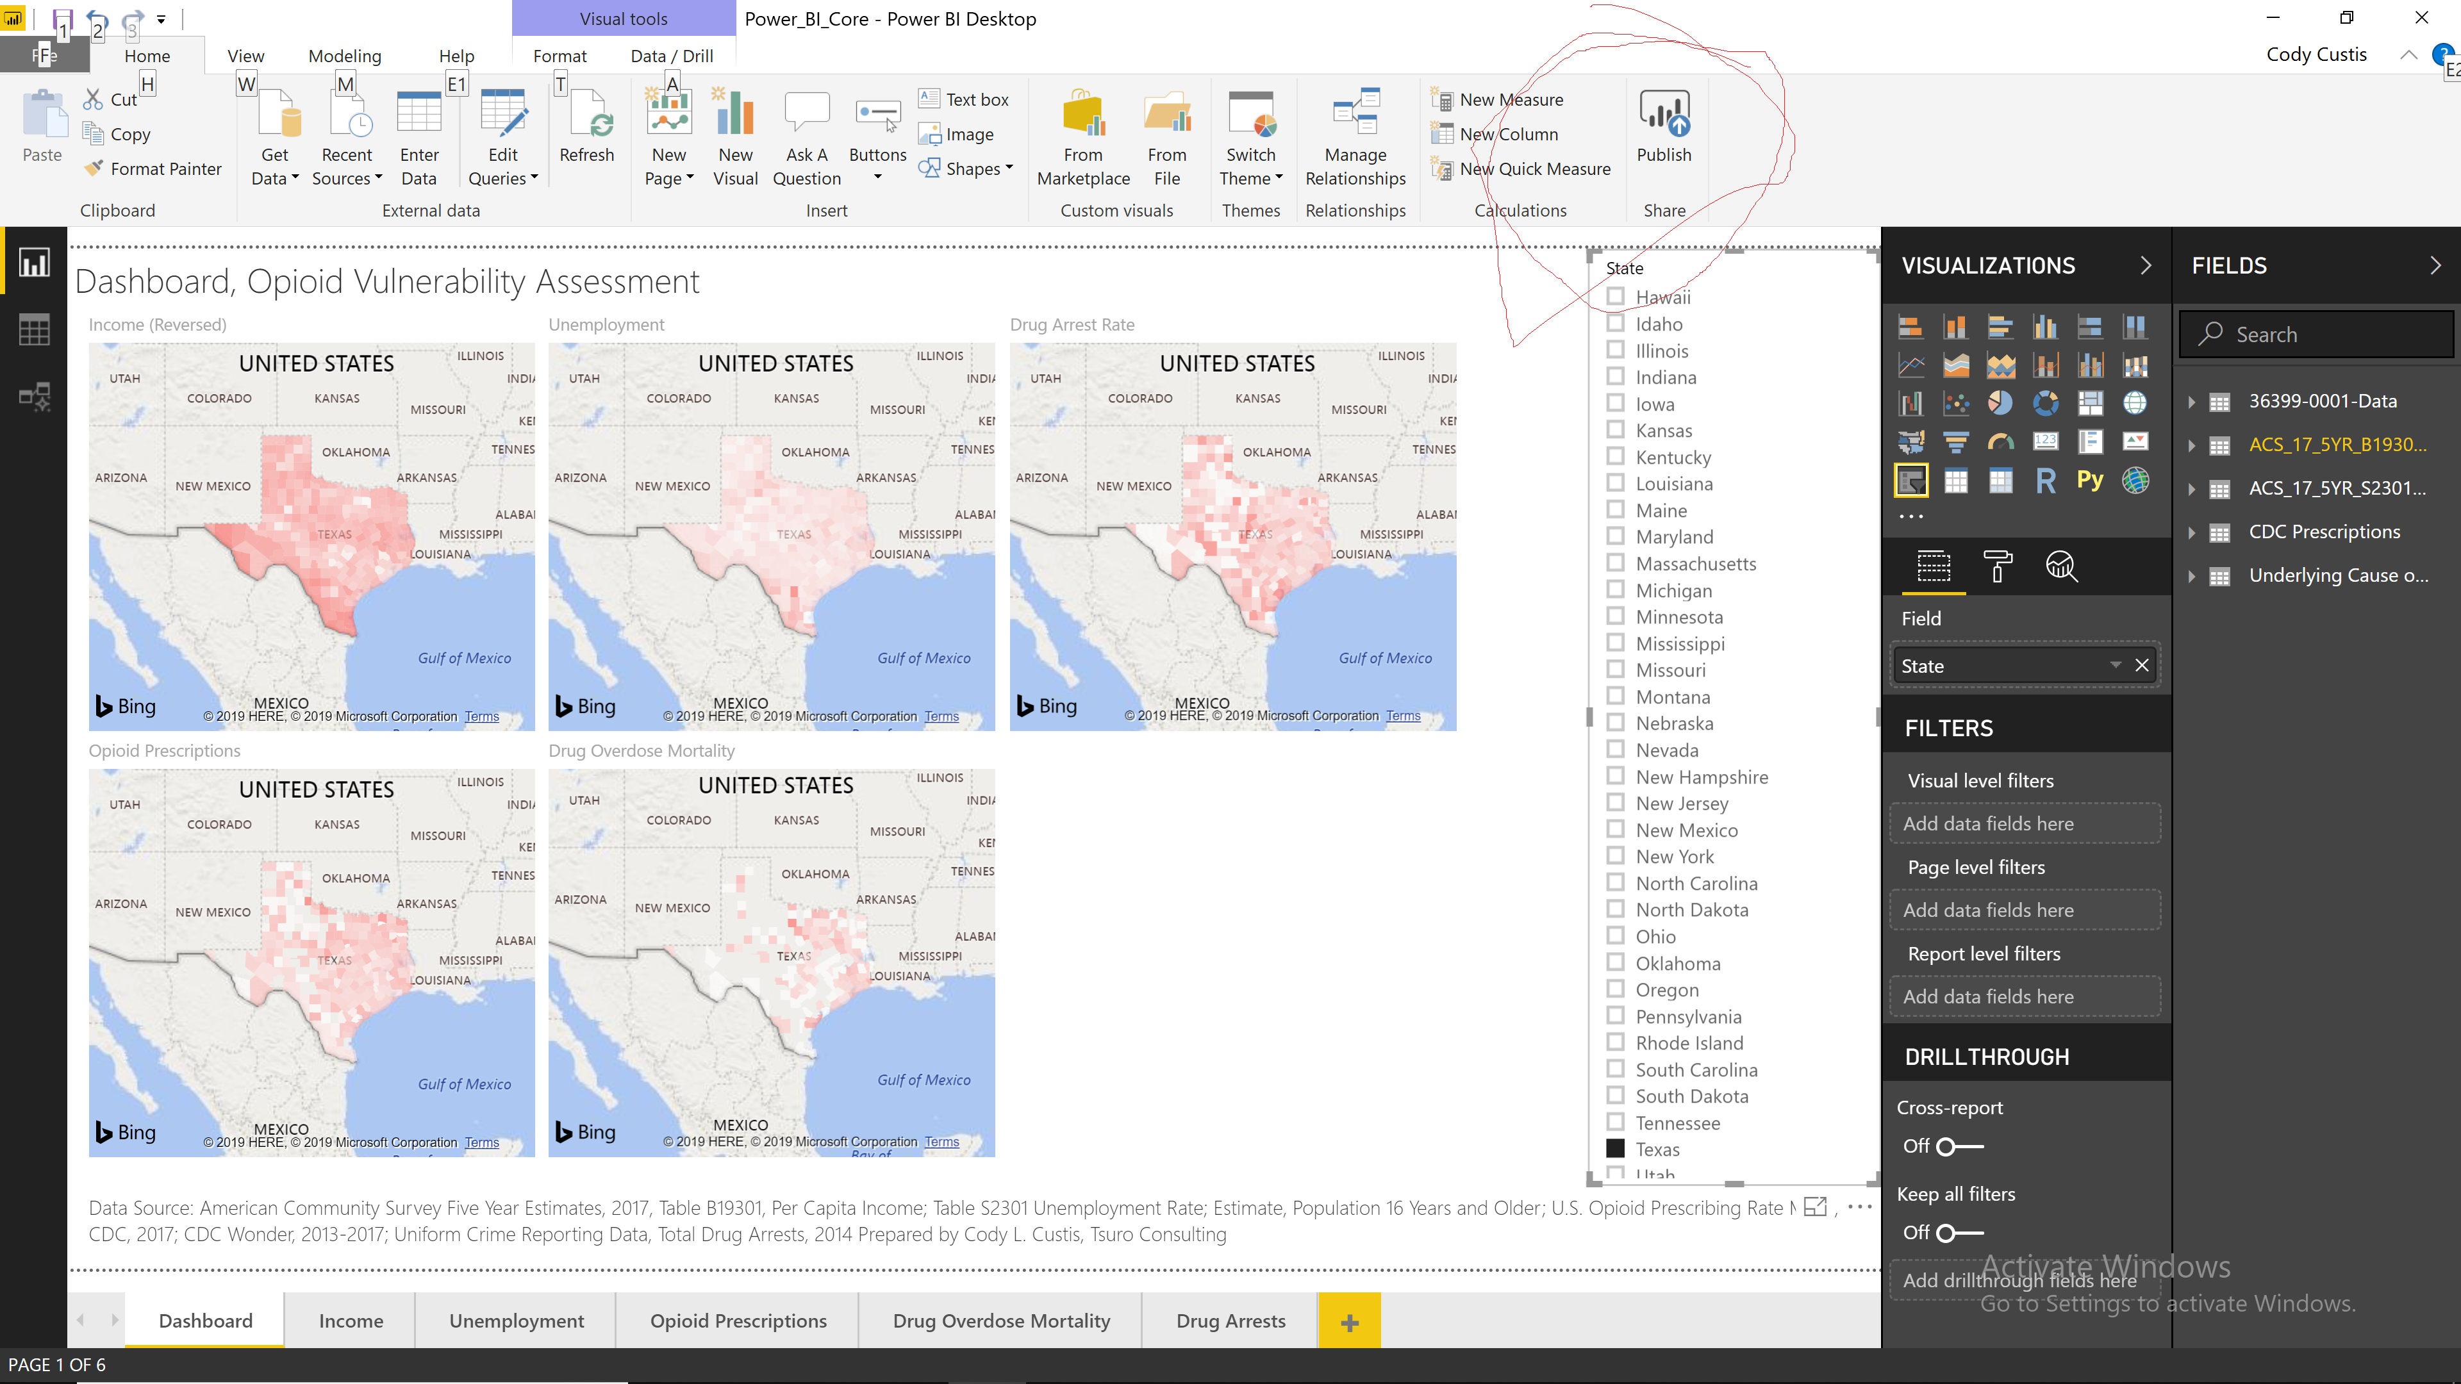
Power BI - Demonstration
Notes:
Power BI’s biggest strength, in my opinion, is ease of public deployment. The dashboard is made in the Power BI Desktop software, which downloads right from the Windows store. Once that dashboard is ready, hit Publish.

Slide 29
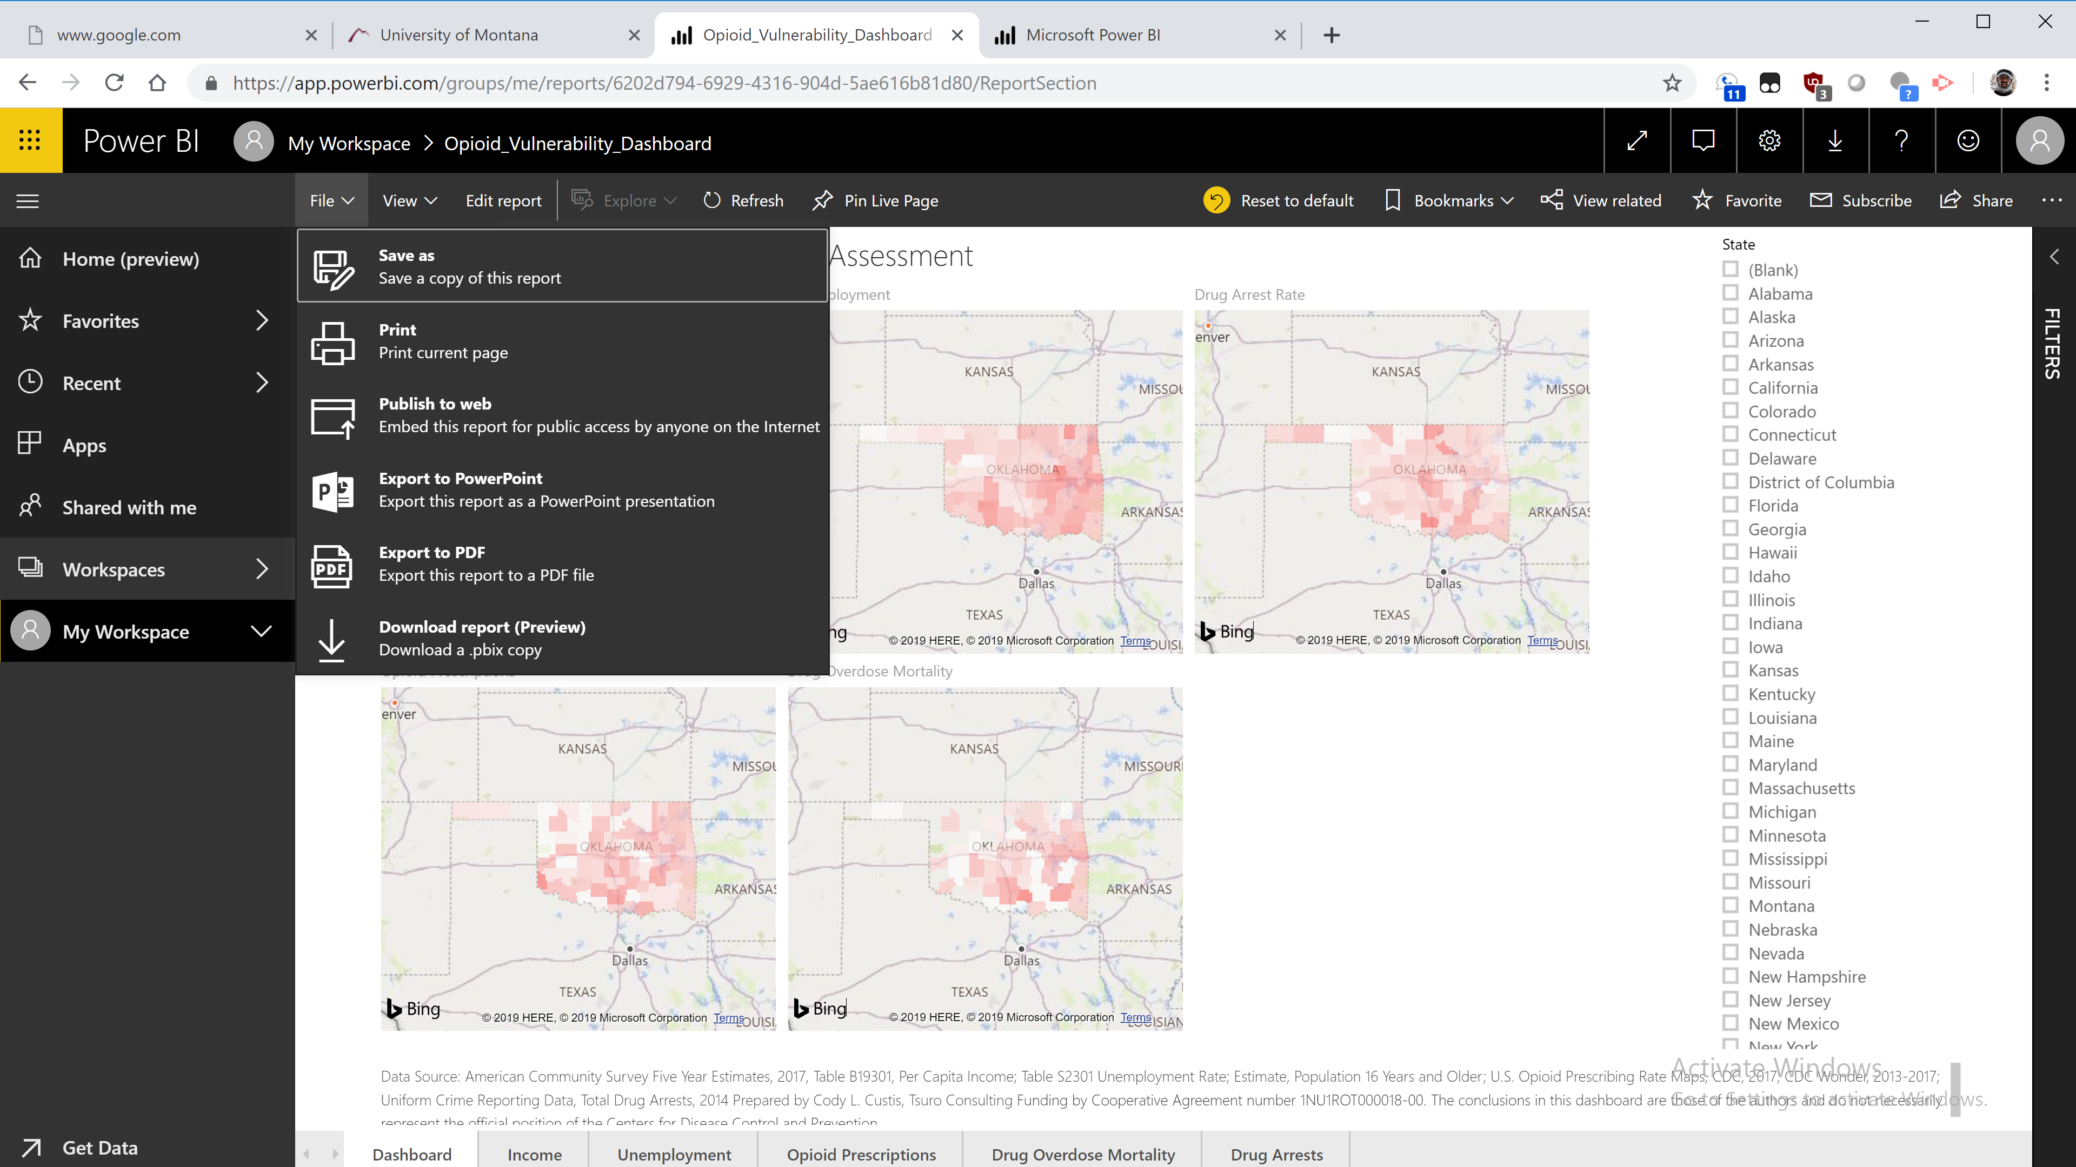
Power BI - Demonstration
Notes:
Which takes you to the Power BI Service on the World Wide Web. We’re still on the private side, in this case, my Power BI Service. There’s a lot that can be done to administer Power BI, but I just want to make the dashboard available to users. So, I hit Publish to web. That makes a live weblink that anyone can access. That’s the hook with Power BI. When you hit Publish to Web, anyone can see your data. However, in this case, the analysis is public (jurisdiction vulnerability assessment) and the data comes from public sources. We want anyone to be able to access this data.

Slide 30
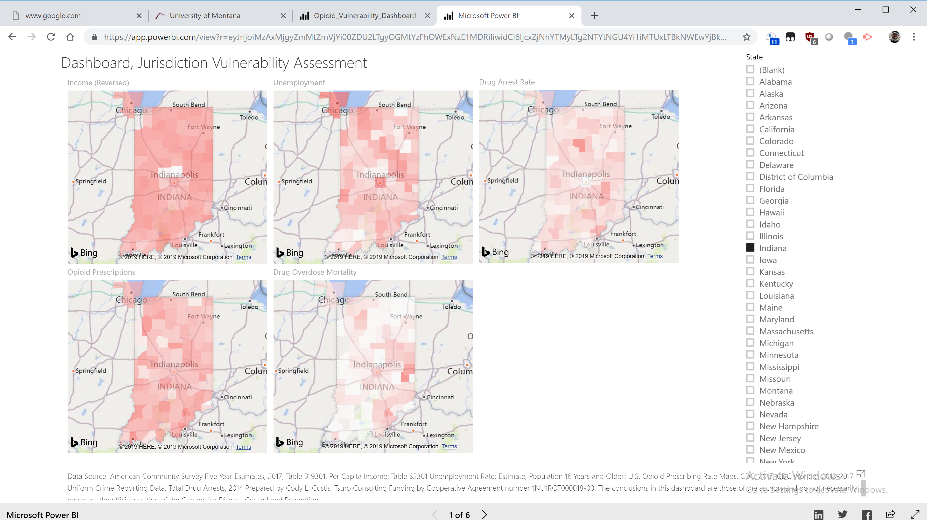
Power BI - Demonstration
Notes:
Anyone with the link can look at these indicators https://app.powerbi.com/view?r=eyJrIjoiMzAxMjgyZmMtZmVjYi00ZDU2LTgyOGMtYzFhOWExNzE1MDRiIiwidCI6IjcxZjNhYTMyLTg2NTYtNGU4Yi1iMTUxLTBkNWEwYjBkMjhiMCJ9)
. Microsoft can, if it chooses, feature them in a public gallery. Even though the dashboard is live on the web, I’ve copied things to the slideshow. The live dashboard allows the viewer to select any state, or even look at nationwide trends. For this project, I created a slicer which allows the viewer to limit the scope to the viewer’s jurisdiction. It’s possible to clear filters and look at nationwide data. If we were live on the Web, this would take around a minute, but since I’m in a presentation…

Slide 31
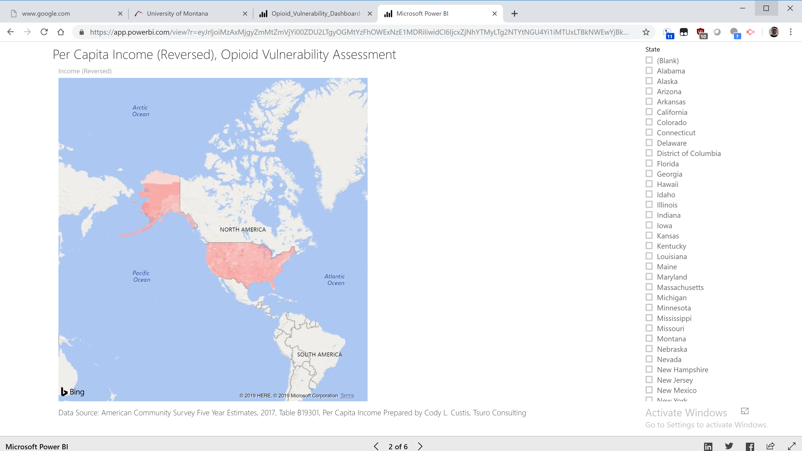
Power BI - Demonstration
Notes:
When we look at nationwide data, we mostly learn that people in Prudhoe Bay, Alaska, make a lot of money. That gets at one of the downsides of Power BI, which is that the default values aren’t always the most useful. We can zoom the map to the continental United States, but the default is… problematic. Software like Tableau, on the other hand, can map Alaska and Hawaii in the lower corner.

Slide 32
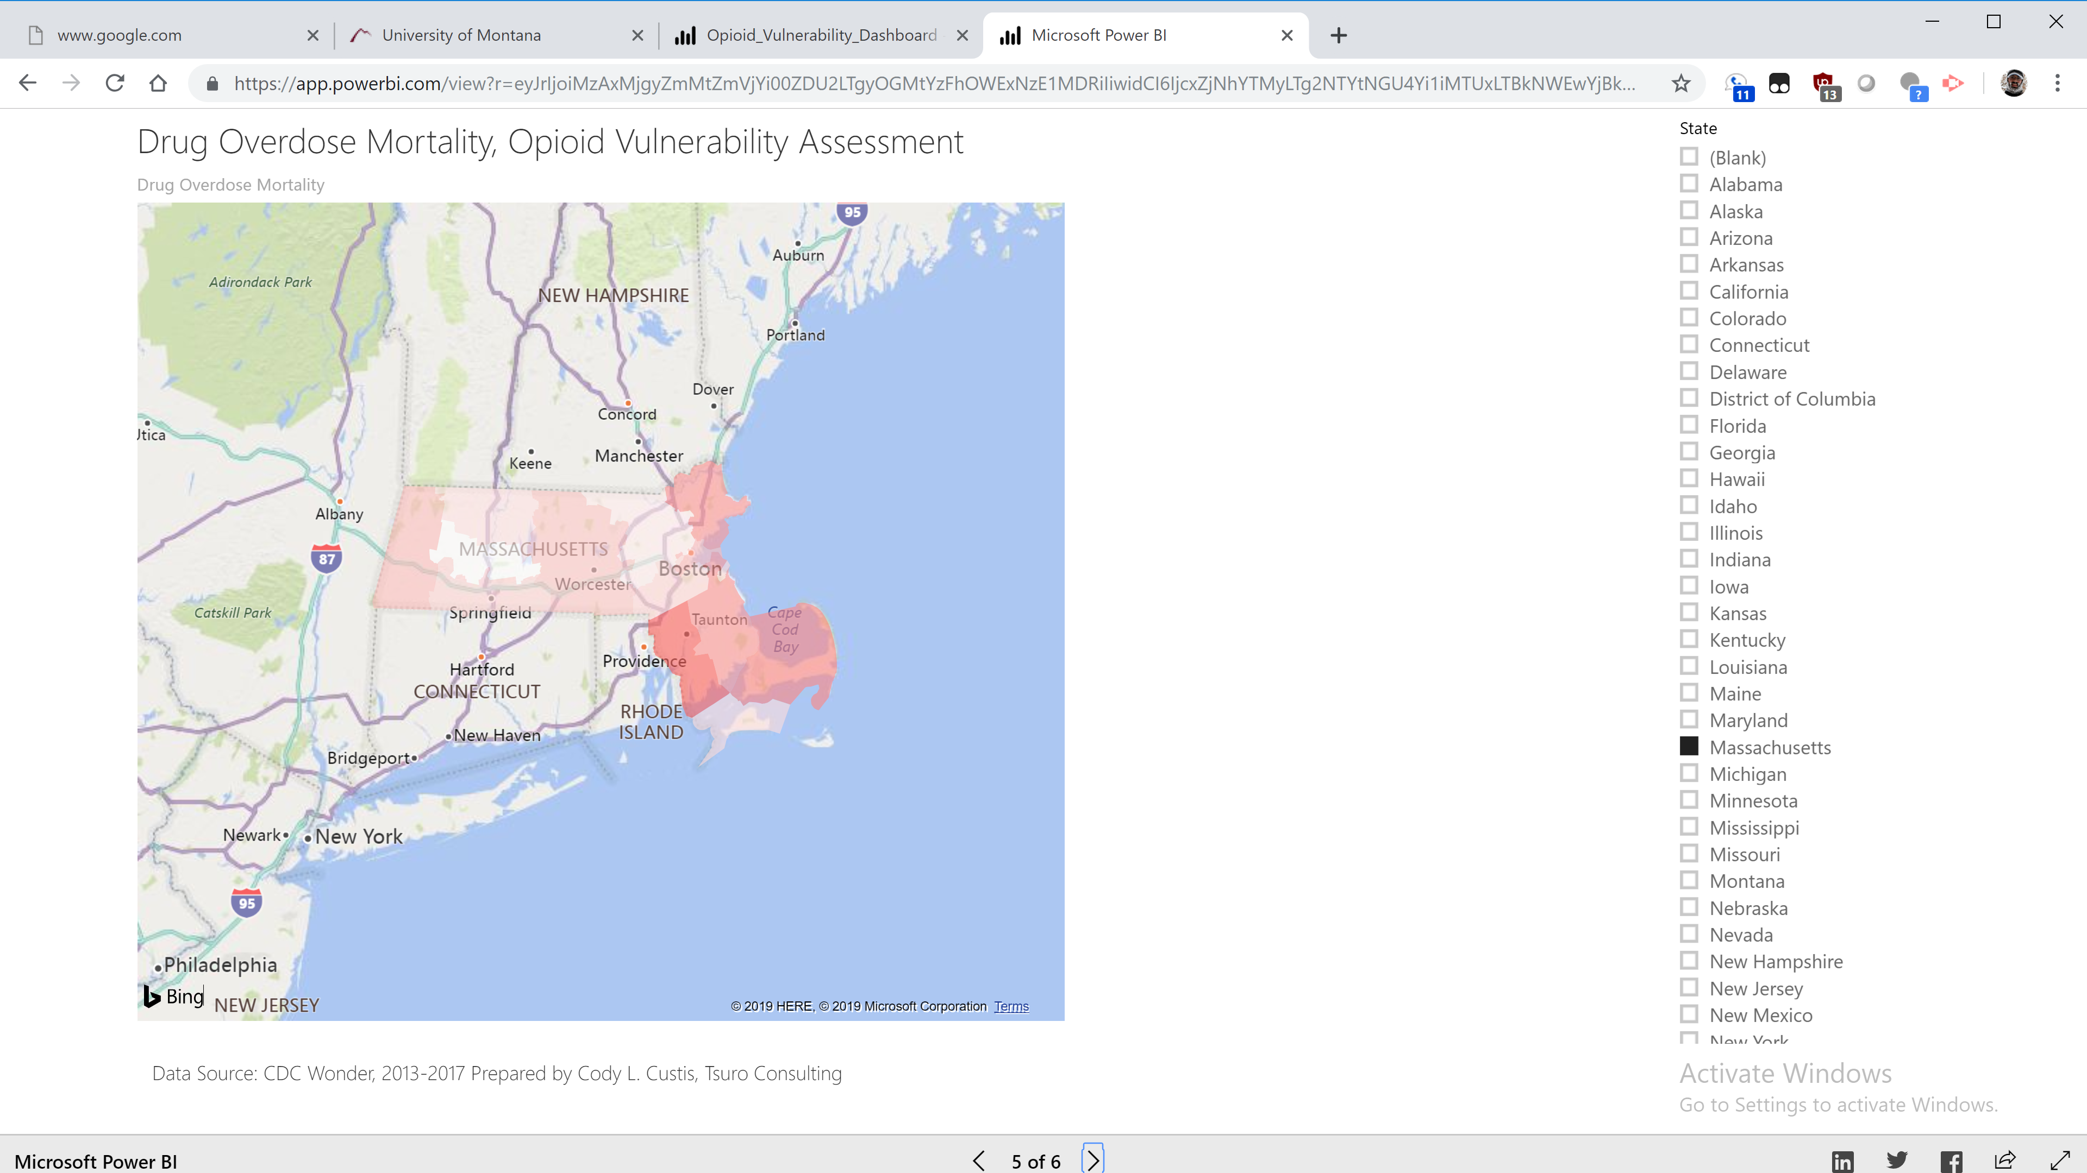
Power BI - Demonstration
Notes:
Still, if we look at overdose mortality in a specific state, say Massachusetts, we get a pretty good basic map. We also have tooltips (not shown) that allow users to look at specific county values. Ideally, I’d have a bookmarked report, but we’ll just have to look at the arrows for now. It’s still a work in progess.

Slide 33
Power BI - Demonstration
So far:
  American Community Survey: Income / Unemployment
  Opioid Prescriptions (CDC)
  Drug Overdose Mortality (CDC Wonder)
  Drug Arrests (Uniform Crime Reporting Data)
Notes:
As of mid-April, we have the following indicators live on Power BI, American Community Survey: Income and Unemployment; Opioid Prescriptions (CDC), Drug Overdose Mortality (CDC Wonder) and Drug Arrests (Uniform Crime Reporting Data). We plan on adding more public data sources: DEA Arcos Data, Drug Overdose Mortality from the CDC Bayesian geospatial model, buprenorphine waivers, among others to the maps. I haven’t tried mapping at the Census Tract level yet, I know that some jurisdictions really want to do the deep drill down, especially for indicators like income.

Slide 34
Power BI - Demonstration
https://app.powerbi.com/view?r=eyJrIjoiMzAxMjgyZmMtZmVjYi00ZDU2LTgyOGMtYzFhOWExNzE1MDRiIiwidCI6IjcxZjNhYTMyLTg2NTYtNGU4Yi1iMTUxLTBkNWEwYjBkMjhiMCJ9
Notes:
Here’s the link, I encourage everyone to check it out later. It’s still a work in progress, there will be more indicators / dashboard features coming.

Slide 35
Power BI - Demonstration
  Advantages: Easy mapping and deployment, Good data wrangling
  Disadvantages: Very limited customization, Business model
Notes:
Let’s talk about the advantages of Power BI. It’s very easy to map and deploy maps using Power BI. In the video I made, I spend more time wrangling the data than making the map. It’s very easy to deploy maps and get them to partners. It has cool slicers, and some cool charts that can be made, like Tableau.
It’s also solid for data wrangling. In my view, much better than Tableau, not as good as R or SAS. It has good drag and drop tools, and access to a pair of Microsoft languages, DAX and M, that can do complicated data manipulation behind the scenes.
The downside is… that there’s very little one do to customize maps. Power BI currently supports point layers like hospitals or geocoded data… using an ArcGIS plugin. The only type of map it makes is heatmaps. If the heatmap is wrong (for example, mapping part of Indiana over Chicago), there’s not much that can be done. The coloring, what you see is mostly what you get. Right now, it’s the Model T of maps, as long as you like what you get, you can get a whole lot of it. If end users are huge on look and feel, hope they like Power BI’s defaults.
Another consideration is that Power BI is free to use, free to deploy for the public, but expensive and complicated for private deployment. If you want to make a map with a non-public indicator, you either have to capture screenshots or investigate licensing, not just for analysts, but for every user.
One last consideration is that Power BI is in perpetual upgrade mode. The method that maps were made in November 2018 isn’t around anymore. Mapping capacity might greatly improve, or might be completely eliminated.
Power BI is a great tool for the department that just wants to get a map made and sent to users.

Slide 36
Funding by Cooperative Agreement number 1NU1ROT000018-00. The conclusions in this presentation are those of the authors and do not necessarily represent the official position of the Centers for Disease Control and Prevention.
CSTE National Office
2635 Century Parkway NE, Suite 700
Atlanta, Georgia 30345
770.458.3811
770.458.8516
jarieh@cste.org

