Slide 1
Jurisdiction Vulnerability Using Social Vulnerability Index
Tsuro Consulting

Slide 2
Roadmap
Model: outcome / predictor selection
Model: model building
Example: Texas

Slide 3
Social Vulnerability
Outcome variables:
Hepatitis C Infection
HIV Infection
Opioid Overdose
Notes:
These are all outcomes associated with intravenous drug use. However, intravenous drug use is difficult to measure. Therefore, we use outcome variables that we can measure.

Slide 4
Social Vulnerability
What factors make a jurisdiction vulnerable?
SVI 2016:
Socioeconomic status: (Income, Unemployed, Below Poverty, No High School Diploma)
Household composition and disability: (Aged 65 or Older, Aged 17 or Younger, Civilian with a Disability, Single-Parent Households)
Minority Status and Language
Housing and Transportation

Slide 5
Social Vulnerability
What factors make a jurisdiction vulnerable?
Van Handel 2016
Drug overdose deaths
Prescription opioid sales
Per capita income
Percent population white, non-Hispanic
Unemployment
Buprenorphine waivers

Slide 6
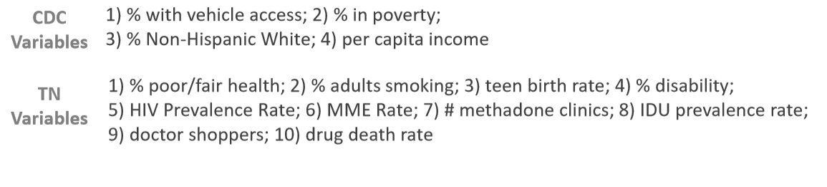
Social Vulnerability
What factors make a jurisdiction vulnerable?
Tennessee 2017

Slide 7
Social Vulnerability
What factors make a jurisdiction vulnerable?
State X (JVA)
Opioid Prescriptions
Drug Arrests
Per Capita Income
Drug Overdose Deaths

Slide 8
Social Vulnerability
What factors make a jurisdiction vulnerable?
Consider:
Ease of collecting variable
Does subject matter expertise suggest a relationship?
Similarity to other variables in the model
How often is variable missing?
Notes:
Choose one to include: DEA Arcos data, IQVIA Xponent, PDMP. Do not include all three!

Slide 10
Model Building
Social Vulnerability: Rankings
Van Handel / Tennessee: Poisson regression

Slide 11
Model Building
Social Vulnerability:
Easy to construct
Easy to explain
Requires care in choosing variables
Forces each variable (or theme) to have equal weight (or weight chosen by modeler)

Slide 12
Model Building
Poisson Regression:
Difficult to construct (R / SAS)
Difficult to explain
Model will weigh / remove predictors as needed
Can forecast rates and predict changes in variables
Unique for each outcome variable

Slide 13
Example: Texas
Predictor Variables:
Socioeconomics: Per Capita Income (2013-2017 American Community Survey)
Crime: Drug Arrest Rate (Uniform Crime Reporting Program Data, 2016)
Prescriptions: IQVIA Xponent (Per 100 Capita Prescriptions, 2017)
Mortality: Drug Overdose Rate (CDC Wonder, 2013-2017)

Slide 14
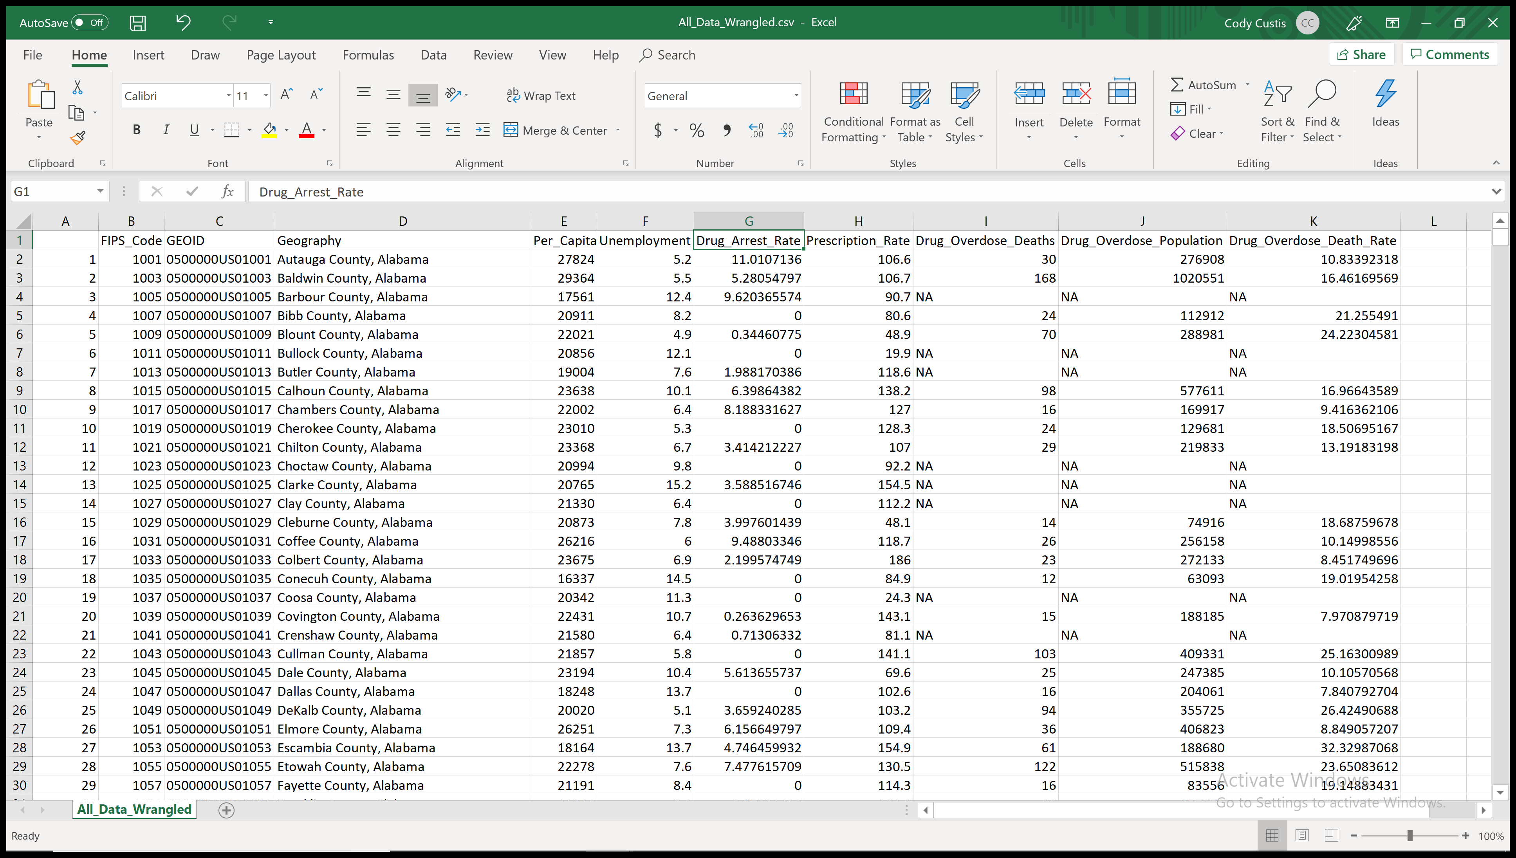
Example: Texas

Slide 15
Example: Texas
Missing Data:
  Assume that zero reflects zero events
  Assign N/A values to statewide median
Geography | State | Per_Capita_Income | Unemployment | Drug_Arrest_Rate | Prescription_Rate | Drug_Overdose_Death_Rate | Arrests_Imputed | Prescriptions_Imputed | Deaths_Imputed
Anderson County, Texas | Texas | 17466 | 4.3 | 45.15486574 | 62.2 | 14.89848243 | 45.15486574 | 62.2 | 14.89848
Andrews County, Texas | Texas | 29903 | 4.5 | 53.84351014 | 52.5 | NA | 53.84351014 | 52.5 | 10.88959
Angelina County, Texas | Texas | 21974 | 7.6 | 41.94725982 | 88.7 | 10.47735752 | 41.94725982 | 88.7 | 10.47736
Aransas County, Texas | Texas | 29999 | 6.7 | 141.5818974 | 83 | 20.63967104 | 141.5818974 | 83 | 20.63967
Archer County, Texas | Texas | 31103 | 3 | 53.16689783 | NA | 25.16068529 | 53.16689783 | 56.9 | 25.16069

Slide 16
Example: Texas
Rank each predictor
Take the mean rank
FIPS_Code | GEOID | Geography | State | Per_Capita_Income | Unemployment | Drug_Arrest_Rate | Prescription_Rate | Drug_Overdose_Death_Rate | Arrests_Imputed | Prescriptions_Imputed | Deaths_Imputed | Income_Rank | Death_Rank | Arrest_Rank | Prescription_Rank | Rank_Average | ST_Income_Rank | ST_Death_Rank | ST_Arrest_Rank | ST_Prescription_Rank | ST_Rank_Average
48001 | 0500000US48001 | Anderson County, Texas | Texas | 17466 | 4.3 | 45.15486574 | 62.2 | 14.89848243 | 45.15486574 | 62.2 | 14.89848 | 3015 | 1439 | 2014 | 1535 | 2000.75 | 239 | 227 | 110 | 168 | 186
48003 | 0500000US48003 | Andrews County, Texas | Texas | 29903 | 4.5 | 53.84351014 | 52.5 | NA | 53.84351014 | 52.5 | 10.88959 | 661 | 597 | 2320 | 1078 | 1164 | 40 | 62 | 140 | 96 | 84.5
48005 | 0500000US48005 | Angelina County, Texas | Texas | 21974 | 7.6 | 41.94725982 | 88.7 | 10.47735752 | 41.94725982 | 88.7 | 10.47736 | 2321 | 558 | 1900 | 2408 | 1796.75 | 182 | 53 | 91 | 233 | 139.75
48007 | 0500000US48007 | Aransas County, Texas | Texas | 29999 | 6.7 | 141.5818974 | 83 | 20.63967104 | 141.5818974 | 83 | 20.63967 | 646 | 2310 | 3107 | 2242 | 2076.25 | 36 | 250 | 248 | 222 | 189
48009 | 0500000US48009 | Archer County, Texas | Texas | 31103 | 3 | 53.16689783 | NA | 25.16068529 | 53.16689783 | 56.9 | 25.16069 | 520 | 2671 | 2298 | 1254 | 1685.75 | 29 | 253 | 139 | 109 | 132.5

Slide 17
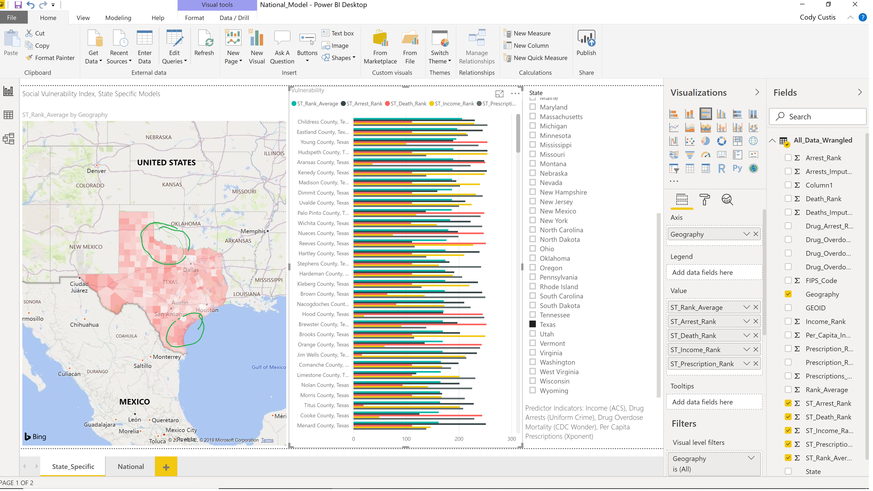
Example: Texas

Slide 18
Example: Texas
Childress County:
  High vulnerability: Arrests, Income, Prescriptions
  Median vulnerability: Drug Overdose (Missing Data)

Slide 19
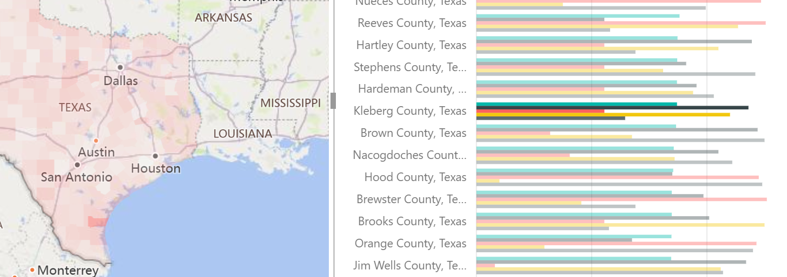
Example: Texas
Kleberg:
  High vulnerability: Arrests and income
  Median: Prescriptions

Slide 20
Example: Texas
Model is built using Excel (can provide file for your state)
Mapped using linked Power BI Desktop (can map in other software)
National Model:
  Rankings within states are the same, but shading looks different
  Some states (Florida) have zeros for arrest data

Slide 21
Example: Texas
Outcome – HIV Diagnoses (https://www.cdc.gov/nchhstp/atlas/index.htm)

Slide 22
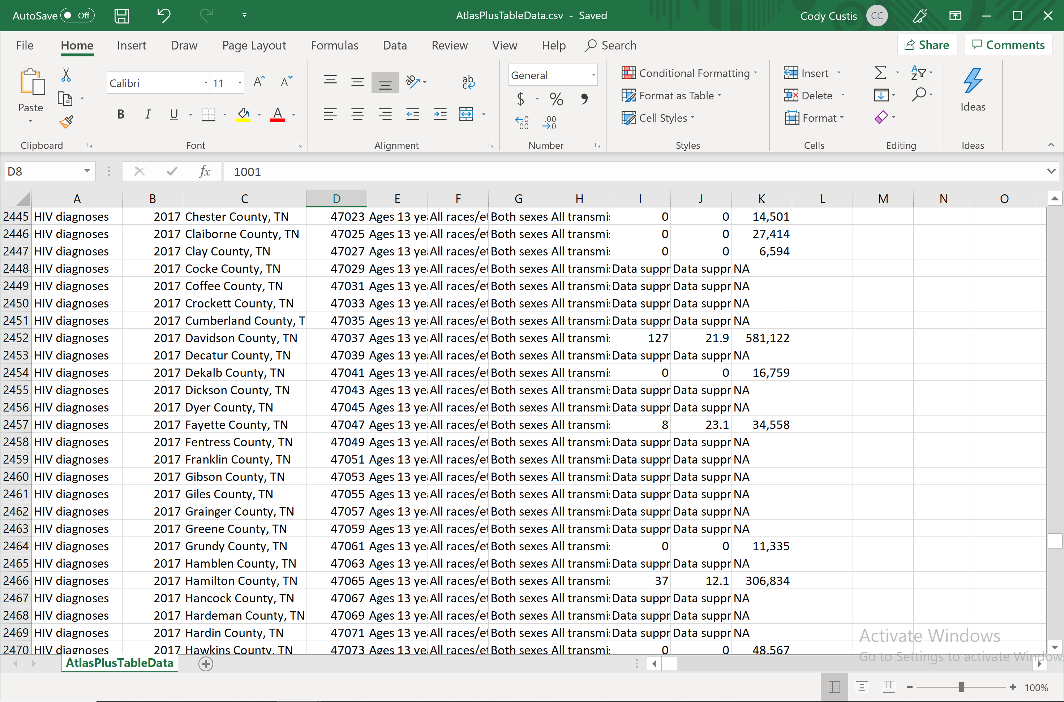
Example: Texas

Slide 23
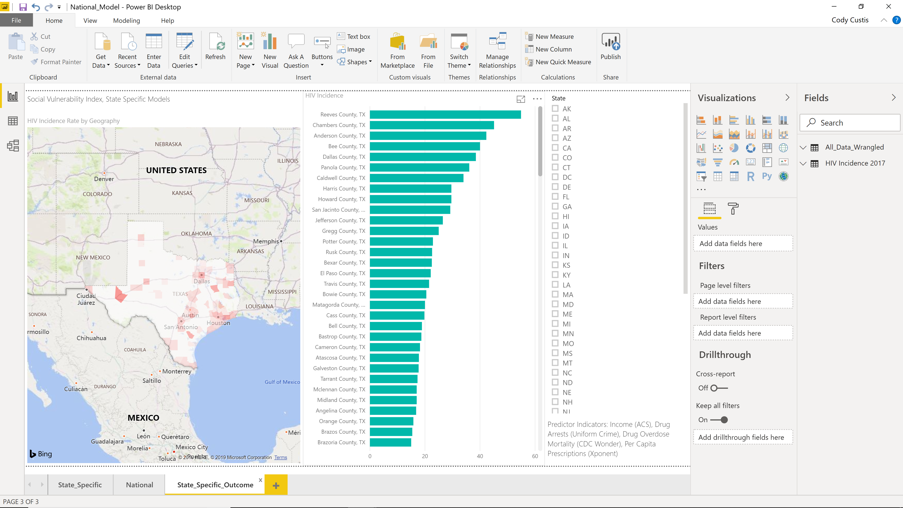
Example: Texas

Slide 24
Example: Texas
Important to remember
  HIV variable is suppressed

Slide 26
SVI: Focus
Focus on areas with high outcome / high vulnerability
Focus on areas with low outcome / high vulnerability
Focus on areas with high outcome / low vulnerability

Slide 27
SVI: Focus
Focus on areas with high outcome / high vulnerability
Are there resources in these localities?
What steps are being taken?
Can we change a predictor variable?

Slide 28
SVI: Focus
Focus on areas with low outcome / high vulnerability
Protective factors

Slide 29
SVI: Focus
Focus on areas with high outcome / low vulnerability
Risk factors
Variables to incorporate
Unusual events: (Patient zero; changes in drug traffic patterns)

