Slide 1
Jurisdiction Vulnerability Index Models
Tsuro Consulting
Notes:
Good day, my name is Jordan Larson and joining me is Cody Custis and we are here as Tsuro Consulting, a public health firm working with CSTE to provide technical consulting on jurisdiction CDC Opioid Vulnerability Assessments. Today, we will be presenting on Jurisdiction VA indicators and index calculations, along with a focus case study of a state-level analysis in Texas.

Slide 2
Roadmap
Jurisdiction Vulnerability Index Models:
Jurisdiction Vulnerability Indicators
Jurisdiction Vulnerability Index
Index focus in Texas
Notes:
The term model isn’t necessarily a formal mathematical or statistical model, but just a way of linking the outcome to the indicators. Today we will be looking closer at two different approaches to modeling vulnerability in jurisdictions. We will begin with an overview of factors, data categories, and indicators useful for vulnerability indexes related to opioids. Then we will look at how the actual index can be calculated, using two different methodologies, a ranking or Poisson regression approach. And finally, we will take a focused look at results from these models for counties in Texas.

Slide 3
Jurisdiction Vulnerability Indicators
What factors make a jurisdiction vulnerable?
  Social Vulnerability Index 2016 (Disaster response):
  Socioeconomic status: (Income, Unemployed, Below Poverty, No High School Diploma)
  Household composition and disability: (Aged 65 or Older, Aged 17 or Younger, Civilian with a Disability, Single-Parent Households)
  Minority Status and Language
  Housing and Transportation
Notes:
Broadly speaking, factors that can play into jurisdiction vulnerability include: previous indexes, demographic and other socioeconomic statuses, household composition and disability data, minority status and language, housing and transportation metrics.

Slide 4
Jurisdiction Vulnerability Indicators
Outcome Metrics (IDU):
  Hepatitis C Infection
  HIV Infection
  Opioid Overdose
Notes:
Hep C incidence, HIV incidence, and opioid overdose and hospitalization are all outcomes associated with intravenous drug use that are the targeted focus of our modeling and analysis efforts. While intravenous drug use is difficult to measure, these outcomes can provide some evidence of needle use patterns.

Slide 5
Jurisdiction Vulnerability Indicators
What factors make a jurisdiction vulnerable (IDU)? (Van Handel 2016)
  Drug overdose deaths
  Prescription opioid sales
  Per capita income
  Percent population white, non-Hispanic
  Unemployment
  Buprenorphine waivers
Notes:
Key correlated dependent variables can include those sources from Van Handel 2016; Drug overdose deaths, prescription opioid sales, per capita income, percent population white, unemployment and buprenorphine waivers.

Slide 6
Jurisdiction Vulnerability Indicators
What factors make a jurisdiction vulnerable?
  State X (Jurisdiction Vulnerability Index)
  Opioid Prescriptions
  Drug Arrests
  Per Capita Income
  Drug Overdose Deaths

Slide 7
Jurisdiction Vulnerability Indicators
Things to consider for selecting indicators
  Ease of collecting variable data
  Does subject matter expertise suggest a relationship?
  Does a variable have similarity to other variables in the model
  How often is a variable missing?
Notes:
Data sources that are challenging to collect, contain missing information often, or are likely correlated with other variables in the model may not work well, especially in statistical models. When variables are highly similar, choose one to include. Fore example, DEA Arcos data, IQVIA Xponent, PDMP. Do not include all three! A good variable will be relatively easy to gather the data for, have current data available, and will be consistently measured and available across counties, or jurisdicitions.

Slide 8
Jurisdiction Vulnerability Index
Multiple methods to consider
  Jurisdiction Vulnerability Index: Rankings
  Van Handel / Tennessee: Poisson regression
Notes:
Two methods discussed today, provide similar results but are very different in terms of process and robustness. A ranking average method is non-statistical, but is very adaptable and works well in applied situations. A Poisson regression approach is a statistical approach and requires some increased technical abilities to calibrate, and run, but the results of such effort can include increased robustness in the model results, and improved prediction.

Slide 9
Jurisdiction Vulnerability Index
Jurisdiction Vulnerability Index (IDU):
  Easy to construct
  Easy to explain
  Requires care in choosing variables
  Forces each variable (or theme) to have equal weight (or weight chosen by modeler)
Notes:
Taking a closer look and rank average approaches; they are easier to construct, explain, and deploy, but require care in terms of variable selection and forgiven on weighting each factor equally.

Slide 10
Example: Texas
Indicator categories
  Socioeconomics: Per Capita Income (2013-2017 American Community Survey)
  Crime: Drug Arrest Rate (Uniform Crime Reporting Program Data, 2016)
  Prescriptions: IQVIA Xponent (Per 100 Capita Prescriptions, 2017)
  Mortality: Drug Overdose Rate (CDC Wonder, 2013-2017)
Notes:
Jumping into our third presentation segment today, we are going to review a ranking average index calculation for the state of Texas. The indicator categories that we are looking at for our Texas model include the above list. Notice we have one variable from each data category, informing the model.

Slide 11
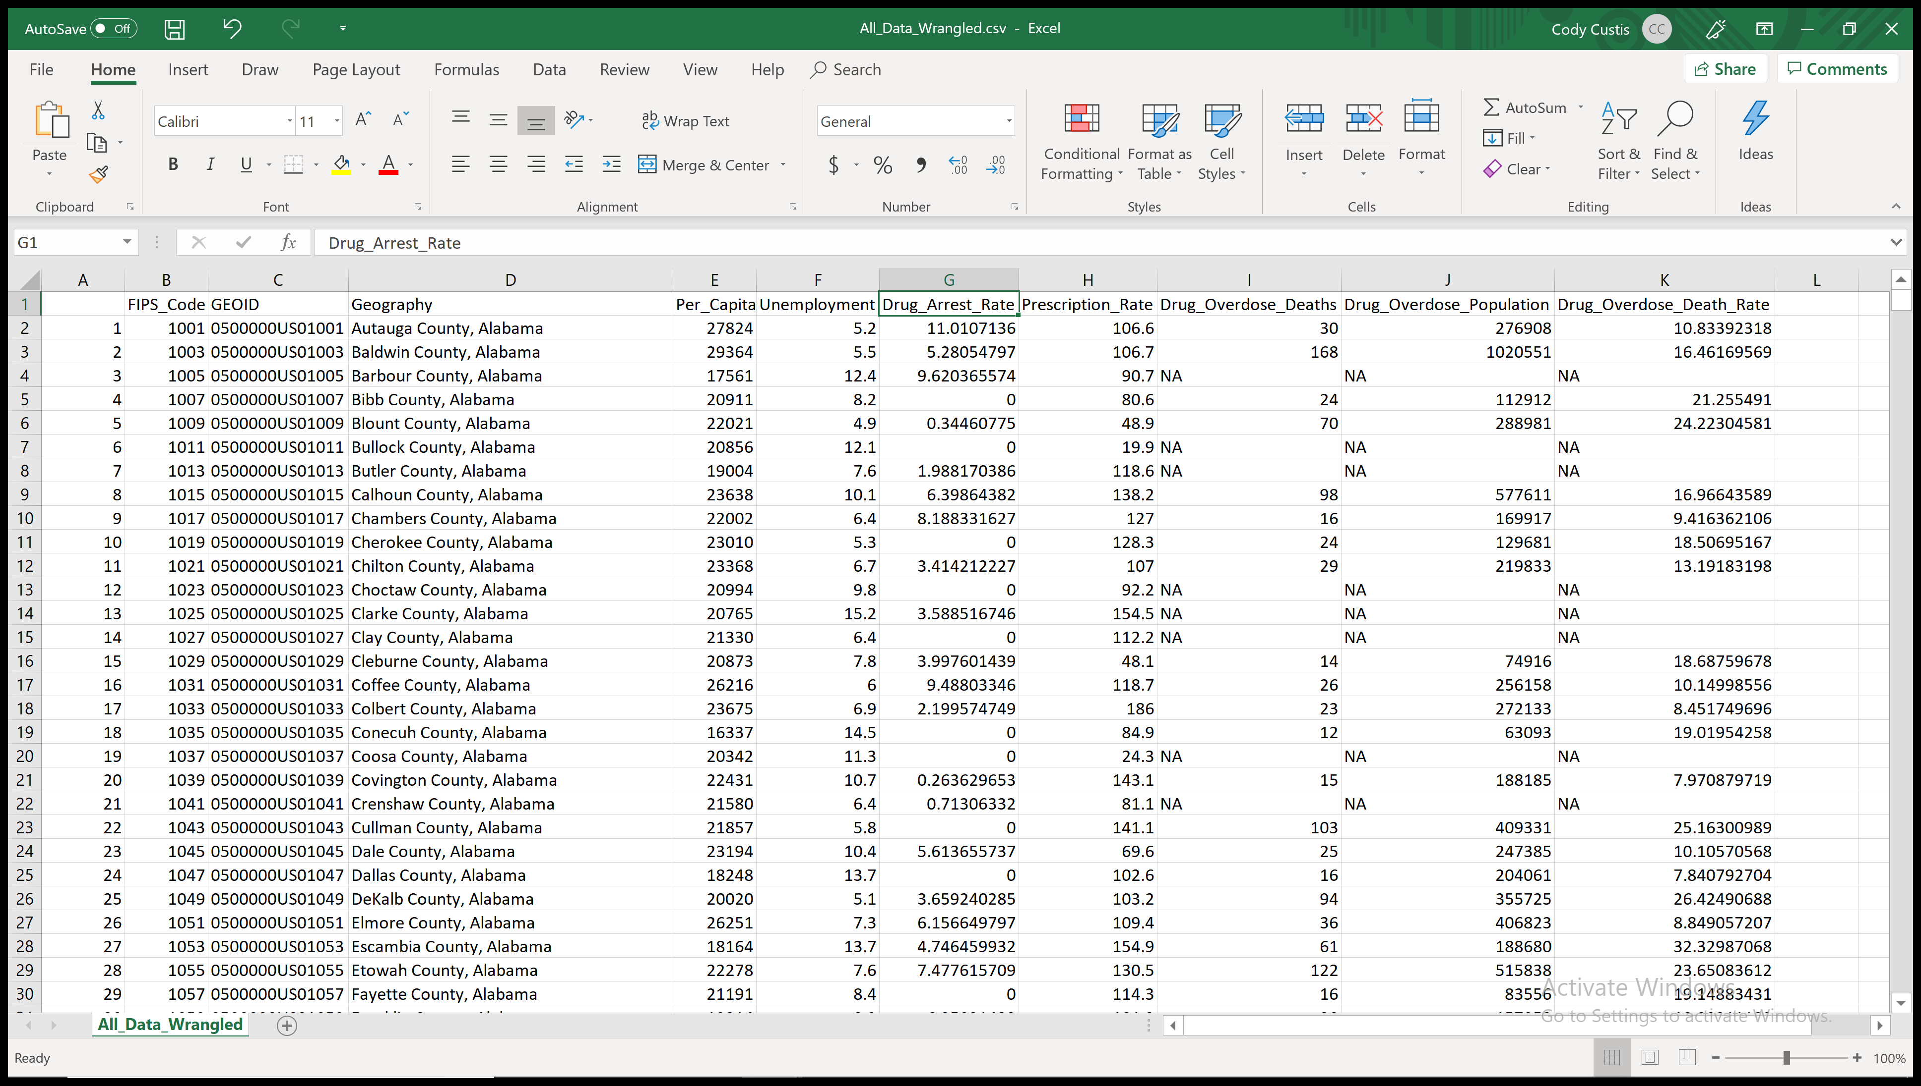
Example: Texas
Notes:
The raw data can be viewed in a spreadsheet, and looks like this.

Slide 12
Example: Texas
Missing Data
  Assume that zero reflects zero events
  Assign N/A values to statewide median
Geography | State | Per_Capita_Income | Unemployment | Drug_Arrest_Rate | Prescription_Rate | Drug_Overdose_Death_Rate | Arrests_Imputed | Prescriptions_Imputed | Deaths_Imputed
Anderson County, Texas | Texas | 17466 | 4.3 | 45.15486574 | 62.2 | 14.89848243 | 45.15486574 | 62.2 | 14.89848
Andrews County, Texas | Texas | 29903 | 4.5 | 53.84351014 | 52.5 | NA | 53.84351014 | 52.5 | 10.88959
Angelina County, Texas | Texas | 21974 | 7.6 | 41.94725982 | 88.7 | 10.47735752 | 41.94725982 | 88.7 | 10.47736
Aransas County, Texas | Texas | 29999 | 6.7 | 141.5818974 | 83 | 20.63967104 | 141.5818974 | 83 | 20.63967
Archer County, Texas | Texas | 31103 | 3 | 53.16689783 | NA | 25.16068529 | 53.16689783 | 56.9 | 25.16069
Notes:
The first thing we need to do in terms of managing data quality is to treat missing or zero data so it does not influence our statistical measurements.

Slide 13
Example: Texas
For each county
  Rank each predictor
  Take the mean of the ranks
FIPS_Code | GEOID | Geography | State | Per_Capita_Income | Unemployment | Drug_Arrest_Rate | Prescription_Rate | Drug_Overdose_Death_Rate | Arrests_Imputed | Prescriptions_Imputed | Deaths_Imputed | Income_Rank | Death_Rank | Arrest_Rank | Prescription_Rank | Rank_Average | ST_Income_Rank | ST_Death_Rank | ST_Arrest_Rank | ST_Prescription_Rank | ST_Rank_Average
48001 | 0500000US48001 | Anderson County, Texas | Texas | 17466 | 4.3 | 45.15486574 | 62.2 | 14.89848243 | 45.15486574 | 62.2 | 14.89848 | 3015 | 1439 | 2014 | 1535 | 2000.75 | 239 | 227 | 110 | 168 | 186
48003 | 0500000US48003 | Andrews County, Texas | Texas | 29903 | 4.5 | 53.84351014 | 52.5 | NA | 53.84351014 | 52.5 | 10.88959 | 661 | 597 | 2320 | 1078 | 1164 | 40 | 62 | 140 | 96 | 84.5
48005 | 0500000US48005 | Angelina County, Texas | Texas | 21974 | 7.6 | 41.94725982 | 88.7 | 10.47735752 | 41.94725982 | 88.7 | 10.47736 | 2321 | 558 | 1900 | 2408 | 1796.75 | 182 | 53 | 91 | 233 | 139.75
48007 | 0500000US48007 | Aransas County, Texas | Texas | 29999 | 6.7 | 141.5818974 | 83 | 20.63967104 | 141.5818974 | 83 | 20.63967 | 646 | 2310 | 3107 | 2242 | 2076.25 | 36 | 250 | 248 | 222 | 189
48009 | 0500000US48009 | Archer County, Texas | Texas | 31103 | 3 | 53.16689783 | NA | 25.16068529 | 53.16689783 | 56.9 | 25.16069 | 520 | 2671 | 2298 | 1254 | 1685.75 | 29 | 253 | 139 | 109 | 132.5
Notes:
The process then moves to the steps to create the rank for each indicator (predictor), and then simply aggregate the ranks by taking a mean of all ranks for each administrative unit in the dataset.

Slide 14
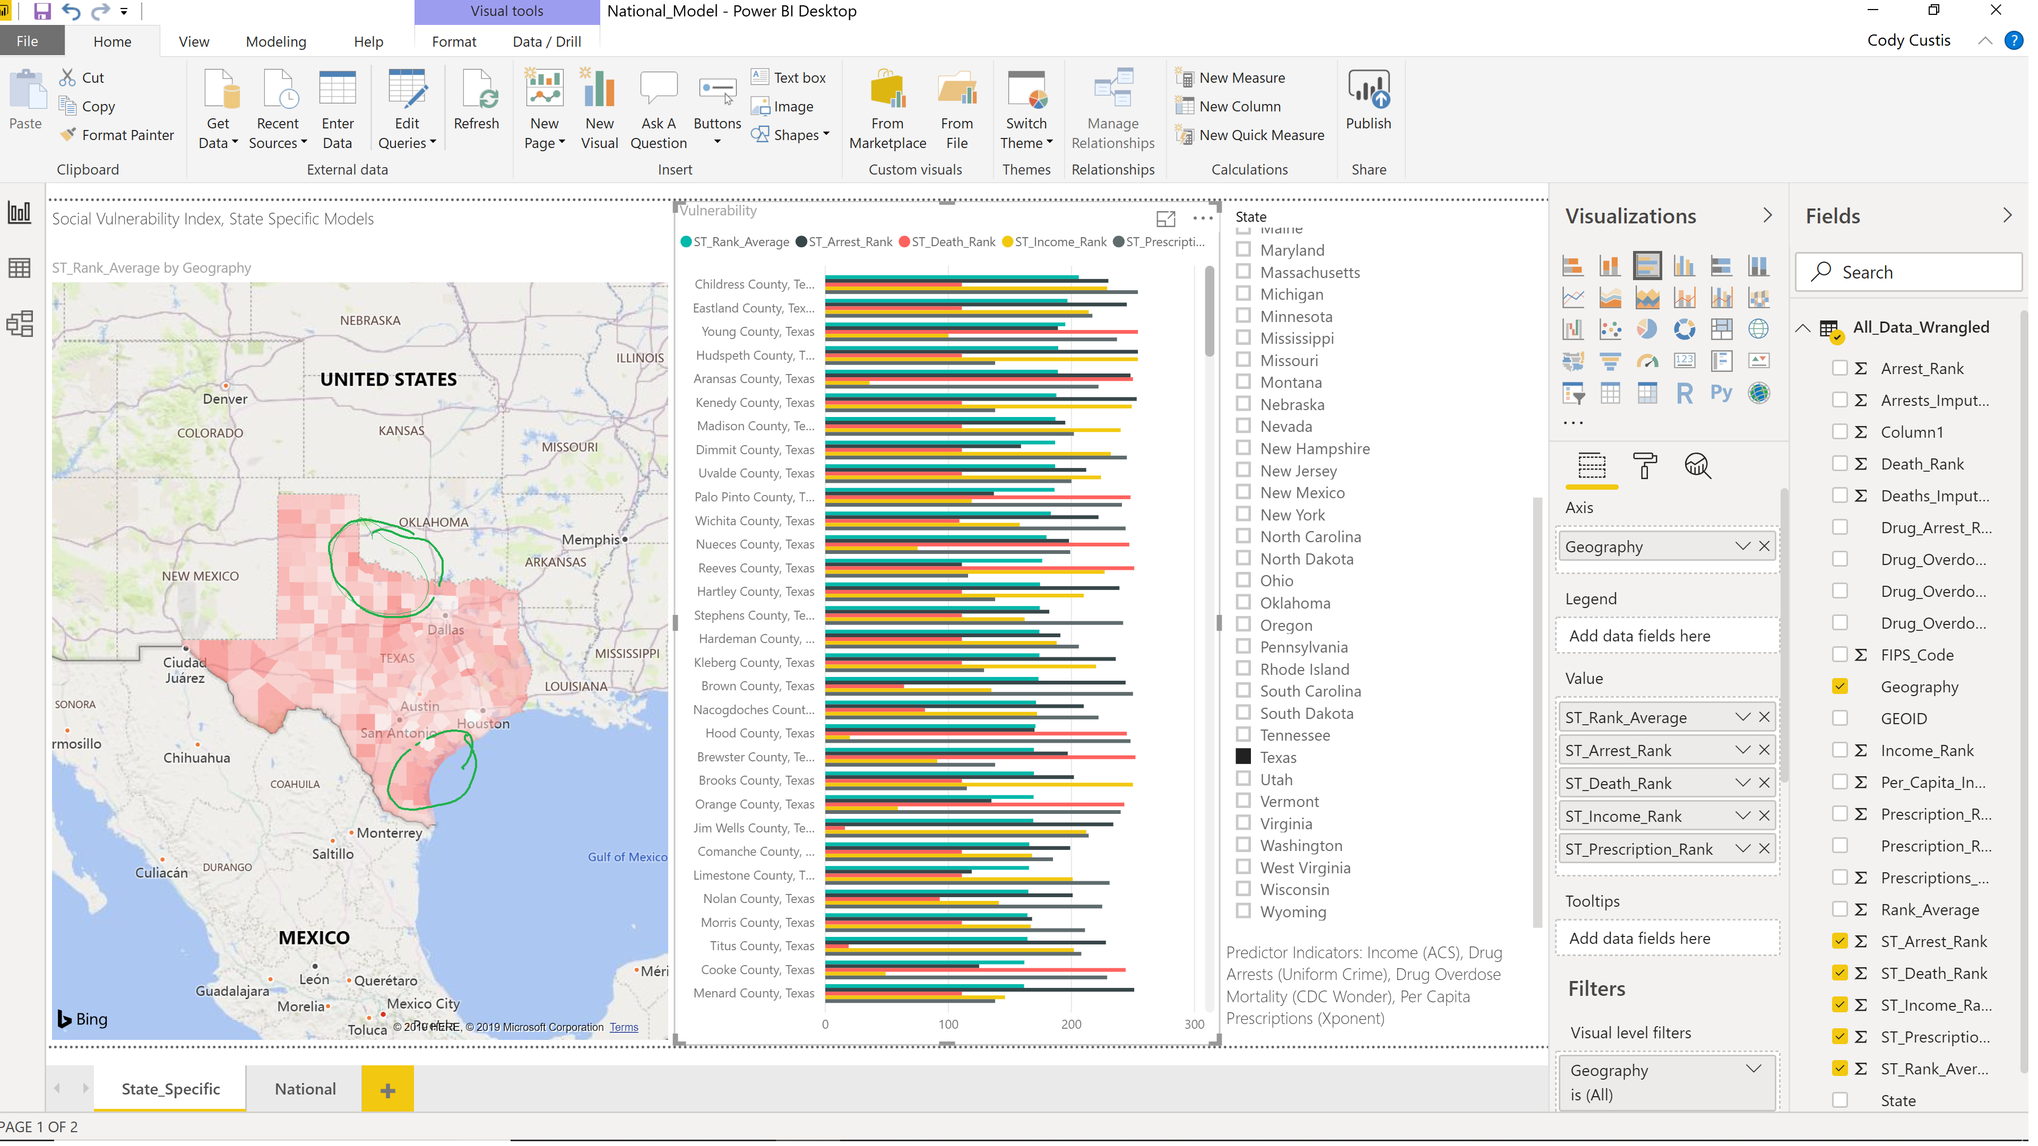
Example: Texas
Notes:
The process will yield some interesting results that can be observed geographically, as well as via a histogram; showing the rank average index, and the individual indicator ranks by county, respectively. Childress ranks higher than other counties in the state.

Slide 15
Example: Texas
Childress County
  High vulnerability: Arrests, Income, Prescriptions
  Median vulnerability: Drug Overdose (Missing Data)
Notes:
Zooming in on one particular unit, Childress County appears as a county of concern because of high and medium vulnerability observations for arrests, income, prescriptions and drug overdoes.

Slide 16
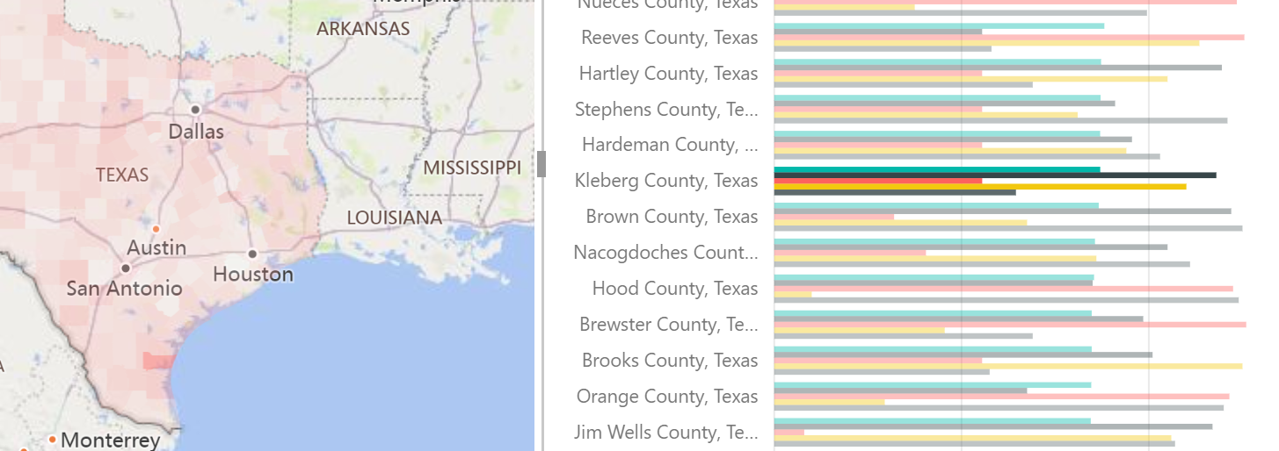
Example: Texas
Kleberg
  High vulnerability: Arrests and income
  Median: Prescriptions
Notes:
Zooming in on another unit, Kleberg County appears also as a region of cocern because of high and medium vulnerability observations for arrests, income, and perspcriptions.

Slide 17
Example: Texas
Model is built using Excel (can provide file for your state)
Mapped using linked Power BI Desktop (can map in other software)
National Model:
  Rankings within states are the same, but shading looks different

Slide 18
Example: Texas
Outcome – HIV Diagnoses (https://www.cdc.gov/nchhstp/atlas/index.htm)
Notes:
HIV incidence is a bit different than Hep C, or overdose. In this next part of the Texas case study, we will be looking at results for HIV diagnoses data.

Slide 19
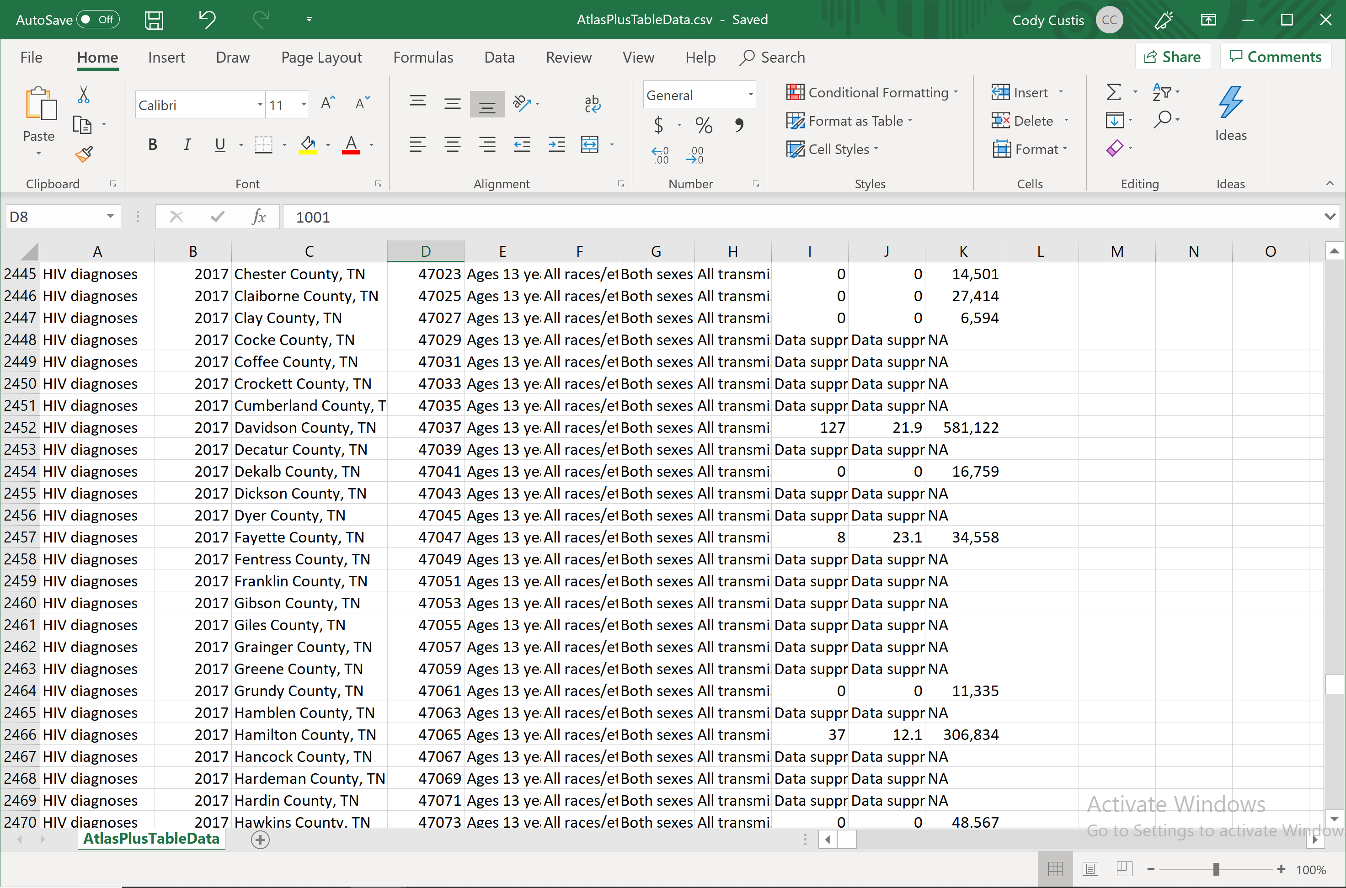
Example: Texas
Notes:
Again, the county-level data can be reviewed in a spreadsheet format.

Slide 20
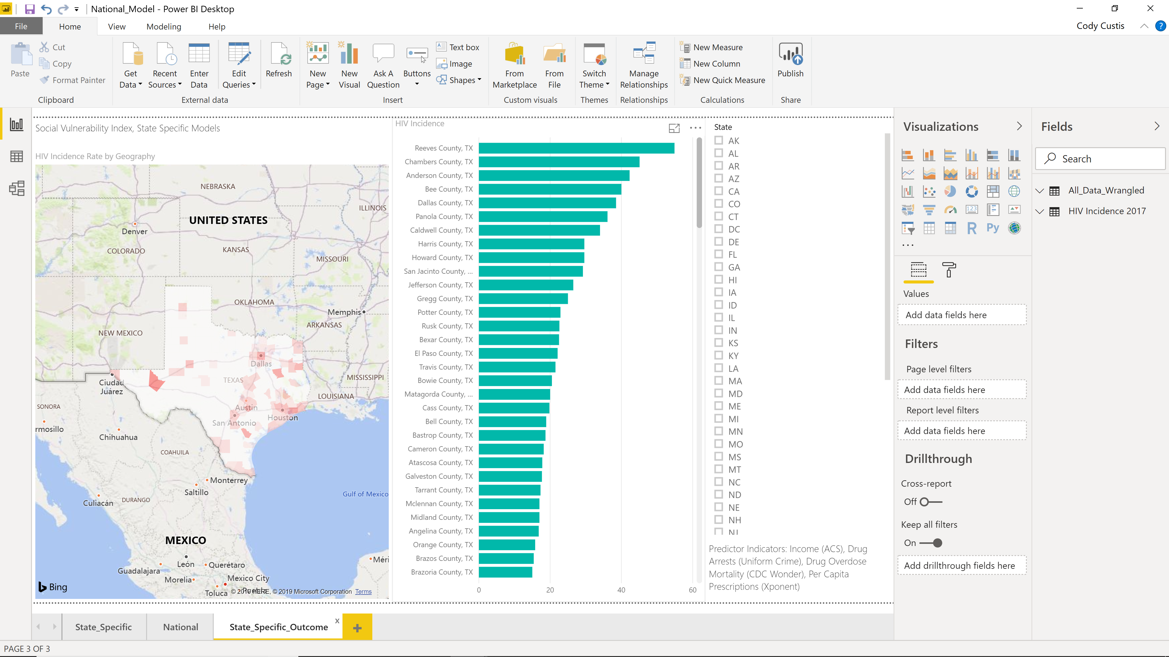
Example: Texas
Notes:
Mapping and graphing the results, we see some areas with higher risk.

Slide 21
Example: Texas
Important to remember
  HIV variable is suppressed

Slide 22
Vulnerability Index: Interpretation
Focus on areas with high metric / high vulnerability
Focus on areas with low metric / high vulnerability
Focus on areas with high metric / low vulnerability
Notes:
These are three interpretations worth figuring out and reviewing for each rank average model index, or for any model. Sometimes mapping the results can help you visualize these focus areas and understand why they matter and why they are uniquely important.

Slide 23
Vulnerability Index: Interpretation
Focus on areas with high metric / high vulnerability
  Are there resources in these localities?
  What steps are being taken?
Notes:
The process of moving from the model results to program resources is unique to each State and jurisdiction, but the process usually involves these kinds of questions.

Slide 24
Vulnerability Index: Interpretation
Focus on areas with low metric / high vulnerability
  Are there protective factors?
  Are the outcome metrics being measured?
Notes:
For example, some areas may have high vulnerability and low HIV / HCV co-infection rates due to a lack of testing facilities.

Slide 25
Vulnerability Index: Interpretation
Focus on areas with high metric / low vulnerability
  Additional indicators
  Unusual events: (changes in drug traffic patterns)
Notes:
When working with State X, we showed a county with very high Acute Hepatitis C incidence. That county was located near a large urban area in another state. It’s not something that easily models, but something that policy makers in that state are aware of.

Slide 26
Funding by Cooperative Agreement number 1NU1ROT000018-00. The conclusions in this presentation are those of the authors and do not necessarily represent the official position of the Centers for Disease Control and Prevention.
CSTE National Office
2635 Century Parkway NE, Suite 700
Atlanta, Georgia 30345
770.458.3811
770.458.8516
jarieh@cste.org
Notes:
Thank you for your time, we are now opening up the call for questions. If anyone is hoping to get ahold of us after the call, we can be reached through contacting CSTE.

