Slide 1

Illinois Extensively Drug-Resistant Organism (XDRO) Registry
Accompanying Guide to Process Map
DPH.XDROregistry@illinois.gov
www.xdro.org
Slides created by IDPH and the CDC Chicago Prevention and Intervention Epicenter
Created August 2016

Slide 2
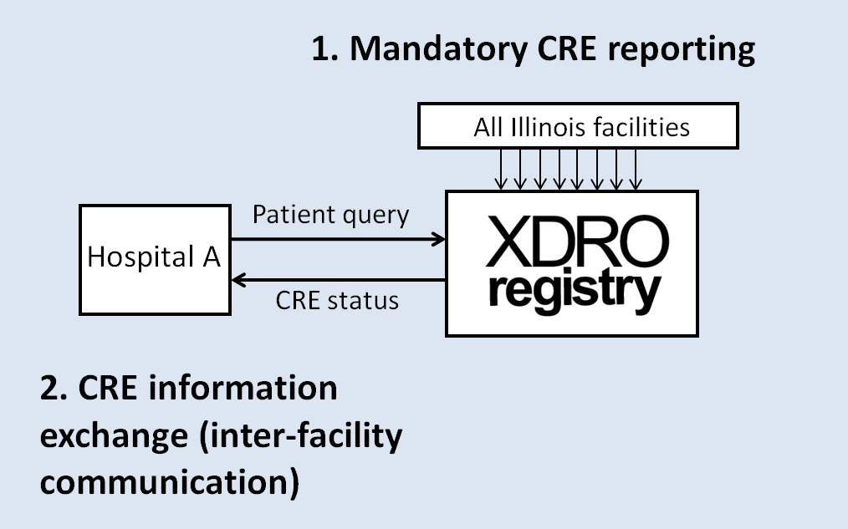
XDRO registry overview
Participants: All Illinois acute care and long-term acute care hospitals (~200), skilled nursing facilities (~800), laboratories
Notes:
As of 11/1/13, all Illinois acute and long-term acute care hospitals, skilled nursing facilities, and laboratories are required to report CRE to the XDRO registry.
The XDRO Registry is a communication system, intended for actionable data.
The registry is also used for surveillance, and we can use XDRO registry data to help track CRE and prevent spread of CRE in Illinois.

Slide 3
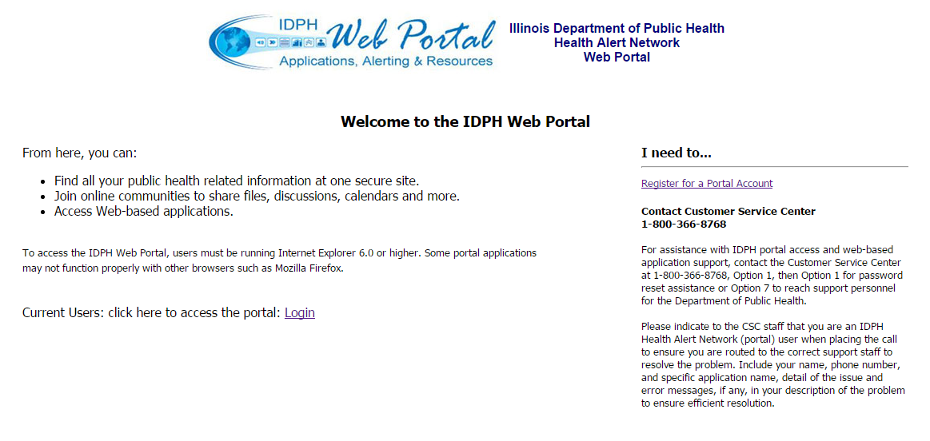
How to obtain XDRO registry access
Apply for access at: http://portalhome.dph.illinois.gov/
Notes:
A potential user first needs to register for an IDPH web portal account through this website. IDPH Security will process the application, set up user name, assign facility site code, etc. for the IDPH web portal.

Slide 4
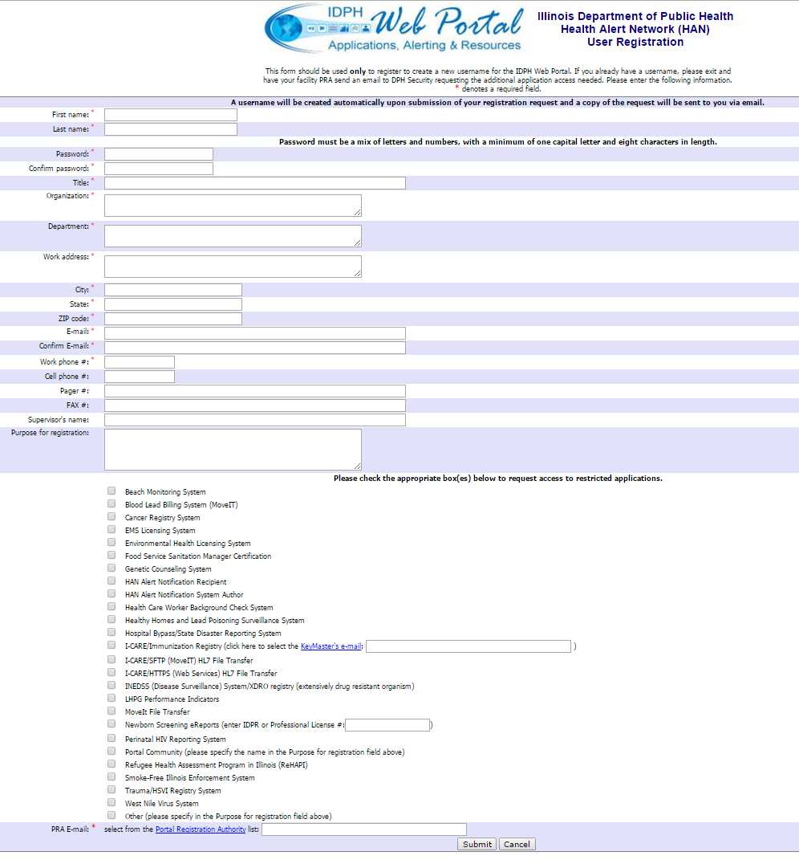
Applicants check here to request I-NEDSS/XDRO access
PRA indicated here
Notes:
Each facility needs to designate a Portal Registration Authority (PRA). This is a staff person at the organization who approves web portal users who say they are affiliated with that agency. Every time an applicant from that organization submits a web portal application, the IDPH Security Team will send an e-mail to the PRA to confirm that the applicant should have access to the system on behalf of that agency.

Slide 5
How to log in to XDRO registry
Log in to the XDRO registry at: http://portalhome.dph.illinois.gov/

Slide 6
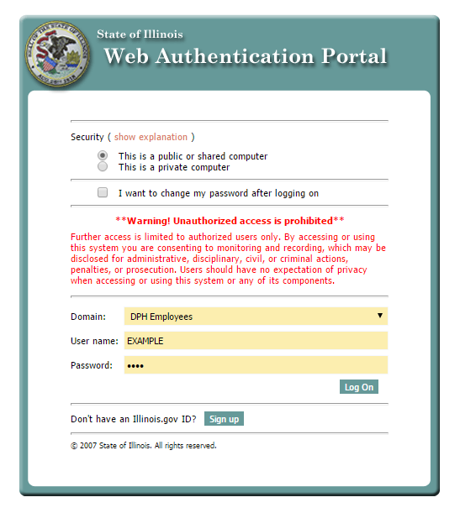
Notes:
Users authenticated here.

Slide 7
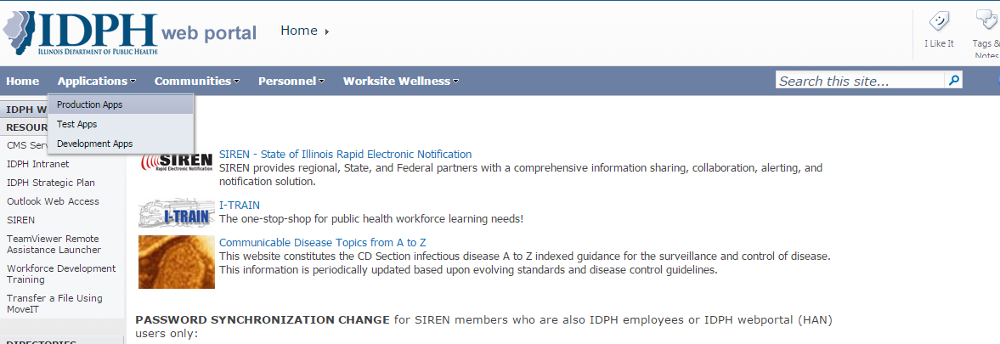
Select “Production Apps”
Notes:
User is now logged in.

Slide 8
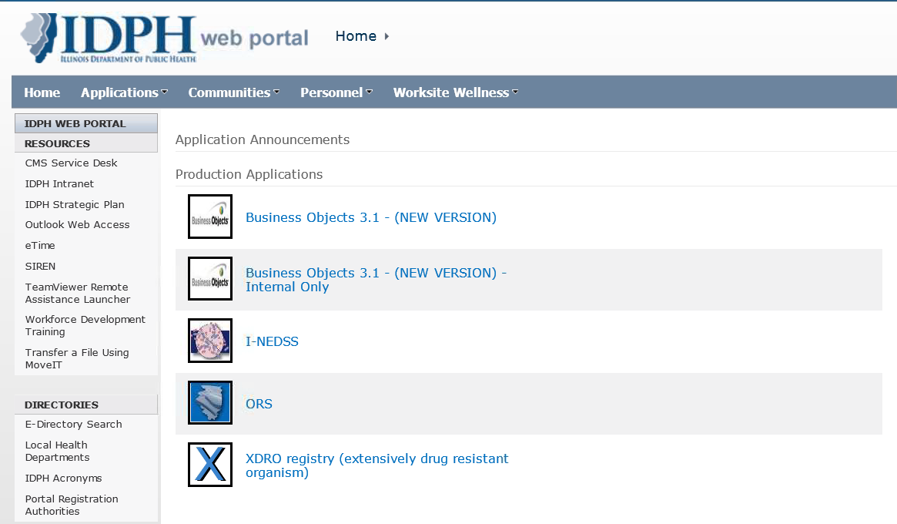
Select “XDRO registry” icon

Slide 9
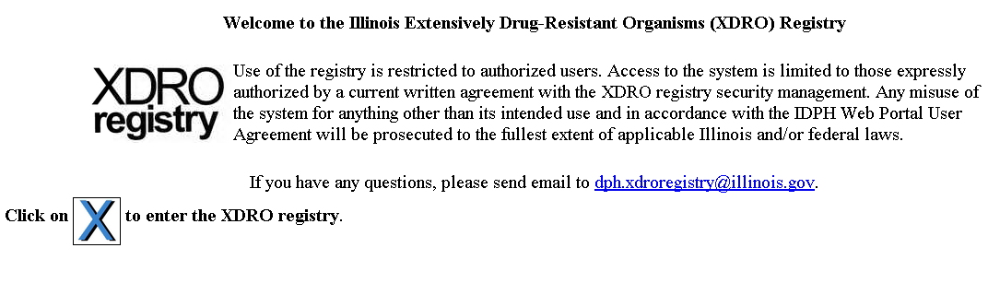
Click on the “X” to enter the XDRO registry

Slide 10
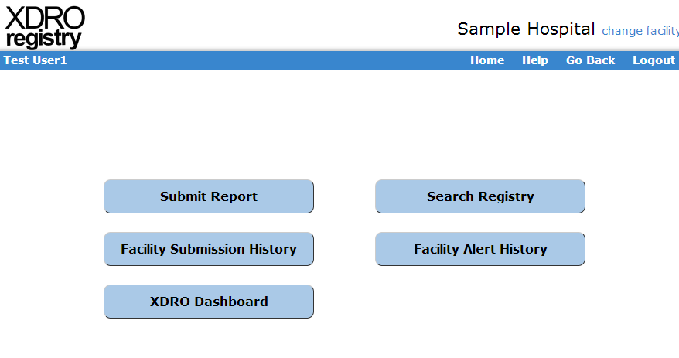
Registry Home Page
Notes:
Next few slides go through 5 functions.

Slide 11
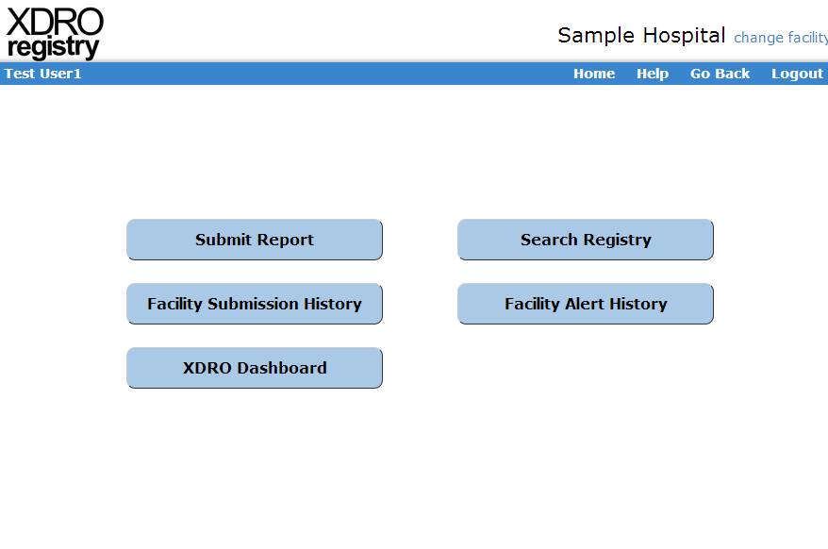

Slide 12
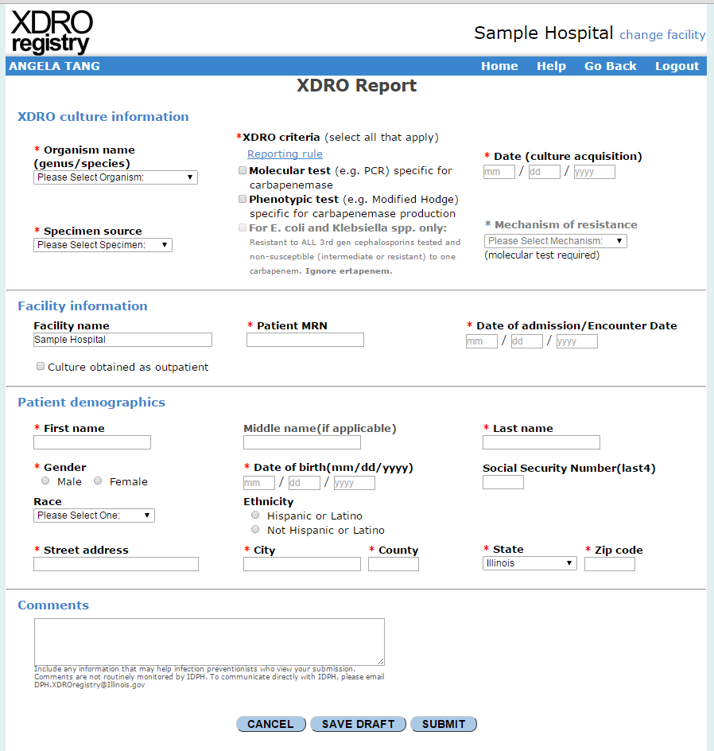
Notes:
-1 page form to report CRE

Slide 13
Notes:
To view any reports that the user’s facility has submitted

Slide 14
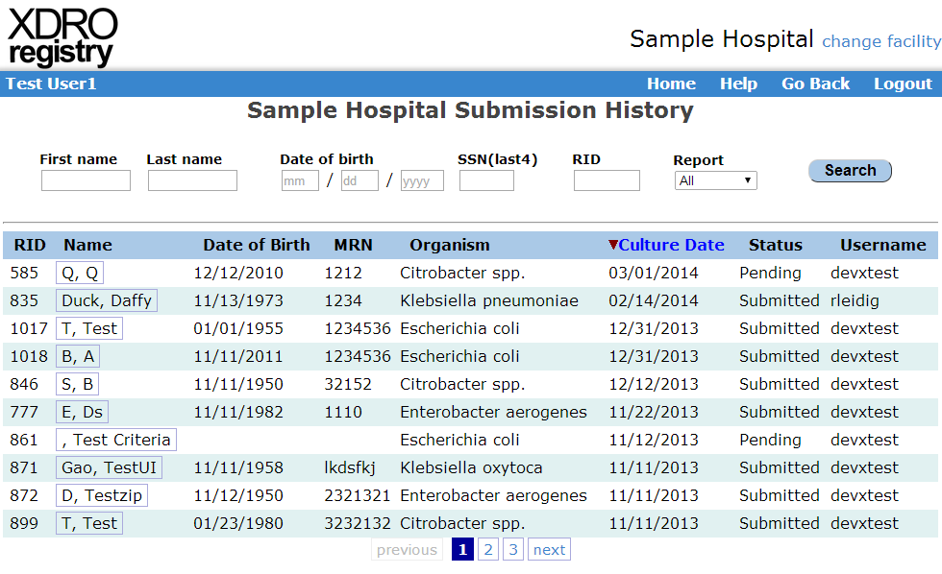

Slide 16
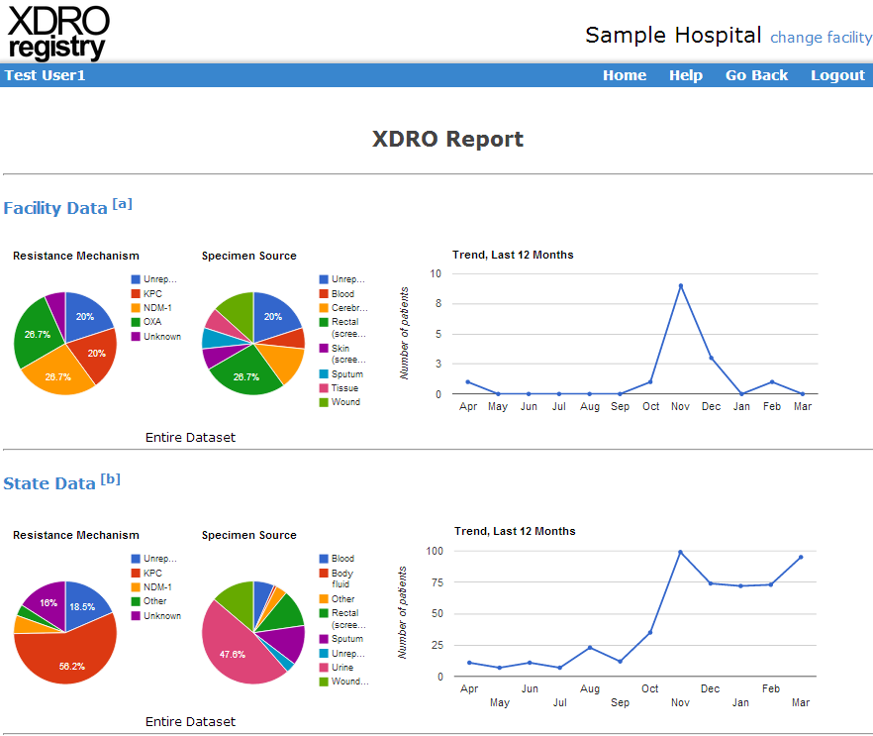
Notes:
Provides quick summary of facility and state data.

Slide 17
Notes:
Search registry=interfacility communication. This is for manual queries.

Slide 18
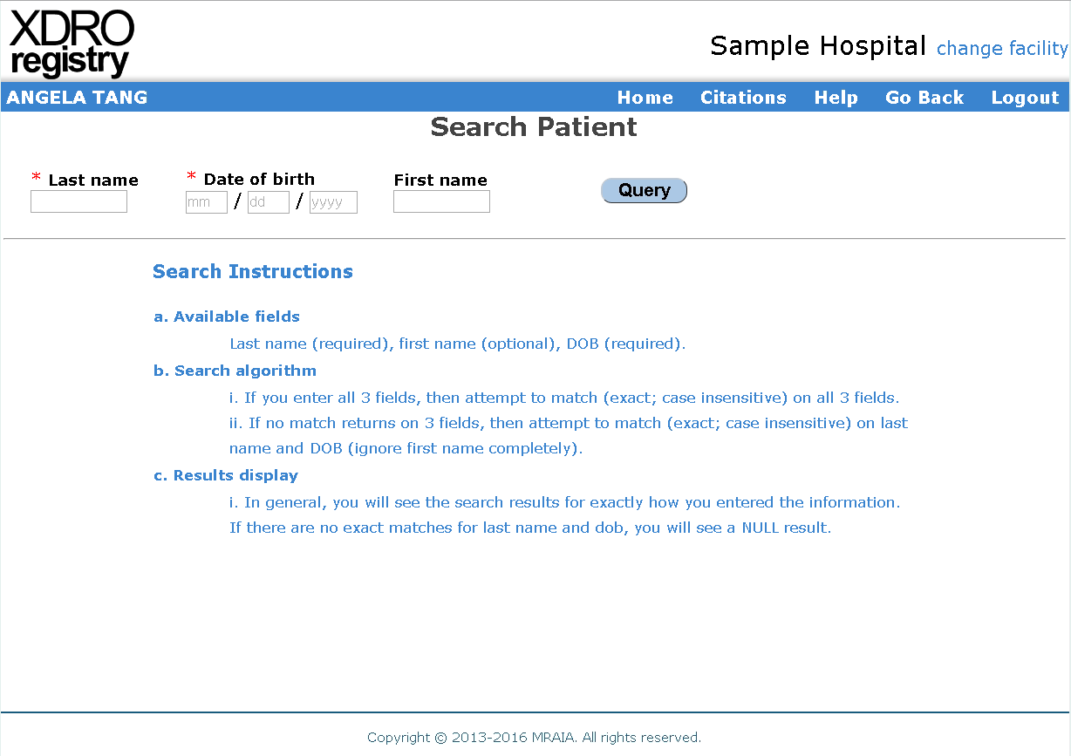

Slide 19
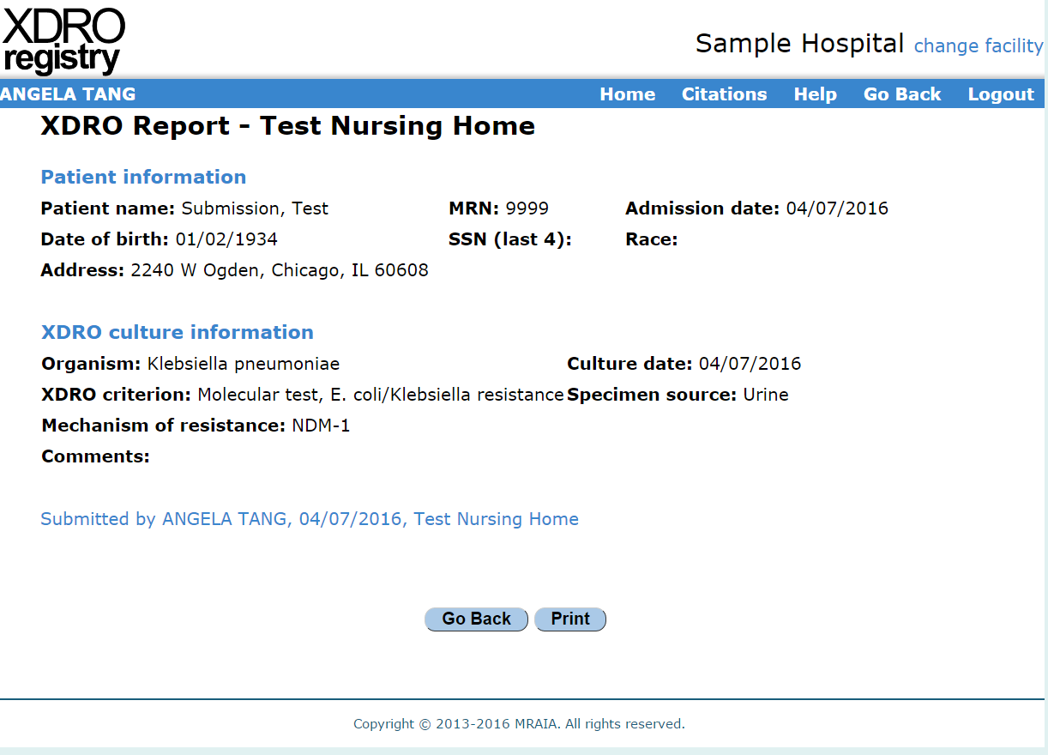
Notes:
Sample XDRO report

Slide 20
Automated Queries and Alerts
Hospital A
Hospital A
IP logs in to registry to view alert
Patient admission list (inpatient only)
Smith, John 1/5/67
Doe, Jane 1/1/89
Patient, Test 1/2/77
XDRO registry
Duck, Daffy 3/5/71
Fudd, Elmer 11/3/50
Smith, John 1/5/67
Hash
25234234235235
23725252434325
15234234235235
Hashing
software
15234234235235
23425252434325
62624535363466
Query
Email alert
Notes:
This diagram gives an overview of how the auto alert process works.
1 & 2: Hospital A generates a list of patients admitted to the hospital. A hashing software converts identifiers to a series of unique numbers.
3: The XDRO registry data also undergo the same hashing process.
The patients in Hospital A’s encrypted list are checked against the XDRO registry’s list for a potential match
4: If there is a match: the XDRO registry will send an email alert to registered users, notifying them of the match and requesting that the user log in to the XDRO registry to find out more information
Automated alerts will enable infection prevention staff to more quickly identify patients admitted with potential CRE, and place them on the appropriate contact precautions

Slide 21
Sample alert email from xdro@mraia.org
Subject: Alert notification from XDRO registry
The XDRO registry has identified that a patient recently admitted to < hospital name> may carry a bacterium that is highly resistant to antibiotics. Please log in to the XDRO registry (dph.partner.illinois.gov) for details.
For questions, email DPH.XDROregistry@Illinois.gov.
E-MAIL CONFIDENTIALITY NOTICE: This electronic mail message, including any attachments, is for the intended recipient(s) only and may not be forwarded or shared with anyone other than the intended recipient(s). If you are not the named recipient or if you believe that you received this e-mail in error, you are not authorized to view the alert. Please unsubscribe from the automated alert system, and also notify DPH.Security@illinois.gov if you need to change your facility status.
If you are not the intended recipient, please be aware that any copying, distribution, dissemination, disclosure, or other use of this e-mail and any attachments is unauthorized and prohibited. This e-mail and any attachments contain information that is confidential, privileged and/or otherwise protected or exempt from disclosure under applicable law, including the Department of Public Health Act, the Communicable Disease Prevention Act, the Communicable Disease Report Act, the Control of Communicable Diseases Code, and the Health Insurance Portability and Accountability Act (HIPAA). Your receipt of this message is not intended to waive any applicable privilege or claim of confidentiality, and any prohibited or unauthorized disclosure is not binding on the sender or the Illinois Department of Public Health. Thank you for your cooperation.
This e-mail may be exempt from disclosure under the Illinois Freedom of Information Act (5 ILCS 140) pursuant to exemptions under sections 7(1)(f) and/or 7(1)(m).
Notes:
This is a sample e-mail that is sent by the auto alert process.
Everyone at the facility who signs up for the alerts (typically IPs) will get this email, so multiple IPs might get this email
Alert IDentification number (AID) will be added to e-mail to help differentiate between e-mails, especially if there are multiple alerts in one day
E-mail has option to unsubscribe from alerts in the red text

Slide 22


Log in to the registry to view alerts
Notes:
The button should be red if there are new automated alerts (i.e., ones that have not been acknowledged yet)

Slide 23
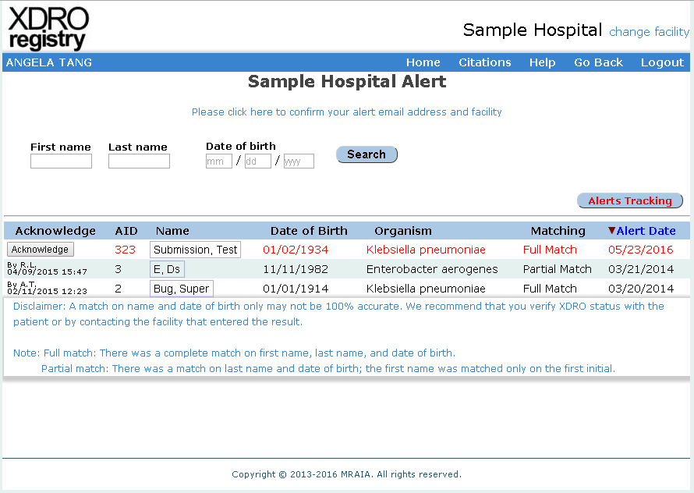
Facility Alert Page
Notes:
Alerts in red have not been acknowledged yet. To acknowledge an alert, you must click the “acknowledge” button, which then creates an automatic initial and timestamp. It will also change the record color from red to black.
Acknowledge button was created to facilitate internal communication: It allows for multiple IP facilities to know that a colleague has seen and "acknowledged" the alert.
If a patient has multiple records in the alert, hitting the acknowledge button for one record will acknowledge all records for that patient.
Matching column indicates if it’s a full or partial match

Slide 24
Alert Tracking Tool
Notes:
An alert tracking tool can be accessed from the alert history page

Slide 25
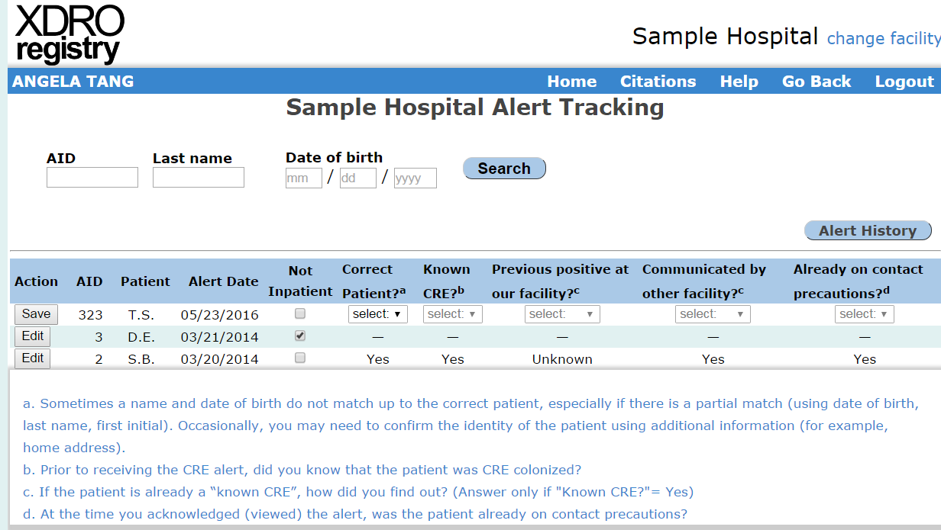
Alert Tracking Tool
Notes:
- Users can fill out information on alerts to help track accuracy, usefulness of the system

Slide 26
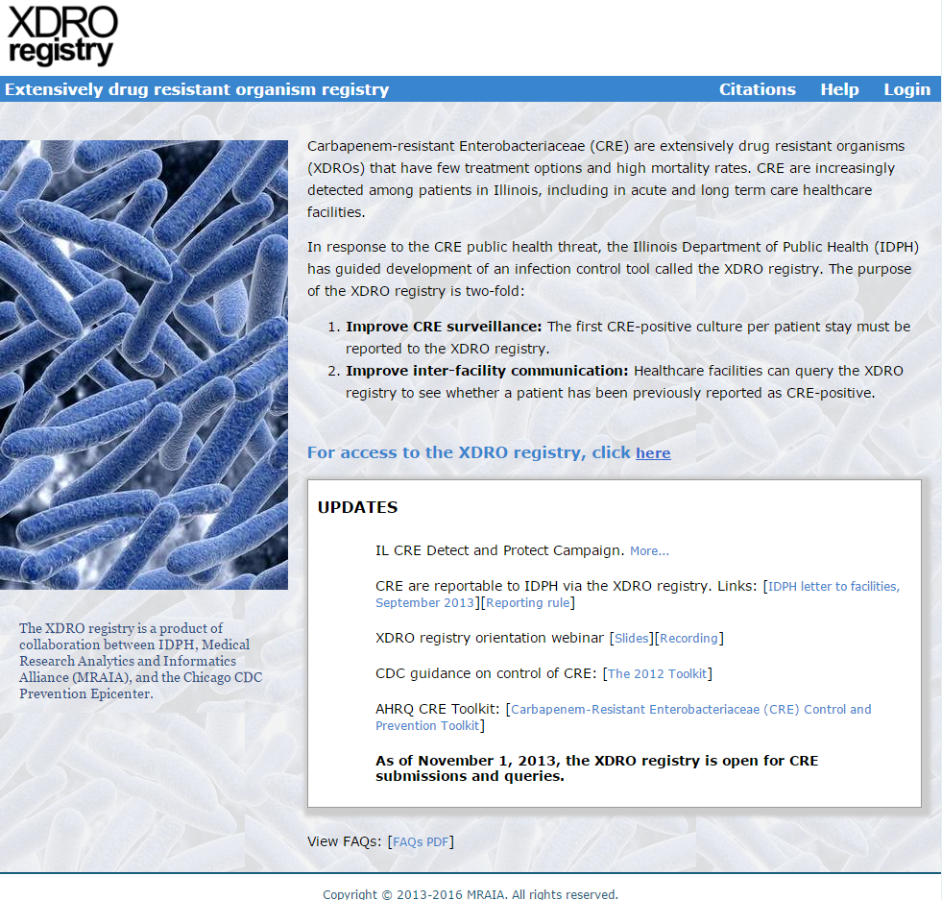
Notes:
XDRO website (www.xdro.org) maintained to provide training, educational material, additional information on CRE and reporting to the registry.

