Slide 1
Comparisons of Estimates from BRFSS and National Health Surveys, NHANES and NHIS, 2011−2016
Jason Hsia, PhD
Population Health Surveillance Branch
CSTE BRFSS Webinar
January 13, 2021

Slide 2
Comparisons of Estimates From the Behavioral Risk Factor Surveillance System and Other National Health Surveys, 2011-2016.
Jason Hsia, Guixiang Zhao, Machell Town, Junling Ren, Catherine A. Okoro,
Carol Pierannunzi, William Garvin
American Journal of Preventive Medicine (2020) 58(6):e181−e190

Slide 3
Behavioral Risk Factor Surveillance System (BRFSS)
State-based surveillance
Established in 1984
Telephone survey
Health-related risk behaviors, chronic health conditions, use of preventive services
Success
For the states to track trends
Other state-based surveillance systems
Useful for policy and research

Slide 4
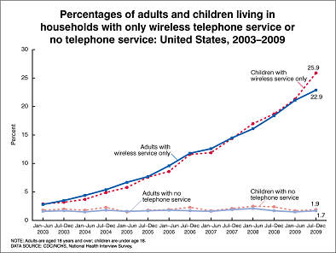
BRFSS Design
Random Digit Dialing (RDD)
Landline (1984-2010)
More than 97% home had landline telephones in mid 80s
Landline + cellular (2011-present)

Slide 5
Ensuring BRFSS Validity
Ideal study
Gold Standards: State level or national level
Comparisons at state level or at national level
Use national benchmark surveys
National Health and Nutrition Examination Survey (NHANES)
National Health Interview Survey (NHIS)

Slide 6
National Health and Nutrition Examination Survey (NHANES)
Multistage stratified cluster sampling
Face-to-face interviews, physical examinations, biological markers
Continuous data collection
Released in 2-year cycle

Slide 7
National Health Interview Survey (NHIS)
Multistage stratified cluster sampling
Face-to-face interviews & follow-up telephone interviews
New sample designs in 2006 and 2016
Same questionnaire used since 1997
Family data file and adult data file

Slide 8
Comparisons between BRFSS and NHANES and NHIS
Nelson DE et al. (2003) Am J Public Health.
1997 data (BRFSS and NHIS)
Ever smoked, current smoking, average number of cig per day (daily, nondaily), height, weight, BMI, hypertension, diabetes, flu and pneumococcal vaccination, no insurance, cost as a barrier to medical care, self-reported health
Subgroup: age, gender, race/ethnicity, education

Slide 9
Comparison Studies (cont.)
Fahimi M et al. (2008) Prev Chronic Dis.
2004 data (BRFSS and NHIS), 2003-04 data (NHANES)
Ever smoked, current smoking, diabetes, height, weight, BMI, self-reported health, asthma, ever had HIV test, binge drinking past 30 days, average number of alcoholic drinks per occasion, no medical care due to cost
Subgroup: age, gender, race/ethnicity, education

Slide 10
Comparison Studies (cont.)
Li C et al. (2012) Prev Med.
2007-08 Data (BRFSS and NHANES), 2008 Data (BRFSS and NHIS)
Current smoking, obesity, physical inactivity, hypertension, self-reported health, no health insurance, diabetes, coronary heart disease, myocardial infarction, stroke, asthma, arthritis
No subgroup analysis

Slide 11
Summary of 3 Comparison Studies
Compared data collected before 2011
Differences between BRFSS and compared surveys
One time point comparison
BRFSS, NHANES, NHIS estimates are subject to sampling errors
Selection of compared variables
Different interests
Dealing with different sample size
n_{BRFSS} (400,000+)>> n_{NHIS} (30,000+)> n_{NHANES}(10,000)

Slide 12
Method of Our Comparison Study
Data sourse
BRFSS 2011-16
NHANES 2011-12, 13-14, 15-16
NHIS 2011-16
Multiple years comparisons
BRFSS is a surveillance system
Expansion from one year comparison

Slide 13
Selection of Studied Variables
Original variables or minimize computation
Key variable(s)
Self-reported health
Widely used variables
Current smoking, average number of alcoholic drinks on days drinking
Height, weight
Hypertension, diabetes, asthma,
No health insurance, unmet health care need because of cost

Slide 14
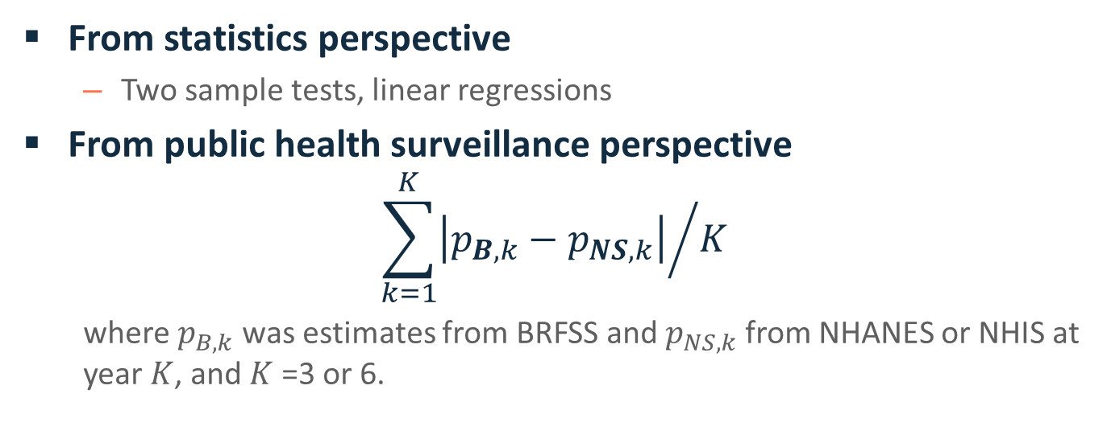
Measuring Difference
From statistics perspective
Two sample tests, linear regressions
From public health surveillance perspective
$${\sum_{k=1}^{K}{\left|p_{B,k}−p_{NS,k}\right|}}/K$$
where $p_{B,k}$was estimates from BRFSS and $p_{NS,k}$from NHANES or NHIS at year $K$, and $K$ =3 or 6.

Slide 15
Results
BRFSS vs. NHANES
9 variables
Overall
BRFSS vs. NHIS
10 variables
Overall, by age, sex, race/ethnicity, and education

Slide 16
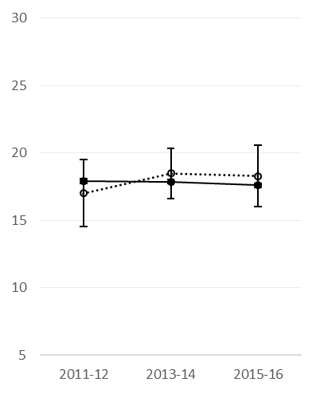
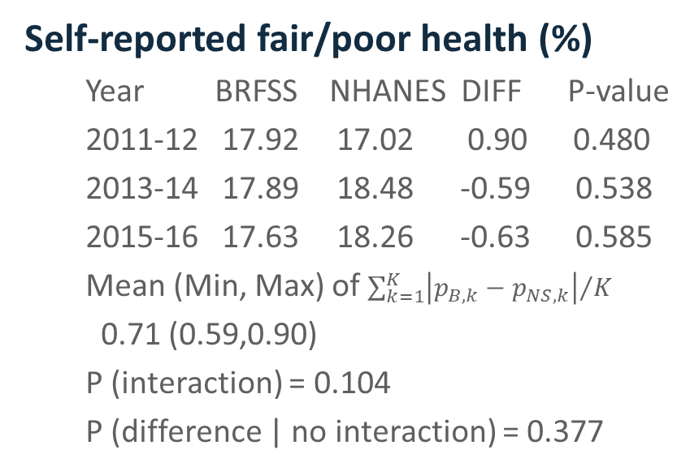
BRFSS vs. NHANES (1)
Self-reported fair/poor health (%)
Year BRFSS NHANES DIFF P-value
2011-12 17.92 17.02 0.90 0.480
2013-14 17.89 18.48 -0.59 0.538
2015-16 17.63 18.26 -0.63 0.585
Mean (Min, Max) of ${\sum_{k=1}^{K}{\left|p_{B,k}−p_{NS,k}\right|}}/K$
0.71 (0.59,0.90)
P (interaction) = 0.104
P (difference | no interaction) = 0.377

Slide 17
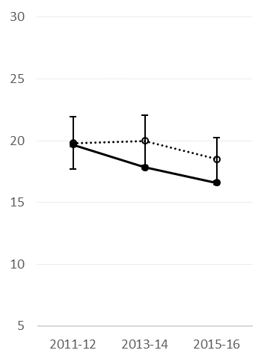
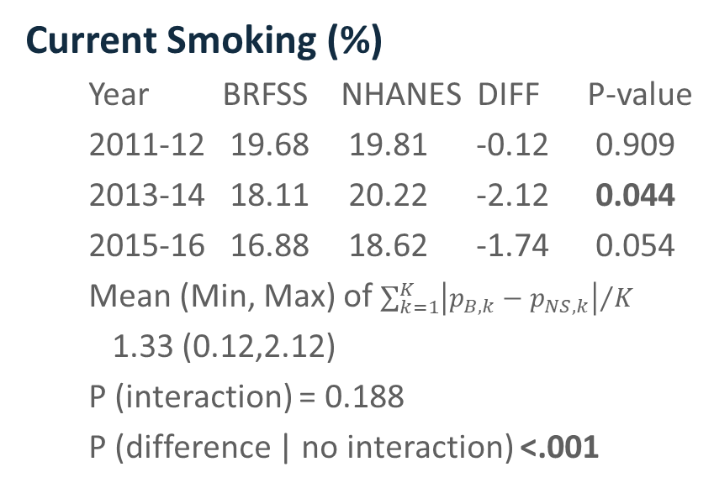
BRFSS vs. NHANES (2)
Current Smoking (%)
Year BRFSS NHANES DIFF P-value
2011-12 19.68 19.81 -0.12 0.909
2013-14 18.11 20.22 -2.12 0.044
2015-16 16.88 18.62 -1.74 0.054
Mean (Min, Max) of ${\sum_{k=1}^{K}{\left|p_{B,k}−p_{NS,k}\right|}}/K$
1.33 (0.12,2.12)
P (interaction) = 0.188
P (difference | no interaction) <.001

Slide 18
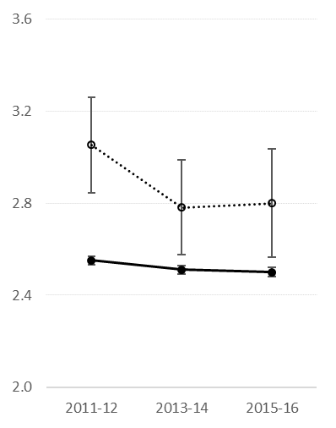
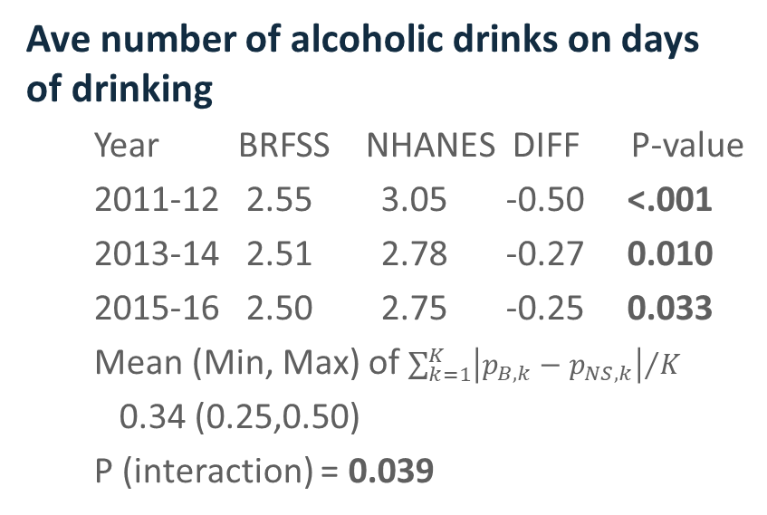
BRFSS vs. NHANES (3)
Ave number of alcoholic drinks on days of drinking
Year BRFSS NHANES DIFF P-value
2011-12 2.55 3.05 -0.50 <.001
2013-14 2.51 2.78 -0.27 0.010
2015-16 2.50 2.75 -0.25 0.033
Mean (Min, Max) of ${\sum_{k=1}^{K}{\left|p_{B,k}−p_{NS,k}\right|}}/K$
0.34 (0.25,0.50)
P (interaction) = 0.039

Slide 19
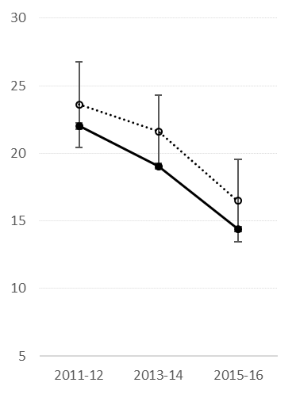
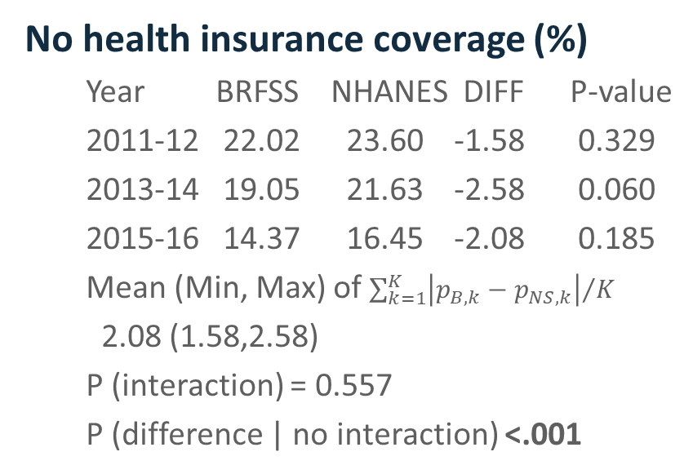
BRFSS vs. NHANES (4)
No health insurance coverage (%)
Year BRFSS NHANES DIFF P-value
2011-12 22.02 23.60 -1.58 0.329
2013-14 19.05 21.63 -2.58 0.060
2015-16 14.37 16.45 -2.08 0.185
Mean (Min, Max) of ${\sum_{k=1}^{K}{\left|p_{B,k}−p_{NS,k}\right|}}/K$
2.08 (1.58,2.58)
P (interaction) = 0.557
P (difference | no interaction) <.001

Slide 20
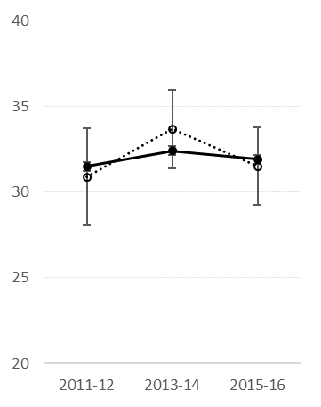
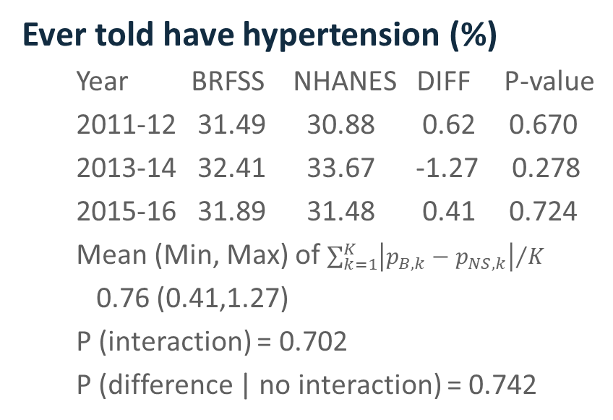
BRFSS vs. NHANES (5)
Ever told have hypertension (%)
Year BRFSS NHANES DIFF P-value
2011-12 31.49 30.88 0.62 0.670
2013-14 32.41 33.67 -1.27 0.278
2015-16 31.89 31.48 0.41 0.724
Mean (Min, Max) of ${\sum_{k=1}^{K}{\left|p_{B,k}−p_{NS,k}\right|}}/K$
0.76 (0.41,1.27)
P (interaction) = 0.702
P (difference | no interaction) = 0.742

Slide 21
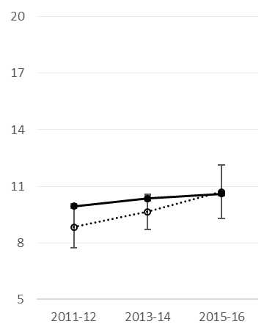
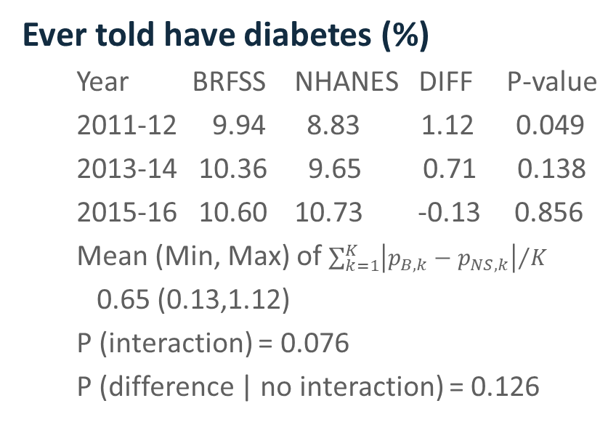
BRFSS vs. NHANES (6)
Ever told have diabetes (%)
Year BRFSS NHANES DIFF P-value
2011-12 9.94 8.83 1.12 0.049
2013-14 10.36 9.65 0.71 0.138
2015-16 10.60 10.73 -0.13 0.856
Mean (Min, Max) of ${\sum_{k=1}^{K}{\left|p_{B,k}−p_{NS,k}\right|}}/K$
0.65 (0.13,1.12)
P (interaction) = 0.076
P (difference | no interaction) = 0.126

Slide 22
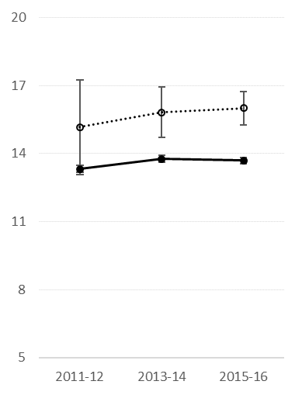
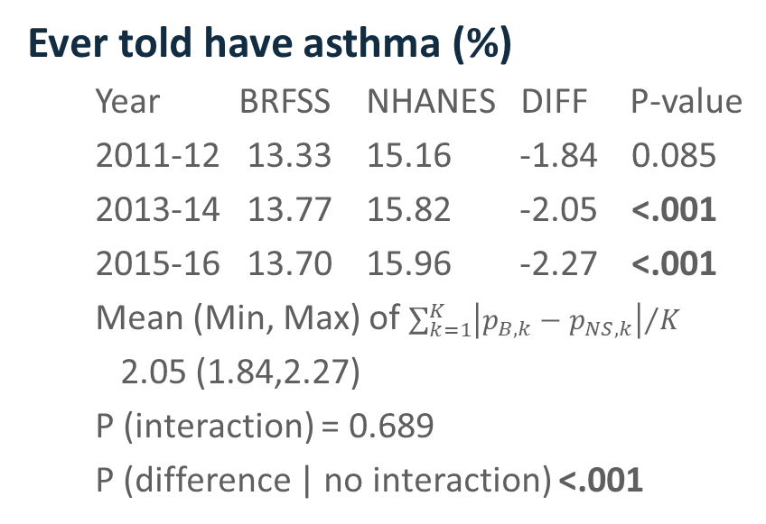
BRFSS vs. NHANES (7)
Ever told have asthma (%)
Year BRFSS NHANES DIFF P-value
2011-12 13.33 15.16 -1.84 0.085
2013-14 13.77 15.82 -2.05 <.001
2015-16 13.70 15.96 -2.27 <.001
Mean (Min, Max) of ${\sum_{k=1}^{K}{\left|p_{B,k}−p_{NS,k}\right|}}/K$
2.05 (1.84,2.27)
P (interaction) = 0.689
P (difference | no interaction) <.001

Slide 23
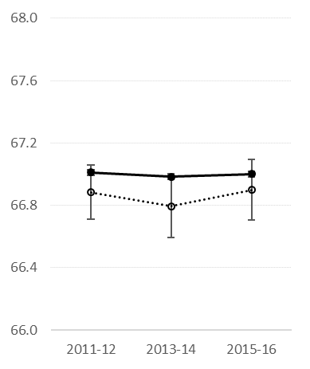
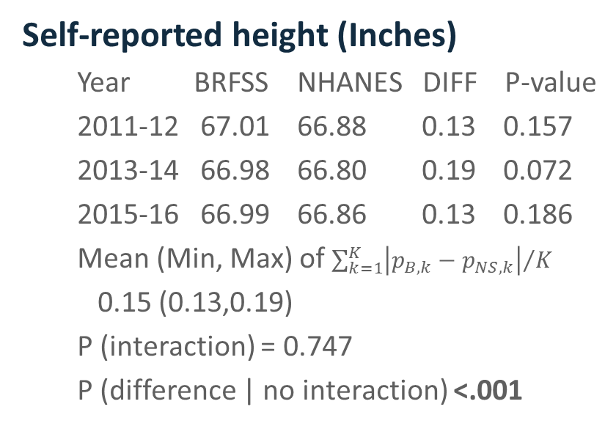
BRFSS vs. NHANES (8)
Self-reported height (Inches)
Year BRFSS NHANES DIFF P-value
2011-12 67.01 66.88 0.13 0.157
2013-14 66.98 66.80 0.19 0.072
2015-16 66.99 66.86 0.13 0.186
Mean (Min, Max) of ${\sum_{k=1}^{K}{\left|p_{B,k}−p_{NS,k}\right|}}/K$
0.15 (0.13,0.19)
P (interaction) = 0.747
P (difference | no interaction) <.001

Slide 24
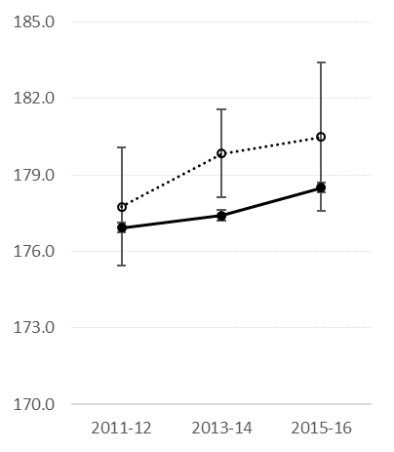
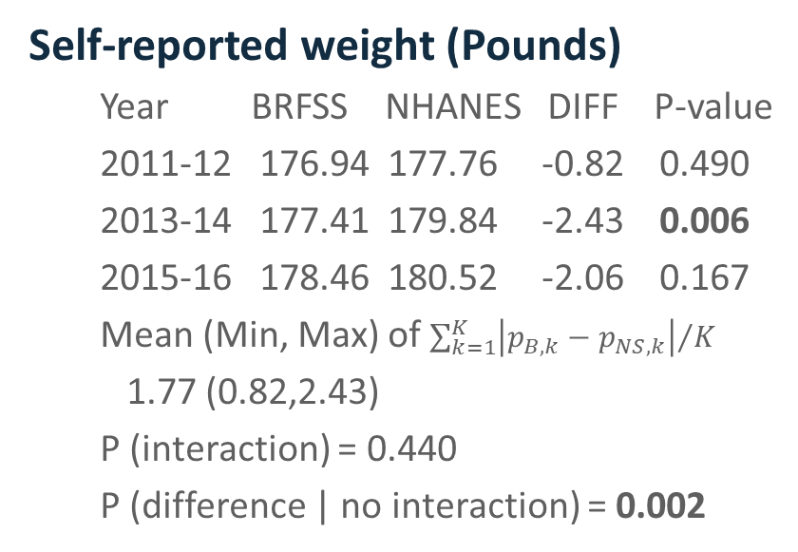
BRFSS vs. NHANES (9)
Self-reported weight (Pounds)
Year BRFSS NHANES DIFF P-value
2011-12 176.94 177.76 -0.82 0.490
2013-14 177.41 179.84 -2.43 0.006
2015-16 178.46 180.52 -2.06 0.167
Mean (Min, Max) of ${\sum_{k=1}^{K}{\left|p_{B,k}−p_{NS,k}\right|}}/K$
1.77 (0.82,2.43)
P (interaction) = 0.440
P (difference | no interaction) = 0.002

Slide 25
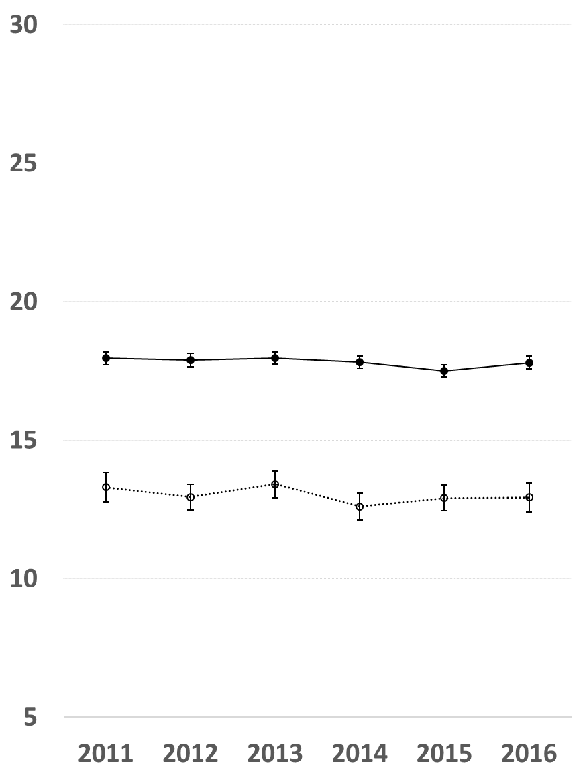
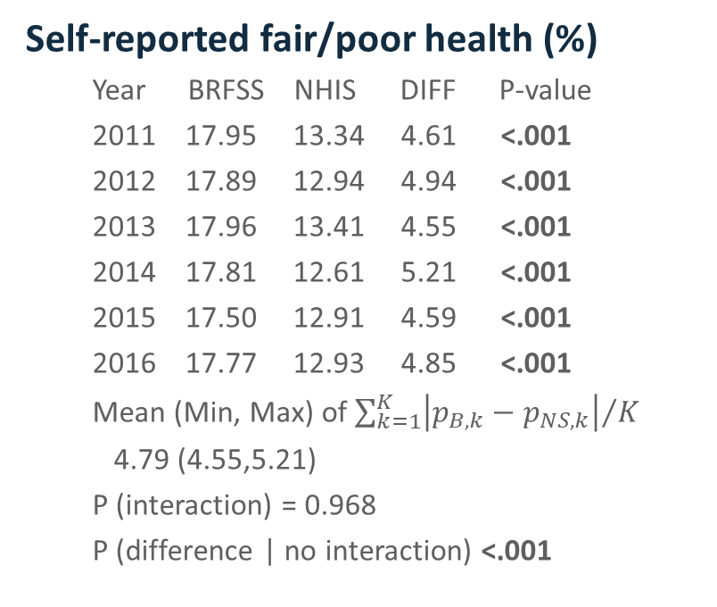
BRFSS vs. NHIS (1)
Self-reported fair/poor health (%)
Year BRFSS NHIS DIFF P-value
2011 17.95 13.34 4.61 <.001
2012 17.89 12.94 4.94 <.001
2013 17.96 13.41 4.55 <.001
2014 17.81 12.61 5.21 <.001
2015 17.50 12.91 4.59 <.001
2016 17.77 12.93 4.85 <.001
Mean (Min, Max) of ${\sum_{k=1}^{K}{\left|p_{B,k}−p_{NS,k}\right|}}/K$
4.79 (4.55,5.21)
P (interaction) = 0.968
P (difference | no interaction) <.001

Slide 26
Self-Reported Fair/Poor Health by Age and Sex (%)

Slide 27
Self-Reported Fair/Poor Health by Race/Ethnicity & Education

Slide 28
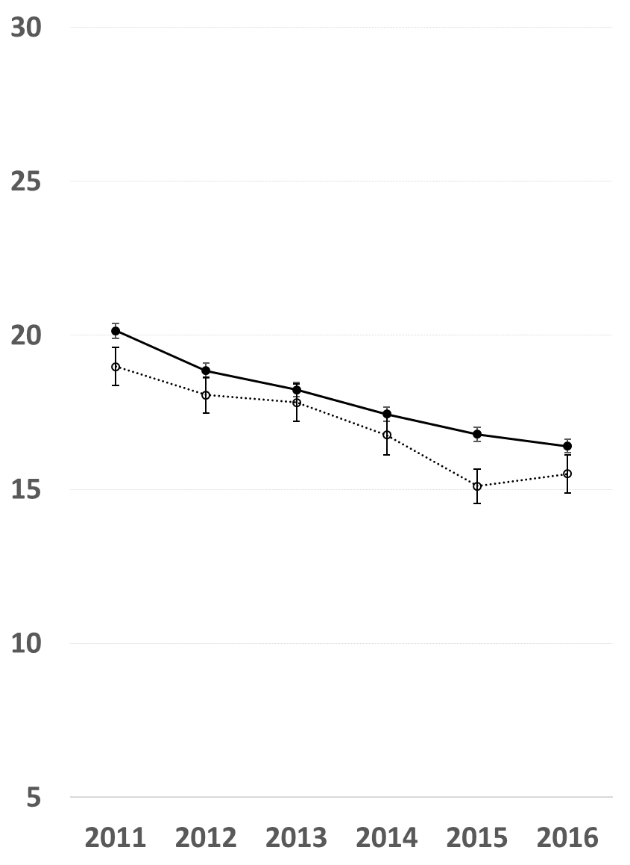
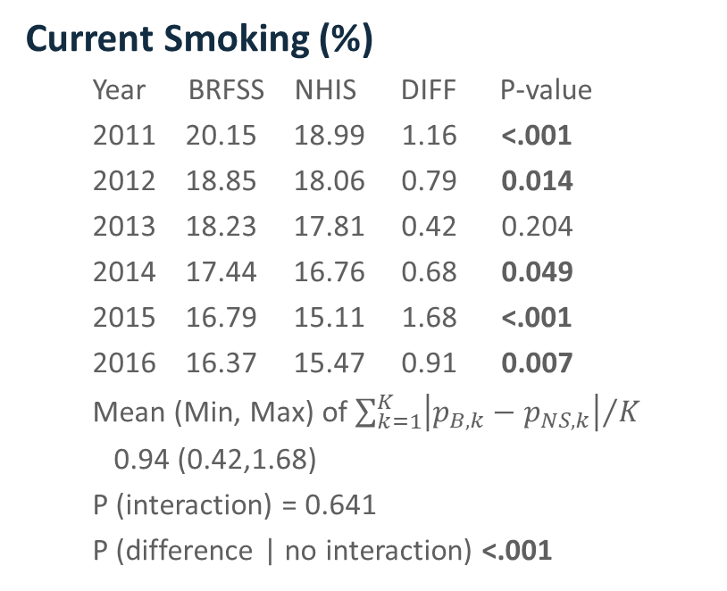
BRFSS vs. NHIS (2)
Current Smoking (%)
Year BRFSS NHIS DIFF P-value
2011 20.15 18.99 1.16 <.001
2012 18.85 18.06 0.79 0.014
2013 18.23 17.81 0.42 0.204
2014 17.44 16.76 0.68 0.049
2015 16.79 15.11 1.68 <.001
2016 16.37 15.47 0.91 0.007
Mean (Min, Max) of ${\sum_{k=1}^{K}{\left|p_{B,k}−p_{NS,k}\right|}}/K$
0.94 (0.42,1.68)
P (interaction) = 0.641
P (difference | no interaction) <.001

Slide 29
Current Smoking by Age and Sex (%)

Slide 30
Current Smoking by Race/Ethnicity & Education

Slide 31
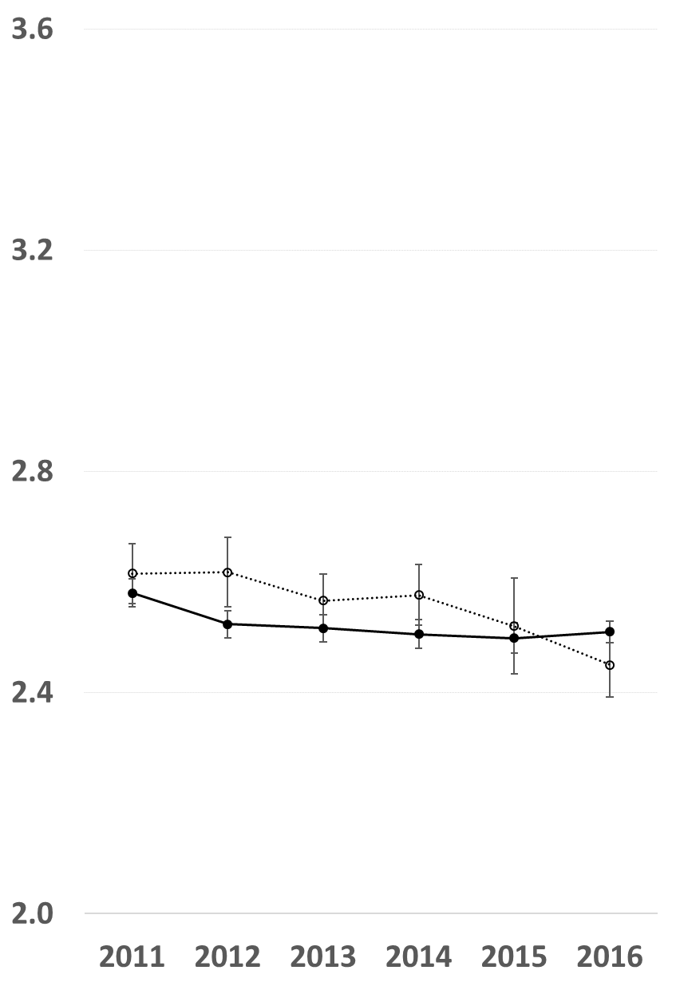
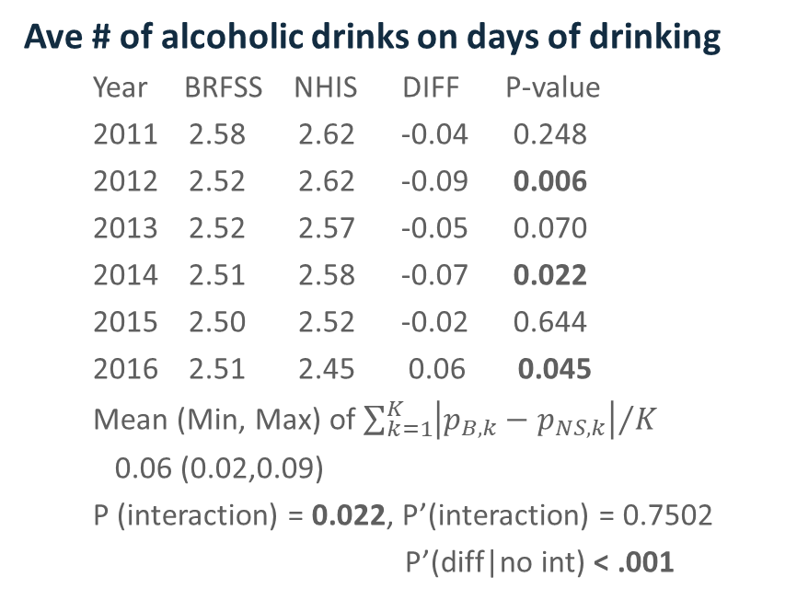
BRFSS vs. NHIS (3)
Ave # of alcoholic drinks on days of drinking
Year BRFSS NHIS DIFF P-value
2011 2.58 2.62 -0.04 0.248
2012 2.52 2.62 -0.09 0.006
2013 2.52 2.57 -0.05 0.070
2014 2.51 2.58 -0.07 0.022
2015 2.50 2.52 -0.02 0.644
2016 2.51 2.45 0.06 0.045
Mean (Min, Max) of ${\sum_{k=1}^{K}{\left|p_{B,k}−p_{NS,k}\right|}}/K$
0.06 (0.02,0.09)
P (interaction) = 0.022, P’(interaction) = 0.7502
P’(diff|no int) < .001

Slide 32

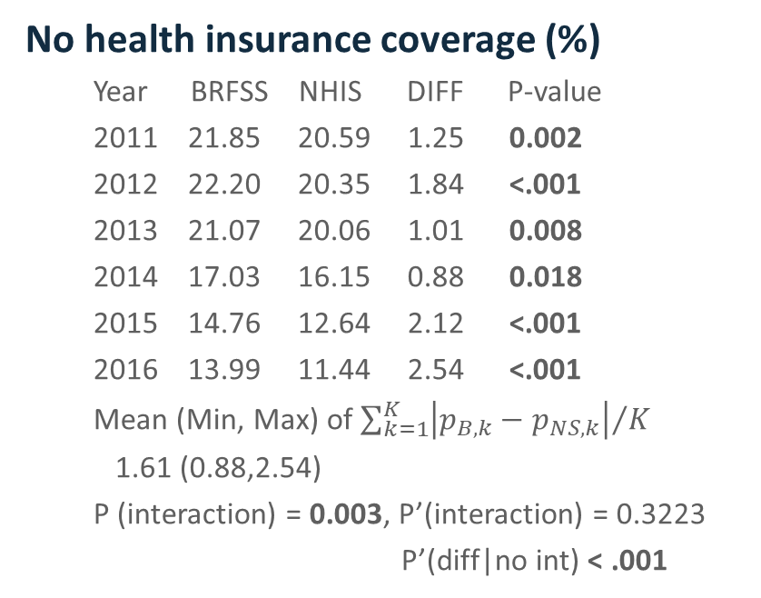
BRFSS vs. NHIS (4)
No health insurance coverage (%)
Year BRFSS NHIS DIFF P-value
2011 21.85 20.59 1.25 0.002
2012 22.20 20.35 1.84 <.001
2013 21.07 20.06 1.01 0.008
2014 17.03 16.15 0.88 0.018
2015 14.76 12.64 2.12 <.001
2016 13.99 11.44 2.54 <.001
Mean (Min, Max) of ${\sum_{k=1}^{K}{\left|p_{B,k}−p_{NS,k}\right|}}/K$
1.61 (0.88,2.54)
P (interaction) = 0.003, P’(interaction) = 0.3223
P’(diff|no int) < .001

Slide 33
No Health Insurance Coverage by Age and Sex (%)

Slide 34
No Health Insurance Coverage by Race/Ethnicity & Education (%)

Slide 35

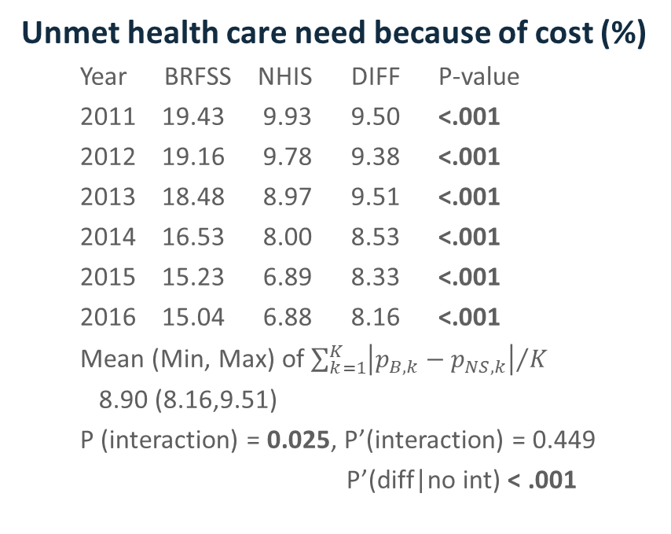
BRFSS vs. NHIS (5)
Unmet health care need because of cost (%)
Year BRFSS NHIS DIFF P-value
2011 19.43 9.93 9.50 <.001
2012 19.16 9.78 9.38 <.001
2013 18.48 8.97 9.51 <.001
2014 16.53 8.00 8.53 <.001
2015 15.23 6.89 8.33 <.001
2016 15.04 6.88 8.16 <.001
Mean (Min, Max) of ${\sum_{k=1}^{K}{\left|p_{B,k}−p_{NS,k}\right|}}/K$
8.90 (8.16,9.51)
P (interaction) = 0.025, P’(interaction) = 0.449
P’(diff|no int) < .001

Slide 36
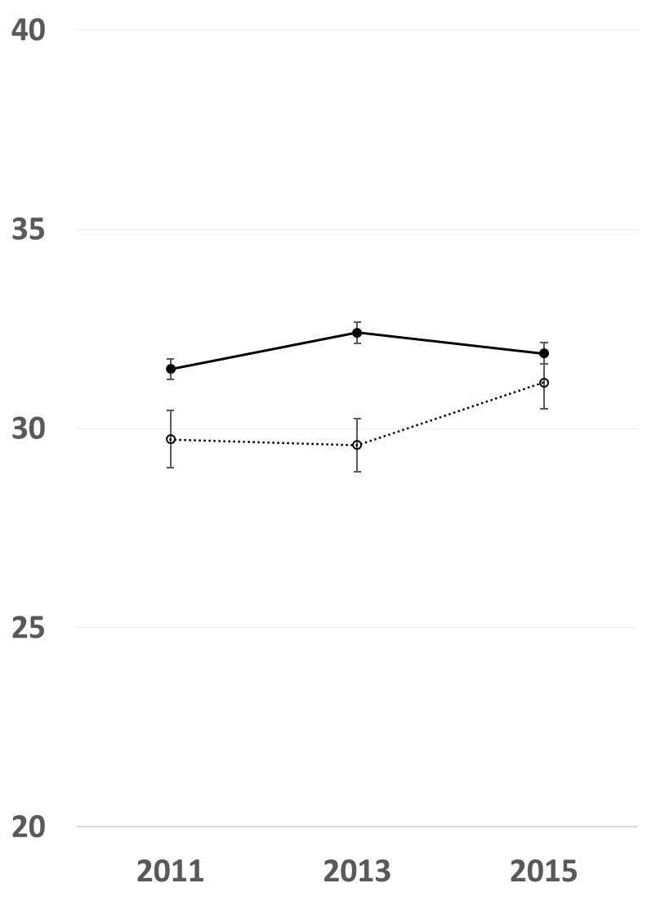
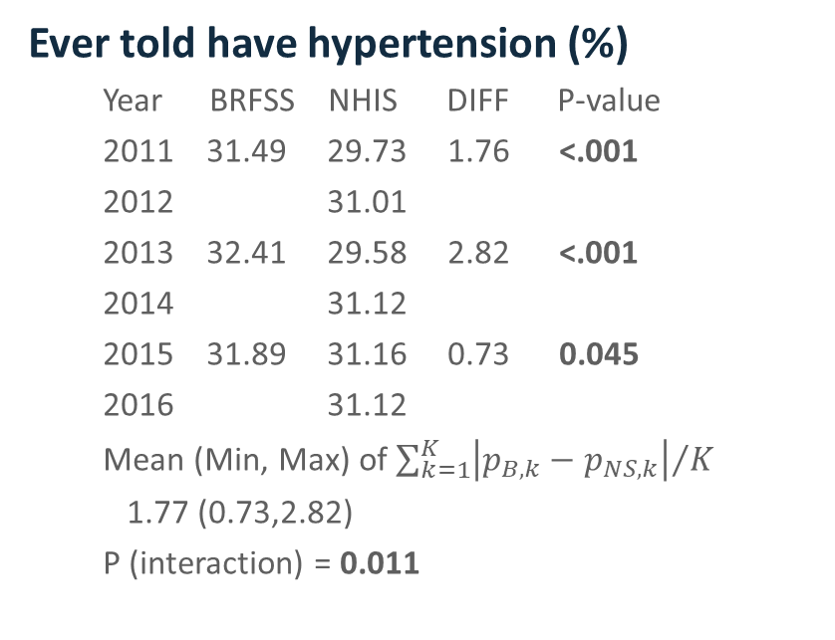
BRFSS vs. NHIS (6)
Ever told have hypertension (%)
Year BRFSS NHIS DIFF P-value
2011 31.49 29.73 1.76 <.001
2012 31.01
2013 32.41 29.58 2.82 <.001
2014 31.12
2015 31.89 31.16 0.73 0.045
2016 31.12
Mean (Min, Max) of ${\sum_{k=1}^{K}{\left|p_{B,k}−p_{NS,k}\right|}}/K$
1.77 (0.73,2.82)
P (interaction) = 0.011

Slide 37
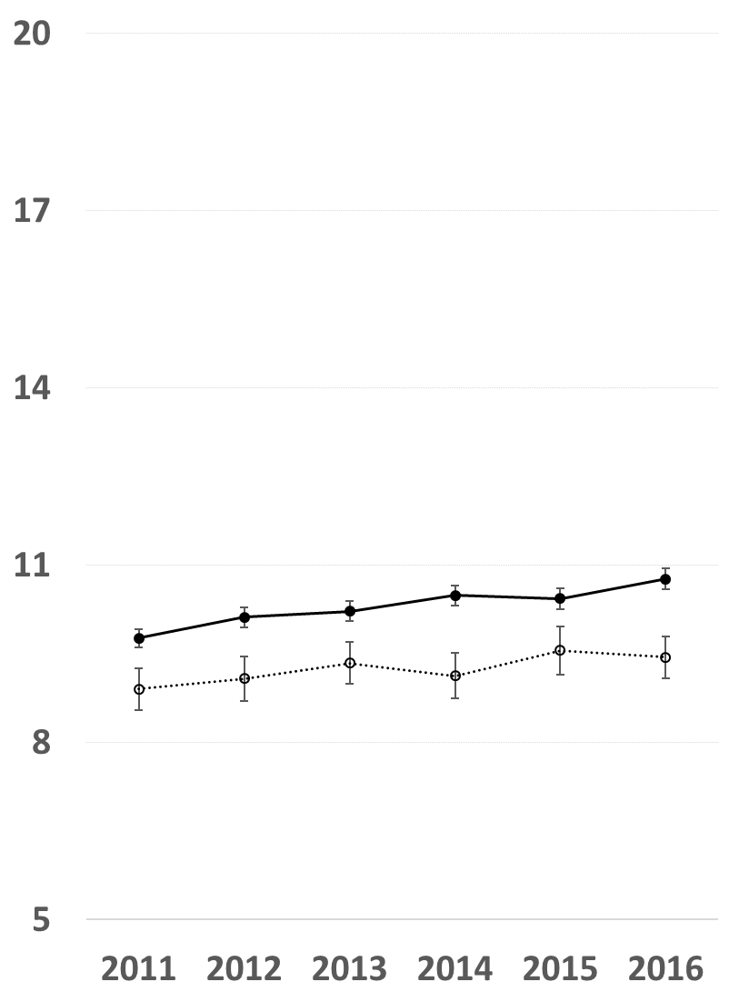
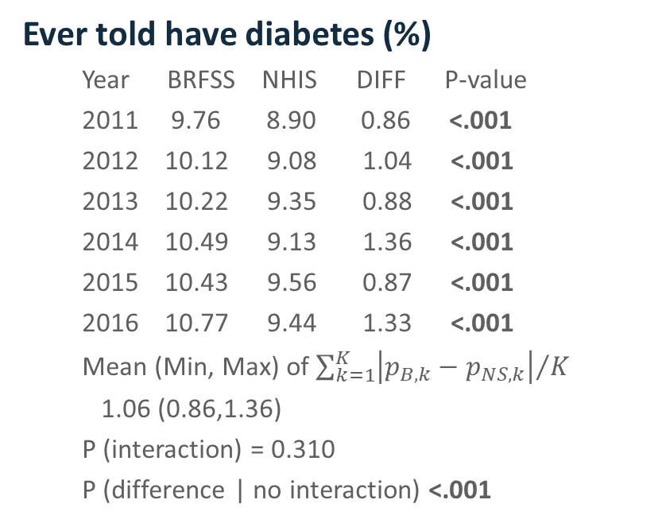
BRFSS vs. NHIS (7)
Ever told have diabetes (%)
Year BRFSS NHIS DIFF P-value
2011 9.76 8.90 0.86 <.001
2012 10.12 9.08 1.04 <.001
2013 10.22 9.35 0.88 <.001
2014 10.49 9.13 1.36 <.001
2015 10.43 9.56 0.87 <.001
2016 10.77 9.44 1.33 <.001
Mean (Min, Max) of ${\sum_{k=1}^{K}{\left|p_{B,k}−p_{NS,k}\right|}}/K$
1.06 (0.86,1.36)
P (interaction) = 0.310
P (difference | no interaction) <.001

Slide 38
Ever Told Have Diabetes by Age and Sex (%)

Slide 39
Ever Told Have Diabetes by Race/Ethnicity & Education (%)

Slide 40
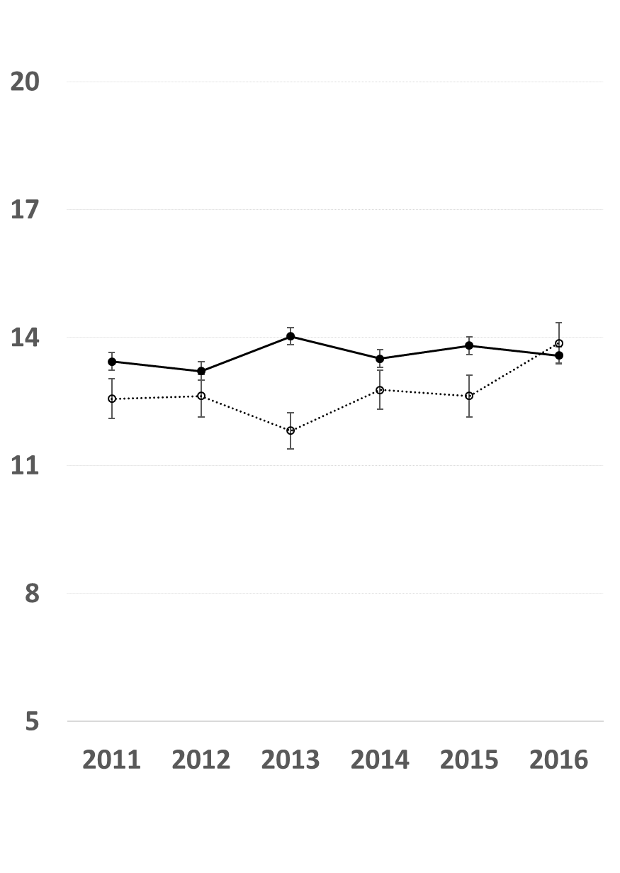
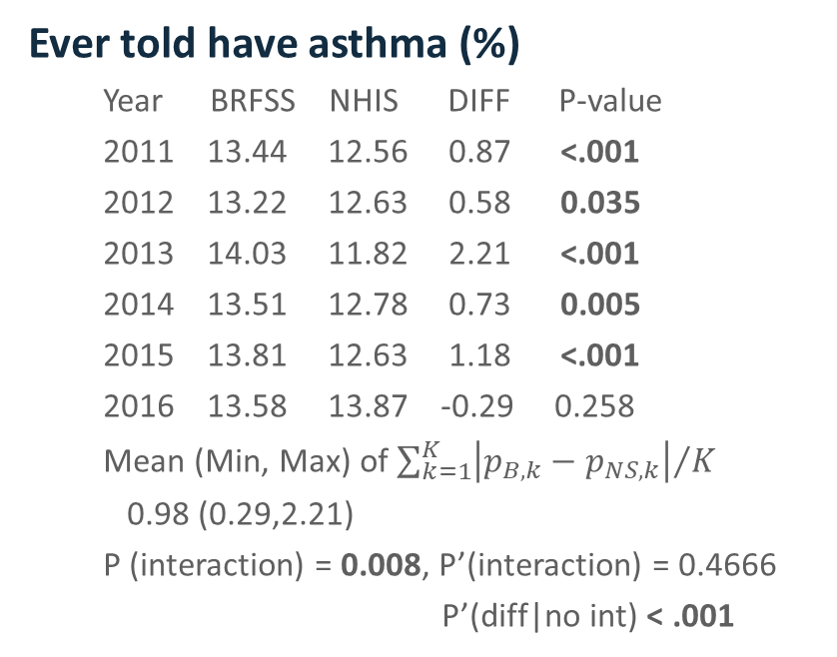
BRFSS vs. NHIS (8)
Ever told have asthma (%)
Year BRFSS NHIS DIFF P-value
2011 13.44 12.56 0.87 <.001
2012 13.22 12.63 0.58 0.035
2013 14.03 11.82 2.21 <.001
2014 13.51 12.78 0.73 0.005
2015 13.81 12.63 1.18 <.001
2016 13.58 13.87 -0.29 0.258
Mean (Min, Max) of ${\sum_{k=1}^{K}{\left|p_{B,k}−p_{NS,k}\right|}}/K$
0.98 (0.29,2.21)
P (interaction) = 0.008, P’(interaction) = 0.4666
P’(diff|no int) < .001

Slide 41
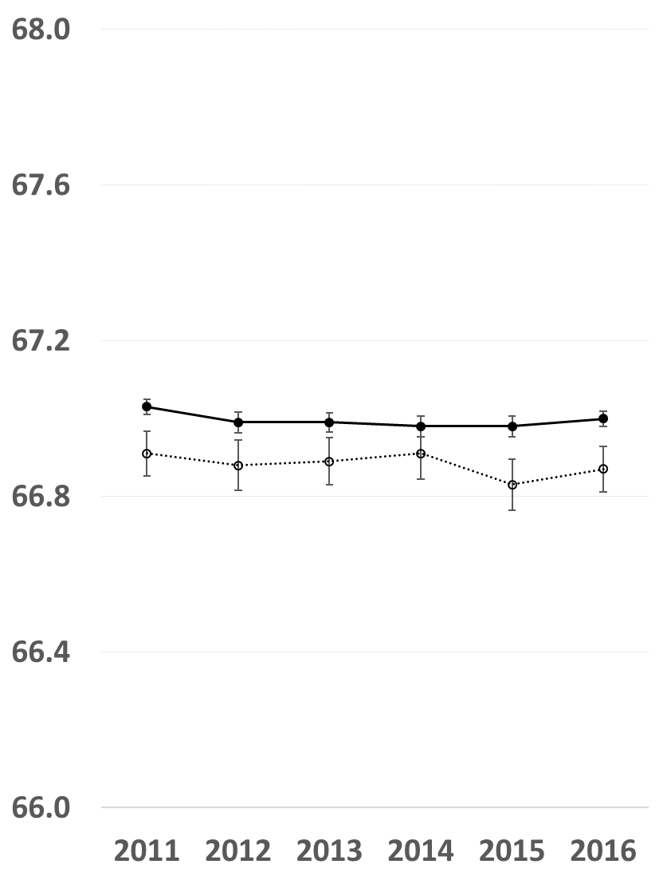
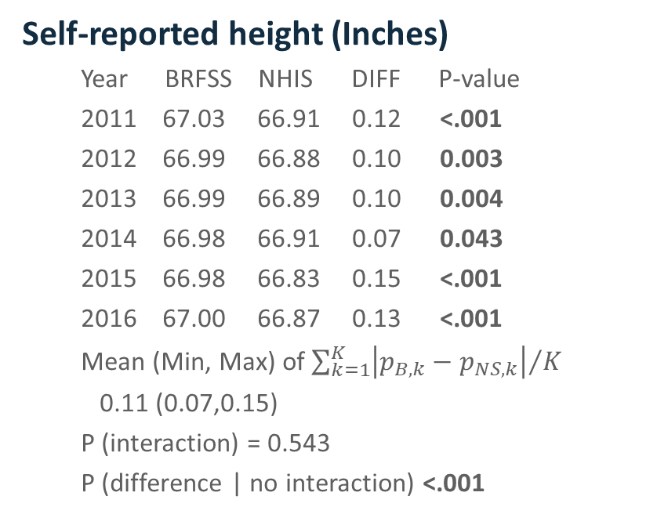
BRFSS vs. NHIS (9)
Self-reported height (Inches)
Year BRFSS NHIS DIFF P-value
2011 67.03 66.91 0.12 <.001
2012 66.99 66.88 0.10 0.003
2013 66.99 66.89 0.10 0.004
2014 66.98 66.91 0.07 0.043
2015 66.98 66.83 0.15 <.001
2016 67.00 66.87 0.13 <.001
Mean (Min, Max) of ${\sum_{k=1}^{K}{\left|p_{B,k}−p_{NS,k}\right|}}/K$
0.11 (0.07,0.15)
P (interaction) = 0.543
P (difference | no interaction) <.001

Slide 42
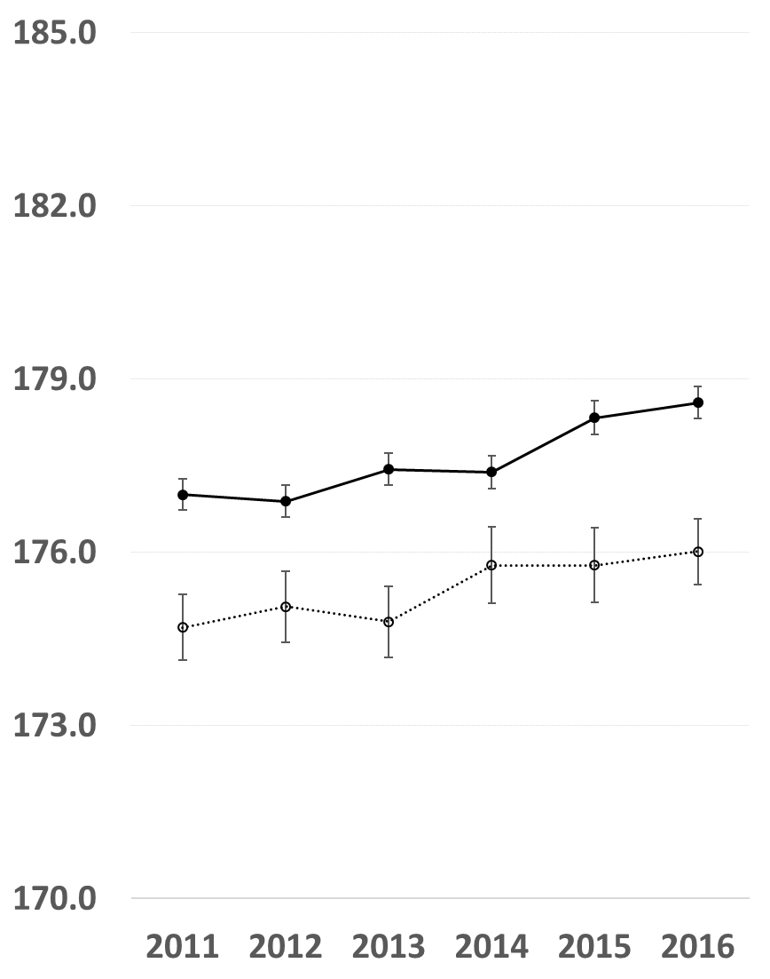
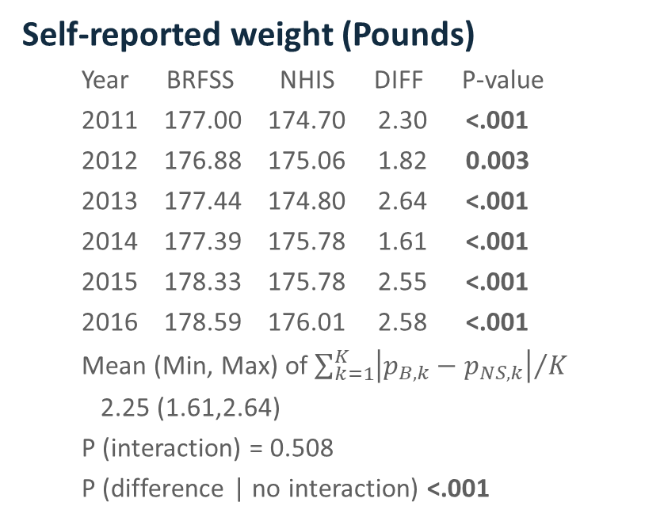
BRFSS vs. NHIS (10)
Self-reported weight (Pounds)
Year BRFSS NHIS DIFF P-value
2011 177.00 174.70 2.30 <.001
2012 176.88 175.06 1.82 0.003
2013 177.44 174.80 2.64 <.001
2014 177.39 175.78 1.61 <.001
2015 178.33 175.78 2.55 <.001
2016 178.59 176.01 2.58 <.001
Mean (Min, Max) of ${\sum_{k=1}^{K}{\left|p_{B,k}−p_{NS,k}\right|}}/K$
2.25 (1.61,2.64)
P (interaction) = 0.508
P (difference | no interaction) <.001

Slide 43
Summary
First comparison study conducted since 2011 redesign
BRFSS had similar time trends to NHANES for all studied variables.
BRFSS had similar time trends to NHIS for most studied variables.
For many variables, the differences in estimates between compared surveys were significantly different.
The absolute differences in most cases were small.

Slide 44
Limitations
The differences between surveys are subject to variation.
Different primary survey interests and survey objectives
Different location of questions in survey instruments
Different implementation protocols

