Slide 1
National Efforts to Address Culture-Independent Diagnostic Tests: Opportunities for Collaborations
Kristy Kubota, MPH
APHL
kristy.kubota@aphl.org
Notes:
Hello! Thank you to Kirk and Thuy for the opportunity today to speak with you all regarding some national public health efforts to address Culture-independent diagnostics tests. My name is Kristy Kubota and I am the Manger for the PusleNet program at APHL. I liase with the PN labs at the local/state level and CDC. I am also manage CIDT activities for the Association.
Today, I will provide a brief overview of the current CIDT multi-analyte panels to market to date and provide an overview of some work being done by groups working to address CIDT issues as it relates to foodborne disease surveillance.

Slide 2
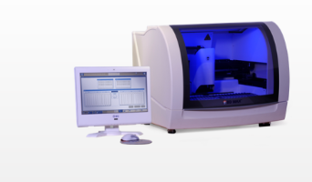
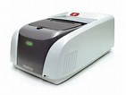
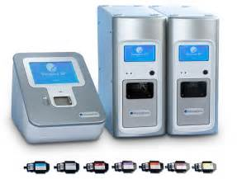
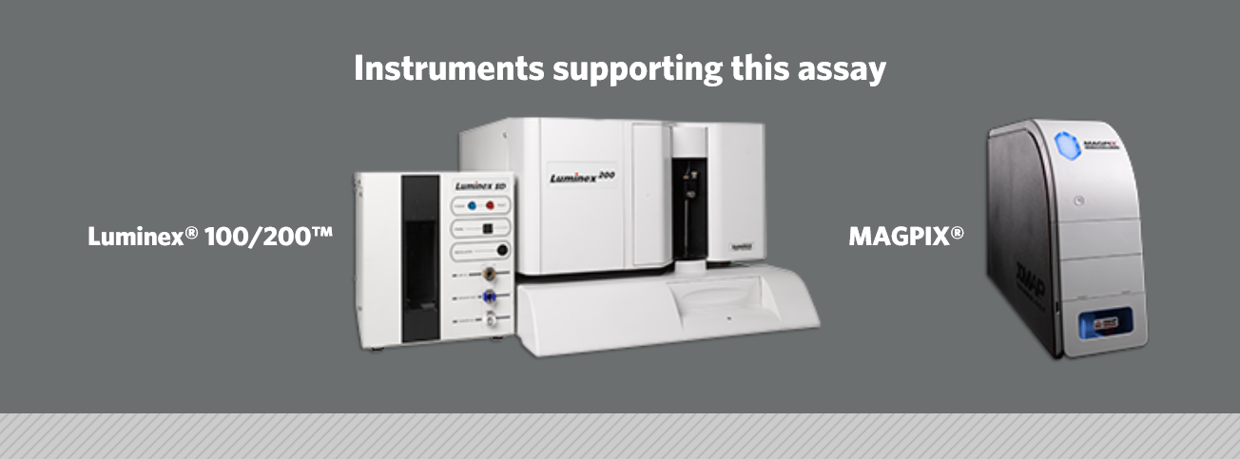
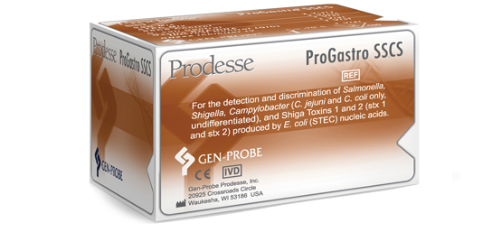
Overview
Since 2013, FDA has cleared 5 Multi-analyte Nucleic Acid Panels
Hologic/Gen-Probe ProGasro SSCS (2013)
Luminex GPP Assay (2013)
BioFire Film Array GI Panel (2014)
BD Diangostics’ BD MAX Enteric Bacterial Panel (2014)
Nanosphere Verigene Enteric Pathogens Panel (2014)
Patient to result testing within hours with no need to culture for pathogen identification
Notes:
Since 2013, FDA has cleared 5 Gastrointestinal CIDT panels. All are considered closed system tests that do not allow random access for physicians to select likely etiologic agents of diarrhea.
Hologic/Gen-Probe’s ProGastro SSCS was the first CIDT multi-analyte panel approved in 2013. Targets on this test identify Salmonella, Shigella, Campylobacter (C. jejunmi/C. coli) and stx1/stx 2 genes. The TAT is 4 hours.
Luminex xTAG GPP identifies 11 pathogens including Campylobacter (C.jejuni, C coli and C lari), Clostridium difficle, Cyrptyosporidium (C. parvrum, C hominis), Ecoli O157, Enterotoxigenic E coli, Giardia, Norovirus (GI/GII), Rotavirus A, Salmonella, Shiga like toxin producting STEC, stx 1/stx2, Shigella (S. boydii, sonnei, flexneri, dysteriae). TAT is 5 hrs.
BioFire most robust panel identifiying more than 20 bacterial, parasitic and viral agents including: Campylobacter (C. jejuni, C oli, C. upsaliensis, C. difficile toxin A/B, Plesiomonas shigelloides, Salmonella, Vibrio (parahaemolyticus, vulnificus, cholearae, Yersinia entercolitica, EAEC, EPEC, ETEC, shiga like toxin producing STEC stx 1/stx2, cryptoporidum, Clycospora cayentanesis, Entaboeba histolytica, Giardia, Adenovirus, Astrovirus, Norovirus G1/G2, Rotoavirua Saprovirus. TAT 1-2 hrs
BD Diagnoistics BD Max Campylobacter, Salmonella, Shigella, Enteroivasive Ec., shiga toxin 1 and 2 genes. TAT 3-4 hrs.
Nanosphere Verigene Enteric Pathogens. Identify Campylobacter (C. jejuni, C coli, C. lari), Salmonella species, Shigella species, Yersinia entercolotica, stx 1 and stx 2 genes, STEC. TAT 2 hrs.
With all these tests patients and clinicans have the ability to obtain results within hours rather than stool culture which can take up to days to identify and characterize the pathogen. As you can see, each manufactuer has different array of targets for GI pathogens. Again, benefit of culture-independent diagnostic test systems are to rapidly identify pathogen(s) which may be contributing to illness.

Slide 3
Overview
Since 2013, FDA has cleared 5 Multi-analyte Nucleic Acid Panels
Hologic/Gen-Probe ProGasro SSCS (2013)
Luminex GPP Assay (2013)
BioFire Film Array GI Panel (2014)
BD Diangostics’ BD MAX Enteric Bacterial Panel (2014)
Nanosphere Verigene Enteric Pathogens Panel (2014)
Patient to result testing within hours with no need to culture for pathogen identification
Public health surveillance depends on isolates!
Notes:
Since 2013, FDA has cleared 5 Gastrointestinal CIDT panels. All are considered closed system tests that do not allow random access for physicians to select likely etiologic agents of diarrhea.
Hologic/Gen-Probe’s ProGastro SSCS was the first CIDT multi-analyte panel approved in 2013. Targets on this test identify Salmonella, Shigella, Campylobacter (C. jejunmi/C. coli) and stx1/stx 2 genes. The TAT is 4 hours.
Luminex xTAG GPP identifies 11 pathogens including Campylobacter (C.jejuni, C coli and C lari), Clostridium difficle, Cyrptyosporidium (C. parvrum, C hominis), Ecoli O157, Enterotoxigenic E coli, Giardia, Norovirus (GI/GII), Rotavirus A, Salmonella, Shiga like toxin producting STEC, stx 1/stx2, Shigella (S. boydii, sonnei, flexneri, dysteriae). TAT is 5 hrs.
BioFire most robust panel identifiying more than 20 bacterial, parasitic and viral agents including: Campylobacter (C. jejuni, C oli, C. upsaliensis, C. difficile toxin A/B, Plesiomonas shigelloides, Salmonella, Vibrio (parahaemolyticus, vulnificus, cholearae, Yersinia entercolitica, EAEC, EPEC, ETEC, shiga like toxin producing STEC stx 1/stx2, cryptoporidum, Clycospora cayentanesis, Entaboeba histolytica, Giardia, Adenovirus, Astrovirus, Norovirus G1/G2, Rotoavirua Saprovirus. TAT 1-2 hrs
BD Diagnoistics BD Max Campylobacter, Salmonella, Shigella, Enteroivasive Ec., shiga toxin 1 and 2 genes. TAT 3-4 hrs.
Nanosphere Verigene Enteric Pathogens. Identify Campylobacter (C. jejuni, C coli, C. lari), Salmonella species, Shigella species, Yersinia entercolotica, stx 1 and stx 2 genes, STEC. TAT 2 hrs.
With all these tests patients and clinicans have the ability to obtain results within hours rather than stool culture which can take up to days to identify and characterize the pathogen. As you can see, each manufactuer has different array of targets for GI pathogens. Again, benefit of culture-independent diagnostic test systems are to rapidly identify pathogen(s) which may be contributing to illness.

Slide 4
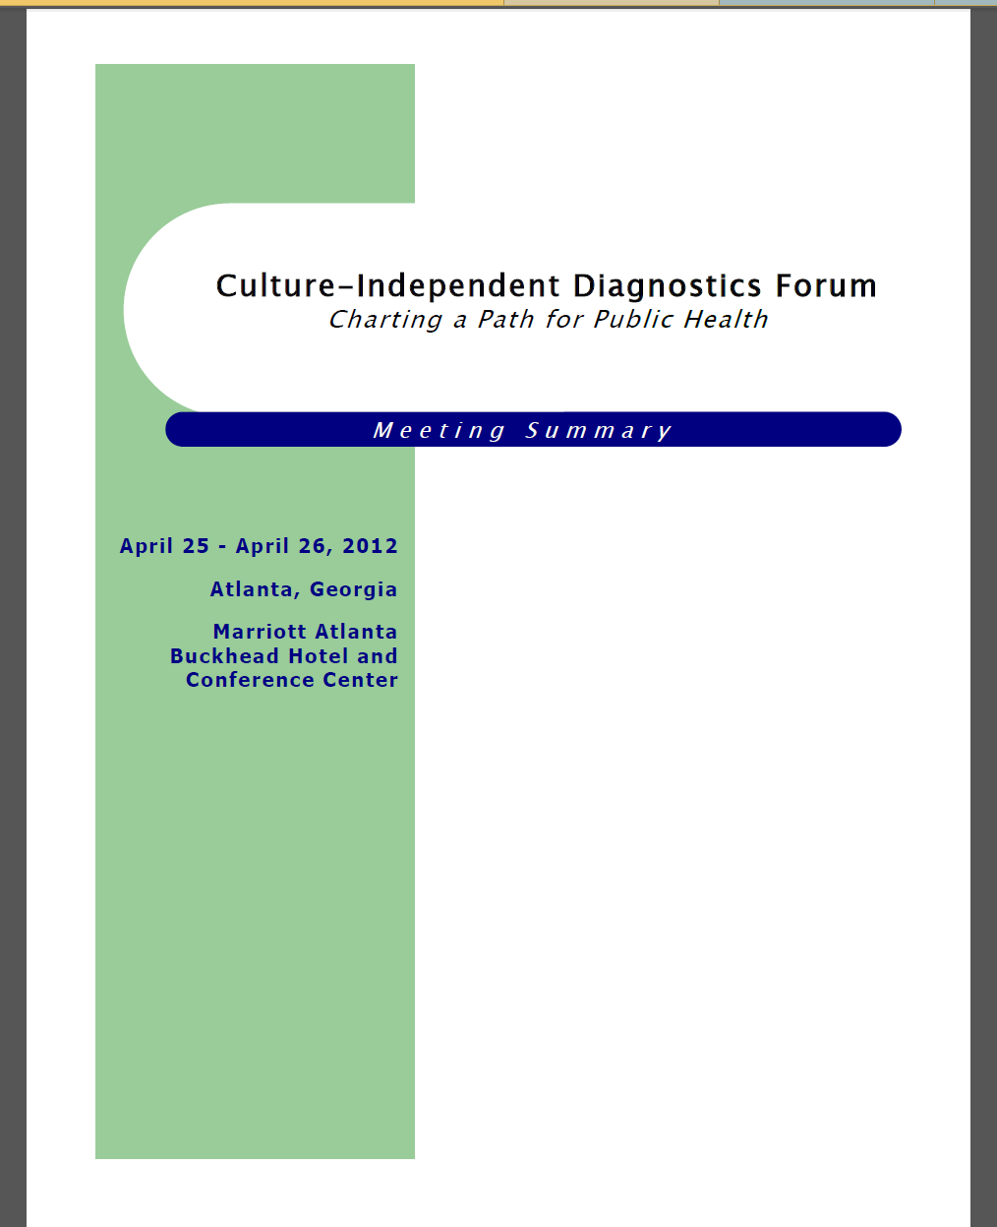
Public Health Partnerships
Outreach to stakeholders
CIDT National Forum (2012)
CDC CIDT Regulatory Workgroup Activities
Associations (CSTE/APHL)
Food Safety Groups (Council to Improve Foodborne Outbreak Response, CIFOR)
CDC/Public Health Labs & Applied public health research
Seeded stool and media evaluation studies
Metagenomic studies
Notes:
In 2012, John Besser within Enteric Diseases Laboratory Branch (EDLB) at CDC and APHL organized a national CIDT forum in Atlanta GA. This meeting brought together clinicians, laboratorians, clinical laboratories, epidemiologists, federal agencie, industry to discuss the emerging trend of CIDT devices being implemented in the clinical lab setting. The goal of this meeting was to identify challenges posed by the emergence of CIDT testing and their anticipated impacts to public health surveillance programs-focusing on primarily foodborne diseases.
Outcomes of this meeting led to the development of several working groups and Associations leading efforts to address the impacts. A CDC CIDT Regulatory workgroup was stood up at CDC led by John Besser and Collette Fitzgerald and associations both at CSTE & APHL and others started working to address the public health surveillance aspects of uptake of CIDTs. Food Safety Groups such as CIFOR begin work. On the applied public health reaserach side, CDC and local/state PHLs begin studies looking to evaluate collection and transport variables in order to have the data necessary to develop data driven guidelines for public health labroatories. CDC and other groups are developing methods for culture-free subtyping and identification using metagenomics. However, this technology will likely not be out to public health laboratories within the next 5-10 years.

Slide 5
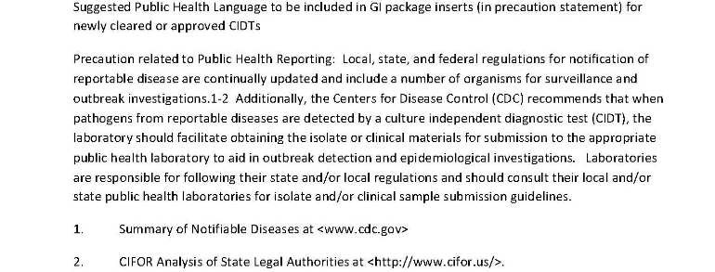
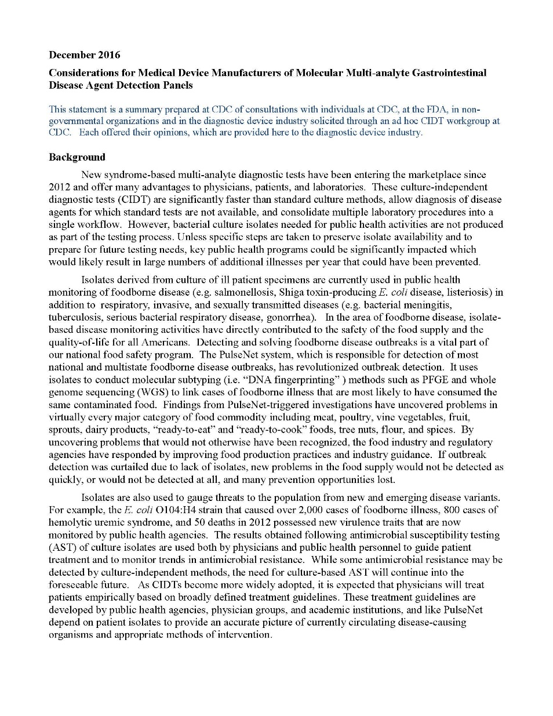
CDC Regulatory Workgroup
Workgroup Members
Federal Agencies
Clinical laboratories
AdvaMed
Associations (APHL, ASM, CSTE, IDSA, CAP)
Projects
Public Health Package Insert Language
Recommendations to Device Manufacturers
Law Project
Exploring reimbursement issues
Notes:
The CDC Regulatory Workgroup as mentioned before was stood up after the CIDT Forum in 2012. Workgroup members include FDA, CDC, Representatives from CAP/CLIA, Clinical laboratories and large reference labs (ASM), AvaMed (trade association for device manurfactuers). Associations (APHL/CSTE/IDSA).
Some projects which have been completed include developing Public health language for package inserts to share with device manufactuers and FDA during the pre market and 510K clearance process. This is important because we learned that through accreditation programs like CLIA and CAP, clinical laboratories must follow package insert language. This language is voluntary but FDA has been encouraging manufactuers to include this under the Limitation sections of the Package insert. The PH language emphasized the need to communicate with local PH departments when implementing this test and to review local jurisdictional reporting and submission regulatations to know what is reportable and what to submit to PH labroatories.
This workgroup has aslo developed in close collaboration with AdvaMed a white paper like document outliying the considerations of PH for the detection of GI pathogen devices. This document has been released to AdvaMed membership.
Future projects this group is working on: A proposal/problem statement has been submitted to the CDC law office to consider work on developing a short 2-3 paper (condensed version of APHL’s State legal authorities and model language jurisdictions can use to update/modify their regulations.
This group has continued to explore reimbursement issues primiarly for reflex culture by clinical laboratories. Currently, CMS (Medicare) does not allow for reimbursement of public health activities. This group has been working on outreach to CMS and AHIP-trade organization for private insurers on this issue.

Slide 6
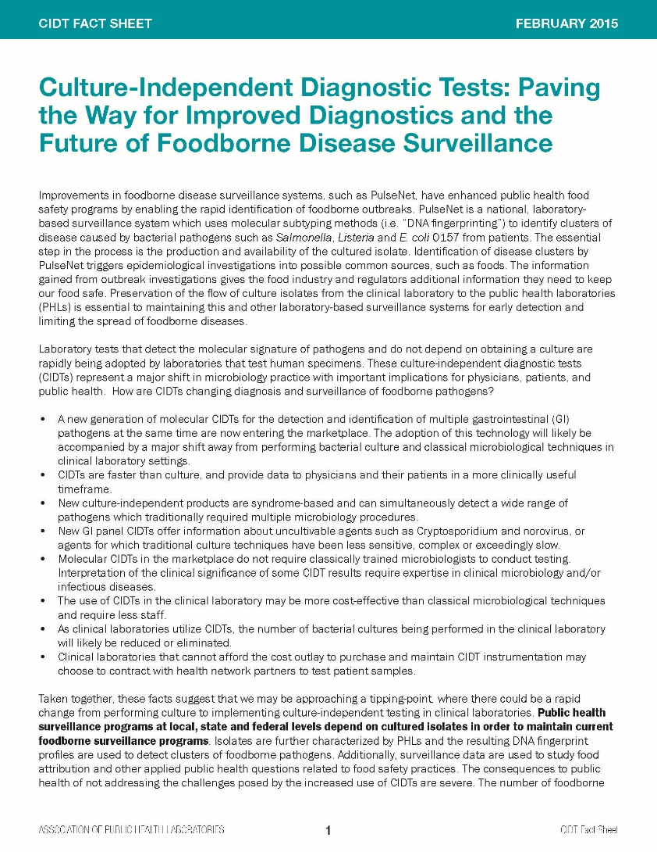
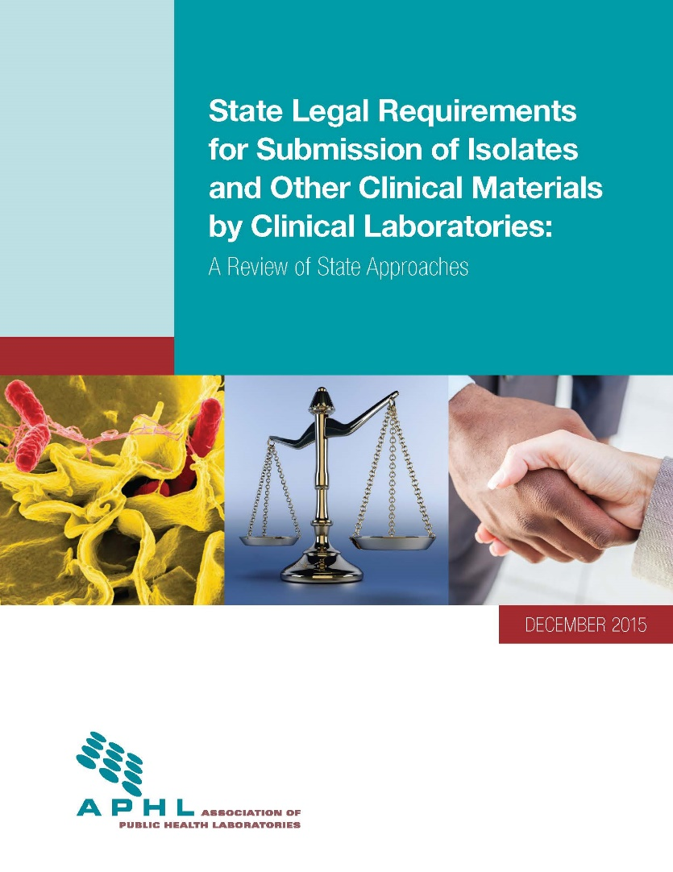
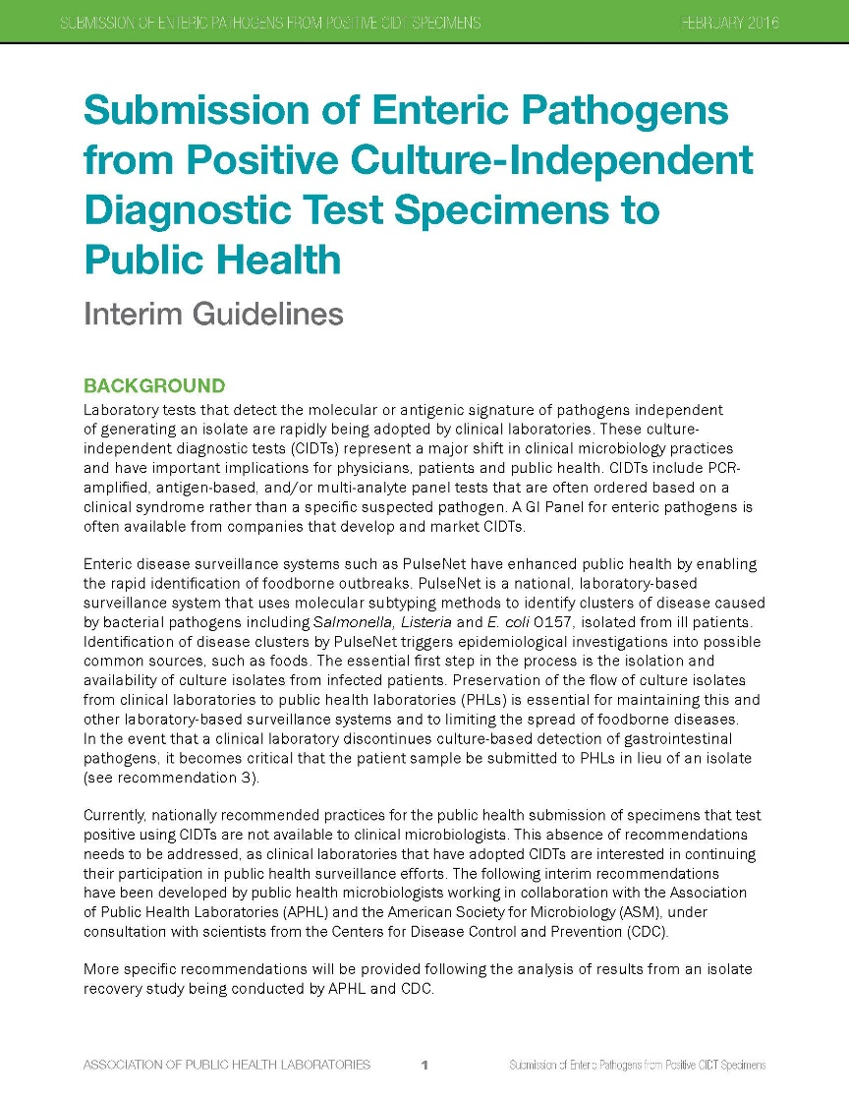
APHL Activities
APHL CID Subcommittee
Factsheet
Analysis of 50 states regulations for clinical material/isolate submission to public health
Interim recommendations
Seeded Stool & Media evaluation studies
CIDT Practice Guidelines for Public Health
Notes:
The AHL CID Subcommittee was established under the Food Safety Committee to address public health laboratory issues as it relates to CIDTs. Since 2015, we have developed products to educate our members on CIDTs and to provide tools such as the analysis of states’ legal requirements for clinical material/isolate submission to public health. APHL contracted with an attorney who had previously developed products for CIFOR. This comprehensive guide lays out all 50 states and DC’s regulation for submission of clinical material and/or isolates submitted to public health. An appendix was also added which provides some model language to help strengthen regulatory language with submitting isolates and/or clinical materials to public health laboratories.
As mentioned previously, the PHLs and CDC have been working on studies to evaluate collection and transport variables in order to have the data necessary to develop data driven guidelines for public health labroatories. Additionally, TN has led efforts and have completed a three year study to look at the impact CIDTs and specimen submission, (rather than isolates), have had on their infrastructure. In addition to developing practice guidelines, the Subcommittee hopes to develop laboratory based metrics for developing a systematic approach for tracking the uptake of CIDTs and impact on the laboratory resources.

Slide 7
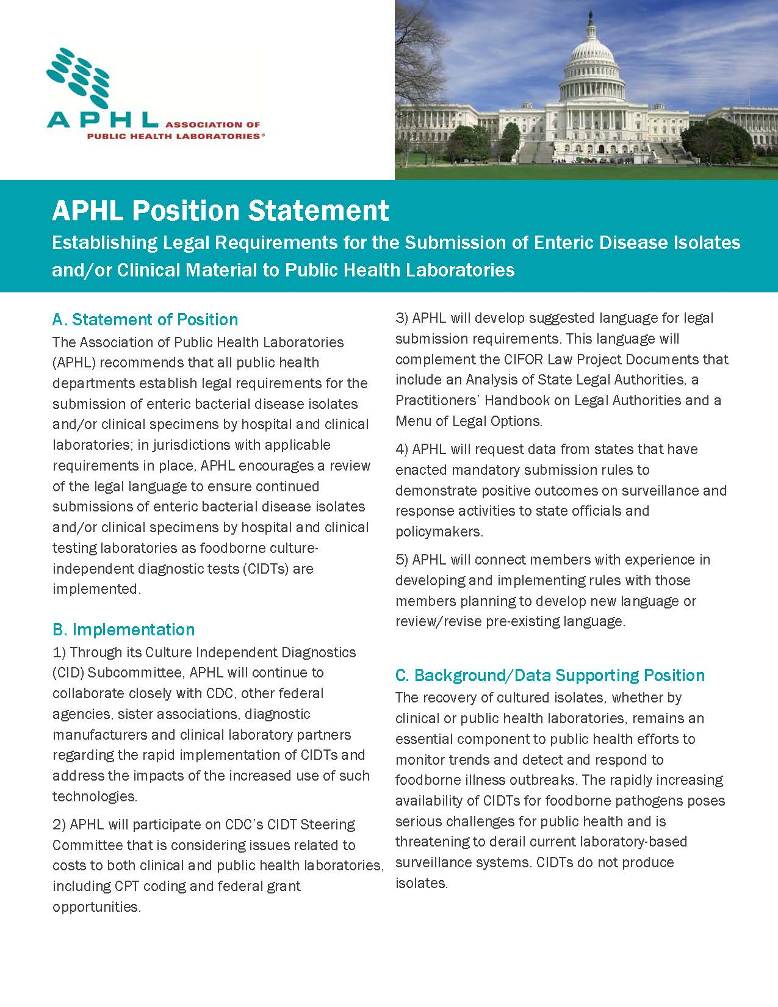
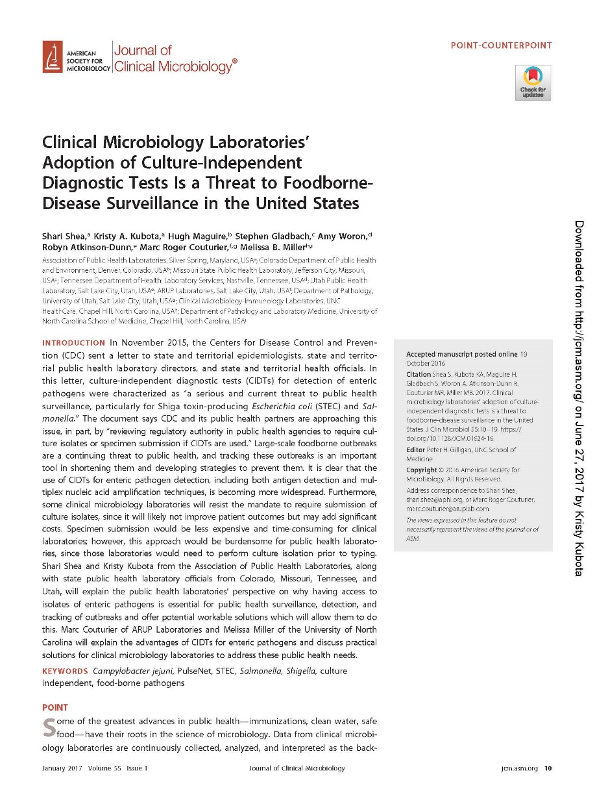
APHL Activities
2015 Position Statement, “Establishing Legal Requirements for Submission of Enteric Disease isolates and/or Clinical Materials to PHL’s
Journal Clinical Microbiology (JCM) Point-CounterPoint, Jan 2017
Notes:
APHL has also developed position statements describing the need to establish legal requirements for submission of disease isolates and/or materials to PHLs. And earlier this year, we worked on a Point CounterPoint published in JCM with clinical microbiologists-Melissa Miller, University North Carolina and Marc Rodger Couturier from ARUP Laboratories in Salt Lake City.

Slide 8



Addressing Challenges & Opportunties
More published studies
Performance characteristics of tests in different populations
Polymicrobial/dual infections
Public health surveillance
Role of CIDTs in exclusion criteria
Trends for disease surveillance & incorporating data into laboratory-based and epi data management systems
Reimbursement
Reimbursement of costs for reflex cultures-who pays for public health activities?
Notes:
I had originally titled this slide “Gap” but really there is opportunity to addressing challenges and opportunities for fostering futher collaboration. I feel that there still needs more published studies on performance chacteristics post-FDA clearance to address how these tests are peforming in the “real-world”. And we know very little about the role of polymicrobial/dual infections. Not a lot of published studies.
On the public health surveillance side, I know CSTE is working to revise case definitions and determine what role CIDTs play in exclusion critieria for daycare workers/children. FoodNet is working to incorporate CIDTs for trend analysis so there is work in that area. All of these activities need cross collaborations between lab/epi. And for both lab and epi sides-need to incorporate CIDT data into data management systems. On the lab side, this is not easy task.
We continue to work on reimbursement-the cost for reflex cuturing and sustainability of public health activities. “Who pays for Public Health” is still an unanswered question.

Slide 9
Resources
IDSA White Paper, “Better Tests Better Care: Improved Diagnostics for Infectious Diseases” (2013)
CIFOR
2nd Edition CIFOR Guidelines for Foodborne Disease Outbreak Response (Chapter 8)
Metrics Project & Tool (C-MET)
American College of Gastroenterology (ACG) Clinical Guideline: Diagnosis, Treatment, and Prevention of Acute Diarrheal Infections in Adults (2016)
InFORM 2017!!!
November 6-9, 2017 Garden Grove, CA
Notes:
I would like to leave you with some additional resources if you haven’t already had a chance to review them. IDSA white paper came out in 2013 but was a call to device manufactures for the need to better testing for infectious diseases. CIFOR has incorporated CIDTs into the revised guidelines Performance indicators(Chapter 8) for foodborne disease programs as well as their metrics project which includes 16 CIFOR metrics with target ranges (and a new entry tool CMET).
The American College of Gastroenterology published their Diarrheal treatment guidelines for Adults in 2016.
And, I can’t leave without putting a plug in for our national foodborne disease and outbreak response conference, InFORM 2017 which will also include discussions on CIDTs throughout the meeting. It will be in November 6-9 in Southern California (Garden Grove).
Hope to see you there and thank you for your attention.

