Slide 1
Lessons Learned
A Multi-Agency, Multi-Disciplinary Approach to After Action Reviews & Reports
CSTE Food Safety Subcommittee Webinar
April 17, 2017

Slide 2
The RRT Mindset:
Continuous Process Improvement
What do we hope to achieve?
  To improve multi-agency and multi-disciplinary response to food and feed contamination events
  Minimize the time between agency notification of a human or animal food contamination event and implementation of effective control measures
Best Practices
  RRT Best Practices Manual: AAR Chapter
  CIFOR Guidelines: Section 6.7 & 7.5
Self-Assessment & Improvement Plans
  Big Picture: Annual Capability Assessment Tool (CAT)
  Incident Specific: After Action Reviews & Reports (w/improvement plans)
    How can we be better prepared to respond to the next incident?
    How can we prevent the next incident?
Notes:
RRT Manual AAR Chapter
Detailed description of how to assign roles and structure/run an after action review meeting
Use of Flowcharts to identify communication issues
Templates/Examples: Simple, Medium, Complex, HSEEP, Lessons Learned Report
Public Link
CIFOR 2nd Edition
Section 6.7 After-Action Meetings and Reports
List of what to cover in an After-Action Report
Section 7.5 Multijurisdictional Outbreak Investigations After-Action Reports
Public Link

Slide 3
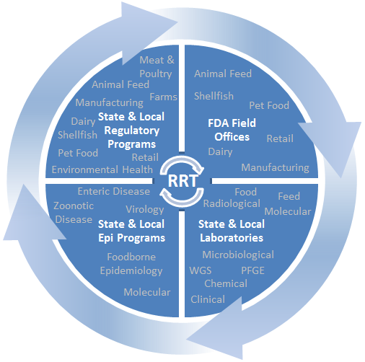
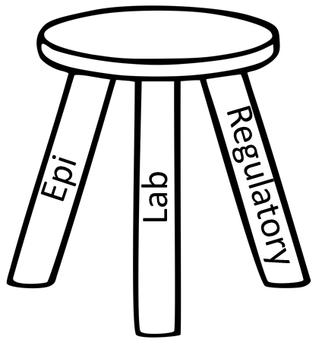
The RRT Mindset: A Team Approach
AARs are about improving:
  Individual activities (lab, epi or regulatory)
  How we work together
It’s important to engage the
various partners involved

Slide 4
The Basics
After Action Review – A no-fault process or meeting whereby everyone involved in the response/event collectively evaluates the response. The emphasis should be on identifying strengths and weaknesses of the jurisdiction’s or multi-agencies plans, protocols, procedures, etc., and the tactics utilized to achieve the strategic goals.
After Action Report – The purpose of an after action report is to analyze results, identify strengths to be maintained and built upon, identify potential areas for further improvement, and support development of corrective actions. The report includes:
  A summary of the incident
  Review of the response process
  Timeline of the events
  Strengths and areas for improvement observed during the response
  Improvement plan (IP)
Improvement Plan (IP) – A formal document that lists responsible
entities to be accountable for agreed upon improvements to a
response process within a designated time frame.
Definitions are from the RRT Manual, 2013
IPs
After Action Reports
Debriefs & Hotwashes
(After Action Reviews)

Slide 5
Common Barriers to AARs
Automatic association (for some) with HSEEP, 50+ pages, etc.
Too many people involved in approval & sign-off
Information sharing/disclosure and legal concerns
End result:
  AAR avoidance
  Draft AARs that never get finalized or shared
Our goal: Develop & support a culture where RRTs dedicate time to AARs at any level
  Scalability is the key: Hotwash → HSEEP
Notes:
Those with an emergency management background or HSEEP training mindset hear AAR and think full scale exercise AAR (50 pages long, etc.) – it’s thorough but is a barrier and can be an impediment to doing more AARs, etc.
Today, we will look at AAR process and outcomes through the lens of the Hep A/Frozen Strawberries outbreak of late summer/early fall 2016.

Slide 6

Virginia Rapid Response Team
(VA RRT)
After Action Reporting
Christy Brennan: RRT Coordinator, VDACS Food Safety Program
Peri Pearson: Food Consultant, VDH Office of Environmental Health Services
Dr. Lauren Turner: Foodborne and Advanced Pathogen Characterization Lead Scientist, DCLS
Commander Martin Guardia: Emergency Operations Coordinator , FDA Baltimore District Office

Slide 7
Virginia Rapid Response Team
(VA RRT)
The VA RRT is managed by a Core Group comprised of the major food safety agencies operating within the
Commonwealth of Virginia.
Virginia Department of Agriculture and Consumer Services (VDACS)
  Food Safety Program, Agricultural Commodities Program,
  Dairy Program, Office of Meat and Poultry Service
Virginia Department of Health (VDH)
  Office of Epidemiology, Office of Environmental Health Services (OEHS),
  Shellfish and Dairy Programs
Division of Consolidated Laboratory Services (DCLS)
U.S. Food and Drug Administration Baltimore District Office (FDA BLT-DO)
United States Department of Agriculture (USDA)

Slide 8
Outbreak of Hepatitis A in Virginia
In June and July of 2016, epidemiologists at the Virginia Department of Health (VDH) identified an increased number of Hepatitis A virus (HAV) cases within the Commonwealth of Virginia.
An epidemiologic investigation was initiated to identify possible commonalities between cases, including use of a standardized questionnaire to collect general information about potential exposures (e.g., travel history, restaurants visited, known contact with a case, etc.).
A supplemental questionnaire was developed during the investigation to collect detailed information from ill persons on additional exposures, including consumption of frozen berries and smoothies as well as the patronage of restaurants specializing in smoothies.

Slide 9
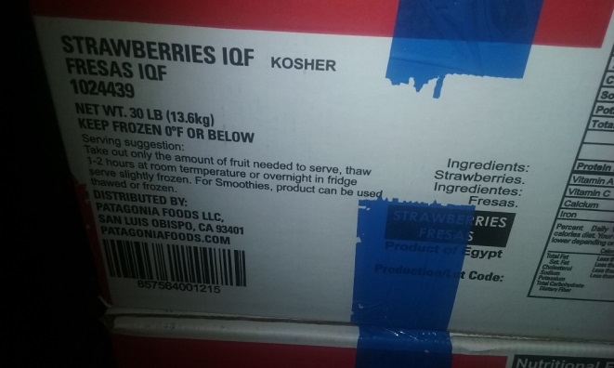
Outbreak of Hepatitis A in Virginia
August 5, 2016: VDH Environmental Health (EH) inspectors visited chain locations and obtained ingredient information for each smoothie and sources for ingredients. Notably, lot identification information on boxes of frozen strawberries was missing and/or inconsistent.
EH Inspectors educated food workers on prevention of cross contamination, cleaning and sanitizing procedures, and employee health reporting requirements to prevent secondary infections.
VDH notified the corporate office of Restaurant Chain A about the outbreak and discovered the frozen strawberries imported from Egypt came from a common source for all retail locations; chain A stopped using Egyptian strawberries in all stores in VA by August 9, 2016.
Notes:
Martin adds ICS part here

Slide 10
Outbreak of Hepatitis A in Virginia
Virginia RRT was activated on August 5, 2016 to facilitate consistent communication from all Virginia agency partners and the FDA during the investigation and began operating under the Incident Command Structure (ICS) with Unified Command for the response.
The VA RRT requested FDA Coordinated Outbreak Response and Evaluation (CORE) network to help coordinate investigational tracebacks in other states and countries; VDH EH was unable to participate on CORE Conference Calls.
The VDACS, VDH, and FDA collaborated to conduct regulatory traceback investigations and collected samples from retail. VDH EH inspectors had limited experience on collection of large quantities of samples and received assistance from DCLS and VDACS.
Notes:
Martin adds ICS part here

Slide 11

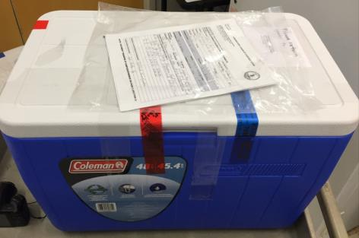
Outbreak of Hepatitis A in Virginia
Traceback analysis identified a single Egyptian firm as the manufacturer of the frozen strawberries linked to the outbreak; several different distribution channels of the product were identified.
The VDACS Food Safety Program placed implicated products under seizure at a cold storage facility in Virginia.
FDA collected frozen strawberry samples from the cold storage facility and at various points along the distribution chain.
Thirteen additional samples of frozen strawberry product were collected by VDH under Chain of Custody from Restaurant Chain A’s implicated Virginia stores and were submitted to DCLS.

Slide 12
Outbreak of Hepatitis A in Virginia
The VA RRT coordinated with FDA to submit 3 retail samples to FDA Office of Regulatory Affairs (ORA) Laboratories for HAV testing.
  An FDA method modification was required for testing frozen strawberries for HAV.
  An additional Hepatitis A outbreak in another part of the country had depleted testing resources which increased testing time.
  Samples deemed “Cannot Rule Out” required confirmatory testing at a second FDA Lab.
In October 2016, FDA’s analysis detected HAV in six of the frozen strawberry samples (2 from Virginia retail locations).
On October 25, 2016, the Egyptian manufacturer recalled all frozen strawberries and frozen strawberry products it imported into the U.S. since January 1, 2016.

Slide 13
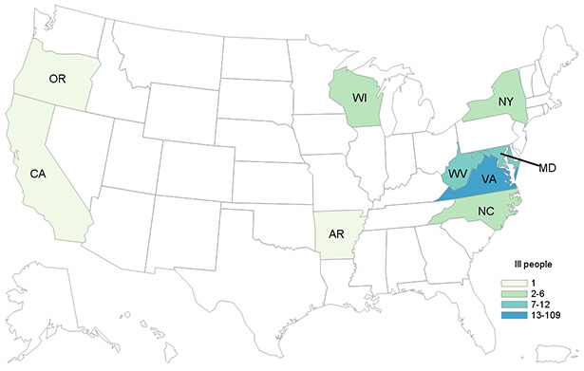
Outbreak of Hepatitis A in Virginia
143 people with Hepatitis A were reported from nine states: Arkansas (1), California (1), Maryland (12), New York (5), North Carolina (4), Oregon (1), Virginia (109), West Virginia (7), and Wisconsin (3); 129 of these cases reported eating a smoothie from Chain A.
Two secondary cases confirmed in Virginia, demonstrating the effectiveness of the public health response
Fourth largest Hepatitis A outbreak recorded in U.S. history (n=143 from 9 states)
Third Hepatitis A outbreak linked to a contaminated food item imported from an HAV endemic country

Slide 14
VA AAR Process
When? - October 28, 2016
Why then ?– No new cases reported for many days, product sampling results completed with confirmation of vector, case patient HAV genotyping completed. The implicated firm(s) involved issued a recall and implicated lots were placed under seizure.
Why an AAR? – Part of a continuous improvement process, discussion and documenting lessons learned helps the team discover the root causes of problems that occurred during the event and will help to avoid those problems in future activations and will increase the effectiveness of the team response.
How? - Examine responses: List what went well and was effective, what needed improvements or was not effective, and determine if any equipment or tools were not provided to complete each task.
Note: Strongly encourage ALL team members to participate!

Slide 15

After Action Report “Hot Wash”
Face to Face/teleconference After Action Review meeting on October 28th
1. AAR SOP and Event Evaluation were distributed by email to the RRT Core team and investigation partners.
  HINT give due dates and reminders
2. RRT Coordinator compiled all comments onto the After Action Form and sent the form back to the RRT Core team and partners for comments and scoring. Opportunities for improvements were hi-lighted.
3. RRT Coordinator issued completed draft of the AAR to team members
4. Improvement plan status updates reviewed and discussed on weekly RRT Conference calls. The team decides on the best method(s) for action to each improvement item. The improvement plan is revised as needed.
Notes:
A lot of new staff on the RRT core team, a face to face meeting gave us the opportunity to meet each other in person, discuss and evaluate the first activation of this year. 12 persons attended the meeting and the FDA EOC called into to the conference call. This works best when the AAR is held just after the event has been determined as closed for the RRT. The VA RRT AAR process is truly a team effort

Slide 16
HAV Response Review: Successes
Success | Factors That Supported Success
Well-coordinated multiagency response- VDACS, VDH DSI, VDH OEHS, DCLS | VA RRT partnership that identifies key points of contact within VA agencies and the FDA BLT DO and a single coordinator to oversee activities between agencies
Identification of HAV outbreaks by VDH Field staff and communication with central office (local, regional and central office Epis) | Good communication and surveillance by Field Epidemiologists to VDH Central Office for coordinated sharing of information and response. Patients did not initially identify “smoothies” as food; District Epis notified and then generated a supplemental questionnaire.
Stopping infections and secondary cases (to date) | Epidemiologist and VDH EH inspector education to food establishment operators and food handlers, reporting requirements, education for patients as a component to every case identified and offering prophylaxis to close contacts.

Slide 17
HAV Response Review: Successes
Success | Factors That Supported Success
Cooperation of industry | Responsive Corporate Support; immediately switched strawberry source from Egypt to Mexico after 6 illness identified
Rapid identification of impacted establishments | EH tracking system for establishments and permit process
Success in food sampling and shipping to FDA | Having DCLS staff trained to perform evidentiary sampling, chain of custody documentation and shipping
Daily case count and updated information about smoothie components for patients | Defined reporting and investigation process with the VDH central office and Field staff

Slide 18
HAV Response Review: Shortcomings
Shortcoming | Recommended Solutions
Challenges with lot numbers-traceability | Firm dependent
Labeling issues with the frozen strawberries, inconsistencies between products from the same sources | No solution for industry, training for staff to recognize this is a potential issue
Sampling procedures for VDH EH | Training video for sampling suggested, in person training, forms or seals that could be used by VDH EH.
Back up commissioned official for primary VDH contacts | Identify backups and mechanisms for alternate to be on 20.88/commissioned calls. Recommend commissioning individuals.
Coordinating through a single POC or defining after hours response plans | Defining among CORE RRT timeline and response plan, then disseminating to field staff
Recommendations varying by state and federal guidance, amount of evidence needed before public notification of health risks
Improvement Plan Developed from Shortcomings List

Slide 19
AARs Improvement Plan following HAV Response
Confirmed the need of all RRT partners to obtain the FDA 20.88 agreement or have commissioned officials.
Confirmed the necessity of constant communication for all involved.
Identified specific training opportunities & equipment needed for field response staff.
Guidance documents for field staff collection and submission of samples under chain of custody needed.
Identified opportunities to educate industry, consumers, and team partners to mitigate the immediate situation and prevent secondary infections.

Slide 20
VA AAR Improvements in Progress
In-person meeting to review sample collection training materials, discuss development of training videos and forms.
Identified an access point for “just-in-time” materials from VDACS website.
Developing a VA RRT webpage on the VDACS site to host linked materials.
Requested a “VA RRT” inbox as a repository for documents shared during the investigation.

Slide 21


Questions??

Slide 22

After Action Reviews (AAR)
For Multi-Agency Responses
Case Study:
Frozen Strawberry Recall
Due to Hepatitis A Virus Concerns
Michigan Rapid Response Team

Slide 23
Incident Timeline
Oct 28 (Fri)
  State Health (MDHHS) and Ag (MDARD) agencies notified by LHD of adult care facility that received recall notice from supplier of imported frozen strawberries. MDARD begins inquiries with FDA about recalled product distribution information.
Oct 30 (Sun)
  Importer recall notice posted to FDA website
Oct 31 (Mon)
  Statewide HAN sent out regarding the recall and PEP guidance. Ag contacts supplier of frozen strawberries requesting distribution lists for recalled product.
Nov 1 (Tues)
  Supplier provides distribution lists - 928 Michigan firms received recalled product.
  Initial state agency conference call to plan and discuss response actions
  DET-DO facilitated discussions with other distributors and verified distribution lists

Slide 24
Incident Timeline - continued
Nov 2 (Wed)
  Ag develops SurveyMonkey to share and collect information
    Provides each LHD with a list of firms/facilities in their jurisdiction that received recalled product
    Gathered firm information and receipt/service of recalled strawberries
Nov 3 (Thurs)
  MDARD and MDHHS host statewide conference call with LHDs, rolling out the survey and outlining the response strategy.
  Daily data cleaning and data summaries.
  State agencies create and maintain a website with list of facilities that report serving the recalled product within the last 14 days
Nov 4 (Fri)
  Updated statewide HAN is sent out with additional communicable disease control information
  857 surveys completed by Nov 4th, over 90% of the total.
Nov 7 (Mon)
  State and LHD conference call to clarify PEP guidance and follow up of establishments
Nov 8 (Tues)
  All surveys are completed statewide.

Slide 25
After Action Review Timeline
Nov 21
  DET-DO coordinates with CORE to ensure MDARD receives FDA CORE AAR survey and is able to incorporate MDHHS and LHD input
Nov 29 - Dec 4
  Health conducts AAR survey of LHD Emergency Program Coordinators
Jan 11 -20
  Ag conducts multi-agency survey of Ag, Health and LHDs
Feb 9
  Multi-agency conference call to discuss survey results and identify priority next steps

Slide 26
AAR Online Survey Results
Survey Dates: 01/11/2017 to 01/20/2017
Survey Response Rates
  Local agencies: 42 / 45
  State agencies: 2 / 2
Respondents
  Rated 5 response attribute/attributes on 1-100
  Provided feedback on identified response areas
    Top positive aspects
    Significant barriers

Slide 27
Ratings of Response Activities
Activity | Effectiveness Rating (100 Point Scale)
General Response Effectiveness | 73
Initial Notifications | 66
Interagency Communication | 73
Within Agency Communications | 81
Public Info/Communications | 69

Slide 28
Response Areas Topics
Feedback Requested
Comments on 14 day Post Exposure Prophylaxis (PEP) window vs 50 day period
PEP Guidance from Health Immunizations Division – clear, concise, and timely?
Need for any more info from Health Immunizations on PEP?
Comments on use of SurveyMonkey for response data collection?

Slide 29
Recommendations To Improve
Multi-Agency Responses from AAR
Use multiple methods to make initial notifications to achieve broad coverage
  Specifically the Michigan Health Alert Network and Michigan Association for Local Public Health listservs
Better utilize existing IT systems to support multi-agency communication and coordination
  Existing webinar and teleconference systems used by some state and local agencies
Capture lessons learned and suggested refinements regarding use of SurveyMonkey for data gathering, reporting, and updating
Notes:
Simple high-level outline of procedures/considerations for launching large scale non-routine multi-agency responses (Initial notifications, briefing(s), and operational plan development)
Breeze software - conference calls
MI-HAN - notifications and document sharing

Slide 30
Sharing Non-Public Information
Single Signature Long-Term Information Sharing Agreements:
FDA and Michigan LHDs
7 of 45 (16%) of Michigan LHDs had these at the time of the response
Likely would have been a barrier to response efforts – LHDs unable to receive distribution information from FDA
Response presented a chance to raise awareness, renew interest and provide an opportunity for FDA outreach
Local, state, and federal agencies working to increase use
Notes:
Since FDA was able to follow-up this incident by coordinating outreach with MDARD to LHDs, additional counties have signed agreements (10 total)

Slide 31
Lessons Learned
Make hot washes/debriefings/AARs a regular part of day-to-day operations
    Scaled appropriately to the response size and complexity
Triage and prioritize incidents to identify the level of AAR formality and documentation needed to support decision-making
    Limit or minimize AAR formality/complexity as a barrier to actually getting it done
Track AAR action items using existing capacity development and continuous process improvement efforts to make sure they get done
    Maintain focus on AAR as a tool to make specific, evidence-based improvements in response capacity

Slide 32
State and FDA District Office
Coordination and Partnership
FDA District Office acted as point of contact for State agencies seeking distribution information for recalled product in Michigan
  Verified the distributor of recalled product in Michigan
  Facilitated contacts with other distributors
  Important because majority of LHDs in Michigan did not have 20.88 agreements in place – could not receive protected information from FDA
FDA District Office served as the conduit for information sharing with FDA CORE during the AAR process
Helped in follow-up with Great Lakes freight ships that received recalled product

Slide 33
Questions?
Justin Henderson
RRT Epidemiologist
Michigan Department of Agriculture
and Rural Development
hendersonj4@Michigan.gov
Lisa Joseph
Emergency Response Coordinator
FDA Detroit District Office
Lisa.Joseph@fda.hhs.gov

Slide 34
“The Best AAR is the One that Gets Done”
Commit to spending time on AAR activities
  Start with taking time to talk about an incident
  Can decide from there whether something needs to be written
Overcoming barriers
  Short & sweet written AARs
  Streamlining approval
    AAR SOP
    ICS can help!
Notes:
Bottom line: “The best AAR is the one that gets done”
Develop a culture where we dedicate time to at least talk about how an incident went and decide what to do – does something need to be written down/improvement plan?
Strategies to overcome barriers:
The bar is set too high: HSEEP compliant, lengthy document
Show what a 1 page AAR template could look like (lessons learned template from AAR chapter?)
Too many people want to edit/sign-off
When is your AAR done? This is where ICS can help us – the AAR is done with the IMT’s IC or UC signs off on it (versus routing through endless layers of approval through multiple agencies/divisions).

Slide 35
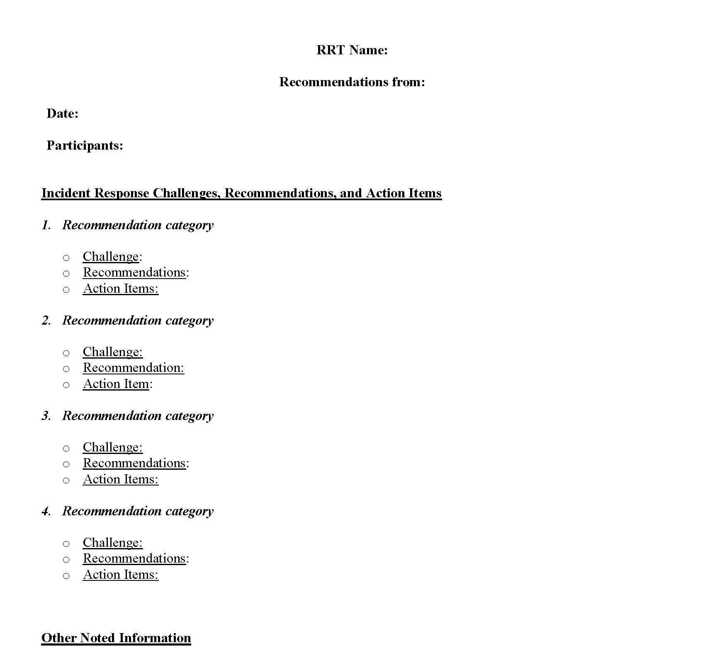

Slide 36
How to begin?
Incremental capacity building is the name of the game
  Start with your own agency, then build out
When adding additional partners
  Consider the ‘what’s in it for me’
  Works best as an add-on to an underlying, pre-established relationship
Develop or leverage a positive incentive system
  Seek management buy-in to institutionalize AAR process
Notes:
Start in your own backyard and build from there (incremental capacity building; just like RRTs!)
Start with a single agency, then State/District, other State Agencies, build out more from there. Continue to build capacity: multi-disciplinary/multi-agency.
Example: LHD outreach and integration as long term effort for RRT (incremental capacity building)
Big(gest) picture: RRTs support the national coordination/response effort, including the national AAR (FDA CORE)
Adding other disciplines/agencies: think ‘what’s in it for me’
Ensure they are benefitting from the AAR process. A positive incentive system/culture.
Example (for epis)
Another way to keep pulling the 3 legs of the stool together, coming to the table, AARs are perfect way to act on that.
This is connected with CDC goals (PHEP grant) – aligned what RRT doing/meeting point.
We want capacity building efforts aligned (so benefits max number of people/initiatives they are plugged into).
Multi-disciplinary/multi-agency AARs are very valuable, but are more complex (Tied to the sign-off barrier mentioned before). It takes time and effort (relationship building) to have a system where this works smoothly and efficiently
Don’t let perfect be the enemy of good: As a starting point, it is better to have your own hotwash and find ways to bring up these topics on standing calls/meetings with other agencies, rather than try to stand up a complex AAR system right off the bat.
Making AARs work for you (and your partners)
Try to get management buy-in to institutionalizing an AAR process: these folks often speak the business language of continuous process improvement and quality systems and will understand/respond to what you’re trying to do when couched in those terms.
Bottom line: AARs don’t have to be big & scary: Don’t let perfect be the enemy of good; and “The best AAR is the one that gets done” (quote attributed to: John Tilden, 3/2/17)

Slide 37
Available Tools & Resources
Best Practices:
  RRT Best Practices Manual (2013), AAR Chapter
    Public Link
  CIFOR Guidelines, 2nd Edition
    Public Link
One Health Systems Mapping and Analysis (OH-SMART)
  Website
  5 minute video
AAR Repositories:
  CIFOR Clearing House
  RRT FoodSHIELD Workgroup (restricted access)
    After Action Exchange Portal (under development)
  Homeland Security Digital Library, Lessons Learned Information Sharing – LLIS (Not food specific)
Notes:
RRT Manual
Detailed description of how to assign roles and structure/run an after action review meeting
Use of Flowcharts to identify communication issues
Templates/Examples: Simple, Medium, Complex, HSEEP, Lessons Learned Report
CIFOR
Section 6.7 After-Action Meetings and Reports
List of what to cover in an After-Action Report
Section 7.5 Multijurisdictional Outbreak Investigations After-Action Reports
BOTH RESOURCES EMPHASIZE:
Scalability: The complexity of the review depends on the size of the outbreak/incident.
Legal concerns: need to be considered when writing (FOI)
Timing:
CIFOR: 1-3 months; mean of 60 days (CDC Preparedness Goal)
RRT: 60 days
OH-SMART
USDA APHIS/One Health Tool
Originally designed for animal disease incidents
Uses a 6-step process to create detailed system maps used to identify opportunities and strengthen system operations
Piloted by MN thus far; hope to expand use among RRTs
Appropriate for larger, more involved incidents
AAX
A secure place (behind log in) to share:
AARs and improvement plans
Metadata associated with AARs
IP items cataloged in a database, which allows for tracking/trending.
Also lets you create/send a hotwash survey and will compile responses
Welcome any input- can set up separate call to walk folks through it.
Anticipated outcomes:
Increased frequency of doing AARs
Increased ease of sharing and finding AAR data in useable format
Identification of national gaps or trends
Interested? We’re happy to have you join our group!
Link to test site home page

Slide 38
Thank You!

