Slide 1
Efforts of the Oregon Health Authority to Address Increased CIDT Usage and its Effects on Epidemiologic Investigation
Julie Hatch, BS, MT(ASCP)
Oregon Public Health Division
Laboratory Surveillance Coordinator
FoodNet Program

Slide 2
CIDTs
Love them
Hate them
What do we do with them?

Slide 3
Testing for Shiga Toxin
Prior to shiga toxin testing, only E. coli O157 was identified by culture.
2009 – first two Oregon labs began routinely testing for shiga toxin as part of a routine stool culture.
Actively began encouraging labs to adopt some form of shiga toxin testing as part of their stool culture.
By end of 2013, 13 labs had incorporated shiga toxin testing.
By end of 2014, 20 labs were running shiga toxin tests.
2017 – Nine labs still not testing for shiga toxin.

Slide 4
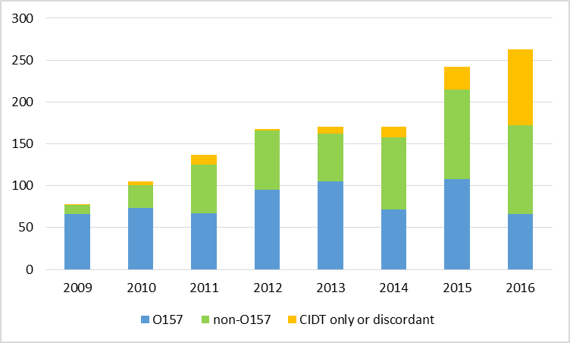
STEC by Year

Slide 5
PCR Testing
2014 – first Oregon lab to use BioFire
GI PCR panels run directly on stool sample.
Multiple organisms tested for at the same time, but don’t have an isolate.
Encourage laboratories to set up reflex cultures.
Submit shiga toxin positive samples immediately to OSPHL.
June 2017 – six labs offer PCR. Three labs offer the provider the choice of GI panel or stool culture, the other three, only offer PCR.

Slide 6
Reflex Cultures
Preferably done by private labs.
If private lab declines, then send positive sample to OSPHL.
Increases burden of testing at OSPHL.
Sacrificed Campylobacter in order to get other pathogens.

Slide 7
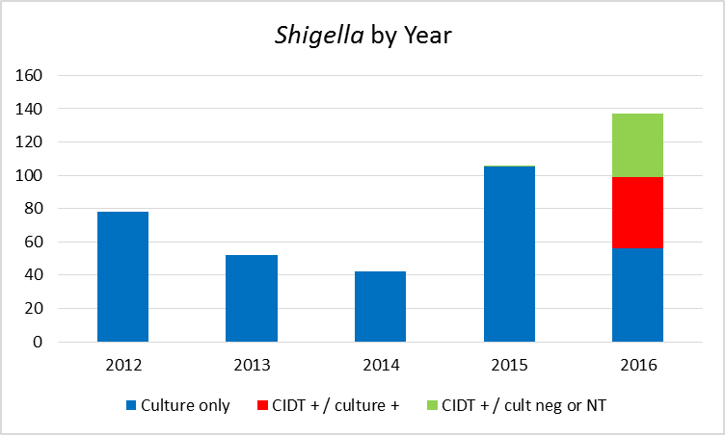
Salmonella and Shigella by Year

Slide 8
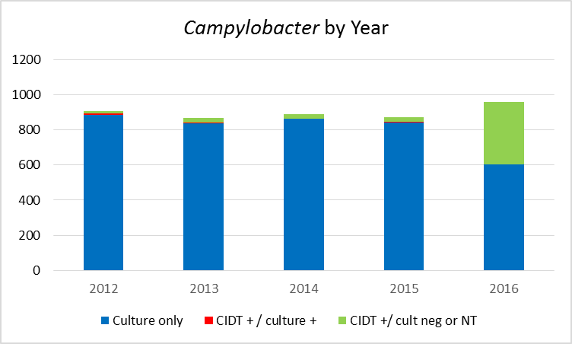
Campylobacter – fewer culture confirmed

Slide 9
Challenges at State & Local Levels
Investigative guidelines updated to address CIDT.
Can’t wait for isolate prior to starting investigation.
Probable cases based on CIDTs add complexity to outbreak investigations.
How do CIDT positives fit in with work and daycare exclusions?
Are case counts really going up, or is it because of increased testing?
Need denominator information.

Slide 10
Negative reflex cultures – possible explanations
Organism is non-viable.
PCR test is more sensitive – too few organisms to recover.
Delay between onset and specimen collection may affect recovery.
Delay in transporting PCR positive specimen to OSPHL.
Antibiotic use prior to collection.
Shigella / EIEC (Enteroinvasive E. coli)

