Slide 1
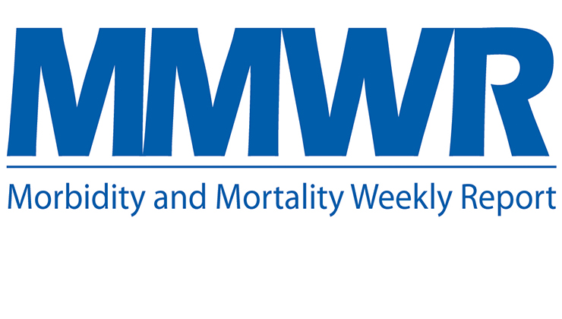
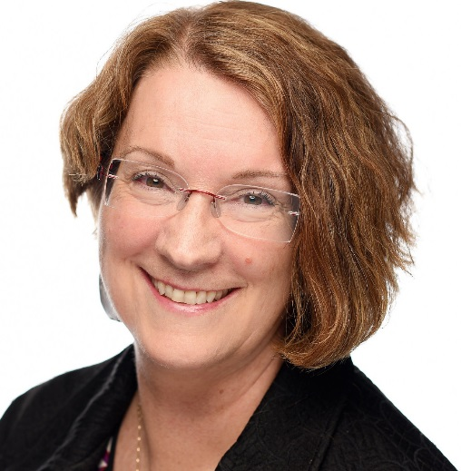
Clear Writing and Successful Navigation of Feedback
Charlotte K. Kent, PhD, MPH
Executive Editor, MMWR Series
2017 CSTE MMWR Intensive Writing Training Course May 1, 2017
Notes:
This is the third in a three part series about writing for MMWR, with much of the guidance relevant for other scientific publications. Our focus on these webinars has been junior authors from state and local health department without a lot of experience in scientific writing. Thus, for those of you participating today and in past webinars with lots of experience writing for other publications, please bear with us. Because today’s webinar will be focused specifically on clear writing and successful navigation of feedback from MMWR, we hope that the webinar will have broad relevance for both experienced and less experience scientific writers wanting to publish in MMWR.

Slide 2
Types of articles in MMWR Weekly
Full Reports
Outbreak Reports
Notes from the Field
Policy Notes
Vital Signs
CDC Grand Rounds
Announcements
QuickStats
Notes:
While there are 8 types of reports/items in the Weekly, the first 3 are what are relevant for state and local health departments submissions. These are Full Reports, Outbreak Reports and Notes from the Field. While Dr. Rasmussen covered some details about these types of reports in the first webinar on March 30, I will be going into more detail about them.

Slide 3
Criteria for Publication
Appropriateness
Originality
Quality
Timeliness
Clarity
Generalist not specialist publication
Notes:
Just as a reminder, I want to quickly review what are the criteria for publication of MMWR reports.

Slide 4
Requirements for MMWR Weekly Full Report/Outbreak Report
Word limit: ~1400
No traditional demarcations except for “Discussion” (e.g., no “Methods” and “Results”)
Reference limit: ≤10
Tables, Figures and Boxes: ≤3
Summary box

Slide 5
Full Report: Lead Paragraph
Similar to both newspaper lead paragraph (who, what, when, where, why, and how?) and abstract in medical journal.
Serves as abstract in PubMed
Limited to 150–200 words
All information regarding methods, data sources, and results repeated elsewhere in report.

Slide 6
Full Report: Lead Paragraph (continued)
Background—What is the problem? Why is this worth writing about?
Method of analysis—Who did what, using what data, and why?
Key findings—Summarize 1 or 2 main results and any actions that resulted.
Public health message—What should be done by public health practitioners or, if relevant, by clinicians or the public?

Slide 7
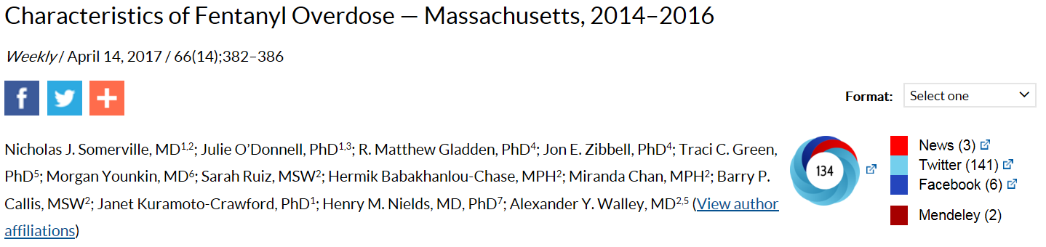
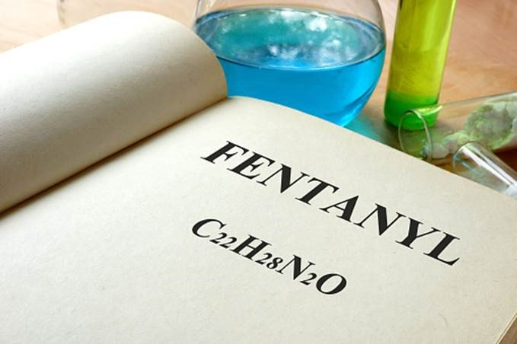

Slide 8
Full Report: Lead Paragraph Background—What is the problem? Why is this worth writing about?
Opioid overdose deaths in Massachusetts increased 150% from 2012 to 2015 (1). The proportion of opioid overdose deaths in the state involving fentanyl, a synthetic, short-acting opioid with 50–100 times the potency of morphine, increased from 32% during 2013–2014 to 74% in the first half of 2016 (1–3).

Slide 9
Full Report: Lead Paragraph Method of analysis—Who did what, using what data, and why?
To guide overdose prevention and response activities (WHY), in April 2016, the Massachusetts Department of Public Health and the Office of the Chief Medical Examiner collaborated with CDC (WHO) to investigate the characteristics of fentanyl overdose in three Massachusetts counties with high opioid overdose death rates.

Slide 10
Full Report: Lead Paragraph Method of analysis—Who did what, using what data, and why? (continued)
In these counties, medical examiner charts of opioid overdose decedents who died during October 1, 2014–March 31, 2015 were reviewed, and during April 2016, interviews were conducted with persons who used illicit opioids and witnessed or experienced an opioid overdose. (WHAT DATA)

Slide 11
Full Report: Lead Paragraph Key findings—Summarize 1 or 2 main results and any actions that resulted.
Approximately two thirds of opioid overdose decedents tested positive for fentanyl on postmortem toxicology. Evidence for rapid progression of fentanyl overdose was common among both fatal and nonfatal overdoses. A majority of interview respondents reported successfully using multiple doses of naloxone, the antidote to opioid overdose, to reverse suspected fentanyl overdoses.

Slide 12
Full Report: Lead Paragraph Public health message—what should be done by public health practitioners or, if relevant, by clinicians or the public?
Expanding and enhancing existing opioid overdose education and prevention programs to include fentanyl-specific messaging and practices could help public health authorities mitigate adverse effects associated with overdoses, especially in communities affected by illicitly manufactured fentanyl.

Slide 13
Question 1:
Which of the following components of the lead paragraph of a Full Report is NOT repeated elsewhere in the report?
Background
Methods
Key findings
Public health message

Slide 14
Question 1:
Which of the following components of the lead paragraph of a Full Report is NOT repeated elsewhere in the report?
Background
Methods
Key findings
Public health message

Slide 15
Outbreak Report: Lead Paragraph
Serves as abstract in PubMed
Establish problem—1‒3 sentences describing existence of outbreak.
Methods of investigation—What done, when, and by whom?
Key findings—Summarize 1 or 2 main results.
Public health response—Actions taken to stem outbreak.
Public health message—State implications and recommend actions in response to investigation.

Slide 16
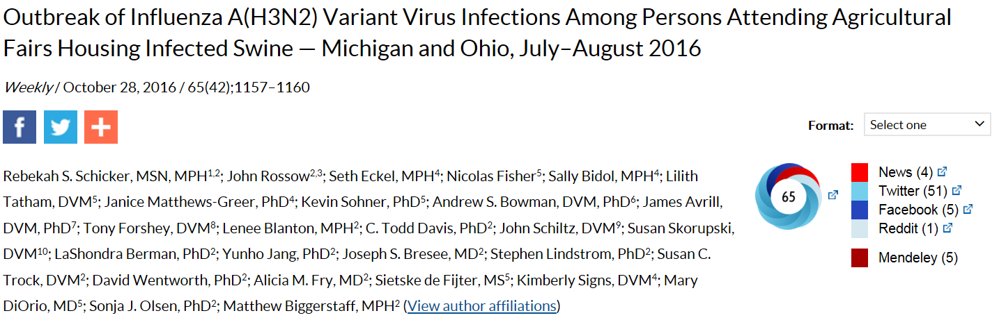
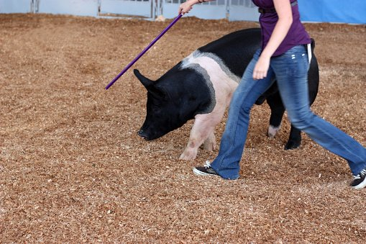

Slide 17
Outbreak Report: Lead Paragraph Establish problem—1‒3 sentences describing existence of outbreak.
On August 3, 2016, the Ohio Department of Health Laboratory reported to CDC that a respiratory specimen collected on July 28 from a male aged 13 years who attended an agricultural fair in Ohio during July 22–29, 2016, and subsequently developed a respiratory illness, tested positive by real-time reverse transcription–polymerase chain reaction (rRT-PCR) for influenza A(H3N2) variant* (H3N2v).

Slide 18
Outbreak Report: Lead Paragraph Establish problem—1‒3 sentences describing existence of outbreak. (continued)
…The next day, CDC was notified of a child aged 9 years who was a swine exhibitor at an agricultural fair in Michigan who became ill on July 29, 2016, and tested positive for H3N2v virus at the Michigan Department of Health and Human Services Laboratory.

Slide 19
Outbreak Report: Lead Paragraph Methods of investigation—What done, when, and by whom? Key findings—Summarize 1 or 2 main results.
Investigations by Michigan and Ohio health authorities identified 18 human infections linked to swine exhibits at agricultural fairs.

Slide 20
Outbreak Report: Lead Paragraph Public health response—Actions taken to stem outbreak.
Notes:
Not every item is covered in all lead paragraphs. In this report the response is not discussed.

Slide 21
Outbreak Report: Lead Paragraph Public health message—State implications and recommend actions in response to investigation.
To minimize transmission of influenza viruses from infected swine to visitors, agricultural fair organizers should consider prevention measures such as shortening the time swine are on the fairgrounds, isolating ill swine, maintaining a veterinarian on call, providing handwashing stations, and prohibiting food and beverages in animal barns.

Slide 22
Outbreak Report: Lead Paragraph Public health message—State implications and recommend actions in response to investigation. (continued)
Persons at high risk for influenza-associated complications should be discouraged from entering swine barns.

Slide 23
Full Reports and Outbreak Reports Summary Boxes
What is already known on this topic?
What is added by this report?
What are the implications for public health practice?
1‒2 sentence response per question written in very clear style.
Notes:
If you are using a mobile device to read MMWR content online, the summary box is the first thing that people will read. Last year, JAMA started having something similar to the Summary Box, because readers want a very quick summary, even shorter than a traditional abstract. Content of the summary box is often the basis for social media messages. Thus, the summary box is very important for communicating your most important points. It should not just be an after thought.
As Dr. Rasmussen mentioned before, creating the summary box could be your first step in focusing your thinking about what you want to convey.

Slide 24
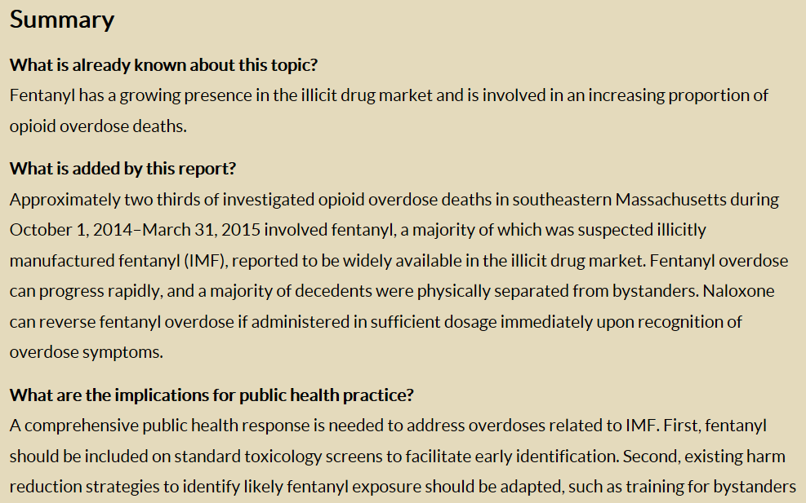

Slide 25
Requirements for MMWR Weekly Notes from the Field
Abbreviated reports of ongoing or recent events of concern to the public health community
Early information, preliminary results, and other similarly incomplete information
Word limit: ~500
Reference limit: absolute minimum
Tables, Figures and Boxes: ≤1

Slide 26
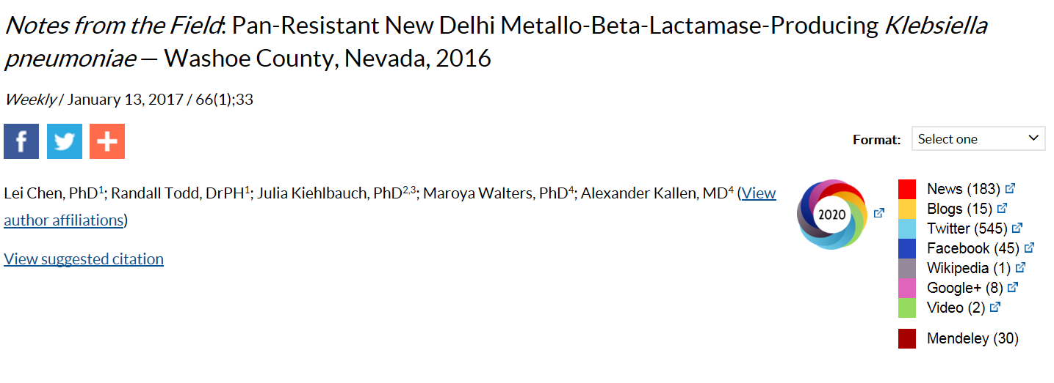

Slide 27
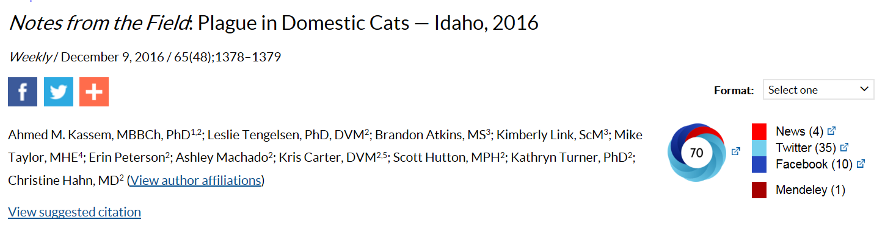
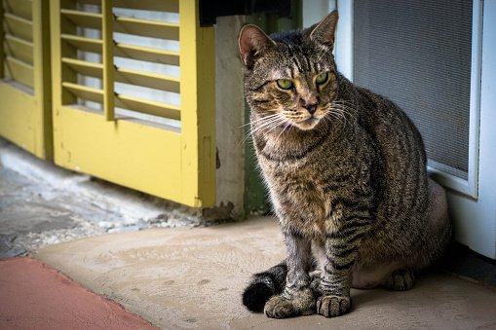

Slide 28
Question 2:
You want to describe lead poisoning among refugee children during the last five years in your state. What type of report would you write?
Full Report
Outbreak Report
Notes from the Field

Slide 29
Question 2:
You want to describe lead poisoning among refugee children during the last five years in your state. What type of report would you write?
Full Report
Outbreak Report
Notes from the Field

Slide 30
Tips for Publishing in MMWR
Read lots of MMWR reports
Familiarize yourself with format, style, and types of articles accepted
Find an example article
Get feedback by giving a presentation on your study
Put yourself in the position of a reader
For MMWR, this should be a generalist, not a specialist
Notes:
This slide and the next Dr. Rasmussen used in the first webinar. Because they are so important I will repeat them.

Slide 31
Common Errors
Failure to follow instructions for authors
Poor organization
Overly complex sentence structure
Meandering discussion
Use of jargon and too many acronyms
Use of first person (MMWR is considered the “voice of CDC”)

Slide 32
Question 3:
Which of the following is NOT a common error in writing for MMWR?
Failure to follow instructions for authors
Clear focus
Use of jargon
Use of first person

Slide 33
Question 3:
Which of the following is NOT a common error in writing for MMWR?
Failure to follow instructions for authors
Clear focus
Use of jargon
Use of first person

Slide 34
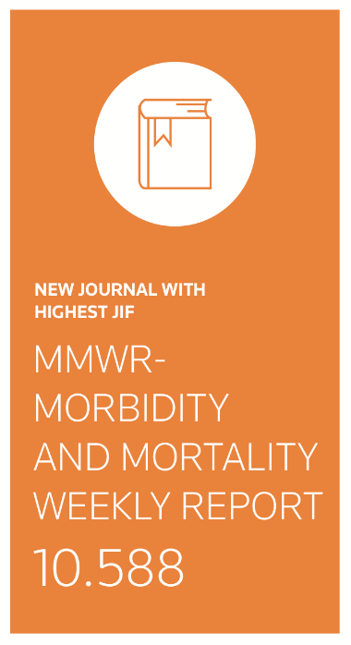
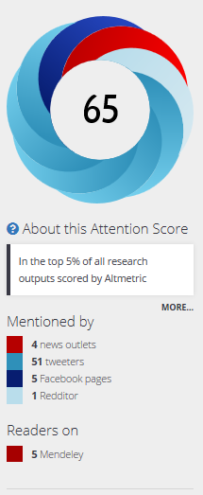
Strategies to navigate MMWR submission, review, clearance, acceptance, and production
Notes:
There are more reviews and quicker production on MMWR than with other scientific journals, which can stressful for authors. However, it is important to remember that by publishing in MMWR that your public health messages will likely be communicated widely.

Slide 35
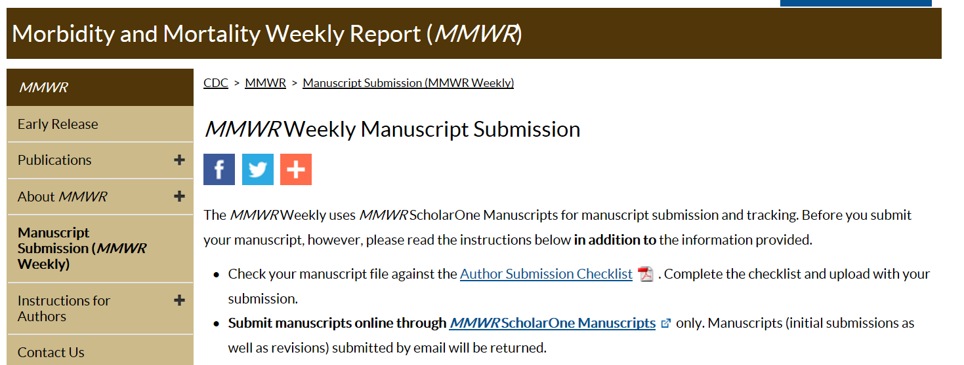

Slide 37
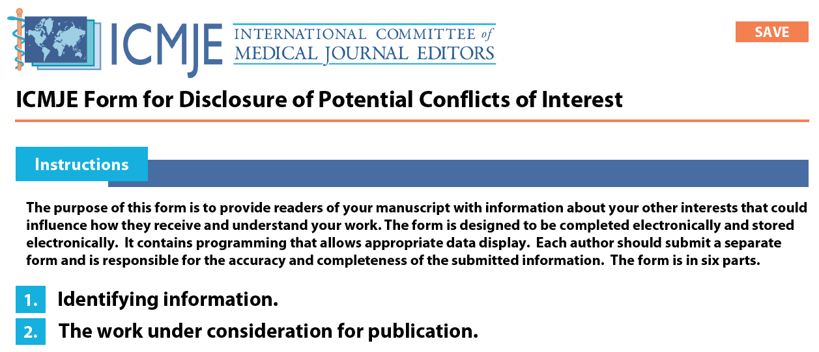

Slide 38
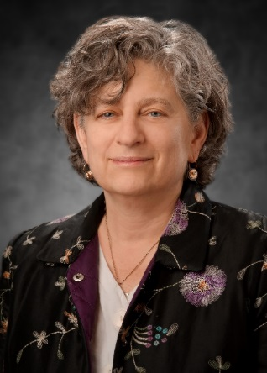
Science Editor Review Jacqueline Gindler, MD Editor, MMWR Weekly
First series of reviews
Determines if we think will be of interest to our readers
If no CDC authors, prepares for review by CDC subject matters experts ‒ CDC Clearance
Usually comments to improve clarity and science from generalist perspective
Respond as you would for peer-review

Slide 39
CDC Clearance
Outside authors are not required to have a CDC coauthor to submit their report.
MMWR only publishes reports that have been cleared according to CDC and MMWR policies. Prior to submission, reports should be cleared by:
Health departments involved in report (for states usually state epidemiologist)
Private or public sector organizations at which any named contributor is employed

Slide 40
Navigating CDC Clearance
Respond as you would for peer-review
Usually takes time (weeks to months)
Editor, MMWR Weekly will be your point of contact
Once cleared, your report can be provisionally accepted
More reviews during production

Slide 41
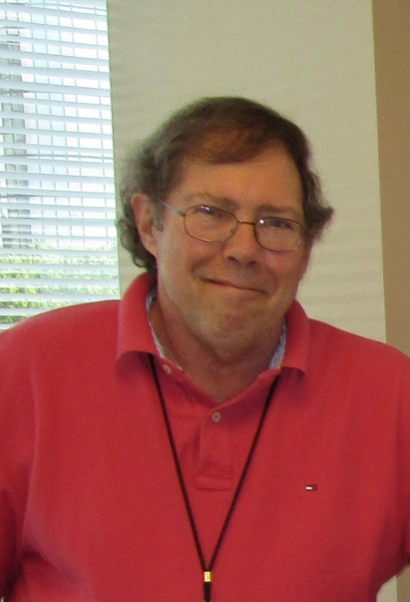
Scheduling Report for Publication
Doug Weatherwax – Team Lead
Corresponding author must be readily available during 5 days of production process
Notes:
Doug will work with you to schedule your report for a time that is good for you. He also will assign the technical writer editor that will be working with you during production.

Slide 42
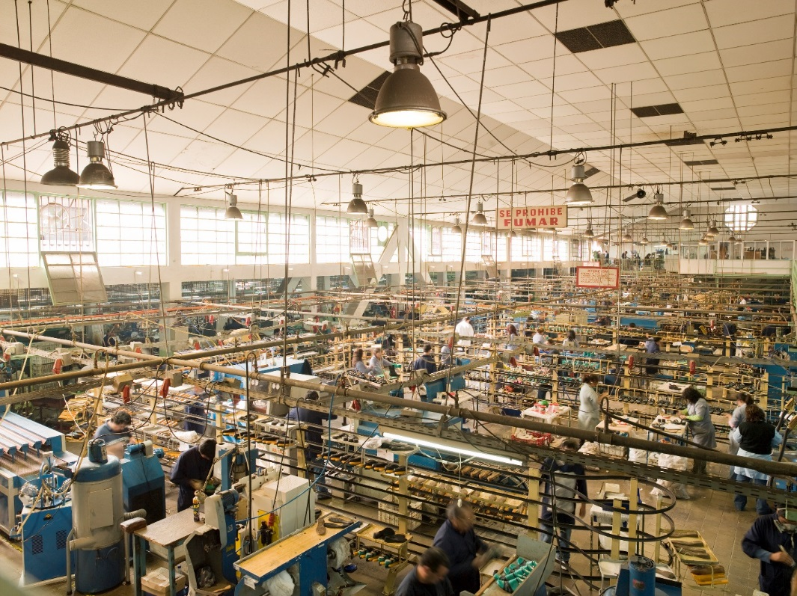

Slide 43


Slide 44
Review during production
Often CDC Director/other senior leaders
Office of the Associate Director of Science
MMWR – Editor-in-Chief and Editor, Weekly
Level 1 (L1) – must address or clearly explain rationale for not doing so
L2 – if data supports then include, otherwise do not
L3 – I’m curious, but decision to include or not rests with authors

Slide 45
Production – All times are Eastern
FRIDAY
9–10 am Authors are sent questions, comments, and/or suggested edits from reviewers of the unedited draft.
Any responses received by 12 pm can be incorporated into FIRST PROOF.
By 4 pm Authors (and reviewers) are sent the FIRST PROOF and any supports (figures, tables, boxes).

Slide 46
Production – All times are Eastern
MONDAY
8 am Deadline for authors to provide corrections or changes to FIRST PROOF.
9–10 am Authors are sent questions, comments, and/or suggested edits from reviewers.
Any responses received by 12 pm can be incorporated into SECOND PROOF.
12–2 pm Authors (and reviewers) are sent the SECOND PROOF.

Slide 47
Production – All times are Eastern
TUESDAY
8 am Deadline for authors to provide corrections or changes to SECOND PROOF.
9–10 am Authors are sent the FINAL PROOF with any additional questions, comments, and/or suggested edits from reviewers.
12 pm Deadline for authors to communicate any FINAL corrections or changes.
Post-production of the issue begins.

Slide 48
Production – All times are Eastern
WEDNESDAY
By 4 pm An eBook (PDF) of the issue is released to the media, printer, and others, with contents embargoed until the issue is posted online at 1 pm Thursday.
THURSDAY
1 pm E-mail distribution of issue to subscribers and online posting on the MMWR website.

Slide 49
Question 5:
Which of the following is NOT true?
Usually CDC clearance takes at least a month.
There are multiple reviews by multiple CDC experts and leaders from submission through publication.
You must be readily available during the entire 9-day production process.

Slide 50
Question 5:
Which of the following is NOT true?
Usually CDC clearance takes at least a month.
There are multiple reviews by multiple CDC experts and leaders from submission through publication.
You must be readily available during the entire 9-day production process.

Slide 51
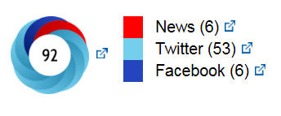
Preparing for media
If CDC author
CDC might do press release
CDC program clears communication messages
Need to coordinate messaging with health department and other collaborators
If no CDC authors
CDC will NOT do press release
Authors’ organizations responsible for communication with media
MMWR
Level 1 (L1) – must address or clearly explain rationale for not doing so.
L2 – if data supports then include, otherwise don’t.
L3 – I’m curious, but decision to include or not rests with authors.

Slide 52
MMWR and Social Media
Usually MMWR promotes reports on social media
Jamey Giddens – MMWR communications
Requires appropriate images for social media and web
Requires approved social media messages
Ideal to have images and messages ready before First Proof
Notes:
Now let’s talk about MMWR and social media.

Slide 53
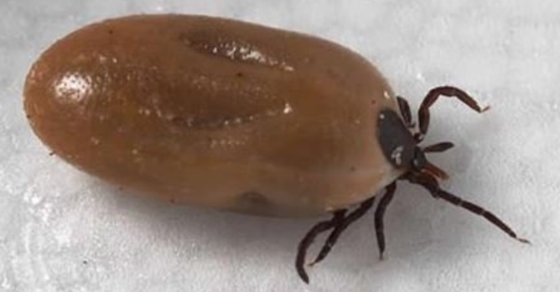
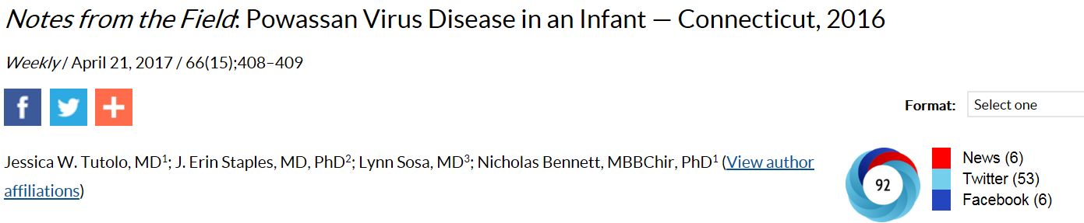

Slide 54
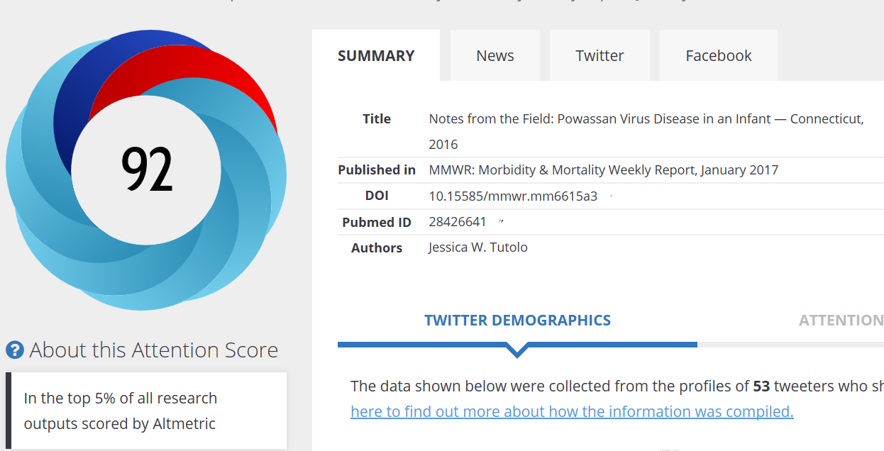

Slide 55
Questions
For more information please contact: Charlotte K. Kent, PhD, MPH cgk3@cdc.gov

