Slide 1
Stage 1 Meaningful Use & Reportable Lab Results
OSELS
Public Health Informatics and Technology Program Office

Slide 2
Presentation Outline
Basics of Meaningful Use
Specifics of Reportable Lab Results
FAQs

Slide 3
MEANINGFUL Use : Basics

Slide 4
Meaningful Use: Terminology
CMS- Centers for Medicare & Medicaid Services
ONC- Office of National Coordinator for Health Information Technology
EP- Eligible Professional
EH- Eligible Hospital
CAH- Critical Access Hospital
MU- Meaningful Use
NACCHO- National Association of County & City Health Officials
JPHIT- Joint Public Health Informatics Taskforce
PHIN – Public Health Information Network
OSELS- Office of Surveillance, Epidemiology and Laboratory Services
CSTE- Council of State & Territorial Epidemiologists

Slide 5
What is EHR Meaningful Use?
Meaningful Use has been defined by 3 requirements-:
Use of certified EHR technology in a meaningful manner
Ensuring that this technology can electronically exchange health information to improve quality of care
Ensuring that the providers of this technology submit information on quality of care and other selected measures to Secretary HHS
Notes:
Meaningful Use can also be described as:
-the use of health information technology to further the goals of information exchange amongst healthcare professionals
-health information technology enabled health reform
-the application of health information technology to improve individual and population health

Slide 6
Meaningful Use :
The Regulations
  Incentive Program for Electronic Health Records: Issued by the Centers for Medicare & Medicaid Services (CMS), this final rule defines the minimum requirements that EH and EP must achieve using their certified EHR technology in order to qualify for the payments.
  Standards and Certification Criteria for Electronic Health Records: Issued by the Office of the National Coordinator (ONC) for Health Information Technology, this rule identifies the standards and certification criteria for EHR technology.
Notes:
Under the HITECH act, eligible health care professionals and hospitals can qualify for Medicare and Medicaid incentive payments when they adopt certified EHR technology and use it to achieve specified objectives. Two regulations have been released; one of which defines the “meaningful use” objectives that providers must meet to qualify for the bonus payments known as the Incentive Program for Electronic Health Records and the other which identifies the technical capabilities required for certified EHR technology known as the Standards & Permanent Certification Criteria for Electronic Health Records.

Slide 7
What are the goals of Meaningful Use?
Improve quality, safety, efficiency, and reduce health disparities
Engage patients and families
Improve care coordination
Ensure adequate privacy & security protections for personal health information
Improve Population and Public Health

Slide 8
Achieving : EHR Meaningful Use
2009
2011
2013
2015
HIT-Enabled Health Reform
Meaningful Use Criteria
HITECH Policies
2011 Meaningful Use Criteria (Capture/share data)
2013 Meaningful Use Criteria
(Advanced care processes with decision support)
2015 Meaningful Use Criteria (Improved Outcomes)
Source : Centers for Medicare & Medicaid Services (CMS)
Notes:
This slide mentions the key dates associated with electronic health records “meaningful use”. The ball began to roll on Feb 17, 2009 with the American Recovery and Reinvestment Act 2009 also known as ARRA; one of the provisions of which include the “HITECH Act”, which stands for Health Information Technology for Economic & Clinical Health. As a result of these efforts on Jan 13, 2010, the Medicare & Medicaid EHR Incentive Program was born, also commonly known as “Meaningful Use”. The final rules on meaningful use were displayed by CMS & ONC on July 13, 2010, published in the federal register on July 28, 2010 and became effective as regulations on Sept 26, 2010. The registration process for the incentive program began on Jan 3, 2011 and the incentive payments are expected to begin on May 1, 2011.
EHR Meaningful Use is a part of an evolutionary path and incremental growth has been proposed through three stages: 2011 marked the Stage 1, which involves data capture and sharing like e-Prescribing, Lab results into EHR’s and Public health reporting, 2013 will see the onset of Stage 2 requirements, that will deal with advanced clinical processes like patient Personal Health Record (PHR) access, electronic summary records and receiving health alerts and immunization information, and Stage 3 in 2015 will strive to achieve improved outcomes and provide access to comprehensive patient data and automated real-time surveillance.
This slide also displays how the health information technology enabled health reform will move through the years ahead.

Slide 9
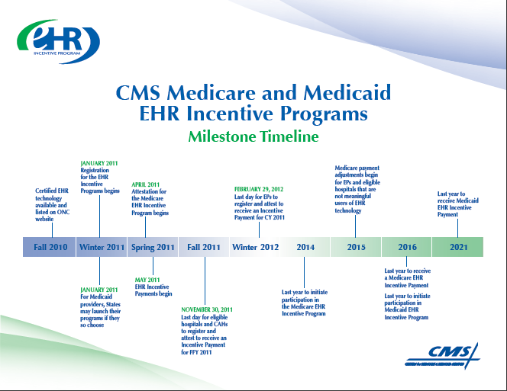
Notes:
This slide includes the milestones and timelines for the CMS Medicare & Medicaid EHR Incentive Programs.
This is a voluntary program, however starting Jan. 2016 there is a penalty clause built-in, which will result in negative adjustment to fees is for Medicare program only.
Notice of Proposed Rule Making (NPRM) for Stage II of Meaningful Use will be available in Jan 2012.

Slide 10
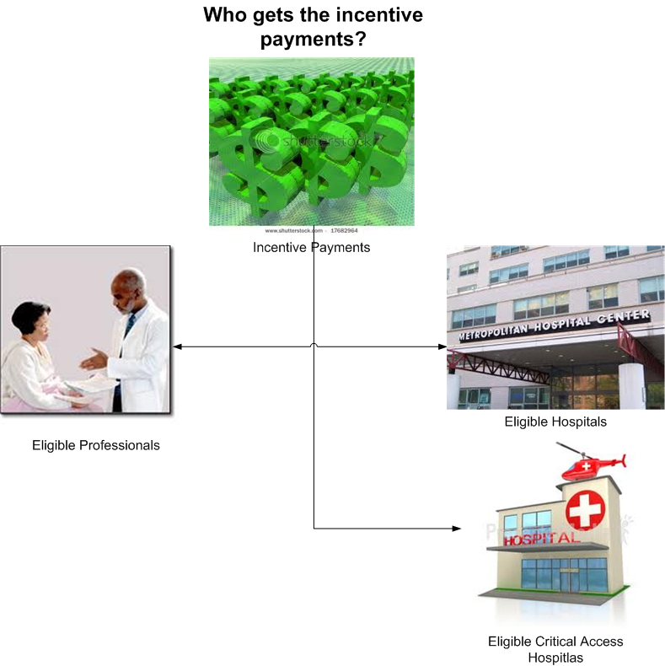
Who will get the incentive?
Notes:
This slide illustrates for electronic health records ‘meaningful use’, the entities who can claim the incentive- the eligible professionals also known as the EP’s and eligible hospitals or critical access hospitals which go by the acronym EH or CAH, respectively. For example, the eligible professionals will get $44,000 over a five-year period through Medicare and $63,750 for Medicaid over six years.

Slide 11
Public Health Objectives : Electronic Health Records Meaningful Use
Stage 1 Meaningful Use has 3 Public Health objectives* which require capability to submit electronic data to:
  Immunization Registries or Immunization Information Systems (IIS)
  Syndromic Surveillance
  Reportable Lab results / Electronic Lab Reporting [ELR]
* Must choose at least one for Stage I

Slide 12
Reportable LAB Results In MU : SPECIFICS

Slide 13
MU Reportable Lab Results
Reportable Lab Results, in meaningful use, refers to the electronic reporting of specified laboratory test results to public health officials by eligible hospitals in accordance with applicable law (state/local) and practice as per the standards and specifications of the Final Rule for MU Stage I.

Slide 14
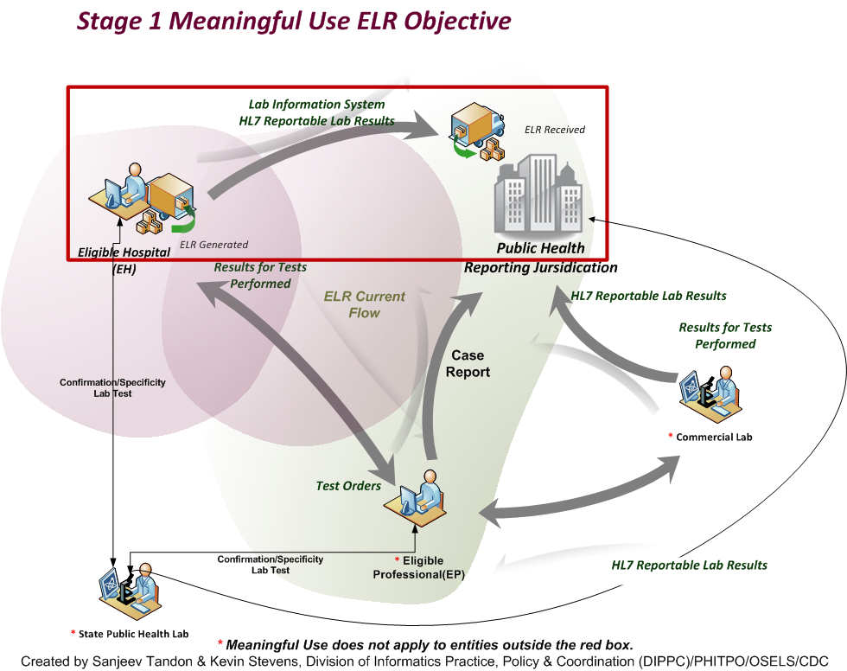
MU Stage 1 Reportable Lab Results Flow
14
Notes:
This slide illustrates ELR and Case Reporting flows. The MU Stage 1 reportable lab results flow is demarcated within the red box and shows the flow from eligible hospitals to public health reporting jurisdictions.

Slide 15
PH Receiving Scenarios
Scenario 1
Scenario 2
Scenario 3
Complete
EHR
And/or
And/or
EHR
LIMS
EHR
LIMS
Hospital
ONC Compliant Messages
Directly to PH
Directly to PH
HIE
(Routing to PH, with Transformation of Message format)
HIE
(Routing to PH, No Transformation of Message format)
HIE
(Routing to PH, No Transformation of Message format)
HIE / HUB
Compliant Messages
Message Receiver
Message Receiver
Message Receiver
Public Health
Data Stores and Applications
Data Stores and Applications
Data Stores and Applications
Eligible hospitals or HIE must certify all modules, since EHR is not performing all the MU functions
Notes:
Stage 1 of Meaningful Use provides incentives to eligible hospitals for sending reportable lab results to PH agencies.
This depicts three possible scenarios under which results could be sent:
From a certified complete EHR system
From an Laboratory Information Management System (LIMS) if it is part of an integrated, certified EHR modular system. This may be routed either directly or through an HIE that receives meaningful use compliant lab results messages and routes them to public health
Through an HIE that transforms message format to make it a meaningful use compliant lab results message before routing to public health. In this case the HIE message transformation component must be certified as part of the integrated EHR component system.
Other scenarios are also possible.

Slide 16
Standards and Specifications for Reportable Lab Results
Section 170.205(c):
  Electronic submission of lab results to public health agencies. Standard. HL7 2.5.1 (incorporated by reference in § 170.299).
  Implementation specifications. HL7 Version 2.5.1
  Implementation Guide: Electronic Laboratory Reporting to Public Health, Release 1 (US Realm) (incorporated by reference in § 170.299).
  HL7 Version 2.5.1 Implementation Guide: Electronic Laboratory Reporting to Public Health can be purchased from here: https://www.hl7.org/store/index.cfm?ref=nav
16

Slide 17
On-Boarding Terminology
Certification
Pre-Testing
Testing
Attestation
In Queue
Validation
Production
Electronic health records (EHRs) and modules go through the certification process to ensure they meet meaningful use objectives &specified standards
Eligible hospitals (EH) and eligible professionals (EP) determine whether their message passes basic format and content compliance
EH/EP exchange messages with public health agency (PHA) to ensure they they contain the correct format and values as determined by the PHA
EH/EP need documentation that they have performed a test
Follows successful testing
Public health evaluation of new electronic data.
EH/EP continuously send information to the PHA. Data flows are monitored for quality assurance
Notes:
Certification
Electronic health records (EHRs) and modules go through the certification process to ensure they meet meaningful use objectives &specified standards
National Institute of Standards and Technology (NIST), and the Office of the National Coordinator (ONC) provides HIT implementers with access to the tools needed to test their implementation. http://xreg2.nist.gov/hit-testing/
Certification process is performed by the Authorized Testing and Certification Bodies (ATCB)
Modular Certification-Eligible hospitals must certify all modules if they are using parts in combination (e.g. EHR + LIMS + HIE for MU functions)
Pre-Testing
Eligible hospitals (EH) and eligible professionals (EP) can use the State parser or the CDC's Message Quality Framework (MQF) to determine whether their message passes basic format and content compliance
MQF is a flexible framework of services and utilities designed to assist public health partners with preparing and communicating quality standard electronic messages https://phinmqf.cdc.gov/
Testing
Eligible hospitals/eligible professionals exchange messages with public health agency (PHA) to ensure that they contain the correct format and values as determined by the PHA
Attestation
Eligible hospitals/eligible professionals need documentation that they have performed a test (whether they are successful or not) to meet Stage I (for year one only a test is needed*) and follow-up submission if the test is successful (unless none of the public health agencies to which an EP submits such information has the capacity to receive the information electronically)
In Queue
Follows successful testing
PHA may queue eligible hospitals/eligible professionals for validation at a later date
Validation
Public health evaluation of new electronic data.
Comparison with paper submission or previous electronic data flows
Production
Eligible hospitals/eligible professionals continuously send information to the PHA. Data flows are monitored for quality assurance

Slide 18
Hospital Certification for MU Stage I
Certification
Process that electronic health records (EHRs) and modules go through to ensure they meet meaningful use objectives and specified standards.
Standards for testing are published by National Institute of Standards and Technology (NIST).
Certification process is performed by the Authorized Testing and Certification Bodies (ATCB).
Notes:
Certification- Process where EHR is certified by an ONC approved certifying body.
HL7 compliant for IIS, ELR, SS messaging requirements
Messages can contain the appropriate vocabulary
Emphasize: Not a public health certification.
Testing- Process where the EH/EP exchange messages with PHA to get the correct format and values as determined by public health agency
In Queue- Follows testing, EH/EP may be prioritized by public health for validation at a later date.
Validation- Public health evaluation of new electronic data. Comparison with paper submission or previous electronic data flows.

Slide 19
Reportable Lab Results : Testing Resource for Hospitals
  National Institute for Standards Testing (NIST) -Test Procedure for Reportable Lab Results
  Describes test procedure for evaluating conformance of complete EHRs or EHR modules http://healthcare.nist.gov/docs/170.306.g_Reportable Lab Results
19

Slide 20
Testing Resources for Public Health
  Two public health message validations tools are available from CDC:
  A national-level tool: Message Quality Framework (MQF).
  A state-level tool: Message Subscription Service (MSS).
  Other non-CDC public health testing tools are available such as Rhapsody and Message Workbench.
  Automated testing tools ensure messages are adhering to standards defined in the messaging guides by:
  validating the structure of the message
  validating that the messages are following the business rules defined for the message
  verifying that the vocabulary defined for the message is utilized.

Slide 21
Frequently Asked Questions (FAQs)

Slide 22
Why did HL7 V2.5.1 get selected as the standard for reportable lab results?
  HL7 2.5.1 requires the use of LOINC standards and also includes a number of enhancements:
    Addition of the specimen segment in HL7 V2.5.1
    Features to address issues about laboratory reporting and CLIA compliance (performing organization name & address, medical director).
22

Slide 23
Is the use of SNOMED mandated in Stage I of MU for Implementation of Reportable Lab Results?
  2.5.1. ELR Implementation Guide specifies a number of vocabulary standards to be followed which includes SNOMED.
23

Slide 24
Can a hospital send reportable lab results messages from their LIS and qualify for MU?
Yes, if the LIS is a certified module in as part of the hospital’s EHR solution, the LIS can help it qualify for MU.
ONC has a website that displays which EHRs and LIS modules are certified for Meaningful Use
  http://onc-chpl.force.com/ehrcert
24
Notes:
From the final rule for the permanent certification program – pg 5
the temporary certification program will sunset on December 31, 2011, or on a subsequent
date if the permanent certification program is not fully constituted at that time.
Testing and certification under the permanent certification program is expected to begin on January
1, 2012, or upon a subsequent date when the National Coordinator determines that the permanent
certification program is fully constituted.

Slide 25
Does each jurisdiction need to have an implementation plan for ELR MU?
There isn’t a requirement for a public health agency to have an implementation plan, though it would be a good idea.
Public health agencies are being contacted by EH and EP who are looking to send data to public health.
Jurisdictions should consider how they will deal with healthcare providers and how they will work with their state Medicaid agencies.

Slide 26

What HITECH funding is available to support ELR MU?
Infrastructure and Interoperability Support for Public Health Laboratories
  Supports 10 Epi and Lab Capacity (ELC) grantees
Electronic Laboratory Reporting Technical Assistance (ELR TA)
Laboratory Technical Implementation Assistance for Public Health (LTIAPH)
Laboratory Interoperability Cooperative (LIC)
Laboratory Interoperability and Enterprise Architecture Solutions
26
Notes:
HITECH funding also supports activities to advance electronic submission of reportable lab results to public health.
Infrastructure and Interoperability Support for Public health Laboratories - Supports 10 states to enable electronic lab reporting from their public health labs to the public health disease surveillance systems. This also supports public health lab reports to EHRs and in some cases, the electronic order of public health lab tests from an EHR and return of those results to the EHR.
ELR TA – This project includes funds to support public health agencies (grantees), as part of 2011 ELC ACA Cooperative Agreement, in implementing ELR. The ELR TA model, funds APHL to provide technical assistance to state and local health departments for design, development, testing, installation and deployment of technologies to support ELR.
LTIAPH - This technical assistance award provides short term help for public health laboratories. The LTIAPH model, funds APHL to provide technical assistance to public health laboratories to implement ELR in the jurisdictions – for example, instead of hiring a vocabulary specialist to do mapping of local codes to standard codes a state can get this type of help from this group.
LIC - The LIC is a 2-year cooperative agreement funded by the Centers for Disease Control and Prevention to recruit, educate, and electronically connect 500 hospital laboratories (including 100 Critical Access Hospitals) with public health agencies to implement MU ELR (submission of electronic data on reportable laboratory results to public health agencies). LIC members include the American Hospital Association (AHA), the College of American Pathologists (CAP), and Surescripts. LIC services include outreach and recruitment, technical assistance, and support for ongoing operations.
Laboratory Interoperability and Entrerprise Architecture Solutions - is intended to ensure that these activities are done in a coordinated and interoperable way so we don’t establish our own laboratory network stovepipe.

Slide 27
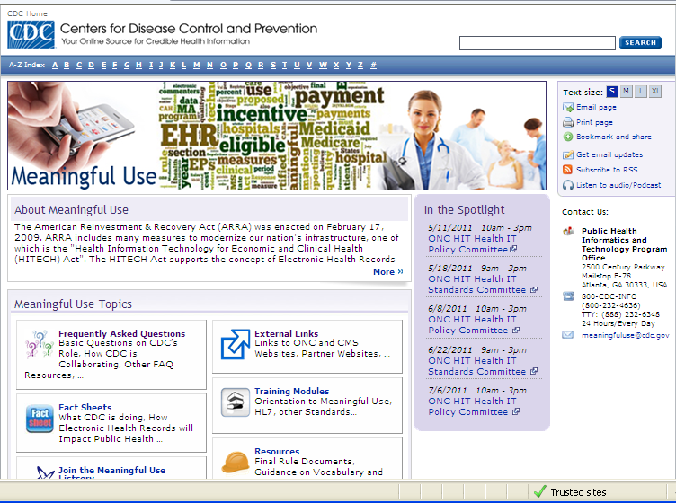
Resources
www.cdc.gov/ehrmeaningfuluse

Slide 28
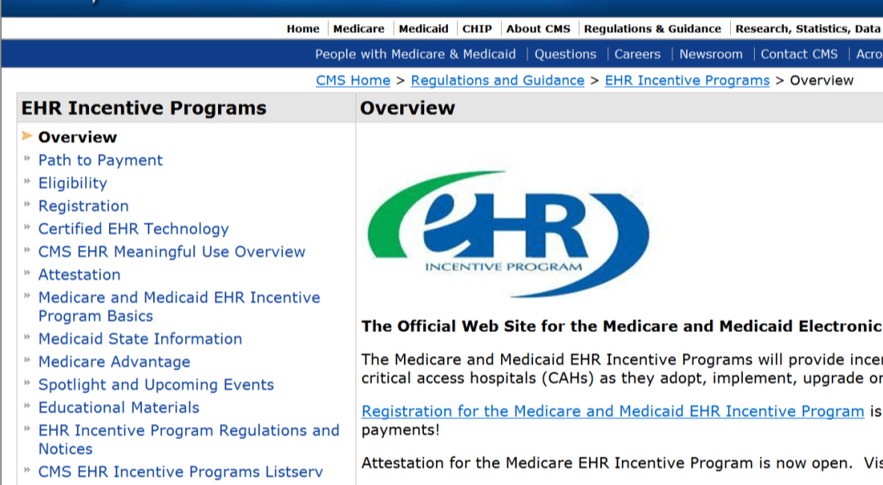
Resources
Get information, FAQs, tip sheets and more at CMS’ s official website for the EHR incentive programs:
  www.cms.gov/EHRIncentivePrograms

Slide 29
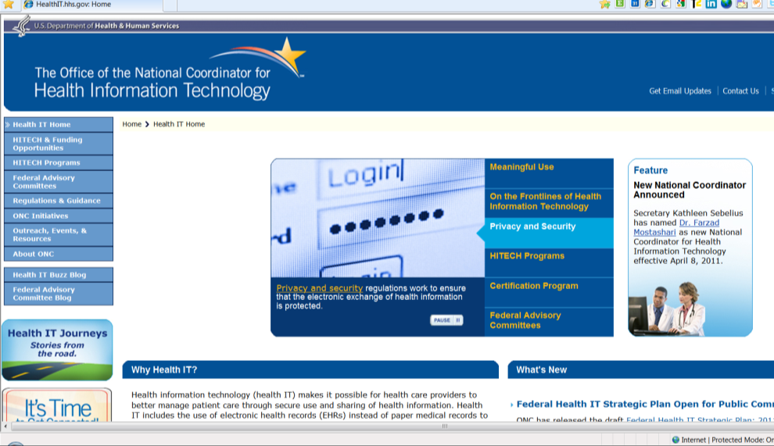
Resources
Learn about certification and certified EHRs, as well as other ONC programs designed to support providers as they make the transition: http://healthit.hhs.gov

