Slide 1
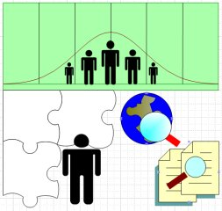
Evaluation of Public Health
Surveillance Systems
CSTE Applied Epidemiology Fellowship Orientation - 2010
Sam Groseclose, DVM, MPH
Division of Healthcare Information (proposed)
PHSPO, OSELS (proposed)
sgroseclose@cdc.gov
Phone: 404-498-0127
Notes:
Not presenting this from an informatics perspective rather focus is on information process and content and how it supports surveillance process leading to public health action

Slide 2
Objectives
Review steps in organizing & conducting surveillance system evaluation
Describe surveillance system attributes that should be assessed or measured
Describe how evaluation of surveillance system for outbreak detection differs from one for individual cases
Notes:
+ Introduce you to some examples from published evaluations.

Slide 3
“Public health surveillance is the ongoing, systematic collection, analysis, interpretation, and dissemination of data regarding a health-related event for use in public health action to reduce morbidity and mortality and to improve health.”
CDC. Updated guidelines for evaluating public health surveillance systems. MMWR 2001;50 (No. RR-13)

Slide 4
“Public health surveillance is the ongoing, systematic collection, analysis, interpretation, and dissemination of data regarding a health-related event for use in public health action to reduce morbidity and mortality and to improve health.”
CDC. Updated guidelines for evaluating public health surveillance systems. MMWR 2001;50 (No. RR-13)

Slide 5
When to evaluate a surveillance system?
Notes:
Are objectives being met? Still relevant?
Is outcome under surveillance still of public health importance?
Is monitoring efficient & effective?
Changes in priorities, epidemiology, and diagnostic procedures can necessitate an evaluation.
As a result of an evaluation, certain system attributes, such as the ability to detect a health-related event, etc., can be improved.
Revision of case definitions occurs during
outbreak investigation as knowledge increases
Novel events
Evaluation may occur when new data source becomes available

Slide 6
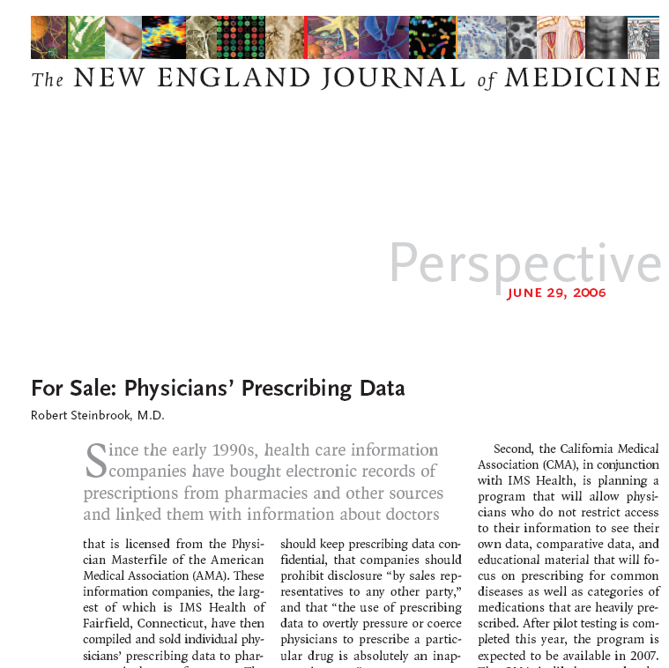

Slide 8
CDC’s Updated Guidelines for Evaluating Public Health Surveillance Systems, 2001

Slide 9
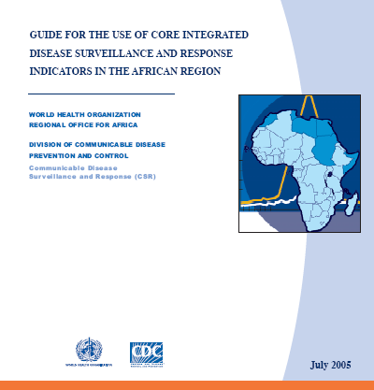
Examples of other guidance
on public health surveillance monitoring & evaluation
Notes:
References provided.

Slide 10
Surveillance evaluation tasks
Engage stakeholders
Describe system
Focus evaluation design
Gather evidence of system’s performance
State conclusions & make recommendations
Ensure use of findings & share lessons learned
Notes:
These six tasks comprise CDC’s recommendations for evaluating public health surveillance systems.

Slide 11
Task A. Engage stakeholders
Who are the system stakeholders?
  Ask your supervisor/colleagues
  Who is funding the system?
  Who uses information derived from system?
Scope, level, & form of stakeholder involvement will vary
  Influence design?
  Provide data?
  Aid interpretation of evaluation findings?
  Implement evaluation recommendations?
Notes:
Stakeholders are the persons or organizations having an investment in what will be learned from the evaluation. For the evaluation of a public health surveillance system, stakeholders might include:
Public health practitioners,
Health-care providers,
Members of affected communities,
Data providers and users,
Professional and private organizations, and
Governments at the local, state, and federal levels
Engaging stakeholders in the evaluation process helps to ensure that the evaluation:
Addresses appropriate questions,
Assesses pertinent attributes, and
Produces acceptable and useful findings
The scope, level, and form of stakeholder involvement will vary for each evaluation.
For example, if potential effect of changes recommended by the evaluation is limited, involvement might be minimal.
On the other hand, if potential effect of recommended changes is substantial, engaging a diverse range of stakeholders becomes more important.
How to engage?
Interview – develop questions ahead of time
Survey – more structured, more stakeholders, more relevant if they are ‘active’

Slide 12
Task B. Describe system
Public health importance
Purpose, objectives, & operation
  Planned use of data
  Case definition
  Population under surveillance
  Legal authority
  System flow chart
    Roles & responsibilities
    Inputs & outputs
Resources
Notes:
who’s doing what where when
Under Task B, the public health importance of the health-related event under surveillance should be described. Aspects of this importance can include:
Indices of frequency (e.g., morbidity and mortality) and summary measures of population health status (e.g., QALYS),
Indices of severity (e.g., disability rates),
Disparities or inequities of the event,
Costs associated with the event ,
Preventability,
Potential clinical course in absence of intervention, and
Public interest.
In addition, the purpose and operation of the system is described, including the planned uses of data, the health-related event, any legal authority for data collection, where in organization(s) the system resides, the level of integration with other systems, and the system’s components such as population under surveillance, time period of data collection, data sources, data management, analysis, and dissemination, and procedures for patient privacy, data confidentiality, and system security.
Lastly, resources used to operate the system are discussed, including sources of funding, the amount of time to operate the system, and costs of other resources.

Slide 13
Public health importance: Should this event be under surveillance?
Indices of frequency or burden
  Case count?
  Incidence rate?
Summary measures of population health status
  Disability-adjusted life-years?
Indices of severity
  Case-fatality rate?
  Hospitalization rate?
Disparities or inequities associated?
Preventability?
Notes:
Source of this information:
Subject matter experts?
Surveillance & research data.
Literature review?

Slide 14
Surveillance system objectives
How are the data to be used for public health action?
Monitor burden or trends
Identify populations at increased risk
Support early detection
Inform risk management & decision-making
Evaluate interventions or policy
Provide situation awareness…

Slide 15
Example: Objectives for Australian National Notifiable Disease Surveillance System (NNDSS)
Miller et al. Comm Dis Intell, 2004
Notes:
Limited system documentation led investigators to conduct survey of key stakeholders: Communicable Diseases Network – to gather their input.

Slide 16
Example: Australian NNDSS processes
Miller et al. Commun Dis Intell, 2004
Notes:
Diagram high-level view of surveillance system processes
May aid in identification of critical stakeholders
Note key steps in p.h. surveillance – collection, reporting, analysis, interpretation, dissemination, & action
What other systems is this dependent upon? What are dependencies – is this standalone or integrated?
Diagramming the system may allow you to identify ‘dependencies’

Slide 17
Resources
Direct costs
  Person-time per year
  IT hardware/software
  Travel
  Training
Indirect costs
  Follow-up diagnostic lab testing
  Case management
  Outbreak response
Prevention benefits/costs from societal perspective
  Cost of missing outbreaks
  Productivity losses averted
Notes:
Indirect costs – case finding; treatment; partner services…

Slide 18
Example:
Resources
Direct costs only
Cost by system phase
Kirkwood et al. J Public Hlth Mngmnt Practice, 2007

Slide 19
Task C. Focus evaluation design
Specify purpose of the evaluation
  Public health objectives?
  Response to health system reform?
Use stakeholder’s input (Task A)
Identify questions that will be answered
How will evaluation information generated be used?
Can you define ‘relative’ performance metrics for attributes a priori?
  What’s acceptable?
Notes:
To focus the design of the evaluation, those who implement the evaluation should determine specific purpose of the evaluation, identify stakeholders (Task A), consider what will be done with the information generated from the evaluation, specify the questions that will be answered by the evaluation, and determine standards for assessing the performance of the system.

Slide 20
Task D. Gather evidence of system’s performance
Usefulness?
  What actions taken based on data from system?
  Meet system objectives?
System attributes
  Simplicity
  Flexibility
  Data quality
  Acceptability
  Sensitivity
  Predictive value positive (PVP)
  Representativeness
  Timeliness
  Stability
Notes:
Task D, gathering credible evidence regarding the system’s performance, involves an indication of the level of the system’s usefulness by describing actions taken as a result of analyzing and interpreting data from the system. Often, published reports and discussions with personnel who operate the system can yield indications of the system’s usefulness.
Also, these system attributes should be described.
…added “data quality” and “stability” to the attributes.

Slide 21
Task E. State conclusions and make recommendations
Conclusions
  Important public health problem?
  System’s objectives met?
  Data applied for public health action?
Recommendations
  Modification/continuation?
    Consider interdependencies between system costs & attributes
  Ethical obligations
    Surveillance being conducted responsibly?
Notes:
Task E in the updated guidelines calls for justifying and stating conclusions and making recommendations.
Conclusions from the evaluation can be justified through appropriate analysis, synthesis, interpretation, and judgment of the gathered evidence (Task D). These conclusions should state whether the system is addressing an important public health problem and is meeting its objectives (Task B).
Recommendations should address the modification and/or continuation of the public health surveillance system. Before recommending modifications to a system, the evaluation should consider the interdependence of the system’s costs and attributes. Strengthening one system attribute could adversely affect another attribute of higher priority. For example, efforts to improve sensitivity, PVP, representativeness, timeliness, and stability can increase the cost of a surveillance system, although savings in efficiency with computer technology (such as electronic reporting) might offset some of these costs.
In addition, the recommendations can address concerns about ethical obligations in operating the system. Because public health practitioners have moral and ethical obligations, discussions with appropriate institution/agency scientific ethics officials are encouraged when projects involve public health surveillance systems.
“Responsible” surveillance: - withholding valuable health information? NHANES survey – knowledge of biomarker data + sharing with participant

Slide 22
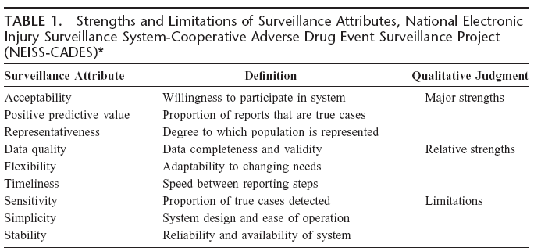
Example: Evaluation conclusions
Jhung et al. Medical care, 2007
Notes:
“Information collected for 9 surveillance system attributes provides evidence that 6 attributes are strengths of NEISS-CADES, and 3 are relative limitations of the system.”
“NEISS-CADES is an effective public health surveillance system that characterizes the burden of outpatient ADEs
treated in US emergency departments. Our evaluation indicates that NEISS-CADES provides complete and valid information on key data elements such as patient diagnosis and disposition, and the names and doses of drugs involved in ADEs. The system is well accepted by its participants and provides nationally representative data that have a high predictive positive value. NEISS-CADES addresses a primary outcome of ADEs—manifestation of patient symptoms and
subsequent health-seeking behavior—and thereby frames ADE surveillance in the context of traditional public health
reporting.”

Slide 23
Task F. Ensure use of findings and share lessons learned
Deliberate effort to use results & disseminate findings?
  Prior discussion of response to potentially negative findings?
  Prior plan to implement recommendations based on findings?
Strategies for communicating findings?
  Tailor content & method to relevant audience(s)
Notes:
The final task is ensuring use of the evaluation findings and sharing lessons learned.
Deliberate effort is needed to ensure that the findings from a surveillance system evaluation are used and disseminated appropriately. When the evaluation design is focused, the stakeholders can comment on decisions that might affect the likelihood of gathering credible evidence regarding the system’s performance. During the implementation of the evaluation, it might be necessary to consider how potential findings (particularly negative findings) might affect decisions made about the surveillance system. When the evaluation’s conclusions and recommendations are made, follow-up might be necessary to remind intended users of their planned uses, and to prevent lessons learned from becoming lost or ignored.
Strategies for communicating the evaluation’s findings and recommendations should be tailored to relevant audiences, including those who provided data used for the evaluation. In the public health community, for example, a formal written report or oral presentation might be an important but not necessarily the only means of communicating the evaluation’s findings and recommendations to relevant audiences.

Slide 24
“The reason for collecting, analyzing and disseminating information on a disease is to control that disease. Collection and analysis should not be allowed to consume resources if action does not follow.”
Foege WH et al. Int J Epidemiology 1976
Similarly, evaluation findings should be applied for surveillance improvement.
Notes:
A notable quotation from a former CDC director.
ETHICAL OBLIGATION to use data for action!!!!

Slide 25
Task D. Gather evidence of system’s performance
Usefulness?
  What actions taken based on data from system?
  Meet system objectives?
System attributes
  Simplicity
  Flexibility
  Data quality
  Acceptability
  Sensitivity
  Predictive value positive (PVP)
  Representativeness
  Timeliness
  Stability
Notes:
Task D, gathering credible evidence regarding the system’s performance, involves an indication of the level of the system’s usefulness by describing actions taken as a result of analyzing and interpreting data from the system. Often, published reports and discussions with personnel who operate the system can yield indications of the system’s usefulness.
Also, these system attributes should be described.
…added “data quality” and “stability” to the attributes.

Slide 26
Example: Usefulness from external stakeholder perspective
Miller et al. Communicable Disease Intelligence, 2004

Slide 27
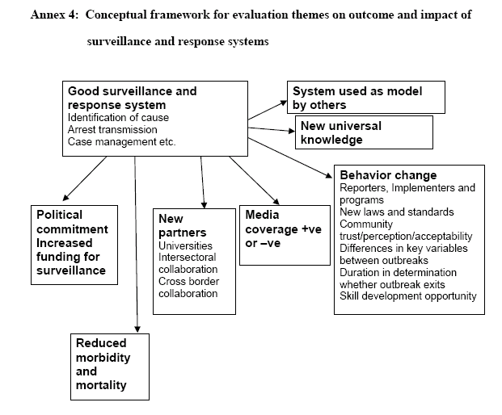
Have your surveillance efforts
resulted in any of these outcomes?
WHO/CDS/CSR/LYO/2004.15
Notes:
Consider other aspects of system performance –
Informatics-based
Community-based perspective
Stakeholders perspective

Slide 28
Task D. Gather evidence of system’s performance
Usefulness?
  What actions taken based on data from system?
  Meet system objectives?
System attributes
  Simplicity
  Flexibility
  Data quality
  Acceptability
  Sensitivity
  Predictive value positive (PVP)
  Representativeness
  Timeliness
  Stability
Notes:
Task D, gathering credible evidence regarding the system’s performance, involves an indication of the level of the system’s usefulness by describing actions taken as a result of analyzing and interpreting data from the system. Often, published reports and discussions with personnel who operate the system can yield indications of the system’s usefulness.
Also, these system attributes should be described.
…added “data quality” and “stability” to the attributes.

Slide 29
Timeliness
Different scales based on outcome & action
  Meningococcal meningitis >> cancer
If timeliness is critical:
  Active surveillance
  Acquire electronic records
  Encourage telephone reports on suspicion
  Educate clinicians and lab staff
  Review as frequently as the data arrive
  Remove barriers to prompt reporting
Adjust investment to importance

Slide 30
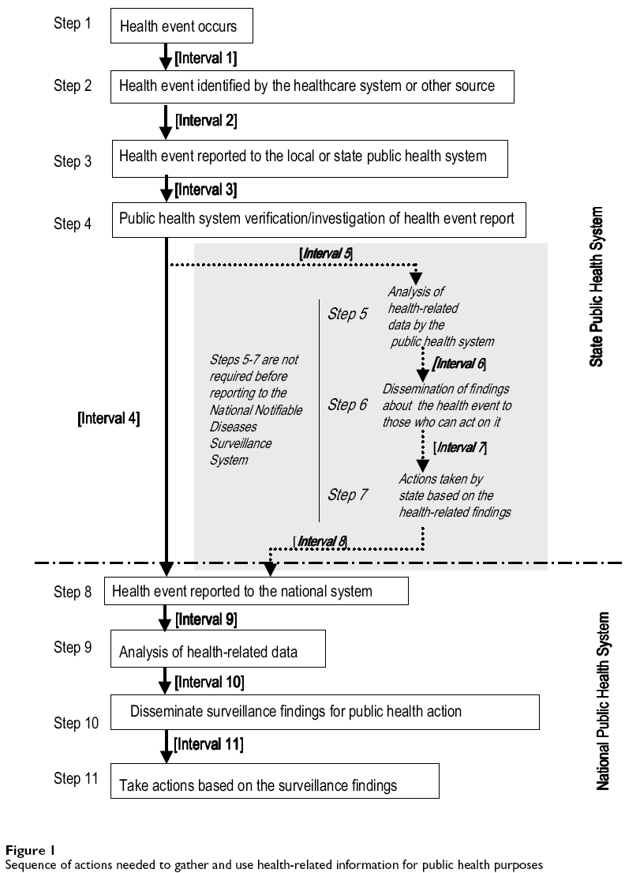
When measuring timeliness, specify the types of dates used and the intervals measured.
Jajosky RA et al. BMC Public Health 2004

Slide 31
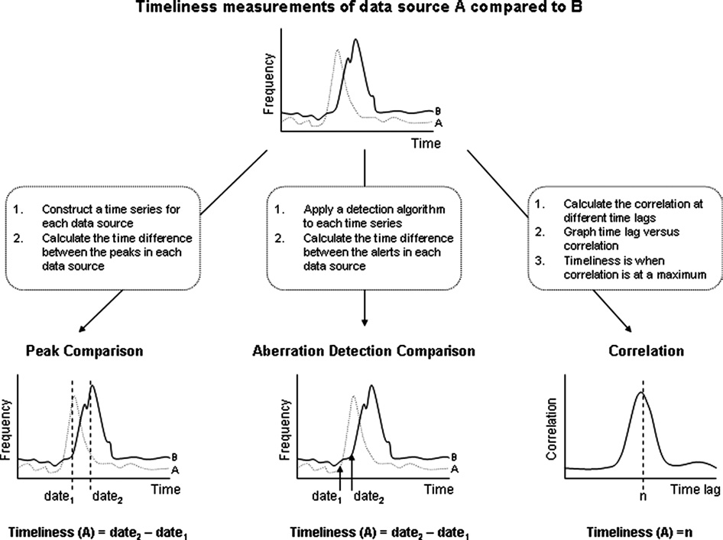
Dailey et al. J Am Med Inform Assoc. 2007;14:626–631

Slide 32
Sensitivity
Proportion of cases detected by the surveillance system
Predictive Value Positive (PVP)
Proportion of reported cases that actually have the health-related event under surveillance.

Slide 33
Sensitivity & PVP of system
Notes:
Remember that sensitivity refers to the proportion of cases detected by the surveillance system, while PVP is the proportion of reported cases that actually have the health-related event under surveillance.
In this table, sensitivity is “A” over “A+C” and PVP is “A” over “A+B”. Other useful measurements are specificity and PVN.
The assessment of sensitivity and PVP provide different perspectives regarding how well the system is operating. Depending on the system’s objectives, assessing PVP whenever sensitivity has been assessed might be necessary.
In addition, the system’s sensitivity can refer to the ability to detect outbreaks (or epidemics), including the ability to monitor changes in the number of cases over time, while PVP can reflect the proportion of epidemics identified by the system that are true epidemics.

Slide 34
Sensitivity
Affected by:
  Case detection process
  Case reporting process
Sometimes referred to as completeness of reporting
If reporting is ‘representative’ & consistent, surveillance system may perform well with moderate sensitivity .
Exceptions: rare disease; disease elimination scenario
Notes:
Consider sensitivity for a largely asymptomatic condition, e.g. chlamydia. – underdetection?
Consider surveillance of a complex clinical syndrome that requires extensive diagnostic evaluation to rule-in/rule-out diagnosis; e.g. PID. – underreporting?
May be more important for rare conditions.

Slide 35
Sensitivity for individual cases
High sensitivity means you miss few cases
To improve sensitivity:
  Broaden case definition
  Encourage reporting on suspicion
  Active surveillance
  Acquire electronic records
  Audit sources for completeness
  Remove barriers
Adjust investment to importance
Tradeoff with positive predictive value

Slide 36
Measuring completeness
Uncorrected method:
  # reported cases / total # cases id’d through active case detection & use of supplemental data sources (gold standard?)
  Example: Lab audit: XX% of total ‘eligible’ lab findings were reported
Under-ascertainment corrected method:
  # reported cases/total # case estimated via capture-recapture methods

Slide 37
Assessing Completeness: Lab Reporting
Jan 2000 - June 2004 -- Uncorrected
33 Patients with Reactive CSF-VDRLs in Lab Audit
(5 Labs So Far)
29 with No CSF Result in Registry
4 with CSF Result in Registry
3 NS Entered for Dx
1 Another
Syphilis Stage Entered for Dx
Only 12% of Reactive
CSF-VDRLs were in the registry
Source: Neurosyphilis (NS) surveillance evaluation, NYC - Lindstrom
Notes:
To date, six large, New York City laboratories have been audited for reactive CSF-VDRLs for the period of January 2000 through June 2004. One lab reported it does not perform CSF-VDRL tests, and another lab has reported only one year of data thus far. The audit captured reactive CSF-VDRLs for 33 patients. However, only four, or 12%, of these reactive CSF-VDRLs identified in the lab audit were found in the registry. Only 3 of the four patients for whom a reactive CSF-VDRL was entered into the registry received a registry diagnosis of neurosyphilis. Likely explanations for these data include the following: labs did not report all reactive CSF-VDRLs; reactive CSF-VDRLs that were reported may have been mistaken for serum test results and entered with a corresponding diagnosis; some reports that were entered into the registry may have originated from providers. The sensitivity of lab reporting is low. These data highlight the underreporting of neurosyphilis in the BSTDC registry with only a fraction of reports that meet the case definition for confirmed neurosyphilis being entered as such.

Slide 38
Assessing Completeness: Provider Reporting Jan 2000-Dec 2003 – Uncorrected
SPARCS Data: New York State database of all hospital discharge diagnoses
  111 Patients with primary discharge diagnosis of NS in NYC hospitals
    Number with any discharge diagnosis of NS expected to be considerably higher
    56 diagnosed NS cases in BSTDC registry January 2000-June 2004
Source: Neurosyphilis (NS) surveillance evaluation, NYC - Lindstrom
Notes:
The auditing of New York City providers is ongoing. The basis of our audit is hospital discharge data for patients diagnosed with neurosyphilis. The SPARCS database maintained by New York State, records all hospital discharge diagnoses. Available data for January 2000 through December 2003 indicated that 111 patients were discharged from New York City hospitals with a primary discharge diagnosis of neurosyphilis. Though these cases should have been reported to the BSTDC, the registry includes only 56 entries with a diagnosis of neurosyphilis over a longer period. Sensitivity of provider reporting is low. These data further suggest the registry underestimates neurosyphilis incidence in New York City.
Statewide Planning and Research Cooperative System-SPARCS

Slide 39
Sensitivity for outbreaks
High sensitivity means you miss few outbreaks
To improve sensitivity, same as for individual cases, plus:
  Syndromic surveillance
  Set investigation threshold low
  Set alarm threshold low
Affected by:
  Magnitude of “signal” cases relative to “baseline” cases
  Shape of outbreak signal – gradual vs. rapid increase
  Outcome’s “incubation period”
Adjust investment to importance
Tradeoff with positive predictive value
Notes:
Per Buckeridge, Signal cases should be > 10%; ideally > 30% of baseline cases.
Outbreak sensitivity varies by relative incubation period, e.g. syphilis/HIV << foodborne illness

Slide 40
Predictive Value Positive (PVP) for cases
High PVP means most cases are good cases
To improve PVP:
  Use narrower case definition
  Encourage clinicians and labs to report only confirmed cases
  Tight decision rules about electronic records to be submitted
  Review cases before entering in system
Tradeoff with sensitivity and timeliness
Adjust investment to importance

Slide 41
Predictive Value Positive (PVP) for outbreaks
High PVP means few false alarms
To improve PVP, similar to cases, plus:
  Set investigation threshold high
  Set alarm threshold high
Tradeoff with sensitivity and timeliness
Missed outbreaks are expensive too
Notes:
Longer one waits to declare an outbreak the greater the likelihood that it will be a ‘real’ outbreak.

Slide 42
Negative predictive value (NPV) for outbreaks
High NPV means you can rely on system to say outbreak is NOT present
Measures to increase sensitivity will usually increase NPV
Active surveillance means more credible negatives
System experience best indicator of actual NPV

Slide 43
Biases in surveillance that result in decreased representativeness:
Population under surveillance
Case-patients
Non-cases
Case ascertainment bias
Reported
(true positive)
Not reported
(false negative)
Reported
(false positive)
Not reported
(true negative)
Information bias
(Data about the case)
Present
(correct)
Present
(incorrect)
Absent
Present
(correct)
Present
(incorrect)
Absent
Notes:
Inaccurate case classification…
And
Inaccurate information on case characteristics.

Slide 44
Example: Case ascertainment bias
Miller et al. Commun Dis Intell 2004
Notes:
Consider representativeness for outbreak detection: geographic coverage is needed -- don’t know what’s going on where you’re not looking!

Slide 45
Representativeness of sentinel surveillance? Gonococcal Isolate Surveillance Project (GISP)
Notes:
Consider representativeness for outbreak detection: geographic coverage is needed -- don’t know what’s going on where you’re not looking!
Example of fluoroquinolone resistance.
Emergence of cephalosporin resistance??

Slide 46
Example:
Data quality
Completeness of data elements
Validity: Compared case reports to independent chart review
Jhung et al. Medical Care, 2007
Notes:
Assess data element completeness
Assess data validity:
Review sample of surveillance data?
Conduct record linkage?
Interview case patients? Chart review?
Influenced by:
Data collection formats
Training & supervision
Data management
Impacts surveillance system acceptability, representativeness, & usefulness

Slide 47
Do you need full information on all cases?
Collecting all data on all cases may result in poor data quality
Alternative approach: Gather core demographic data on all cases, but full case report on only selected ones.
  Unusual cases by age, sex, location, time of year?
  Cases during suspected outbreak?
  Random sample?
Notes:
Data quality – needs can vary
Increased efficiency???? With alternative approach.

Slide 48
Example:
Simplicity
- System structure
- Ease of operation
Single data source
Trained data abstractor
Multiple agencies involved
Jhung et al. Medical Care, 2007
Notes:
Simplicity refers to system’s structure & ease of operation.

Slide 49
Flexibility
Able to collect new information?
Able to modify case definition (e.g., aggregation of codes for syndromic surveillance) ?
Able to apply evolving standards (e.g., data, messaging) ?
Standalone system >> Integrated system
Notes:
Flexibility refers to systems’ ability to adapt to changing information needs or operating conditions.
Example:
Syndromic surveillance:
Nurse classification into fixed syndrome categories LESS FLEXIBLE vs. use of e-data that includes chief complaint or ICD coded information that allows creation of numerous syndrome categories based on mapping of granular data to syndrome categories.

Slide 50
Privacy & confidentiality
Defined roles & authorities for viewing & use of sensitive/personal information?
Controlled dissemination of sensitive/personal information?
  Suppression of personal identifiers?
  Systematic prevention of indirect identification of individuals by protocol & practice?
Defined data use and release policies?
Defined policy for response to inappropriate data release?

Slide 51
Summary
Periodic evaluation required
Focus on surveillance data utility
Interplay between attributes
  Relative importance of selected attributes for different surveillance systems & purposes
  As you change one attribute, you impact others
  With finite resources, emphasize different attributes based on surveillance objectives
  Changing tolerance for ‘missing outbreaks’ or other performance characteristics
Guidelines can (& should) be adapted
Notes:
To promote the best use of public health resources, all public health surveillance systems should be evaluated periodically. The frequency of the evaluation (for example, whether its done yearly, every two years, etc.) depends on the maturity and nature of the system.
As progress in surveillance theory, technology, and practice continues to occur, guidelines for evaluating surveillance systems will necessarily evolve.
CDC’s guidelines are recommendations that can be adapted to a variety of systems, including health information systems used for public health action, including surveillance; pilot-tested surveillance systems; and information systems at individual hospitals or health-care centers

Slide 52
Challenges
Regular, frequent monitoring of surveillance processes
Balance technology & people to optimize surveillance
Standards development with public health input
  Electronic health record
Collaboration with health care sector
Coordinated national surveillance network in a federal system

Slide 53

Thanks to Bob German,
Richard Hopkins, & Heather Lindstrom
*********************
The findings and conclusions in this presentation are those of the author and do not necessarily represent the official position of the Centers for Disease Control and Prevention.
Notes:
Thanks for your attention.

