Slide 1
National Public Health Performance Standards Program
Orientation to the
Essential Public Health Services

Slide 2
Overview
Applied epidemiology is critical in fulfilling all of the 10 Essential Public Health Services
Framework and tools for understanding how the core public health functions are performed include:
  10 Essential Public Health Services
  National Public Health Performance Standards Program (NPHPSP)
  Public Health Accreditation Board (PHAB)

Slide 3
After this presentation, you will be able to. . .
Describe the core functions of public health and the 10 Essential Public Health Services
Explain how the 10 Essential Services are utilized within the NPHPSP to assess and improve public health performance
Identify resources related to NPHPSP and public health agency accreditation (PHAB)

Slide 4
Recent Public Health History
1988 – Three core public health functions
1994 – 10 Essential Public Health Services
2002 – National Public Health Performance Standards Program (NPHPSP) Version 1
2007 – NPHPSP Version 2
2011 – Voluntary Accreditation for Public Health Agencies

Slide 5

Three Core Functions of Public Health
The Future of Public Health (1988, Institute of Medicine Report):
Conclusion: Public health was in “disarray”
Developed 3 core functions:
  Assessment
  Policy Development
  Assurance
Notes:
First, a little history. Many of you may be familiar with the core functions, which were outlined in the 1988 Institute of Medicine report - The Future of Public Health. As stated in the IOM report, the three core functions of public health are assessment, policy development and assurance. This is a good start to describing public health, but 1994, when the country was exploring issues related to health care reform, the public health sector felt that a better definition and description of public health was needed. A “Core Functions of Public Health Steering Committee” was convened to address this need. This Steering Committee involved representatives from Public Health Service Agencies (CDC, HRSA, Office of Disease Prevention and Health Promotion, etc.) and key National Public Health Organizations. The committee produced a statement called “Public Health in America.”

Slide 6
Essential Public Health Services
Developed by the Core Public Health Functions Steering Committee (1994)
  Included reps from national organizations and federal agencies
  Charge: To provide a description and definition of public health
  Developed the “Public Health in America” statement

Slide 7
Vision:
Healthy People in Healthy Communities
Mission:
Promote Physical and Mental Health
and
Prevent Disease, Injury, and Disability
Notes:
Public Health in America – Vision and Mission
The Public Health In America statement provides a vision and mission for public health as well as the context of what public health should be prepared to do and how public health service is delivered. The vision for public health is broad, “Healthy People in Healthy Communities.” The mission identified is to “Promote Physical and Mental Health and Prevent Disease, Injury, and Disability”.

Slide 8

Public Health
Prevents epidemics and the spread of disease
Protects against environmental hazards
Prevents injuries
Promotes and encourages healthy behaviors
Responds to disasters and assists communities in recovery
Assures the quality and accessibility of health services
Notes:
The Public Health in America statement also includes a section that defines the “purpose” of public health. These include:
Preventing epidemics and the spread of disease
Protecting against environmental hazards
Preventing injuries
Promoting and encouraging healthy behaviors
Responding to disasters and assists communities in recovery
Assuring the quality and accessibility of health services

Slide 9
Essential Services of Public Health
Monitor health status
Diagnose and investigate health problems
Inform, educate, and empower people
Mobilize communities to address health problems
Develop policies and plans
Enforce laws and regulations
Link people to needed services / assure care
Assure a competent workforce – public health and personal care
Evaluate health services
Conduct research for new innovations
Notes:
The last part of the Public Health in America statement defines the “Essential Services of Public Health”. The ten essential services are shown up here on the screen and include:
Monitor health status to identify and solve community health problems
Diagnose and investigate health problems and health hazards in the community
Inform, educate, and empower people about health issues
Mobilize community partnerships to identify and solve health problems
Develop policies and plans that support individual and community health efforts
Enforce laws and regulations that protect health and ensure safety
Link people to needed personal health services and assure the provision of health care when otherwise unavailable
Assure a competent public and personal health care workforce
Evaluate effectiveness, accessibility, and quality of personal and population-based health services
Research for new insights and innovative solutions to health problems
Basically, any public health activity can fit into one of these ten categories. So for example, Essential Service #1 includes activities such as data collection, community health assessments and the maintenance of population health registries. As another example, Essential Service #7 includes personal health care services as well as transportation and other enabling services and assuring the availability of culturally appropriate personnel and materials. Since the release of the ten Essential Services, numerous initiatives have explored the utility and feasibility of these services and have found them to be a good descriptor of public health.

Slide 10
The Essential Services as a Framework
Provides a foundation for public health activity
Describes public health at both the state and local levels
Used as a foundation for the National Public Health Performance Standards Program (NPHPSP) instruments
Accreditation of State and Local Health Departments
Notes:
10
The Essential Public Health Services provide the fundamental framework for the NPHPS instruments.
By describing the public health activities that should be undertaken in all communities, these activities describe the full range of public health responsibilities.
In 1994, the Core Public Health Functions Steering Committee (convened by DHHS) developed this list of responsibilities.
Using the Essential Services assures that the standards fully cover the gamut of public health activities needed at state and community levels.
When you look at the 3 different NPHPSP instruments, you will see that each includes a chapter or section devoted to each Essential Service.

Slide 11
ES 1 - Monitor Health to Identify and Solve
Community Health Problems
Accurate, periodic assessment of the community’s health status, including:
  Identification of health risks
  Attention to vital statistics and disparities
  Identifications of assets and resources
Utilization of methods and technology (e.g., GIS) to interpret and communicate data
Population health registries
Notes:
11
Monitor Health Status to Identify and Solve Community Health Problems
This service includes accurate diagnosis of the community’s health status; identification of threats to health and assessment of health service needs; timely collection, analysis, and publication of information on healthcare access, utilization, costs, and outcomes of personal health services; and attention to the vital statistics.
Motoring conditions that influence health are decentralized across the community. Data is maintained by police on crime, drug use, and traffic-related injuries. Fire departments collect information on smoke detectors, fire-related injuries, and location of toxic chemical in the community. Hospitals have discharge and emergency services data. Schools have attendance data, student immunizations data, and graduation rates. Many other system partners have important data as well. All of this data when brought together helps describe health in the community.
This service informs decision-makers on health matters and supports selection of effective policy, plans and interventions to improve health. Efficient and effective use of computer and communication technology is needed to assure information is timely.

Slide 12
ES 2 - Diagnose and Investigate Health Problems and Hazards in the Community
Timely identification and investigation of health threats
Availability of diagnostic services, including laboratory capacity
Response plans to address major health threats
Notes:
12
Diagnose and Investigate Community Health Problems and Hazards
This service includes epidemiological identification of emerging health threats; public health laboratory capability using modern technology to conduct rapid screening and high volume testing; active infectious disease epidemiology programs; and technical capacity for epidemiological investigation of disease outbreaks and patterns of chronic disease and injury.
This service draws heavily on epidemiology and laboratory diagnostic services. Within this service, public health and its system partners establish protocols for contact and source tracing as well as incident specific responses to address infectious disease and toxic agents found in the community. Risk assessment and hazard analysis, offered through this service, supports regulatory compliance programs and enforcement actions.
Within these protocols are specific guidance on communicating information to appropriate system partners so they can take appropriate action on diagnosis and investigation findings. Communicating to the public is implemented through EPHS 4 – the inform and educate service but it is informed by protocol from this service.

Slide 13
ES 3 - Inform, Educate, and Empower People About Health Issues
Initiatives using health education and communication sciences to:
  Build knowledge and shape attitudes
  Inform decision-making choice
  Develop skills and behaviors for healthy living
Health education and health promotion partnerships within the community to support healthy living
Media advocacy and social marketing
Notes:
13
Inform, Educate and Empower People About Health Issues
This service involves:
Making health information and educational resources accessible;
Providing health information and education activities that shape attitudes and build knowledge necessary to reduce health risk and promote better health;
Establishing health communication plans and activities that use media advocacy and social marketing approaches to shape attitudes and build knowledge;
Enabling informed decision-making among individuals in making health choices and among leaders establishing health policies for the community.
Maintaining health education and promotion program partnerships with schools, faith communities, work sites, personal care providers, and others to implement and reinforce health promotion programs that shape attitudes, knowledge, skills, and behaviors needed in a healthy community populations.
These activities assist to empower people to make informed decisions regarding individual and community health matters.

Slide 14
ES 4 - Mobilize Community Partnerships to Identify and Solve Health Problems
Constituency development and identification of system partners and stakeholders
Coalition development
Formal and informal partnerships to promote health improvement
Notes:
14
Mobilize Communities to Identify and Solve Community Health Problems
Community health improvement is a collaborative effort requiring:
Skilled conveners and organizers,
Social responsiveness (above self-interest) from community members, and
System structures that link community assets and the public’s will to act.
One person or organization can start community change but neither can make change alone. It is critical for public health system leaders to effectively convene and organize for community actions that can improve health.
Actions within the public health system that demonstrate this service are:
Convening and facilitating multiple community groups to undertake health improvement work. Convener should seek to include those that are not typically considered to be involved in health-related matters. Mobilized groups can undertake defined preventive, screening, and rehabilitation initiatives, or support other programs activities that influence health.
The building of coalition is one form or system to facilitate collaboration. Other forms exist. The key however is that structures must be maintained to support the mobilization of the community in order to draw upon the full range of community assets including people, organizations, and the physical environment that can support the improvement of health.
Many broadly focused processes of community action exist across the U.S. under names like Healthy Communities, Livable Communities, and Loveable Communities. An even greater number of issue specific processes exist and are addressed under names such as Healthy Mothers and Babies, Mother’s Against Drunk Driving, and many, many other collaborative groups taking action to address environmental, economic, historical, and other efforts that can improve community health and quality of life.

Slide 15
ES 5 - Develop Policies and Plans that Support Individual and Community Health Efforts
Policy development to protect health and guide public health practice
Community and state planning
Alignment of resources to assure successful planning
Notes:
15
Develop Policies and Plans That Support Community Health Efforts
Policies addressing specific health-related issues are public statements establishing directions individuals, organizations, or governments follow to protect and promote health. Policies are established by organizations and governments to identify consistent behaviors that are expected. Community and organization leaders have responsibility to articulate policies built on proven scientific finding and shaped by community values. Policies having negative or positive influences on health touch every aspect of community life. Safety standards that makers of automobiles and producers of electrical materials follow demonstrate policies that protect people from injury. Food handling guidelines protect people from illness. Other policy examples designed to encourage or support healthy behaviors can be identified in zoning rules. For example, zoning that requires sidewalks in new residential developments. This type of policy has influence on health by supporting the opportunity for physical activity as well as improving pedestrian safety. In addition, organizational leaders can influence health with policies that govern use of tobacco at company facilities, the availability of health insurance for employees, or facilities and time that allow for and promote physical activity. These are all examples of health-related policies that are important for community leaders to understand and apply. How well is health-related policy used to improve health in our community?
Health plans provide strategic and operational guidance on how to improved health. Plans establish a set of objectives and related actions to make measurable health improve. Community health plans are more likely to be accepted and applied if the plans are made with the active participation of those the plans affect. Establishing a community health improvement plan builds on other essential services that result in development of good community health data, use of relevant public health science in decision-making, effective community education, establishment of supportive health-related policies, and mobilization efforts necessary to bring about health improvements. Community health improvement is not limited to issues classified within traditional public health or health services categories, but may include environmental, business, economic, housing, land use, and other community issues indirectly affecting the public’s health.
This service represents decision-making and action to plan and measure general community health improvement. In addition, this essential service addresses more specific health plans like those that focus on preparation and response to disasters and all the human health and environmental implications resulting from disasters.

Slide 16
ES 6 - Enforce Laws and Regulations that Protect Health and Ensure Safety
Review, evaluation, and revision of legal authority, laws, and regulations
Education about laws and regulations
Advocating of regulations needed to protect and promote health
Support of compliance efforts and enforcement as needed
Notes:
16
Enforce Laws, Regulations, and Rules That Protect Health and Ensure Safety
Governmental officials form public health and other regulatory officials have responsibility to assess legal authority and effectiveness of regulations. If regulations are not based on appropriate public health science and contemporary practice standards or if there are new regulations needed to properly protect health, public health leaders should advocate for needed regulator change. The primary purpose of health-related regulation is not punishment but compliance. Public health should employ the use of education and other methods to enable individuals and organizations to comply with health and safety regulations. If there is failure to comply, it is essential that public health use its enforcement authority to protect the public.
Compliance and enforcement areas for public health include sanitary codes, especially in the food industry; protection of drinking water supplies; enforcement of clean air standards; protection from toxic and physical hazards in the environment; and monitoring the quality of medical services delivered through facilities such as laboratories, nursing homes, and home healthcare agencies.

Slide 17
ES 7 - Link People to Needed Personal Health Services and Assure the Provision of Health Care when Otherwise Unavailable
Identifying populations with barriers to care
Effective entry into a coordinated system of clinical care
Ongoing care management
Culturally appropriate and targeted health information for at risk population groups
Transportation and other enabling services
Notes:
17
Link People to Personal Health Services
This service (often referred to as the "outreach" or "enabling" service) includes assuring effective entry of people into a coordinated system of clinical care, especially the socially disadvantaged. This may involve identifying and addressing potential barriers related to cultural, language of materials, or staff serving special population groups. It most certainly involves providing people access and linkage to a coordinated system of personal healthcare that provides ongoing "care management," transportation services, and targeted health information to high risk population groups. The system should also ensure delivery of effective health promotion and disease prevention services within the community as well as provision of technical assistance to community providers who wish to improve or offer health promotion services.

Slide 18
ES 8 - Assure a Competent Public and Personal Healthcare Workforce
Assessment of the public health and personal health workforce
Maintaining public health workforce standards
  Efficient processes for licensing / credentialing requirements
  Use of public health competencies
Quality improvement and life-long learning
  Leadership development
  Cultural competence
Notes:
18
Assure a Competent Public and Personal Health Care Workforce
This service includes:
Education and training for personnel to meet the needs for public and personal health service;
Efficient processes for licensure of professionals and certification of facilities with regular verification and inspection follow-up;
Adoption of continuous quality improvement and life-long learning within all licensure and certification programs;
Active partnerships with professional training programs to assure community-relevant learning experiences for all students; and
Continuing education in management and leadership development programs for those charged with administrative or executive roles.
Actions to achieve the intent of this service may include assessing the supply and competencies of those providing person healthcare and public health services. Assuring health workers are properly trained and recognized by licensure or other credentialing processes. Supporting access to a system for life-long learning to maintain and grow health worker competencies, including the provision of mentors who can cultivate leadership and cultural competencies within the workforce.

Slide 19
ES 9 - Evaluate Effectiveness, Accessibility, and Quality of Personal and Population-based Health Services
Evaluation answers:
  Are we doing things right?
  Are we doing the right things?
Evaluation must be ongoing and should examine:
  Personal health services
  Population based services
  The public health system
Evaluation should drive resource allocation and program improvement
Notes:
19
Evaluate Effectiveness, Accessibility, and Quality of Health Services
This service calls for ongoing evaluation of health programs, based on analysis of health status and service utilization data, to assess program effectiveness and to provide information necessary for allocating resources and reshaping programs.
Its through this service we should answer the questions
Are we doing things right? and
Are we doing the right things to effectively improve health?
Evaluation must be seen as a consistent part of all public health work. Evaluation can be identified in many forms such as customer service feedback, quality improvement programs that examine the process of service delivery, or rigorous case control evaluation. All levels of evaluation are needed. Evaluation is needed for effective decision-making and resource allocation. It is through evaluation that we understand our improvements.

Slide 20
ES 10 - Research for New Insights and Innovative Solutions to Health Problems
Identification and monitoring of innovative solutions and cutting-edge research to advance public health
Linkages between public health practice and academic / research settings
Epidemiological studies, health policy analyses and health systems research.
Notes:
20
Research for New Insights and Innovative Solutions to Health Problems
This service includes continuous linkage with appropriate institutions of higher learning and research and an internal capacity to mount timely epidemiological and economic analyses and conduct needed health services research.
Public health professionals have great opportunity to develop new information needed to better understand how community health can be improved. Necessity often requires innovative solutions to the health problems State and local public health professionals face. Most of our health service advances originated from the experience and insight of frontline public health workers and confirmed in collaboration study with health researchers. Public health at the State and local level must develop the capacity to participate in and guide health services research. Linkages must be established with research and academic centers in order to stimulate and capture new insights and innovations we need to public health problems. Such research must be fully participatory with those it studies and intend to affect.

Slide 21
The EPHS – What Are they Asking?
“What’s going on in our state/community? Do we know how healthy we are?”
“Are we ready to respond to health problems or threats? How quickly do we find out about problems? How effective is our response?”
“How well do we keep all people and segments of our State informed about health issues?”
4. “How well do we really get people and organizations engaged in health issues?”
5. “What policies promote health in our State? How effective are we in planning and in setting health policies?”
Notes:
The ten essential services are shown here on the screen and include:
Monitor health status to identify and solve community health problems.
Diagnose and investigate health problems and health hazards in the community.
Inform, educate, and empower people about health issues.
Mobilize community partnerships to identify and solve health problems.
Develop policies and plans that support individual and community health efforts.
Enforce laws and regulations that protect health and ensure safety.
Link people to needed personal health services and assure the provision of health care when otherwise unavailable.
Assure a competent public and personal health care workforce.
Evaluate effectiveness, accessibility, and quality of personal and population-based health services.
Research for new insights and innovative solutions to health problems
These are the foundation of any public health activity.
For example, any public health program needs data to operate. Essential Service #1 includes activities such as data collection, community health assessments and the maintenance of population health registries. As another example, Essential Service #7 includes personal health care services, transportation and other enabling services such as assuring the availability of culturally appropriate personnel and materials.
Since the Ten Essential Services were released, numerous initiatives have explored the utility and feasibility of these services and have found them to be a good descriptor of public health practice.

Slide 22
The EPHS – What Are they Asking?
“When we enforce health regulations are we up-to-date, technically competent, fair and effective?”
“Are people receiving the medical care they need?”
“Do we have a competent public health staff? How can we be sure that our staff stays current?”
9. “Are we doing any good? Are we doing things right? Are we doing the right things?”
“Are we discovering and using new ways to get the job done?”
Notes:
The ten essential services are shown here on the screen and include:
Monitor health status to identify and solve community health problems.
Diagnose and investigate health problems and health hazards in the community.
Inform, educate, and empower people about health issues.
Mobilize community partnerships to identify and solve health problems.
Develop policies and plans that support individual and community health efforts.
Enforce laws and regulations that protect health and ensure safety.
Link people to needed personal health services and assure the provision of health care when otherwise unavailable.
Assure a competent public and personal health care workforce.
Evaluate effectiveness, accessibility, and quality of personal and population-based health services.
Research for new insights and innovative solutions to health problems
These are the foundation of any public health activity.
For example, any public health program needs data to operate. Essential Service #1 includes activities such as data collection, community health assessments and the maintenance of population health registries. As another example, Essential Service #7 includes personal health care services, transportation and other enabling services such as assuring the availability of culturally appropriate personnel and materials.
Since the Ten Essential Services were released, numerous initiatives have explored the utility and feasibility of these services and have found them to be a good descriptor of public health practice.

Slide 23
Assessment
Monitor health status (ES 1)
Diagnose and investigate health problems and hazards (ES 2)

Slide 24
Policy Development
Inform, educate, and empower people (ES 3)
Mobilize community relationships (ES 4)
Develop policies and plans (ES 5)

Slide 25
Assurance
Enforce laws and regulations (ES 6)
Link people to needed health services (ES 7)
Assure a competent workforce – public health and personal care (ES 8)
Evaluate health services (ES 9)
Conduct research for new innovations (ES 10)*

Slide 26
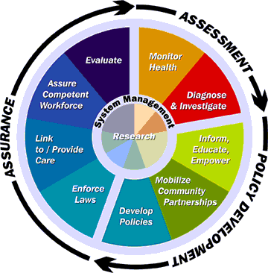

Slide 27
What is the role of epidemiology in the provision of the 10 Essential Public Health Services?
Monitor health status
Diagnose and investigate health problems
Inform, educate, and empower people
Mobilize communities to address health problems
Develop policies and plans
Enforce laws and regulations
Link people to needed services / assure care
Assure a competent workforce – public health and personal care
Evaluate health services
Conduct research for new innovations
Notes:
The last part of the Public Health in America statement defines the “Essential Services of Public Health”. The ten essential services are shown up here on the screen and include:
Monitor health status to identify and solve community health problems
Diagnose and investigate health problems and health hazards in the community
Inform, educate, and empower people about health issues
Mobilize community partnerships to identify and solve health problems
Develop policies and plans that support individual and community health efforts
Enforce laws and regulations that protect health and ensure safety
Link people to needed personal health services and assure the provision of health care when otherwise unavailable
Assure a competent public and personal health care workforce
Evaluate effectiveness, accessibility, and quality of personal and population-based health services
Research for new insights and innovative solutions to health problems
Basically, any public health activity can fit into one of these ten categories. So for example, Essential Service #1 includes activities such as data collection, community health assessments and the maintenance of population health registries. As another example, Essential Service #7 includes personal health care services as well as transportation and other enabling services and assuring the availability of culturally appropriate personnel and materials. Since the release of the ten Essential Services, numerous initiatives have explored the utility and feasibility of these services and have found them to be a good descriptor of public health.

Slide 28
NPHPSP Vision
A partnership effort
to improve the
quality of
public health practice
and
performance of
public health systems
Notes:
The NPHPS is a partnership effort – with national public health organizations - to improve the practice of public health and the performance of public health systems through the establishment and implementation of standards. Currently, there are program standards in some public health related areas (e.g., laboratory standards) but no national standards for overall public health systems like there are in other sectors (e.g., hospital standards through JCAHO, law enforcement agency standards through CALEA). So this is a much-needed and ground-breaking effort.

Slide 29

Public Health System
Schools
Civic Groups
Nursing Homes
EMS
Neighborhood Organizations
Community Centers
Non-Profit Organizations
Home Health
Hospitals
Drug Treatment
Public Health Agency
Laboratories
Doctors
Mental Health
Law Enforcement
Faith Institutions
CHCs
Tribal Health
Fire
Transit
Employers
Elected Officials
Corrections
Notes:
29

Slide 30
A system of partnerships that includes, but is not limited to . . .
Media
Churches
Schools
Business
Philanthropy
Federal DHHS
State Health Department
Local Health Departments
Tribal Health
Healthcare
Providers
Justice &Law
Enforcement
Environ.
Health
Community
Coalitions
Mental
Health
Transportation
Community
Services

Slide 31
Our goal is an integrated system of partnerships
Media
Churches
Schools
Business
Philanthropy
Federal DHHS
State Health Department
Local Health Departments
Tribal Health
Healthcare
Providers
Justice & Law
Enforcement
Environ.
Health
Community
Coalitions
Mental
Health
Transportation
Community
Services

Slide 32





NPHPSP National Partnership
CDC – Overall lead for coordination
ASTHO – Develop and support state instrument
NACCHO – Develop and support local instrument; MAPP
NALBOH – Develop and support governance instrument
APHA – Marketing and communications
PHF – Performance improvement; data collection and reporting system
NNPHI – Co-coordination of partnership, support through institutes, training workshop and user calls
Notes:
Without the productive partnership between CDC’s Public Health Practice Program Office and five national public health organizations: APHA, ASTHO, NACCHO, NALBOH, and PHF the NPHPSP would not have gotten off the ground.
CDC conducts the overall coordination, with each partner playing a lead role in a specific piece of the program. ASTHO, NACCHO, and NALBOH led the development of performance standards for state and local public health systems and governing entities. APHA has been a leader in the area of marketing and communications. And the Public Health Foundation has been active in several research areas, such as validity testing and researching technical assistance resources.
And we are pleased to have a new partner, the National Network of Public Health Institutes, who will provide a crucial link between the program and state public health institutes across the nation. And we are pleased to have a new partner, the National Network of Public Health Institutes, who will provide a crucial link between the program and state public health institutes across the nation.

Slide 33
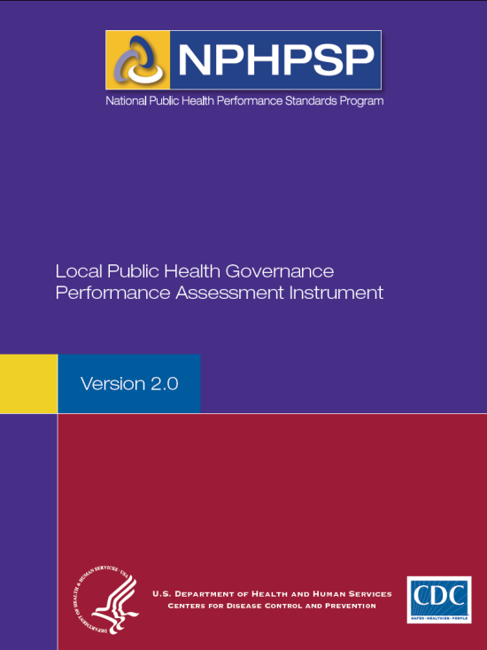
Three NPHPSP Instruments
State
Local
Governance

Slide 34

NPHPSP State Instrument Use
(Thru August 2010, n = 28 states + DC)
WA
MT
ND
ME
OR
MN
VT
NH
ID
NH
SD
WI
NY
MA
MA
WY
MI
RI
IA
PA
RI
NV
NE
CT
OH
CT
UT
IL
IN
NJ
CO
WV
CA
KS
MO
VA
DE
KY
NC
MD
OK
TN
AZ
NM
AR
SC
MS
AL
GA
TX
LA
AK
FL
HI
*Also includes sites using field test versions of the NPHPSP State Public Health System Performance Assessment.
Notes:
Completed (Blue): States that completed implementation of the state instrument
Field Test (Yellow): States that participated in pilot/field testing of the state instrument, only

Slide 35
NPHPSP Local Instrument Use
(Thru August 2010)
WA
MT
ND
ME
OR
MN
VT
ID
NH
SD
WI
NY
MA
WY
MI
IA
PA
RI
NV
NE
CT
UT
IL
IN
OH
CO
WV
NJ
CA
KS
MO
VA
DE
KY
NC
MD
OK
TN
AZ
NM
AR
SC
MS
AL
GA
TX
LA
AK
FL
HI
Significant Use (67% or greater)
Moderate Use
(33% - 66%)
Limited Use
(1% - 32%)
*Also includes sites using field test versions of the NPHPSP Local Public Health System Performance Assessment.
Notes:
Significant Use (Dark Blue): Completion range = 67% or greater of local health departments completed use of the local instrument
(Total number of significant use states = 6)
Moderate Use (Blue): Completion range = 33% - 66% of local health departments completed use of the local instrument
(Total number of moderate use states = 4)
Limited Use (Light Blue): Completion range = 1% – 32% of local health departments completed use of the local instrument
(Total number of limited use states = 12)
Field Test (Yellow): States that participated in pilot/field testing of the local instrument, only
(Total number of field test states = 8)
NOTE: TEXAS, FLORIDA, AND MISSOURI ALSO SERVED AS PILOT/FIELD TEST SITE FOR THE LOCAL INSTRUMENT, ALTHOUGH ARE NOT SHADED IN YELLOW
NOTE: Completion rate for Maine (1/1 = 100%)

Slide 36
NPHPSP Governance Instrument Use
(Thru August 2010)
WA
MT
ND
ME
OR
MN
VT
ID
NH
SD
WI
NY
MA
WY
MI
IA
PA
RI
NV
NE
CT
UT
IL
IN
OH
CO
WV
NJ
CA
KS
MO
VA
DE
KY
NC
MD
OK
TN
AZ
NM
AR
SC
MS
AL
GA
TX
LA
AK
FL
HI
Significant Use (67% or greater)
Moderate Use
(33% - 66%)
Limited Use
(1% - 32%)
No Boards of Health
*Also includes sites using field test versions of the NPHPSP Local Public Health Governance Performance Assessment.
Notes:
Significant Use (Dark Blue): Completion range = 67% or greater of local health departments completed use of the local instrument
(Total number of significant use states = 1)
Note: New Jersey is the only state showing significant use of the governance instrument.
Moderate Use (Blue): Completion range: 33% - 66% of local boards of health completed use of the governance instrument
(Total number of moderate use states = 0
Note: There are no states showing moderate use of the governance instrument.
Limited Use (Light Blue): Completion range = 1% - 32% of local boards of health completed use of the governance instrument
(Total number of limited use states = 8)
Field Test (Yellow): States that participated in pilot/field testing of the governance instrument, only
(Total number of field test states = 4)

Slide 37
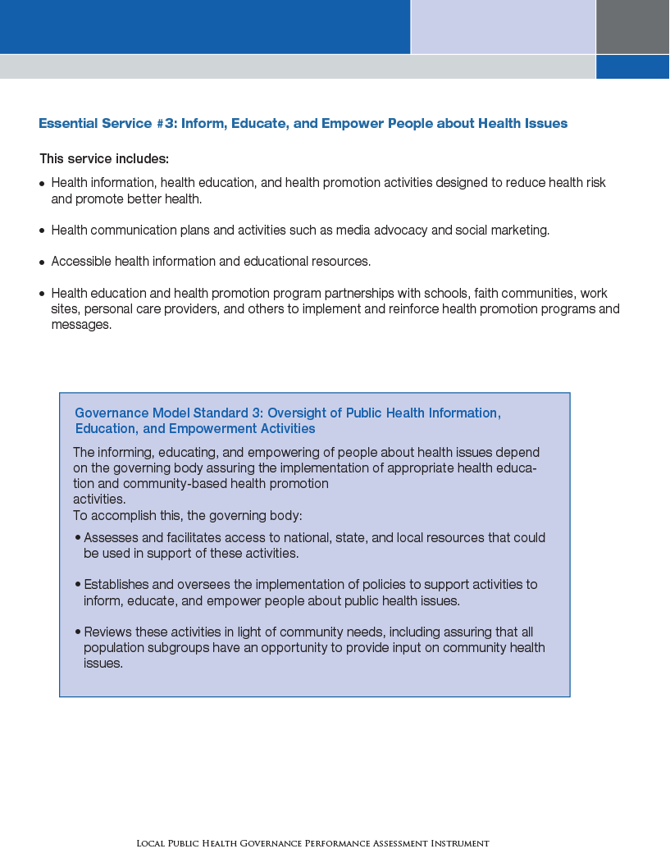


Instrument Format
Essential
Service
Model
Standard

Slide 38
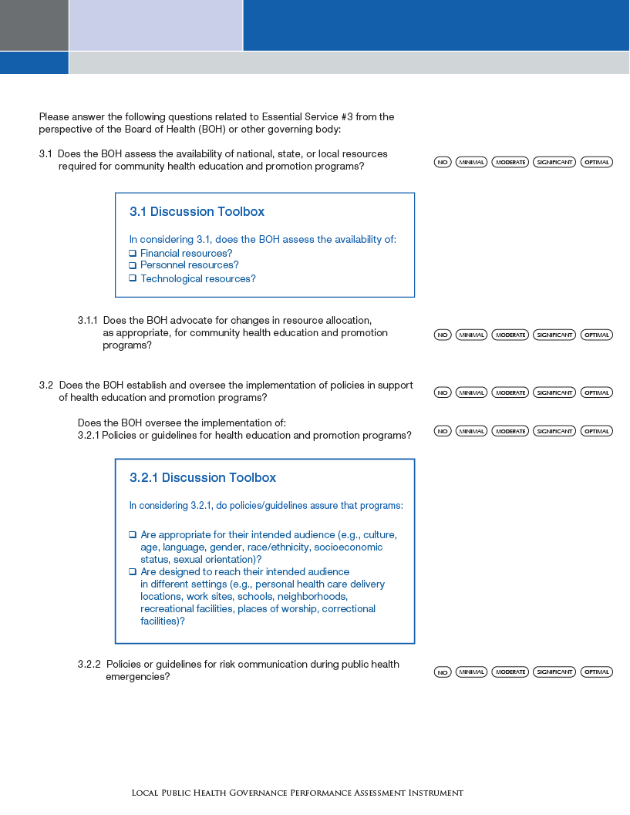
Instrument Format
Measures
or
Questions
Discussion
Toolbox

Slide 39
ES 1 – Monitor Health Status
State Model Standard 1.1

Slide 40
NPHPSP – State Instrument MS 1.1
Stem question excerpted from instrument with subquestions and discussion toolbox

Slide 41
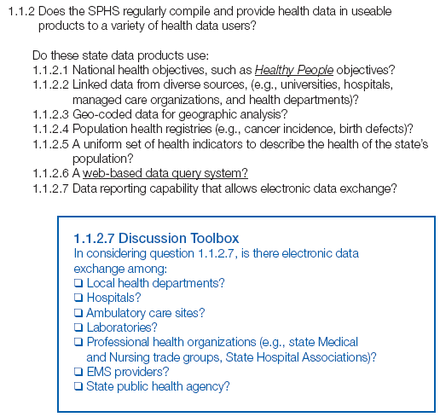
NPHPSP – State Instrument MS 1.1
Stem question excerpted from instrument with subquestions and discussion toolbox

Slide 42
NPHPSP Reports
How Did We Perform in the Ten Areas of Essential Public Health Services (EPHS)?
EPHS |  | Score
1 | Monitor Health Status to Identify Community Health Problems | 65
2 | Diagnose and Investigate Health Problems and Health Hazards | 96
3 | Inform, Educate, and Empower People about Health Issues | 73
4 | Mobilize Community Partnerships to Identify and Solve Health Problems | 41
5 | Develop Policies and Plans that Support Individual and Community Health Efforts | 69
6 | Enforce Laws and Regulations that Protect Health and Ensure Safety | 85
7 | Link People to Needed Personal Health Services and Assure the Provision of Health Care when Otherwise Unavailable | 65
8 | Assure a Competent Public and Personal Health Care Workforce | 72
9 | Evaluate Effectiveness, Accessibility, and Quality of Personal and Population-Based Health Services | 55
10 | Research for New Insights and Innovative Solutions to Health Problems | 79
Overall Performance Score |  | 70

Slide 43
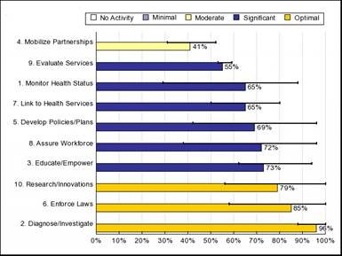
NPHPSP Reports (Example)
Where Do We Excel? Where Do We Need To Take A Closer Look?
Rank ordered performance scores for each Essential Service, by level of activity
Notes:
The range bars show the minimum and maximum values of responses within the Essential service and an overall score.
Tip: To guide your assessment of the data, look at wide range bars and areas that had lower performance scores.

Slide 44
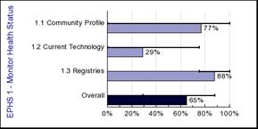
Drill Deeper to Focus Improvement
Figure 4: Performance scores for questions within each model standard/Essential Service
Use data file to pinpoint specific weaknesses
Model Standard Scores may mask variation:
  Community Profile
  Current Technology
  Population Health Registries
Notes:
If you find a low score or problem in one of the state model standards, you need to look further into your database to find more specific areas of concern that may need your attention. The stem question level of examination may be the most helpful to you as you begin to think about priorities and strategies for improvement.

Slide 45

Public Health Accreditation Board
A non-profit organization dedicated to the development and implementation of a national voluntary accreditation program for state, local, and tribal public health departments
Established May 2007 in Alexandria, VA
Governed by state, tribal and local public health officials and board of health members
Dr. Kaye Bender, President & CEO
Co-funded by CDC and RWJF
Notes:
-Brand new, independent entity that is governed largely by state and local public health officials and board of health members.
-Deliberately includes many venues for potential applicants to inform and shape its development and, later, its ongoing operations.
-PHAB was incorporated in May 2007 and is a non-profit organization located in the Washington DC area
-PHAB is composed of a small, but growing staff and works closely with partner organizations such as ASTHO, NACCHO, NALBOH and APHA, among others
-State and local health department leaders are taking an active role in building the program and representing governmental public health practice through involvement on the board of directors and PHAB workgroups.
-Health departments will continue to be called upon to volunteer for workgroups, provide feedback on standards and pilot test the program before it launches 2011

Slide 46
Voluntary Accreditation Goal
The goal of a voluntary national accreditation program is to improve and protect the health of the public by advancing the quality and performance of state, local, territorial and tribal public health departments.
Notes:
The goal of a national accreditation program is not only recognize high achievers, but also to bring national attention and resources to bear on quality and performance improvement for all health departments that choose to participate
Emphasis is on quality improvement (QI), which is built into program
Accreditation is a means to the ongoing journey of performance and quality improvement, and PHAB presents a unique opportunity to shore up governmental public health capacity at the state, local, territorial and tribal levels
46

Slide 47
Eleven Domains
Part A
Administrative Capacity and Governance
Part B
Conduct assessment activities focused on population health status and health issues facing the community
Investigate health problems and environmental public health hazards to protect the community
Inform and educate about public health issues and functions
Engage with the community to identify and solve health problems
Notes:
Quickly, run through the 11 Domains.
Part A includes one domain – Administrative Capacity and Governance
Part B includes 10 domains, based on the 10 Essential Public Health Services. They are numbered Domains 1-10.

Slide 48
Eleven Domains (cont.)
Develop public health policies and plans
Enforce public health laws and regulations
Promote strategies to improve access to healthcare services
Maintain a competent public health workforce
Evaluate and continuously improve processes, programs, and interventions
Contribute to and apply the evidence base of public health

Slide 49
PHAB Timeline
2007 |  |  |  | 2008 |  |  |  | 2009 |  |  |  | 2010 |  |  |  | 2011
1 | 2 | 3 | 4 | 1 | 2 | 3 | 4 | 1 | 2 | 3 | 4 | 1 | 2 | 3 | 4 | 1 | 2 | 3 | 4
Internal Operations
Standards and Measures
Vetting
Assessment Process
18 Month Beta Test
Applications
Notes:
You can see on this slide that the PHAB work actually began back in late 2007. The PHAB Board was formed and staff were hired.
Workgroups were then formed and began meeting in 2008. The Standards Development Workgroup met throughout 2008 and finalized the current DRAFT standards and measures in November for the PHAB Board to review.
The draft standards and measures were created by practitioners! The standards development workgroup, PHAB board of directors, and research and evaluation committee have spent tireless hours developing, reviewing and improving the draft standards and measures.
Further, an ALPHA test, or desk review, of an earlier draft by 6 local and 2 state health departments further contributed to their refinement. The draft released on 2/2 is the 12th iteration!
Starting late this summer PHAB will be conducting an 18 month beta test. The feedback collected from both the public comment period and the beta testing will be used to form the final set of standards and measures.
It is anticipated that PHAB will begin the accreditation application process in 2011.
49

Slide 50
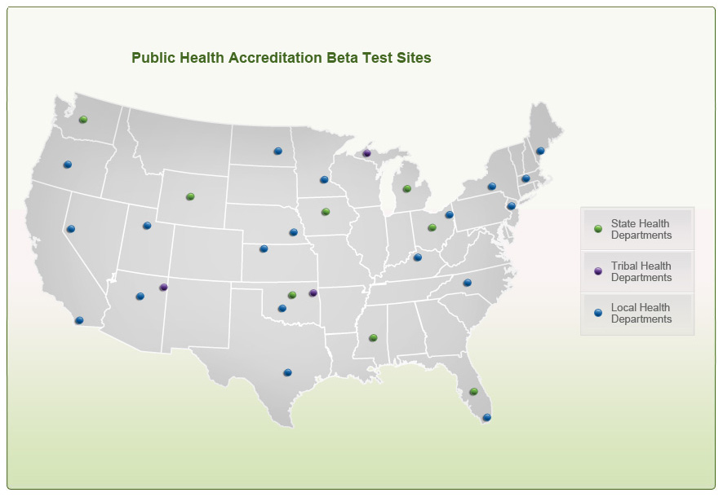

Slide 51
Local Health Department Beta Test Sites
Coconino County Health Department (AZ)
County of San Diego Health and Human Services Agency (CA)
Miami-Dade County Health Department (FL)
Norton County Health Department (KS)
Franklin County Health Department (KY)
City of Portland Public Health Division (ME)
Amherst Public Health Department, Northampton Health Department, and the Quabbin Health District (MA)
Hennepin County Human Services and Public Health Department (MN)
Public Health Solutions District Health Department (NE)

Slide 52
Local Health Department Beta Test Sites
Carson City Health & Human Services (NV)
Township of Bloomfield Department of Health & Human Services (NJ)
Tioga County Health Department (NY)
The Public Health Authority of Cabarrus County, Inc (NC)
Central Valley Health District (ND)
Mahoning County District Board of Health (OH)
Comanche County Health Department (OK)
Deschutes County Health Services (OR)
Austin/Travis County Health and Human Services (TX)
Tooele County Health Department (UT)

Slide 53
State Health Department Beta Test Sites
Florida Department of Health
Iowa Department of Public Health
Michigan Department of Community Health
Mississippi State Department of Health
Ohio Department of Health
Oklahoma State Department of Health
Washington State Department of Health
Wyoming Department of Health

Slide 54
Tribal Health Department Beta Test Sites
The Navajo Nation Division of Health (AZ)
Keweenaw Bay Indian Community – Department of Health & Human Services (MI)
Cherokee Nation Health Service (OK)

Slide 55
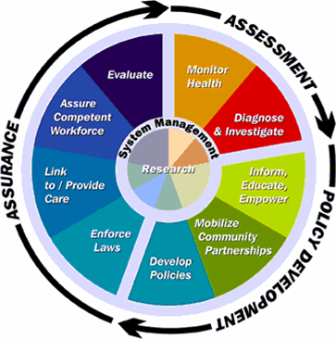
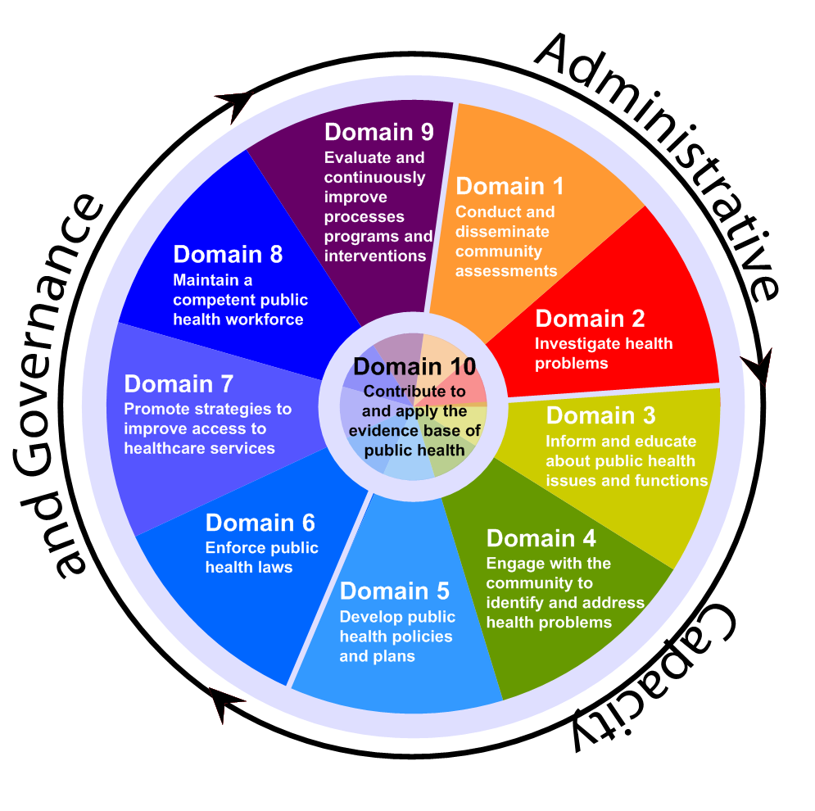
The Essential Public Health Services
NPHPSP and PHAB

Slide 56
Four Concepts Applied in NPHPSP
…and how they relate to accreditation
NPHPSP
Based on the ten Essential Public Health Services
Focus on the overall public health system (but acknowledges agency as hub / convener)
Describe an optimal level of performance
4. Support a process of quality improvement
Accreditation
Same – also includes 11th domain about admin / governance
Focus on agency (but acknowledges importance of the system and agency in building the system)
Standards / measures that can be met, but also have “stretch” opportunities.
4. Support a process of quality improvement

Slide 57
Strengthening the public health system…
Health
care delivery system
Community
Assuring the Conditions for Population
Health
Governmental
Public Health Infrastructure
Employers
and Business
Academia
The Media

Slide 58
…and its core – the governmental component
Health
care delivery system
Community
Assuring the Conditions for Population
Health
Governmental
Public Health Infrastructure
Employers
and Business
Academia
The Media

Slide 59
Resources
The Future of Public Health, 1988
  Website: http://www.iom.edu/?id=15251
The Future of the Public’s Health in the 21st Century, 2002 (an update to the Future of Public Health)
  Website: http://www.iom.edu/?id=15246
Public Health in America
  Website: http://www.health.gov/phfunctions/public.htm

Slide 60
Resources
NPHPSP
  Online Toolkit at www.cdc.gov/od/ocphp/nphpsp includes:
    Assessment Instruments, Model Standards, & User Guide
    Sample preparation, assessment,& performance improvement materials from users
  Monthly User Call Series: contact Jennifer McKeever at 202-842-2022 or jmckeever@nnphi.org for more info
  Technical Assistance: 1-800-747-7649 or phpsp@cdc.gov
PHAB
  Website: www.phaboard.org
  Phone: 703-778-4549

Slide 61
Thank you!
Teresa Daub
Office for State, Tribal,
Local and Territorial Support
404-498-0317
tdaub@cdc.gov

Slide 62
Questions?
Notes:
62
Questions

