Slide 1
Data Collection and Analysis
Bela T. Matyas, MD, MPH
Notes:
1

Slide 2
Surveillance: Definition
Public health surveillance is the ongoing, systematic collection, analysis, interpretation and dissemination of data regarding health-related events for use in public health actions to reduce morbidity and mortality and to improve health

Slide 3
Public Health Surveillance: Goals
Describe the background incidences of diseases, and define diseases
Detect changes and explain causes
Estimate magnitude of the problem
Identify control and prevention measures
Develop effective actions and evaluate interventions

Slide 4
Attributes of a Public Health Surveillance System
Sensitivity
Timeliness
Representativeness
Predictive value
Accuracy and completeness
Simplicity
Flexibility
Acceptability

Slide 5
Confidentiality
Public health surveillance deals with potentially sensitive information
  medical information
  some diseases are stigmatizing
Systems need to protect patient confidentiality

Slide 6
Diseases & Conditions of Public Health Significance
Characteristics:
  Magnitude (incidence & prevalence)
  Morbidity (degree of severity)
  Mortality (case-fatality rate)
  Premature mortality (YPLL)
  Communicability
  Health burden & economic cost
  Political and public pressure
  Preventability

Slide 7
Diseases & Conditions, cont.
Communicable infectious diseases
Zoonotic diseases
Environmental diseases & conditions
Occupational diseases & conditions
Chronic diseases
Birth defects
Injuries
Hospital-acquired infections
Proxies (vaccination status, etc.)

Slide 8
How Communicable Diseases are Transmitted
Airborne, Droplet-borne
Person-to-person
Waterborne, Foodborne
Bloodborne
Sexually transmitted
Vehicle-borne
Zoonotic (incl. vectorborne)

Slide 9
Airborne & Droplet-borne
Airborne
  droplet nuclei and air currents; breathing
  e.g. – measles, chicken pox, legionella, tuberculosis, ?SARS
Droplet-borne
  visible droplets, limited distance; coughing, sneezing
  e.g. – pertussis, Gr. A strep, SARS, flu

Slide 10
Person-to-Person
Salivary
  kissing, via hand; e.g. – respiratory diseases
Fecal-oral
  poor hygiene, via hand; e.g. - GI diseases
Close contact
  direct contact; e.g. – lice, scabies, fungal infections, Gr. A strep, MRSA

Slide 11
Waterborne & Foodborne
Waterborne
  via drinking water or bathing
  e.g. – giardia, hepatitis A, cholera, cryptosporidium
Foodborne
  via food (food handling vs. intrinsic)
  e.g. – salmonella, shigella, campylobacter, norovirus, hepatitis A, botulism

Slide 12
Bloodborne, Sexually Transmitted & Vehicle-borne
Bloodborne
  e.g. – HIV, hepatitis B, hepatitis C
Sexually transmitted
  e.g. – syphilis, gonorrhea, chlamydia
Vehicle-borne
  via inanimate objects
  e.g. – Clostridium difficile

Slide 13
Zoonotic (Animal-borne)
Vectorborne
  insects & bugs, incl. mosquitoes, ticks
  e.g. – Lyme disease, West Nile, EEE
Mammals
  e.g. – rabies, toxoplasmosis, cryptosporidium
Birds & reptiles
  e.g. – psittacosis, salmonella

Slide 14
Basic Structure of Public Health Surveillance
Core surveillance systems:
  healthcare providers (physicians)
  hospitals/ICPs
  laboratories
Supplemental surveillance systems:
  e.g.: sentinel, proxy, syndrome, risk factor

Slide 15
PH Surveillance: System Objectives
Identify a representative and consistent sample (trends, patterns)
  e.g. Lyme disease, hepatitis C
Provide early detection and warning
  e.g. influenza, EEE, West Nile virus
Detect cases for intervention
  e.g. tuberculosis, measles, enterics, meningococcal disease

Slide 16
Infectious Disease Mortality in the United States, 1980-1996
80
70
60
50
40
Crude ID Mortality Rate
Deaths per 100,000 population
30
20
10
0
1980
1982
1984
1986
1988
1990
1992
1994
1996
Year
Source: JAMA 1996;275:189-193 and unpublished CDC data

Slide 17
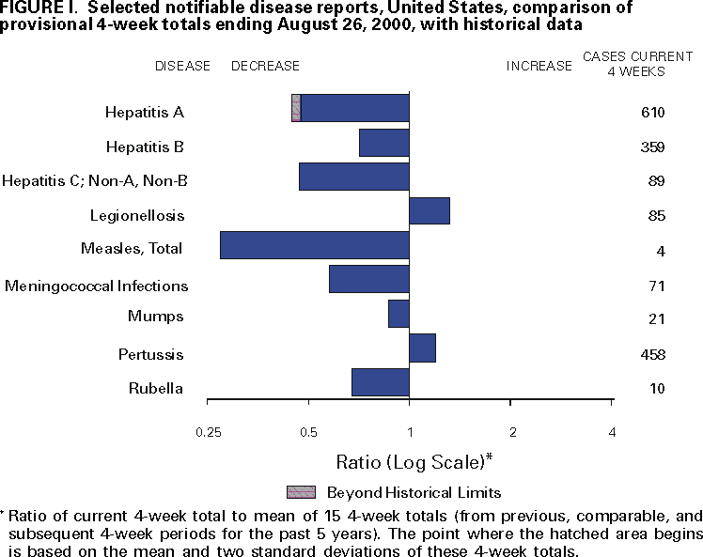

Slide 18
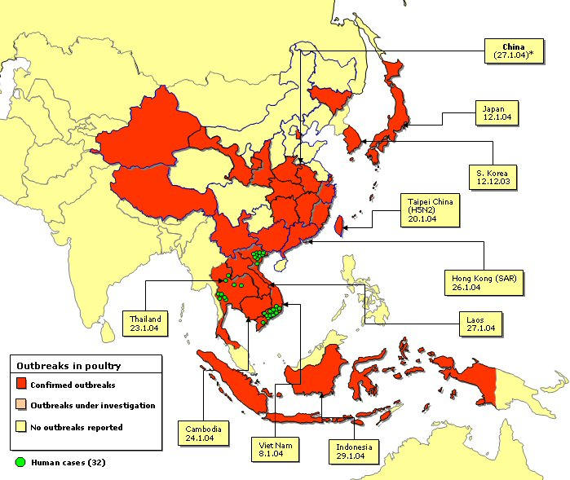
Recent outbreaks of H5 Avian Influenza in Asia
As of: 24 February 2004 (with first dates of reporting)
Sources: World Organization for Animal Health World Health Organization
http://europa.eu.int/comm/health/ph_threats/com/Influenza/ai_recent_en.htm
Notes:
Sources: World Organization for Animal Health
World Health Organization
This map shows countries and regions that have
reported confirmed and suspected H5 outbreaks. Outbreaks in Taipei China were related to H5N2 subtypes which is of Low Pathogenicity in poultry.

Slide 19
N
W
E
Massachusetts Department of Public Health Surveillance Program
S

Slide 20
Evaluation
As an application of surveillance data
Evaluation of surveillance systems

Slide 21
PH Surveillance: Purposes
Surveillance for background disease, trends
Surveillance for outbreaks
Surveillance for emergent pathogens
Prevention/education opportunities
Monitoring efficacy of public health control measures (e.g. immunizations)

Slide 22
PH Surveillance: Means
Case reporting
  addresses representative surveillance and case detection; addresses early detection less well (e.g. EEE)
  relies on laboratory reporting and on reporting by MDs and ICPs
  list of reportable diseases and conditions
  electronic laboratory reporting

Slide 23
Surveillance Indicators
CDC/CSTE surveillance case definitions
Key indicators of disease, incl.:
  clinical symptoms
  laboratory results
  other, e.g. epidemiologic link

Slide 24
Surveillance Indicators, cont.
Patient-identifying information
Provider-identifying information
Demographic information
Exposure information
  e.g. travel, pets, foods

Slide 25
Reporting by Providers
Priority list of conditions & diseases (clinical diagnostic component critical, or timeliness critical)
Means: telephone, confidential fax, mail, via ICP; HAN-based and web-based reporting in some states
For emergencies (e.g. meningococcal disease), 24/7 by phone
Tool: case report form

Slide 26
2001 Human Arbovirus Cases, MA Timelines: Onset to Diagnosis

Slide 27
The Potential Power of Case Reporting by Physicians
West Nile virus, New York City, 1999
Epidemiological investigation
started

Slide 28
Laboratory Reporting
Most consistent
Generally most accurate
Most relied upon

Slide 29
Laboratory Surveillance
Role of lab isolates in routine surveillance
  e.g. meninge serogroups
  e.g. salmonella serogroups
  e.g. E. coli O157 PFGE
Role of lab isolates in outbreak surveillance
  case ascertainment
  linking cases

Slide 30
PH Surveillance: Means, cont.
Risk factor surveillance
  addresses early detection
  e.g. mosquitoes, birds and horses for EEE and WNV; wild and domestic animals for rabies; food inspections; drinking water testing

Slide 32
First Surveillance Events in Relation to Hypothetical WNV Activity; Richmond County and US, 2000
Horse,
Richmond
Ae. japonicus,
Westchester;
Cx. pipiens,
Richmond
Sentinel
Chicken,
Westchester
Midpoint human cases
Cx. Pipiens
population
Viral & Cx. pipiens abundance
Human,
Richmond
Crow,
Suffolk
Crow,
Richmond
Apr
May
Jun
Jul
Aug
Sep
Oct

Slide 33
PH Surveillance: Means, cont.
Sentinel surveillance
  addresses early detection
    e.g. influenza, Lyme disease
  addresses representative surveillance
    e.g. Lyme disease; serotypes and pulsed-field gel electrophoresis (PFGE) patterns for enterics; PFGE patterns for meningococcal disease; antibiotic resistance patterns for invasive bacterial pathogens

Slide 34
PH Surveillance: Means, cont.
Cluster reports
  addresses case detection
  clusters generally reported by event organizer, institution, or local health department
Proxy surveillance
  addresses early detection
  e.g. food illness complaints

Slide 35
PH Surveillance: Means, cont.
Syndrome surveillance
  addresses early detection
  e.g. influenza, rotavirus in New York City using ER-based syndrome reporting
  most such systems untested for predictive value (e.g. pharmacy sales)

Slide 36
ANTHRAX
Impact of Active Surveillance on Survivability
Phase I
Initial Symptoms
Phase II
Acute Illness
Surveillance
Traditional Disease
Detection
Gain of 2
days
Effective Treatment
Period
(Linear)
Anthrax Attack
Non Communicable
Victims Directly
Exposed
10⁵
Fatalities With
Early Warning
and an Informed
Public Health
Response
Number Dead
Fatalities With Traditional
Public Health Response
t
= 0
Time (days)
Animal or Human Indicators

Slide 37
Syndrome Surveillance
Relies on syndrome as proxy for disease
Sensitivity variable, but generally high
Permits earlier identification
Critical driver for efficacy is predictive value of syndrome, which is directly related to the disease’s proportionate share of the syndrome
Is affected by syndrome “noise”

Slide 38
Syndrome Surveillance, cont.
Predictive value positive (PVP)
  The proportion of reported cases that actually have the health related condition under surveillance
Low PVP for syndrome surveillance
  Many of the detected cases are not true cases
  Often less specific case definition
  May waste resources in investigating non-cases or false-outbreaks

Slide 39
Syndrome Surveillance, cont.
Can’t use common syndromes to detect rare diseases (low signal to noise ratio)
Best systems are local and use ER, urgent care, and 911 data
Myths and fallacies:
  Utility of “data mining” (data quality issues)
  Statistical aberrations as signals
  Utility for bioterrorism surveillance
  CDC’s BioSense
  Pharmacy data, etc.

Slide 40
Early Warning – Biosensors
Strengths
  Sensitive and specific
  Near real-time detection possible
Weaknesses
  Need to be near event for detection
  Require confirmatory follow-up testing
  False positive and false negative test results
  Efficacy and cost-benefit unknown
  Susceptible to pseudo-attacks

Slide 41
Affecting Outcomes
No. viable
organisms
released
No. clinical
cases
1 hr 12 hr 5 days 14 days

Slide 42
PH Surveillance: Intensity
Passive surveillance
  routine lab, MD, ICP reports
Enhanced passive surveillance
  e.g. encephalitis in summer, influenza in fall/winter
Active surveillance
  e.g. sentinel influenza surveillance, mosquito testing for EEE/WNV, outbreak investigations

Slide 43
Local, State, and Federal Levels
Local:
  Disease reports; case investigation and outbreak response/control; prevention
State:
  Surveillance (incl. disease reports); control of outbreaks affecting multiple communities or on request; prevention
Federal (CDC):
  National surveillance; coordination of multi-state outbreaks

Slide 44
National Surveillance
National Notifiable Disease Surveillance System
  Reports to CDC from states & territories
  Morbidity and Mortality Weekly Report
  Emerging Infectious Diseases Journal
DOD influenza-like illness surveillance
EHSNet (environmental health data)
USPS BDS (anthrax detection in mail)

Slide 45
National Surveillance, cont.
ELEXNet (environmental lab data)
CDC surveillance activities:
  Influenza, vibriosis, listeriosis, etc.
  PHLIS/PHLIP (public health lab data)
  PULSENET (PFGE data)
  FOODNET
  Biosense
Dept. of Homeland Security
  Biowatch

Slide 46
International Surveillance
World Health Organization
  Collaborative and voluntary
  Disease and condition-specific
  Uneven coverage
  Uneven quality
  E.g., influenza (pandemic & avian)

Slide 47
World Health Organization
Influenza Network
4 WHO Collaborating Centers for Influenza
(London, Atlanta, Melbourne, Tokyo)
110 National Collaborating Laboratories
(in 79 countries)
Approx. 70 U.S. Collaborating Laboratories
Sentinel surveillance sites in states

Slide 48
Current Directions in
Public Health Surveillance
Electronic data transmission, laboratory and medical
Advances in laboratory analysis
Administrative data sets
Syndrome surveillance
Geographic information systems

Slide 49
PH Surveillance: Issues
Application of public safety paradigm to public health (i.e. centralization vs. decentralization)
“Nationalization” of surveillance
  Disease reporting to CDC
  Biosense, etc.
  National electronic lab reporting
Reporting by providers

Slide 50
Data Analysis
Qualitative analysis
  Data trend monitoring
  Tracking complaints
  Case series
  Descriptive epidemiology
Quantitative analysis
  Signal detection, perturbation analysis
  Analytical epidemiology

Slide 51
Descriptive Epidemiology
Concerned with description rather than explanation
Looks for associations between cases based on person, place and time considerations:
  Person - demographics, symptoms
  Place - location, common exposures
  Time - onset of illness, epidemic curve

Slide 52
Person: Frequency Tables
Notes:
Here is another example of person descriptive epi that we saw in Module 2.

Slide 53
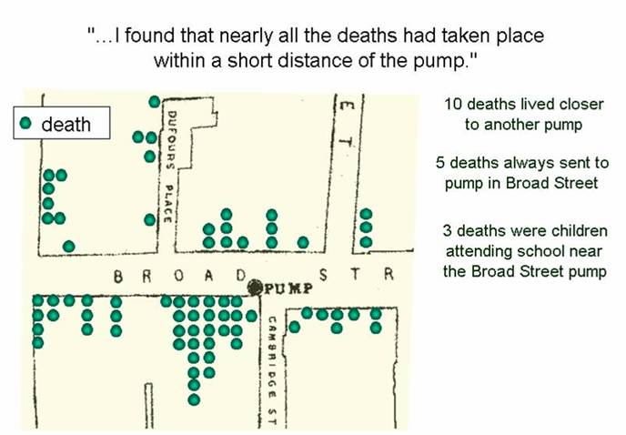
Place: Spot Maps
Dr. John Snow, September 1854
Notes:
This is an example of descriptive epi and place association.
[Ask who is familiar with John Snow] John Snow is considered to be the father of epidemiology. In the mid-1800’s, before germ theory showed that cholera was caused by an organism, there was an epidemic of cholera in London. John Snow began to plot the cholera cases on a map and, although it is not shown in this picture, there were two main water pumps in the city. A majority of the cases that occurred seemed to live or work in the area surrounding one of the two pumps, and thus could’ve gotten their water from the one pump. Based upon this data, Dr. Snow was able to convince the government to remove the pump handle of the one water pump in question and the epidemic came to an end. Therefore, descriptive epi can be very powerful in supporting your conclusions.

Slide 54
Place: Common Exposure Location
Examples
  Case 1 – rest. A, B, C, D
  Case 2 – rest. B, E, F
  Case 3 – rest. A, B, G, H, I
  Case 4 – rest. B, D, J, K

Slide 55
Time: Epidemic Curve
12
Fatal
11
Non-fatal
10
9
8
7
Number of Patients
6
5
4
3
2
1
0
6/27
8/2
9/6
10/11
11/15
12/20
1/24
2/27
4/3
Date
Source: Centers for Disease Control and Prevention
Notes:
On the epidemic curve
One of the reasons for repeat interview
Make life a lot easier for everyone if you get the information the first time

Slide 56
Point-Source Exposure
10
9
8
7
6
5
Number of Cases
4
3
2
1
0
1
3
5
7
9
11
13
15
Days

Slide 57
Ongoing Exposure
10
9
8
7
6
5
Number of Cases
4
3
2
1
0
1
3
5
7
9
11
13
15
Days

Slide 58
Secondary Exposures
10
9
8
7
6
5
Number of Cases
4
3
2
1
0
1
3
5
7
9
11
13
15
Days

Slide 59
Analytical Epidemiology
Helps identify direction, strength and validity of association
Compare by exposure status
  Cohort (Follow-up) study
  Experimental study
Compare by outcome status
  Case-Control study

Slide 60
Measures of Association Between Exposure & Disease
Selection of measure depends on type of study
  “Relative risk” for cohort studies
    Risk of developing disease given the exposure
  “Odds ratio” for case-control studies
    Odds of having the exposure given the disease

Slide 61
Cohort Studies
Groups of exposed and unexposed individuals can easily be identified
Compare risk of illness by whether exposure did or didn’t occur (e.g., food was/wasn’t eaten)
Notes:
On the other end is the cohort study, which is done when you have a well-defined population.
[Ask audience for examples of when case-control studies would be appropriate]
[EX: Church supper outbreak]
In a cohort study attempt to interview all people in the population.
Attack rates, relative risks, and 95% confidence intervals will be described later in this module.

Slide 62
Attack Rate: Measure of Occurrence
Attack Rate (AR)
Expresses occurrence of a disease among a particular at-risk population for a limited period of time, often due to a very specific exposure
Can be event-specific or food-specific, for example
Number of ill people with exposure
Total number of people with exposure
AR =
Notes:
[Ask audience for someone to define an attack rate]
You can see on the slide the official definition of an attack rate. Basically, an attack rate is just a percentage of people who became sick due to an exposure. For example, if 25 people out of 100 total people who attended a wedding reception became ill, then the event-specific attack rate for the wedding reception would be [pause for answer] 25%. If only 50 people at the wedding reception ate the chicken and 20 people who became sick at the chicken, then the food-specific attack rate for the chicken would be [pause for answer] 20/50 = 40%.
Although harder to think of practically, you can also calculate the attack rate for people without an exposure. For example, in our wedding reception, we had 50 people who did not eat the chicken, right? Of those, 5 still became ill. So, we could calculate an attack rate for people who did not eat the chicken to be [pause for answer] 5/50 = 10%
This demonstrates the importance of having information on both ills and wells when doing an outbreak investigation.

Slide 63
Estimating Risks Associated with “Exposure”
Compare attack rates among exposed and unexposed
Relative Risk =
Attack Rate (exposed) / Attack Rate (unexposed)
Notes:
So now that we have calculated our various attack rates, we can use them to determine if a certain exposure is associated with disease.
Relative risk, which is the attack rate in the exposed population divided by the attack rate in the unexposed population. Once again, from the wedding reception – what was the attack rate in those who ate the chicken [pause for answer 40%]? And what was the attack rate in those who did not eat the chicken [pause for answer 10%]? So the risk difference would be [pause for answer 4]. [Ask audience if anyone can describe the relative risk in practical terms]. The relative risk describes how much more likely the exposed group is to develop illness when compared to the unexposed group. In our example, those who ate the chicken were 4 times more likely to become ill than those who did not eat the chicken.

Slide 64
Using the 2 by 2 Table to Calculate Relative Risk
Estimates magnitude of association between exposure and
disease
in exposed group
relative to unexposed group
a / (a + b)
c / (c + d)
RR=
RR = 1 No Association
  RR < 1 Negative Association
  RR > 1 Positive Association
Notes:
Another way of comparing attack rates is Relative Risk (In Cohort studies) or Odds Rates (in case control studies). [Ask how many people have seen/used a 2x2 table]
2X2 tables give you the same info as attack rate – just in a slightly different format.
Each begins with a two by two table matching exposure and illness. The cells of this table contain the count of the number of individuals matching the exposure status and illness outcomes listed. {walk through each cell and the equation}
If the attack rate in the exposed is the same as the attack rate in the unexposed (so the risk difference is zero), what number would you expect when you divide the two? [pause for answer 1]. So a RR=1 means no association. If the attack rate in the exposed is higher than the attack rate in the unexposed, such as for the vanilla ice cream in the church supper, what number would you expect [pause for answer >1]. So a RR>1 means a food is associated with disease. Finally, if the attack rate in the exposed is less than the attack rate in the unexposed, such as for the chocolate ice cream, what number would you expect [pause for answer <1 but >0].

Slide 65
Case-Control Studies
Used when groups of exposed and unexposed individuals cannot easily be identified
Compare ill with non-ill individuals to determine likelihood of having had the exposure (e.g., eating a specific food)
Notes:
The first study design is the case-control study. A case-control study is one in which the exposure group is not well defined.
[Ask audience for examples of when case-control studies would be appropriate]
[EX: Community wide outbreak in which you don’t know the source of the outbreak or where the] [exposure occurred. You will not be able to identify or interview the entire population.]
[EX: Pulsenet info relating several cases with the same pattern, community based outbreak]
[EX: Another example – an outbreak involving a very large group – wedding reception with 500 persons.] [Don’t have resources to interview all 500 for a cohort, so could do a case control study.]
In this study, you would select the number of cases that meet the case definition. The best cases are lab confirmed positives. Ideally, choose 2 or 3 controls for every case. Often doing well to get one.

Slide 66
Odds Ratio from Case-Control Studies
Measurement of the odds of having an exposure (e.g., specific food consumption) given the disease
Estimates the Relative Risk
Odds Ratio (OR)
Odds of exposure among cases
Odds of exposure among controls
a / c
b / d
ad
bc
=
=
=

Slide 67
Using the 2 by 2 Table to Calculate Odds Ratio
Estimates magnitude of association between exposure and
disease
in diseased group (cases)
relative to non-diseased group (controls)
OR =
a /c
b /d
=
ad
bc
OR = 1 No Association
  OR < 1 Negative Association
  OR > 1 Positive Association
Notes:
Another way of comparing attack rates is Relative Risk (In Cohort studies) or Odds Rates (in case control studies). [Ask how many people have seen/used a 2x2 table]
2X2 tables give you the same info as attack rate – just in a slightly different format.
Each begins with a two by two table matching exposure and illness. The cells of this table contain the count of the number of individuals matching the exposure status and illness outcomes listed. {walk through each cell and the equation}
If the attack rate in the exposed is the same as the attack rate in the unexposed (so the risk difference is zero), what number would you expect when you divide the two? [pause for answer 1]. So a RR=1 means no association. If the attack rate in the exposed is higher than the attack rate in the unexposed, such as for the vanilla ice cream in the church supper, what number would you expect [pause for answer >1]. So a RR>1 means a food is associated with disease. Finally, if the attack rate in the exposed is less than the attack rate in the unexposed, such as for the chocolate ice cream, what number would you expect [pause for answer <1 but >0].

Slide 68
Validity of Findings
Is the observed association between exposure and disease due to alternative explanations?
Bias: systematic error (selection, information {recall, interviewer, misclassification})
Confounding
Chance: sampling variability and sampling size

Slide 69
Examples of Bias
Random misclassification of cases vs. controls or exposed vs. unexposed
  categories of persons less “clean”
  biases OR or RR toward “1.0”
Recall bias
  cases better remember exposures than do controls
  problem with retrospective studies
  may result in inflated OR

Slide 70
Confounding
Alternative explanation for the association, linked to both exposure and outcome
Yellow index
finger
Lung cancer
Smoking

Slide 71
Evaluating the Role of Chance
P value
  Probability a given association could have occurred by chance alone
  “Statistically significant” defined as p ≤ 0.05
  Consider all available evidence when interpreting P values
Notes:
We’re almost there. In addition to the measures of association (relative risk), there are also measures of confidence that need to be calculated (and for which a computer can be very useful).
The p-value describes the probability a given association could have occurred by chance alone. Scientific convention dictates that an exposure is significant if there is at most a 5% chance that the result could’ve occurred by chance. Or, conversely, you are greater than 95% sure that this result reflects a true association.
A 95% confidence interval is another way of looking at this. This is a range of numbers in which the true relative risk lies. For example, if you remember the wedding reception from several slides ago, we had a a relative risk of 4. If you have a 95% confidence interval of 2 and 8, then those who at the chicken could be as little as 2 times more likely to get ill or as much as 8 times as likely to get ill. However, because it does not include 1, then you still have an association. If you have a 95% confidence interval that does not include 1, then your p-value will be <=0.05.
When it comes to P values
A 100% probability is indicated by P=1.0
A 0 % probability is P=0.0
A 5% probability (chance that it will happen) is P=.05
Epidemiologists have agreed that significant associations (ones not likely to be due to chance alone) are those which have ≤0.05
Can use example of flipping coins is it unlikely to flip a coin 2 times and get heads both times? How about 4X? 10X? When do you begin to suspect you have a trick coin?
Confidence Interval has to do with how certain we are with our risk estimates (Risk Ratio or Relative Risk). Attack rate (exposed) divided by attack rate (nonexposed)= a number. But we recognize that number is really just an estimate which is affected by the number of people we were able to gather information from. Example: Truth is that 50 of 100 people ill after pot luck.
Initially we were only able to interview 10% of the group – 5 ill and 5 well. Because of problems with individuals memories and biological differences, we might not have high confidence that the result from our sample of 10 people will tell us the truth if we were able to interview all 100 persons.
Computers can calculate confidence intervals to help us gauge how the number of people interviewed impacts the certainty of our estimate.

Slide 72
Evaluating the Role of Chance, cont.
95% Confidence Interval
  Range within which the true association lies, based on 95% assurance
Notes:
We’re almost there. In addition to the measures of association (relative risk), there are also measures of confidence that need to be calculated (and for which a computer can be very useful).
The p-value describes the probability a given association could have occurred by chance alone. Scientific convention dictates that an exposure is significant if there is at most a 5% chance that the result could’ve occurred by chance. Or, conversely, you are greater than 95% sure that this result reflects a true association.
A 95% confidence interval is another way of looking at this. This is a range of numbers in which the true relative risk lies. For example, if you remember the wedding reception from several slides ago, we had a a relative risk of 4. If you have a 95% confidence interval of 2 and 8, then those who at the chicken could be as little as 2 times more likely to get ill or as much as 8 times as likely to get ill. However, because it does not include 1, then you still have an association. If you have a 95% confidence interval that does not include 1, then your p-value will be <=0.05.
When it comes to P values
A 100% probability is indicated by P=1.0
A 0 % probability is P=0.0
A 5% probability (chance that it will happen) is P=.05
Epidemiologists have agreed that significant associations (ones not likely to be due to chance alone) are those which have ≤0.05
Can use example of flipping coins is it unlikely to flip a coin 2 times and get heads both times? How about 4X? 10X? When do you begin to suspect you have a trick coin?
Confidence Interval has to do with how certain we are with our risk estimates (Risk Ratio or Relative Risk). Attack rate (exposed) divided by attack rate (nonexposed)= a number. But we recognize that number is really just an estimate which is affected by the number of people we were able to gather information from. Example: Truth is that 50 of 100 people ill after pot luck.
Initially we were only able to interview 10% of the group – 5 ill and 5 well. Because of problems with individuals memories and biological differences, we might not have high confidence that the result from our sample of 10 people will tell us the truth if we were able to interview all 100 persons.
Computers can calculate confidence intervals to help us gauge how the number of people interviewed impacts the certainty of our estimate.

Slide 73
Statistical Software
Data management
  Excel, other flat-file formats
  Access, Epi-Info, other relational databases
  CDC’s Outbreak Management System
Data analysis
  Epi-Info, Stat-Calc
  SAS, SPSS
  R (open source)

Slide 74
Informatics in PH
Data management
Data exchange and dissemination
  Electronic and web-based
  Standardized messaging (e.g. HL7)
Consider security issues and HIPAA
  Encryption, layered passwords
  Sharing & merging of databases

Slide 75
New Analytic & IT Tools
New analytic tools
  R – open source analytical suite
  Geographic information systems
  Signal detection and perturbation analysis, e.g. SatScan
  Web-based OMS
IT tools
  ELR and EMR
  Web-based reporting

