Slide 1
Technical Guidance for
HIV Surveillance Programs
Risk Factor Ascertainment
Anna Satcher Johnson, MPH
Team Lead, Research and Dissemination Team
CSTE Webinar
September 18, 2012
National Center for HIV/AIDS, Viral Hepatitis, STD, and TB Prevention
HIV Incidence and Case Surveillance Branch

Slide 2
Objectives/Goals
Definitions and Standard Terminology
Risk factor classification
Process and outcome standards
Procedures for risk factor ascertainment
Education and training

Slide 3
Why is collection of HIV risk factor information important?
Identify new or unusual cases
Monitor trends in the transmission of HIV
Allocate resources
Plan prevention programs
Target risk reduction interventions
Evaluate HIV programs

Slide 4
Definitions and standard terminology

Slide 5
Definitions & Standard Terminology
Risk factor (RF) - A behavior or event associated with an increased risk of becoming infected with HIV (e.g., male-to-male sexual contact, injection drug use, using drugs while having sex).
Patient history variables (PHV) - Individual risk behaviors or events on which data are routinely collected in the Patient History section of the HIV Case Report forms (CRF).

Slide 6
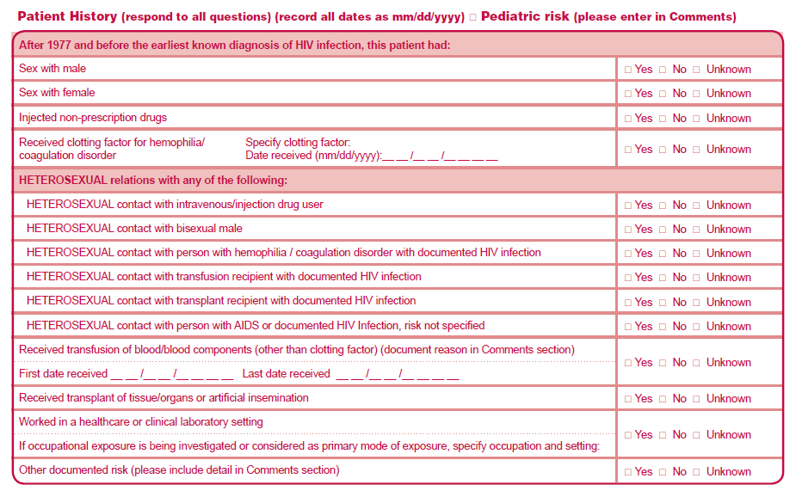
Patient History Variables

Slide 7
Definitions & Standard Terminology (cont.)
Cases of Public Health Importance (COPHI) - Cases reported with rare or unusual PHV information.
  First priority for follow-up :
    occupational exposure
    a human bite or tattoo
    blood transfusion
    transplant recipient
    pediatric case when the biological mother is HIV negative
    other

Slide 8
Definitions & Standard Terminology (cont.)
No identified risk (NIR) - cases reported without any or insufficient PHV information, or with unconfirmed COPHI risk factor information, for which a transmission or exposure category cannot be determined.

Slide 9
Risk factor classification

Slide 10
Transmission Category
Classification of PHV data by assigning risk factor hierarchically.
  Meant to convey the most likely way the person was infected
Hierarchy
  Male-to-male sexual contact (MSM)
  Injection drug use (IDU)
  MSM/IDU
  Heterosexual contact (HC)*
  Perinatal exposure
  Other§
  No Identified risk (NIR)
  *Heterosexual contact with a person known to have, or to be at high risk for, HIV infection. See next slide for additional information on females.
  §Includes hemophilia, blood transfusion, blood products. artificial insemination, and occupational exposure and risk factor not reported or identified.

Slide 11
Female Heterosexual Contact
2008 Female Presumed Heterosexual Contact Workgroup
  Definition for classifying heterosexual contact cases among females accepted by HICSB in 2010
  States encouraged to use the new definition
    CDC will continue reclassifying using multiple imputation
  Definition (using patient history variables)
    Female at birth - marked as “yes”
    Sex with male - marked as “yes”
    Injected prescription drugs - Not marked as “yes” (may be marked as “No”, “Unknown,” or may be missing)

Slide 12
Exposure Category
Classification of PHV data by assigning individual variables into mutually exclusive categories.
    Meant to convey all the known ways the person could have been exposed to HIV
Mutually exclusive (non-hierarchical)
  Male-to-male sexual contact
  Injection drug use
  Heterosexual contact*
  Male-to-male sexual contact and injection drug use
  Injection drug use and heterosexual contact*
  Male-to-male sexual contact and heterosexual contact*
  Male-to-male sexual contact, injection drug use ,and heterosexual contact*
  Perinatal exposure
  Other (Cases of Public Health Importance)§
  No identified risk factor
*Risk factor of heterosexual partner does not have to be reported.
§Includes perinatal exposure, hemophilia, blood transfusion, blood products. artificial insemination, and occupational exposure and risk factor not reported or identified.

Slide 13
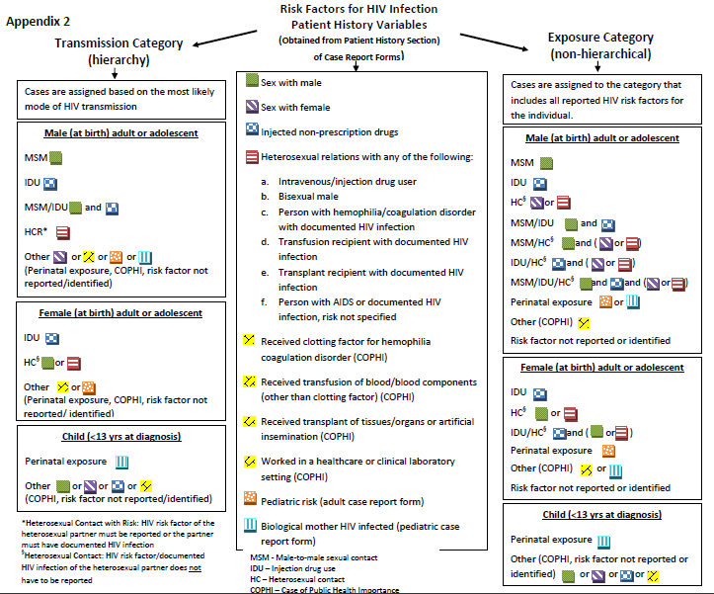

Slide 14
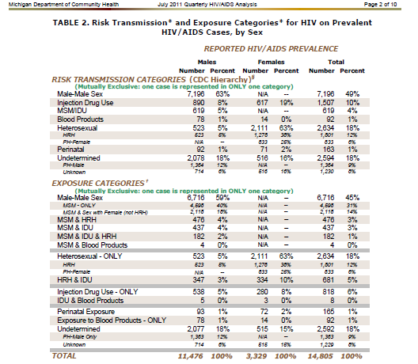

Slide 15
Process and outcome standards

Slide 16
Process Standards
75% of all initial case reports should have at least one PHV marked as “yes” on the CRF
  if a laboratory report was the initial report, then 75% of the first subsequent case report forms
  When calculating, numerator should not include cases for males whose only PHV marked as “yes” is “sex with female”
All initial reports reviewed by health department staff to prioritize/determine if epi follow-up necessary
NIR cases are followed up within one month of initial case report date

Slide 17
Process Standards
Program conducts audits on a regular basis (at least annually) to assess the degree to which the outcome standard has been achieved
Written manual with policies, procedures, and training and evaluation plans

Slide 18
Outcome Standard
At least (≥) 85% of cases for a report year have sufficient HIV risk factor information to be classified into a transmission category
  Standard is assessed 12 months after the report year
  CDC-supplied SAS program must be used to assess completeness of risk factor ascertainment for HIV disease cases reported during a calendar year

Slide 19
Risk Factor Ascertainment Procedures

Slide 20
Risk Factor Ascertainment Procedures
Designate staff person responsible for RF Ascertainment
Prioritize follow-up
1-COPHI
2-NIR cases (no patient history
variables reported as “yes”)
3-Cases reported with incomplete RF info (insufficient info to classify into a transmission category)
4-New cases over old ones

Slide 21
NIR follow-up
All NIR cases should be followed up (no time limit)
  Investigations should continue until all reasonable sources of information have been exhausted
Medical chart review at initial reporting facility
  If lab first facility of report, the next subsequent care facility of case report
Prioritize facilities based on number of NIR cases

Slide 22
NIR follow-up (cont.)
Inquire about all PHVs
  RF investigation should not stop because one PHV reported as “yes”
  If provider leaves PHV field blank, do not assume it means “no”

Slide 23
Data Quality Assurance
Visual editing of 100% of hardcopy case reports
Monitor NIR cases by field staff
Re-abstract first 10-20 records of new staff

Slide 24
Education and training

Slide 25
Procedural Manual
Manual should be specific
  what sources of information/facilities are to be searched & in what order
  what evidence/documentation is acceptable for a particular risk factor
  the importance of collecting information on multiple PHVs & not stopping when a single PHV has been selected
  performance expectations in terms of turn-around time, communication with providers, etc.

Slide 26
Risk Factor Training & Education
Goals
  Provide concise, clear training materials
  Be more proactive (surveillance staff)
  Systematic reminders & re-training

Slide 27
Risk Factor Training
Experienced Surveillance staff provide routine risk factor ascertainment training to both:
  Internal staff
  External reporting providers
Why?
  Share expertise + credibility
  Provide consistent definitions & guidelines
  Reminder to provider
    ask about all known HIV risk factors & document

Slide 28
Internal Staff Training
New Staff
1) Provide early orientation
    Stress importance →
    patient history variables = demographics
    How & why important
    Give staff tools
      packet of risk factor definitions (new guidelines)
      written materials: how patient history variables collected locally

Slide 29
Internal Staff Training
New Staff
2) Provide more extensive training
  Senior staff presenter
    Big picture: consequences of missing data
    Examples
    Sample exercises
  Strategies for eliciting patient history information from providers
  Re-abstract to test what’s learned

Slide 30
Internal Staff Training (cont.)
Re-training existing staff
  At least annually
  Presentations, meetings, newsletters, etc. (opportunity for updates)
  Ensures consistent, single message
  Generate summary reports by staff on NIRs to identify areas needing improvement

Slide 31
Education & Training of Providers
Be clear, realistic, & concise
Reporting aids
  HIV risk factor definitions
  Patient- and provider-administered questionnaires
Direct to the right person at the facility
  Consider staff turnover

Slide 32
Education & Training of Providers (cont.)
Train at least one person/site
Via existing visits, training sessions, meetings, letters, e-mail, etc.
Maintain a log
  Facilities that have/not been trained
  Identify & target those that do not document risk
Include Dear Dr. Letter – include HIPPA, confidentiality, etc.

Slide 33
Education & Training of Providers (cont.)
Annual & routine risk factor communication
  Visits, calls, e-mails, newsletters, training sessions, meetings, professional publications, etc.
Give feedback early
Use the feedback reports
  Data tables, Q/A management reports, etc.
    missing risk factor data
    incomplete reporting
    goal = yes, no, or unknown for each risk factor for each case

Slide 34
Numerous Tools for Providers
CDC Risk
Factor
Definitions
Patient
Questionnaire
Provider-
Administered
Questionnaire
Dear Dr.
Letters:
HIPPA, Reporting,
Confidentiality
Tool Kit &
Provider Ltr
Feedback
report

Slide 35
Major Changes from previous Technical Guidance
Revised definition of “Risk Factor”
Added patient history variable (PHV) to list of standard terms
Prototype Forms for Collecting Risk Factor Data removed
Added “Risk Factor Assignment Diagram” (Appendix 2)
Discontinued use of “No reported risk” (NRR) category
Assessment of RF outcome standard no longer allows for the use of a representative sample; CDC-supplied SAS program must be used for assessment
Updated definition for categorizing cases into female heterosexual contact category
HIV risk factor definitions updated to include current terminology

Slide 36
Exposure Category Implementation Workgroup
State/local representatives
  Sara Bodach (New York City)
  Sharon Carter (Virginia)
  Erika Chapman (Indiana)
  Sutopa Chowdhury (Rhode Island)
  Miranda Fanning (Texas)
  Garret Lum (District of Columbia)
  Mari Gasiorowicz (Wisconsin)
  Daniel Gordon (NY state)
  Victoria Lazariu (NY state)
  Mark Miller (West Virginia)
  Eve Mokotoff (Michigan)
  Thomas Shavor (Tennessee)
  Yaa Simpson (Chicago)
  Stephanie Townsell (Chicago)
  Jenna Waggoner (North Carolina)
CDC representatives
  Anna Satcher Johnson
  Stacy Cohen
  Patricia Joyce
  Cheryl Bañez Ocfemia
  Luke Shouse

Slide 37
Technical Guidance for
HIV Surveillance Programs https://partner.cdc.gov/sites/NCHHSTP/HICSB/default.aspx

Slide 38
Questions

Slide 39
Thank you!
For more information please contact Centers for Disease Control and Prevention
1600 Clifton Road NE, Atlanta, GA 30333
Telephone: 1-800-CDC-INFO (232-4636)/TTY: 1-888-232-6348
E-mail: cdcinfo@cdc.gov Web: http://www.cdc.gov
The findings and conclusions in this report are those of the authors and do not necessarily represent the official position of the Centers for Disease Control and Prevention.
National Center for HIV/AIDS, Viral Hepatitis, STD, and TB Prevention
Place Division name here

