Slide 1
Technical Guidance for
HIV Surveillance Programs
Molecular HIV Surveillance
Rebecca Ziebell
Cheryl Bañez Ocfemia
CSTE Webinar
October 2, 2012
National Center for HIV/AIDS, Viral Hepatitis, STD, and TB Prevention
HIV Incidence and Case Surveillance Branch
Notes:
Good afternoon, everyone. My name is Rebecca Ziebell, and I am a Public Health Analyst on HICSB’s Incidence and Viral Resistance Team. Cheryl Bañez Ocfemia is unable to present to you today, so I have stepped in to present on her behalf the Molecular HIV Surveillance chapter of the Technical Guidance for HIV Surveillance Programs.

Slide 2
Objectives
To provide an overview of Molecular HIV Surveillance (MHS)
To describe general concepts related to MHS
To discuss the structural requirements, process standards, and outcome standards for MHS
Notes:
During this webinar, I will
Provide an overview of Molecular HIV Surveillance, or MHS,
Briefly describe some general concepts related to MHS, and
Discuss the structural requirements, process standards, and outcome standards for conducting MHS

Slide 3
Overview of MHS (1)
Component of the National HIV Surveillance System
Formerly known as “Variant, Atypical, and Resistant HIV Surveillance (VARHS)“
HIV nucleotide sequence data and molecular epidemiology are used :
  To estimate prevalence of HIV-1 drug resistance―not limited to transmitted drug-resistance associated mutations (TDRMs)
  To monitor the distribution of HIV-1 genetic subtypes and recombinants
  To describe patterns of HIV-1 transmission
  To assist HIV-1 treatment, prevention, and program planning and evaluation
Notes:
Molecular HIV Surveillance (MHS) is a component of the National HIV Surveillance System. Prior to the 2013 Funding Opportunity Announcement earlier this year, this activity was referred to as Variant, Atypical, and Resistant HIV Surveillance (VARHS). With the new FOA, we have expanded upon the goals and objectives of VARHS.
Like VARHS, MHS still collects HIV nucleotide sequence data. However, a broader emphasis will be placed on using the tools and principles of molecular epidemiology:
To estimate the prevalence of and monitor trends in HIV drug resistance mutations, including, but not limited to, transmitted drug resistance–associated mutations (TDRMs);
To monitor the distribution of HIV genetic subtypes and recombinant forms
To describe patterns of HIV transmission, clusters, and diversification; and
To assist HIV treatment, prevention, and program planning and evaluation.
(Note that from this point on, all references to HIV in this presentation refer to HIV-1 infection.)

Slide 4
Overview of MHS (2)
Supports the National HIV/AIDS Strategy
HIV nucleotide sequence data:
  Might be used to determine duration of infection and estimate incidence
  Could serve as a marker for linkage to and quality of care
  Could reveal transmission patterns and provide insight into prevention
Notes:
MHS provides a unique perspective about HIV disease in the U.S. and supports the National HIV/AIDS Strategy goals of reducing new HIV infections, increasing access to care and optimizing health outcomes, and reducing HIV-related health disparities.
Specifically, HIV nucleotide sequence data that are collected through MHS activities might be used to determine duration of infection and estimate incidence, could serve as a marker for linkage to and quality of care, and could reveal transmission patterns and provide insight into prevention.

Slide 5
General concepts
Notes:
Before discussing the specifics about MHS activities, I will briefly describe some of the general concepts that are crucial to MHS.

Slide 6
HIV Drug Resistance
HIV has a rapid reproduction rate and very high mutation rate
HIV drug resistance can occur naturally
  Mutations that are drug resistant can be present, even in the absence of drug pressure
Expanded and suboptimal use of antiretroviral drugs contributes to HIV drug resistance
  CDC estimates 1 in 6 newly diagnosed HIV infections contain ≥ 1 mutation associated with transmitted antiretroviral drug resistance
Notes:
HIV has a rapid reproduction rate and a very high mutation rate, and it lacks the mechanism to correct mistakes that occur as it reproduces. Some of these mutations (i.e., polymorphisms) are naturally drug resistant. In other words, drug-resistant mutations can be present in HIV infection, even in the absence of antiretroviral drugs.
Expanded and suboptimal uses of antiretroviral drugs have also contributed to the emergence of drug-resistant strains of HIV, resulting in suboptimal virologic responses, treatment failures, and the transmission of drug-resistant strains of HIV. CDC estimates that one in six newly diagnosed HIV infections contain one or more mutations that is associated with transmitted antiretroviral drug resistance.

Slide 7
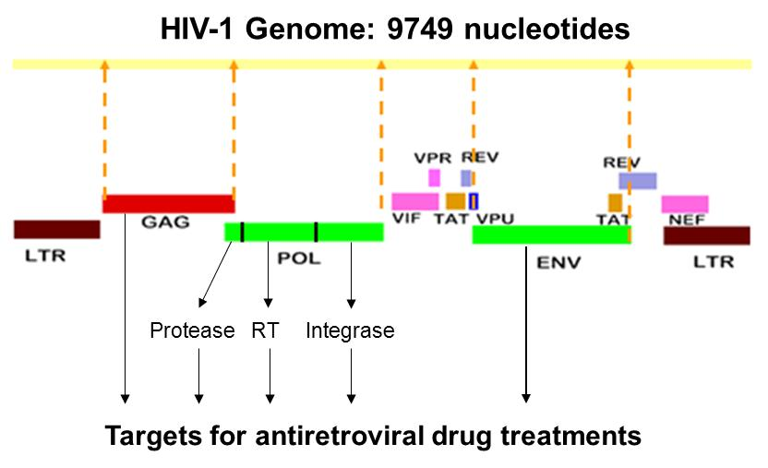
HIV Genotype Testing (1)
Considered a part of the standard of care
Detects the presence of mutations associated with antiretroviral drug resistance
Amplifies pol region of the HIV nucleotide sequence
Comparisons are made between patient’s sequence and a standard “wild-type” sequence
Notes:
HIV genotype testing is considered a part of the standard of care for persons infected with HIV and is used to detect the presence of mutations associated with antiretroviral drug resistance. The U.S. Department of Health and Human Services and the International Antiviral Society-USA (IAS-USA) recommend that HIV genotype testing be performed at entry into care, prior to initiation of antiretroviral therapy, and upon treatment failure.
Standard HIV genotypic assays extract viral RNA from the blood plasma of an HIV-infected person and amplify the protease and reverse transcriptase (RT) genes of the pol region of the HIV nucleotide sequence. The nucleotides in the amplified section of the sequence are translated into corresponding amino acids and compared to the amino acids in a standard “wild-type” sequence. Amino acids that differ from those present in the wild-type virus are called mutations, and some of these may be associated with resistance to antiretroviral drugs.

Slide 8
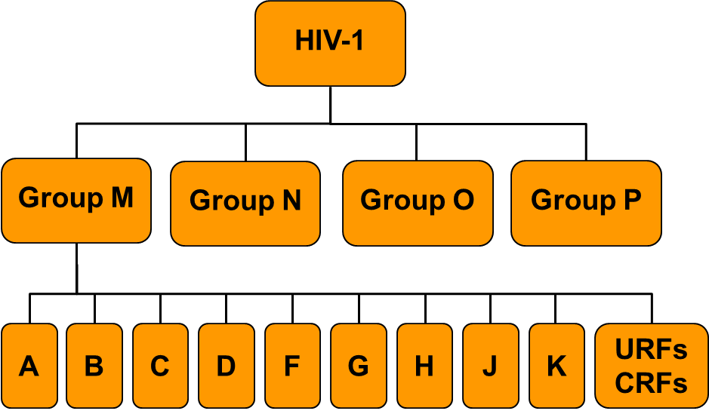
HIV Genotype Testing (2)
Distinguishes between subtype B and non-B variants of HIV-1
Phylogenetic analyses are conducted to classify potential non-B variants, circulating recombinant forms, and unique recombinant forms
Genetic Diversity of HIV-1
Notes:
Standard genotyping methods used to identify mutations associated with antiretroviral drug resistance can also be used to distinguish between subtype B and non-B variants of HIV. More advanced phylogenetic techniques are also available for more accurate classification of viral strains into the various subtypes, circulating recombinant forms, and unique recombinant forms. Phlyogenetic methods can also be used to study the relationship between HIV strains and to detect those that are closely related (i.e., clusters).

Slide 9
MHS Structural requirements
Notes:
So, now that we’ve reviewed the background information, I’d now like to switch gears and discuss the structural requirements of MHS.

Slide 10
Policies and Procedures
MHS activities should expand upon existing infrastructure of HIV case surveillance
MHS-specific policies and procedures should be incorporated into local guidance documents
Notes:
Because MHS is an extension of HIV case surveillance, MHS staff, in collaboration with CDC, should expand on the existing infrastructure to collect the information needed to achieve MHS objectives. MHS should follow the current laws and regulations of each jurisdiction and should also be conducted in accordance with the Technical Guidance for HIV Surveillance Programs and Security and Confidentiality Guidelines.
Additionally, MHS policies and procedures should be developed and incorporated into local guidance documents.

Slide 11
Staffing Needs
Collaboration with HIV case surveillance staff
Depends on phase of program implementation, HIV morbidity, resource availability
At least a partial full-time MHS coordinator and partial full-time MHS data manager
Expertise in three areas
  Programmatic
  Technical
  Scientific
Notes:
HIV case surveillance staff and MHS staff must collaborate to effectively integrate MHS into the local HIV surveillance system and to implement MHS successfully. The number of staff needed to conduct MHS activities at the local level depends on the phase of program implementation, HIV morbidity, and resource availability, but will typically include a partial full-time employee (FTE) for MHS coordination and a partial FTE for MHS data management.
MHS staff should also have expertise in three areas―programmatic, technical, and scientific―and ensure that the activities related to project coordination, surveillance and epidemiology, and data management are conducted.

Slide 12
Programmatic: Project coordination
Overall management of MHS and collaboration
Efforts to establish the regulatory authority
Development and implementation of MHS activities
Compliance with security and confidentiality requirements
Collection of antiretroviral (ARV) use history data for all new HIV diagnoses
Electronic transfer of all HIV nucleotide sequence data
Participation in CDC-sponsored meetings
Monitoring efforts to meet process and outcome standards
Notes:
From a programmatic perspective, MHS staff are responsible for the following.
The overall management of MHS and collaboration with other surveillance staff, including integration of MHS into the local HIV surveillance system
Coordination of efforts to establish the regulatory authority to obtain HIV nucleotide sequence data from laboratories, if not already available
Development and implementation of MHS activities, including local MHS guidance, policies, and procedures
Compliance of MHS activities with CDC and local security and confidentiality requirements
Collection of antiretroviral use history data for all new HIV diagnoses. areas that are currently funded to conduct HIV Incidence surveillance are already doing this, but this might not be done routinely in non-incidence funded areas
Collaboration with laboratories to develop and implement procedures for the electronic transfer of all HIV nucleotide sequence data to the health department. Though ARV use history data should be collected for all NEW HIV diagnoses, nucleotide sequence data should be collected for ALL diagnoses, not just those that are new diagnoses.
Participation in CDC area visits, trainings, and workshops highlighting MHS activities as required
Continued monitoring of MHS activities to ensure that process and outcome standards are achieved

Slide 13
Technical: Data Management
Receipt, storage, processing, and analysis of MHS data
Development of processes to ensure data quality
Proficiency in Base SAS software and other data management/analytical applications
Preparation of MHS data for local analysis and transmission to CDC
Notes:
From a technical perspective, the MHS staff are responsible for
The development, integration, and maintenance of data management systems for the receipt, storage, processing, and analysis of MHS data
Development of processes to ensure that MHS meets or exceeds data quality outcome standards
Ongoing proficiency in Base SAS software and other locally-required data management/analysis applications
Preparation of MHS data for local analysis and transmission to CDC
Because nucleotide sequence data are unlike other HIV-related laboratory data, MHS staff should be familiar with the complexities of retrieving and managing these data. I will elaborate on this in just a bit.

Slide 14
Scientific: Surveillance and Epidemiology
Data analysis
Dissemination of data reports and publications
Notes:
MHS staff are also responsible for the scientific aspects, including the analysis of HIV drug resistance and subtypes and circulating recombinant forms in the jurisdiction, and development and dissemination of MHS data reports and publications for use by public health partners.

Slide 15
MHS PROCESS STANDARDS
Notes:
So, what process standards does MHS entail?

Slide 16
Process Standards (1)
Secure and confidential reporting
Collect ARV use history data for all new diagnoses and enter into the Testing and Treatment History (TTH) document in eHARS
  Ever Taken Any Antiretroviral Medications
  Name(s) of ARV Medication Taken
  Date ARVs First Began
  Date of Last ARV Use
  Date Patient Reported Information
Notes:
The secure and confidential transfer of any HIV-related data, including HIV nucleotide sequence data, is of utmost importance. Areas should review existing state and local policies on maintaining patient confidentiality and develop specific steps that will be taken to secure the data.
Information on the prior use of antiretroviral drugs for all newly diagnosed persons is needed to estimate the prevalence of total HIV drug resistance, including transmitted drug resistance-associated mutations (TDRMs). MHS areas can collect ARV use history data using the CDC Adult HIV Confidential Case Report Form or other forms (e.g., state-based case report forms). Information on ARV use should be entered into eHARS on the Testing and Treatment History (TTH) Document.
The TTH variables related to ARV use include:
Ever Taken Any Antiretroviral Medications ― this variable is used to determine whether the patient took any ARVs at any time. The information collected should indicate whether antiretroviral drugs have ever been used (i.e., no time limit should be placed on the history of antiretroviral drug use) and the date on which that information was obtained.
Name(s) of ARV Medication Taken ― this variable lists verifies that at least one medication taken was an ARV.
Date ARVs First Began ― this date represents the earliest date of any ARV use and determines whether the patient took any ARVs before the collection date of the specimen from which the nucleotide sequence was obtained.
Date of Last ARV Use ― this variable represents the date when ARVs were last taken by the patient.
Date Patient Reported Information — represents the date when this information was obtained from the patient

Slide 17
Process Standards (2)
Review or update laws and regulations
  Do they specifically reference HIV nucleotide sequence data?
  Does the language allow for broad interpretation?
Collaborate with laboratories
  Which laboratories perform HIV genotype testing?
Obtain HIV nucleotide sequence data for all diagnoses
  HIV nucleotide sequence is an intermediate product
  What method and format will be used to transfer sequence data from the laboratory to the health department?
  Electronic transfer is the preferred method
  Should comply with security and confidentiality requirements
Notes:
MHS areas should review existing state laws and regulations regarding the reporting of HIV test results to the health department. Areas should determine if HIV nucleotide sequence data are specifically referenced. If they are not, areas should work with their legal counsel to determine if the current laws and regulations can be broadly interpreted to include the reporting of HIV nucleotide sequence data (e.g., “all tests indicative of HIV infection and care”). Otherwise, areas should consider modifying existing laws and regulations to ensure the reporting of HIV nucleotide sequence data for public health surveillance.
MHS relies on collaboration with laboratories performing HIV genotype testing. Each area should identify public, commercial, and private laboratories that perform HIV genotype testing for area residents. Specifically, MHS areas should work with laboratories to determine whether HIV genotype testing occurs on-area or at a reference laboratory and establish a procedure for obtaining the HIV sequence data for all persons diagnosed, not just for those who are newly diagnosed.
As I mentioned earlier, obtaining nucleotide sequence data is not as straightforward as collecting other laboratory data. The primary output of HIV genotyping systems is a genotype report that provides a drug resistance interpretation for clinical use. However, the HIV nucleotide sequence, which is the basis of MHS activities, is an intermediate product of these HIV genotype testing systems. Additionally, sequence data are often not stored with other laboratory test results, and the HIV genotype testing system that holds the sequence data may not be connected to the laboratory’s main computer network. Close collaboration with the laboratory administration and technical staff, including IT staff, and often the manufacturer, is needed to extract the HIV nucleotide sequence data from HIV genotype testing systems and link the sequence data to standard patient information (e.g., collection date, ordering physician) prior to transfer to the health department.
Once MHS areas have established a process for extracting the sequence data from the genotyping systems, MHS areas should work with the laboratory staff to determine the best method and format (e.g., HL7 messaging, FASTA, ASCII, .txt) for transferring the files to the health department. Depending on the surveillance program’s infrastructure, technical capabilities, and state reporting laws and regulations, programs might rely on a combination of methods.
The electronic transfer of nucleotide sequence data is the preferred method. Transfer of sequence data can be coordinated with the electronic laboratory reporting (ELR) of other HIV-related laboratory data, coordinated with the transmission with data from existing state systems (e.g., NEDSS Messaging solution), or transmission of sequence data from the laboratory directly using the Secure File Transfer Protocol (SFTP).
If ELR is not currently an option, MHS areas can implement other acceptable methods, including portable and external storage components that have encryption software that meets the federal Advanced Encryption Standards (AES). If removable or external storage devices are used, these devices must include only the minimum amount of information necessary to accomplish the assigned task; must be encrypted or stored under lock and key when not in use; and must be sanitized immediately following the given task.
Regardless of the method or combination of methods selected, security and confidentiality requirements at the state and CDC should be followed.

Slide 18
Process Standards (3)
Store and validate HIV nucleotide sequence data
  eHARS functionality will be available soon
  Store sequences in original format
  Data validation is important
Link sequence data with case surveillance data
Monitor and evaluate data quality
Prepare monthly data transfers to CDC
Analyze and disseminate data
  CDC will provide a local dataset and SAS programs for analysis
  Areas with available resources can process and analyze data
  Analysis of transmitted drug-resistance associated mutations should be included
Notes:
The Laboratory Document in eHARS will soon be able to accommodate HIV nucleotide sequence data. Until then, MHS areas should develop procedures for processing and managing the sequence data upon receipt at the health department. All areas should develop processes for parsing and importing the data into a local MHS database, exporting these data from the local MHS database, and using SAS software to merge these data with CDC-specific demographic and clinical variables from eHARS.
Depending on the genotyping system, sequence data may exist as two separate nucleotide sequences from the PR and/or RT genes of the pol region or as a single, combined PR and RT sequence. Regardless, sequences should be stored in its original format.
The data should also be validated to ensure that the data received are reasonable. For example, the lengths of the sequences received should be compared to expected lengths. Sequences should also be assessed for embedded, non-sequence characters. Any findings that indicate erroneous data should be further investigated.
Once the nucleotide sequence data have been validated, the data should be linked with case surveillance information. MHS areas should develop processes for merging and linking the sequence data with other data from eHARS. Unmatched sequence data may indicate a reporting delay in eHARS or may indicate a new case that has not been reported to the HIV surveillance system.
As with other HIV surveillance data received, ongoing monitoring of the completeness and quality of MHS data elements should be conducted, and until eHARS functionality is up and running, sequence data should be merged and transferred to CDC monthly.
Data analysis for the purpose of dissemination should also be conducted. On a semi-annual basis or as deemed appropriate, CDC will provide a local dataset and accompanying SAS program for MHS areas to conduct local data analyses. Alternatively, MHS areas that have staff with knowledge of Perl, Java, and XML can choose to process the sequence data reported from laboratories by installing and using a program that can process nucleotide sequence data and identify mutations. CDC currently uses Sierra, a web service offered by the Stanford HIV Drug Resistance Database. Staff should have advanced SAS skills to locally develop their own SAS programs to read in outputs from processed sequences, apply surveillance mutation lists, and analyze the data.

Slide 19
Transmitted Drug-resistance
Associated Mutations (TDRMs)
MHS has a broader emphasis on all drug resistance associated mutations
Persons can be included in TDRM analysis (based on the CDC HIV-1 surveillance mutation list) if:
  The nucleotide sequence is from a specimen that was drawn within three months after the date of collection of the diagnostic specimen (i.e., the HIV-positive specimen that led to the report in eHARS)
  AND
  The person has no evidence of prior ARV use (as determined by ARV history use data).
Notes:
Just a quick note about transmitted drug-resistance associated mutations. As I mentioned earlier, MHS is an expansion of the goals and objectives of VARHS and has a broader emphasis on all drug resistance-associated mutations. Transmitted drug-resistance associated mutations are a subset of the total drug resistance and can still be monitored through MHS activities.
In order to be included in analysis of transmitted drug-resistance–associated mutations, persons must have
A nucleotide sequence from a specimen that was drawn within three months after the date of collection of the diagnostic specimen (i.e., the HIV-positive specimen that led to the report in eHARS).
and
No evidence of prior ARV use (as determined by ARV history use data).

Slide 20
MHS Outcome standards
Notes:
Finally, I’ll describe the outcome standards for MHS.

Slide 21
Outcome Standards (1)
Meeting other outcome standards as specified in other chapters of the Technical Guidance for HIV Surveillance Programs is important to MHS
MHS outcome standards relate only to persons residing in MHS area at time of diagnosis
Notes:
Meeting the surveillance standards for case ascertainment, data quality, timeliness, and completeness are essential to the success of MHS. The outcome standards for MHS relate only to persons who resided in the surveillance area at the time of diagnosis.

Slide 22
Outcome Standards (2)
For assessment at 12 months after the end of the diagnosis year:
  At least 50% of newly diagnosed HIV disease cases reported to the national HIV surveillance system for a calendar year should have an initial HIV nucleotide sequence from a specimen obtained within 3 months of HIV diagnosis
  At least 85% of newly diagnosed HIV disease cases with a nucleotide sequence reported to the national HIV surveillance system for a calendar year should have HIV treatment history data.
Notes:
For assessment at 12 months after the end of the diagnosis year,
At least 50% of newly diagnosed HIV disease cases reported to the national HIV surveillance system for a calendar year should have an initial HIV nucleotide sequence from a specimen obtained within 3 months of HIV diagnosis, and
At least 85% of newly diagnosed HIV disease cases with a nucleotide sequence reported to the national HIV surveillance system for a calendar year should have HIV treatment history data.

Slide 23
Main Takeaway Points
MHS is a component of the National HIV Surveillance System
Integration with case surveillance is key
HIV nucleotide sequence data and ARV use history data can provide a unique perspective about HIV disease in the U.S.
Notes:
MHS is a component of the National HIV Surveillance System,
Integration with case surveillance is key, and
HIV nucleotide sequence data and ARV use history data can provide a unique perspective about HIV disease in the U.S.

Slide 24
Acknowledgements
State and Local Representatives | CDC Representatives
Rory Angulo (Connecticut) | Cheryl Bañez Ocfemia
Mary-Grace Brandt (Michigan) | Rebecca Ziebell
Mariama Gondo (Florida) | Joseph Prejean
Dan Gordon (New York) | David Kim
Tom Jaenicke (Washington) | Richard Kline
Michelle Porter (Texas) | Magan Pearson
Lucia Torian (New York City) | Neeraja Saduvala

Slide 25
Questions

Slide 26
Thank you!
For more information please contact Centers for Disease Control and Prevention
1600 Clifton Road NE, Atlanta, GA 30333
Telephone: 1-800-CDC-INFO (232-4636)/TTY: 1-888-232-6348
E-mail: cdcinfo@cdc.gov Web: http://www.cdc.gov
The findings and conclusions in this report are those of the authors and do not necessarily represent the official position of the Centers for Disease Control and Prevention.
National Center for HIV/AIDS, Viral Hepatitis, STD, and TB Prevention
Place Division name here

