Slide 1
Technical Guidance for
HIV Surveillance Programs
--
Special Diagnostics
Richard M. Selik, MD
M. Patricia Joyce, MD
Medical Epidemiologists
CSTE Webinar
November 27, 2012
National Center for HIV/AIDS, Viral Hepatitis, STD, and TB Prevention
HIV Incidence and Case Surveillance Branch

Slide 2
Learning Objectives and Overview
Meaning of “special diagnostics”: Tests to
  Resolve uncertain infection status
  Identify unusual viral strains (especially HIV-2)
Reasons for uncertain infection status
  False negative tests
  False positive tests
Rationale and definition for stage 0 HIV infection
Reason for misclassification of HIV type
  Antibody cross-reactivity
Surveillance definition of HIV-2 infection
Relation of special diagnostics to COPHI
Process standards for special diagnostics

Slide 3
Definition of Special Diagnostics
Special (non-routine) tests to:
Resolve uncertain infection status (generally by use of nucleic acid tests [NATs])
Identify unusual viral strains (especially HIV-2)
Compare viral strains in transmission network (phylogenetic sequencing)

Slide 4
Reasons for Uncertain Infection Status (1)
False negative tests
  Early HIV infection
    Before RNA has increased enough to be detectable, about 10 days after infection (“eclipse period”)
    Before p24 antigen has become detectable (2 weeks after infection)
    Before antibodies have increased enough to be detectable (“window period”)
      IgM antibodies (detectable 3 weeks after infection)
      IgG antibodies (detectable 4 to 6 weeks after infection)

Slide 5
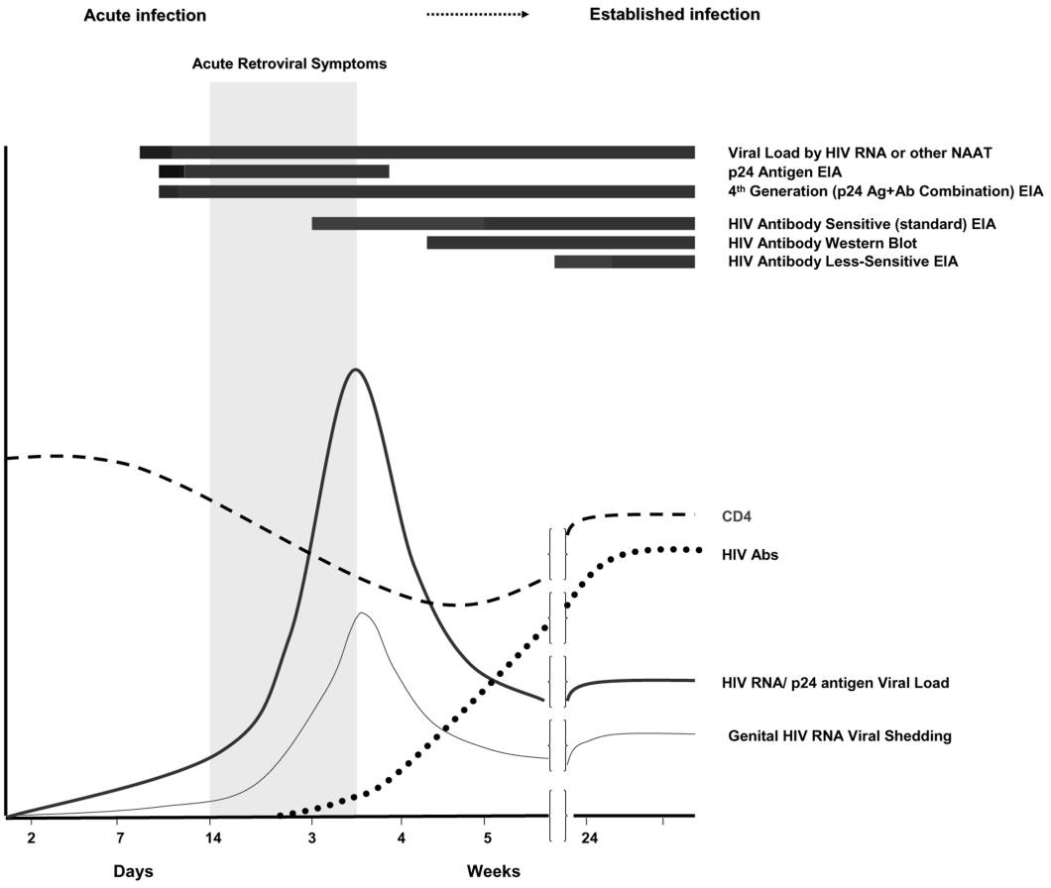
False Negative HIV Tests occur during Eclipse Period and Acute Infection
Eclipse
Period
RNA
Nucleic acid tests
(e.g., RNA viral load)
Symptoms
4th gen. combination antigen/antibody test
p24
antigen
IgM IA
Western blot (IgG)
Acute Infection
Antibody tests
Nucleic acid tests (e.g., viral load) and antigen tests
CD4 T-lymphocyte count
HIV antibody
RNA in blood
Genital viral shedding
1 2 3 4 5 24
Weeks after infection

Slide 6
Reasons for Uncertain Infection Status (2)
False negative tests (continued)
  Late HIV infection (impaired antibody production due to advanced HIV disease)
  Pre-existing impaired antibody production (e.g., congenital immunodeficiency, or acquired immunodeficiency due to immunosuppressive medication)
  Immune suppression of viral replication by an unusually strong immune system, causing undetectable viral load (“elite controller” )

Slide 7
Reasons for Uncertain Infection Status (3)
False negative tests (continued)
  Unusual HIV strains
    Rarely a reason for false negative results with currently available initial antibody tests but HIV-2 could yield indeterminate HIV-1 Western blot result
    HIV-2 infection gives undetectable HIV-1 viral load results
  Sample-handling errors
    Mislabeling
    Incorrect storage temperature
  Defective test kit

Slide 8
Reasons for Uncertain Infection Status (4)
False positive tests
  Passive transfer of maternal antibodies to an infant
  Nonspecific antibody reactivity (to non-HIV antigens)
  False positive NAT (especially if low but “detectable” viral load) due to contamination of specimen
  Sample-handling errors
  Defective test kit

Slide 9
Rationale for Stage 0
Staging system cannot apply to early HIV infection if stage depends only on CD4 test results or OIs, because low CD4 levels and OIs can occur in early HIV infection, which could lead to confusion between early HIV infection and stage 3.
Early HIV infection
Low CD4 T-lymphocyte count
CD4 T-lymphocyte count
HIV antibody
RNA in blood
Genital viral shedding
1 2 3 4 5 24
Weeks after infection
Based on: Pilcher CD, Christopoulos KA, Golden M. Public Health Rationale for Rapid Nucleic Acid or p24 Antigen Tests for HIV. The Journal of Infectious Diseases 2010; 201(S1):S7–S17.

Slide 10
Rationale for Stage 0
Defining Stage 0 as diagnosis within 6 months after negative or indeterminate HIV test results
  Enables early HIV infection to be included in staging system independent of CD4 test results and OI diagnoses
  Brings attention to important opportunity for prevention of transmission to other persons
    Includes acute infection, associated with high viral load and high infectivity
    Promotes early treatment
    Uses negative test results available for high-risk persons who test every several months

Slide 11
Criteria for Stage 0 HIV Infection
Involve “special diagnostics” because of diagnostic uncertainty due to discordant test results
Apply to all ages
  Adults
  Adolescents
  Children known not to have acquired HIV infection perinatally from their mother

Slide 12
Stage 0 may be recognized based on:
Testing history: Negative/indeterminate conclusion of test results in past 180 days, and positive conclusion of test results now (may include non-acute infections) or
HIV testing algorithm with conclusion of acute infection, such as
  Positive initial serologic test (e.g., 4th generation combination antigen/antibody test)
  Negative or indeterminate supplemental antibody test
  (e.g., HIV-1/HIV-2 type-differentiating immunoassay),
  Concluding positive HIV-1 NAT
or
  Negative initial serologic immunoassay
  Concluding positive HIV-1 NAT

Slide 13
Exception
HIV infection is not Stage 0 if negative or indeterminate HIV test used as criterion for earliness was preceded by >60 days by clinical or laboratory evidence of earlier onset of HIV infection, such as
CD4 T-lymphocyte test result indicative of stage 3
Opportunistic illness indicative of stage 3
Confirmed positive HIV test result
“Physician-documented” (not laboratory-test-documented) diagnosis of HIV infection

Slide 14
Surveillance Programs Should Persuade Labs to Report Stage 0 Acute Infection by:
Routine reporting of all test results in the algorithm (including preliminary results of initial tests and negative or indeterminate antibody test results preceding the positive NAT), enabling surveillance program to recognize acute infection when results are reviewed
and/or
Specially notification (e.g., by phone) on finding acute infection

Slide 15
Misclassification of HIV Type due to
Cross-Reactivity of Antibody Tests
Initial antibody immunoassays (e.g., HIV-1/2 + O) are designed to detect both HIV-1 and HIV-2 antibodies, but not to distinguish between them.
HIV-1 and HIV-2 Western blot antibody tests usually cross-react with antibodies of the other type
  HIV-1 WB is positive in most HIV-2 infections
  HIV-2 WB may be positive in HIV-1 infections
To avoid misclassification of HIV type, tests with greater specificity are needed
  HIV-1/HIV-2 type-differentiating immunoassay
  (e.g., Multispot)
  HIV-2 DNA test and HIV-1 RNA test

Slide 16
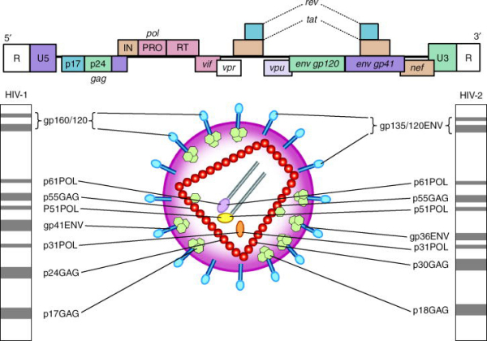
HIV-1 and HIV-2 Proteins detected by Western blot

Slide 17
What are COPHI ?
Cases of public health importance (COPHI) are those cases where either:
-the risk factor reported is unusual
-or where other circumstances exist, such as unusual strains of HIV
These may necessitate investigation, intervention, or communication with CDC

Slide 18
COPHI consist of 2 basic types
Unusual risk factors
Transplants, transfusions, hemophilia, occupational, non-neonatal pediatric, and others
Special diagnostic (problems)
Difficulty detecting atypical HIV strains
  (HIV-2; possible Group O; others)

Slide 19
HIV-2 Risk Factors
Native of West Africa or other endemic area
Sex partners of person from country where HIV-2 is endemic or known HIV-2 infected
Persons who received blood transfusion or had non-sterile injection in country where HIV-2 endemic
Persons who shared needles with person from HIV-2 endemic country, or with person known HIV-2 infected
Children of women with risk factors for HIV-2 infection or who are known HIV-2 infected
TG Vol 1 Page 26 (3-27) Appendix 3 August 2007

Slide 20
HIV-2 Prevalent Countries
West African nations:
Benin
Burkina Faso
Cape Verde+
Cote d'Ivoire+
Gambia+
Ghana
Guinea
Guinea-Bissau+
Liberia
Mali+
Mauritania+
Niger
Nigeria+
Sao Tome
Senegal
Sierra Leone+
Togo
Other African Nations:
Angola+
Mozambique+
Other countries where HIV-2 reported:
Portugal
France
India
Brazil
Canada
United States
(+ indicates more than 1% HIV-2
prevalence in general population)

Slide 21
Why a COPHI Investigation ?
To investigate unusual clinical, laboratory, or geographic occurrences that have potential public health significance
To investigate cases of possible unusual transmission and provide scientific evidence to support or refute the possibility of transmission
To create epidemiologic and laboratory profiles of HIV-infected patients without detectable antibody responses
To collect information on occurrence of HIV-2 and unusual non-B subtypes of HIV-1 in US

Slide 22
What Prompted HIV-2 Testing in the Past?
Both HIV-1 screening and confirmatory tests are positive but patient has:
  risk factor for HIV-2, or
  undetectable or extremely low HIV-1 viral load when patient not on antiretroviral therapy, or
  antiretroviral therapy seems ineffective because of:
      persistently low CD4 levels, or
      decreasing CD4 count and/or signs and symptoms of clinical deterioration

Slide 23
HIV-2 Surveillance Case Definition
One or more of the following criteria:
FDA-approved HIV1/HIV-2 type-differentiating antibody immunoassay (TDAI) test result positive for HIV-2 and negative for HIV-1
Or
Positive HIV-2 NAT result (DNA test rather than an RNA test)
Or
Positive HIV-2 Western blot (WB) (or immunoblot or line assay) result and negative or indeterminate HIV-1 WB result
Or
Diagnosis of HIV-2 infection by a laboratory expert experienced in differentiating HIV-2 from HIV-1 if laboratory evidence for HIV-2 is ambiguous

Slide 24
Undifferentiated HIV
Surveillance Case Definition
The HIV type is “undifferentiated” if a laboratory expert or definitive NAT results cannot resolve ambiguous antibody-test evidence for HIV-2:
HIV-1/HIV-2 type-differentiating (TDAI) test result is “undifferentiated” (positive for both HIV-1 and HIV-2)
or
HIV-2 WB is positive and HIV-1 WB is positive

Slide 25
Dual HIV
Surveillance Case Definition
The HIV type is “dual” (both 1 and 2) if both an HIV-1 NAT and an HIV-2 NAT are positive

Slide 26
Perinatal HIV-2 Exposure
In perinatally exposed children aged <18 months, antibody tests are not used to diagnose HIV infection because of the expectation that they will be falsely positive due to passive transfer of maternal antibody, and the NAT routinely used to diagnose HIV in children is likely to be negative because it is specific for HIV-1.
An HIV-2 DNA test should be used if the mother is known to have HIV-2 infection, and a positive result would satisfy the criteria for a case.
Otherwise, the diagnosis of HIV-2 infection in a child will probably need to wait until the child is 18 months old.

Slide 27
When to Contact the CDC COPHI Coordinator for Discordant Lab?
All cases of HIV-2
Unusual HIV-1 strains if the patient has possible false-negative screening tests (e.g. Group O suspected)
Diagnostic uncertainty (e.g. to “rule-out” Acute HIV-1)
Contact Pat Joyce: pjoyce@cdc.gov or 404-639-0934

Slide 28
Process Standards
Stage 0
  Start special diagnostic investigation within 1 week after receiving report of possible stage 0 (combination of discordant test results)
  Confirm or rule out stage 0 within 1 month later
  Prioritize partner services for stage-0 cases
HIV-2
  Start special diagnostic investigation within 3 months after receiving report of possible HIV-2 infection
  Notify CDC COPHI coordinator
  Complete investigation within 3 months after start
  If HIV-2 is confirmed, answer “Yes” to eHARS question: “Did documented laboratory test results meet approved HIV diagnostic algorithm criteria?”
False positive test results
  If subsequent tests show definite absence of infection, delete false positive results from data (avoid counting non-cases as cases)

Slide 29
Major Changes from Previous Technical Guidance
Special diagnostics chapter is separate from risk factor ascertainment chapter (where main section on COPHI is)
New chapter describes causes of diagnostic uncertainty, about which CDC COPHI coordinator may be consulted
Defines stage 0 (because it may be associated with diagnostic uncertainty), which provides opportunity for prevention of transmission
Clarifies surveillance criteria for HIV-2 cases and to report all HIV-2 strains to CDC COPHI coordinator
Eliminates requirement to report unusual HIV-1 strains to CDC COPHI coordinator unless the unusual strain is associated with false negative test results

Slide 30
Main Takeaway Points
Special diagnostics are mainly for:
  Resolving diagnostic uncertainty
  Recognizing Stage 0 HIV infection
  Diagnosing HIV-2 infection
All known or suspected HIV-2 cases must be reported to CDC COPHI coordinator

Slide 31
Questions

Slide 32
Thank you!
For more information please contact Centers for Disease Control and Prevention
1600 Clifton Road NE, Atlanta, GA 30333
Telephone: 1-800-CDC-INFO (232-4636)/TTY: 1-888-232-6348
E-mail: cdcinfo@cdc.gov Web: http://www.cdc.gov
The findings and conclusions in this report are those of the authors and do not necessarily represent the official position of the Centers for Disease Control and Prevention.
National Center for HIV/AIDS, Viral Hepatitis, STD, and TB Prevention
Place Division name here

Slide 33
Surveillance Definition of Stage 0 HIV Infection
Timeline for Stage 0 diagnosis depends on scenario
Scen-ario | Test results in past testing episode | Maxi-mum interval | Test results in present testing episode
 |  |  | Initial test | Maxi-mum interval | First supple-mental test | Maxi-mum interval | Second supple-mental test
1 | Negative or Indet. | 180 days | Pos. | No limit | Positive
2a |  |  | Pos. | No limit | Negative or Indet. | 180 days | Positive
2b |  |  | Neg. /Ind. | 180 days | Positive (NAT)

