Slide 1
Technical Guidance for
HIV Surveillance Programs
Introduction to Policies and Procedures
Anna Satcher Johnson, MPH
Research and Dissemination Team Leader
CSTE Webinar
May 29, 2012
National Center for HIV/AIDS, Viral Hepatitis, STD, and TB Prevention
HIV Incidence and Case Surveillance Branch

Slide 2
Objectives/Goals
Background and purpose of HIV surveillance in the U.S.
Purpose of technical guidance for HIV Surveillance Programs
Definition of document-based surveillance
Notes:
The objectives for this webinar are to provide an overview of
Background and purpose of HIV surveillance in the U.S.
Purpose of technical guidance for HIV Surveillance Programs
Definition of document-based surveillance

Slide 3
Background of HIV Surveillance in the United States
1981 - AIDS (HIV Infection, stage 3) surveillance
1985 – 1st HIV antibody test
Mid 1990s – widespread use of highly active antiretroviral therapies (HAART) dramatically slowed progression from HIV to AIDS
2008 – all 50 states, DC, and 6 U.S. dependent areas have implemented confidential, name-based HIV surveillance
Notes:
This slides provides a very general overview of HIV surveillance in the United States since the beginning of the epidemic.
1981 AIDS (also now referred to as HIV infection, stage 3) reporting was initiated at the national level in 1981 to help monitor the scope and impact of the HIV epidemic.
In 1985, after the Food and Drug Administration (FDA) approved the first HIV antibody tes, several states expanded their AIDS surveillance systems to include surveillance for HIV infection.
Mid-1990s, associated with widespread use of highly active antiretroviral therapies (HAART) that began, the progression of HIV infection to AIDS has dramatically slowed among treated persons, and an increasing number of persons with HIV infection are living longer and staying healthier.
Although AIDS surveillance remains important because it provides information about populations for whom treatment is not accessed or has not succeeded, reliance on AIDS surveillance data alone does not adequately describe the burden of HIV disease in the population or current trends in HIV and thus the national HIV surveillance system transitioned to using HIV diagnosis and incidence data.
By 2008, all 50 states, the District of Columbia, and 6 U.S. dependent areas successfully implemented confidential name-based HIV infection reporting

Slide 4
Purpose of HIV Surveillance in the United States
At the federal, state, city and territorial levels
  To provide accurate epidemiologic data in order to monitor the incidence and prevalence of HIV infection and morbidity and mortality related to HIV disease
  To use HIV surveillance data trends to assist in public health policy planning, enhance efforts to prevent HIV transmission, improve allocation for treatment services, and assist in evaluating public health interventions
Notes:
The purpose of HIV surveillance at the federal, state, city and territorial levels are
To provide accurate epidemiologic data in order to monitor the incidence and prevalence of HIV infection and morbidity and mortality related to HIV disease
To use HIV surveillance data trends to assist in public health policy planning, enhance efforts to prevent HIV transmission, improve allocation for treatment services, and assist in evaluating public health interventions

Slide 5
Technical Guidance for
HIV Surveillance Programs
A CDC/CSTE Collaboration
Purpose: Serves as a resource for all HIV surveillance project areas and to provide a basis for standardized data collection to ensure complete, timely, and high quality data
Notes:
The technical guidance for HIV surveillance programs is a CDC/CSTE collaboration that reflects CDC and CSTE guidance for standards and best practices
The technical guidance was developed to serve as a resource for all HIV surveillance project areas and to provide a basis for standardized data collection to ensure complete, timely, and high quality data

Slide 6
Volume I:
Policies and Procedures for HIV Surveillance
Introduction to Policies and Procedures
Access to Source Data and Completeness of Reporting
Data Management
Evaluation and Data Quality
Death Ascertainment
Record Linkage
Pediatric HIV Surveillance
Data Analysis and Dissemination
Case Residency
Duplicate Review
Geocoding and Linking HIV data
Risk Factor Ascertainment
Molecular HIV Surveillance
HIV Incidence Surveillance
Integrated Epidemiologic Profiles
Reporting
Special Diagnostics
Notes:
This shows the contents of volume 1 of the technical guidance. Each chapter was developed by workgroups composed of staff from state and local health departments and CDC.
There are 17 chapters in Volume 1. Today, I will provide an overview of the 1st chapter, introduction to policies and procedures for HIV surveillance

Slide 7
Introduction to Policies and Procedures:
Contents of Chapter
Background and Purpose
Practices and Standards
Surveillance Using Document-based Data Management
Organization of Technical Guidance for HIV Surveillance Programs
CSTE Position Statements
Notes:
This slide provides an overview of what is in the introduction to policies and procedures TG chapter
Background and Purpose
Practices and Standards
Surveillance Using Document-based Data Management
Organization of Technical Guidance for HIV Surveillance Programs
CSTE Position Statements

Slide 8
Practices and Standards
Structural Requirements (prerequisites)
  What a program must, should, or may HAVE to operate an HIV surveillance system
Process Standards (best practices)
  What a program must, should, or may DO to achieve the objectives
Outcome Standards
  Measurable objectives
Notes:
To achieve the goal of uniformity with data quality from the various surveillance systems, Technical Guidance for HIV Surveillance Programs includes structural requirements (what a program must, should, or may HAVE to operate an HIV surveillance system), process standards (what a program must, should, or may DO to achieve the objectives), and outcome standards (measurable objectives).

Slide 9
Practices and Standards (cont.)
Required: Certain process and outcome standards are listed as requirements; these are activities and measurable objectives that, when met, certify a fully functioning surveillance system with high data quality.
Recommended: Other processes or measures are recommendations of best practices that will help to meet the outcome standards.
Notes:
Specific process and outcome standards are listed as requirements. These activities and measurable objectives, when met, certify a fully functioning surveillance system with high data quality.
Other processes or measures are recommendations of best practices that will help to meet the outcome standards.

Slide 10
Definition of Reportable Events
Sentinel Events
HIV exposure (children)
HIV
infection
1st positive confidential HIV test
1st CD4+ T-cell count, viral load test, and viral resistance test
1st CD4+
T-cell count <200 cells
per μL
OI
Death
Notes:
To monitor HIV in the U.S., surveillance staff need to collect accurate information for key events during the time an individual is first diagnosed with HIV infection until death.
At a minimum, information that defines a case is required to be reported. Demographic and other information that allow for follow-up of case reports and the determination of the burden of disease in the population should also be reported. Reportable information (required, recommended, optional) is described in the Instructions for Completing the Data Collection Form.

Slide 11
Document-based Data Management
Case Report Forms (adult and pediatric)
Laboratory reports
Death certificates
Birth certificates
Relevant information from other databases
Other health department reports
Notes:
This information is collected from many sources and documents, such as health care providers (adult and pediatric case report forms), laboratories (laboratory reports), and vital records offices (birth and death certificates

Slide 12
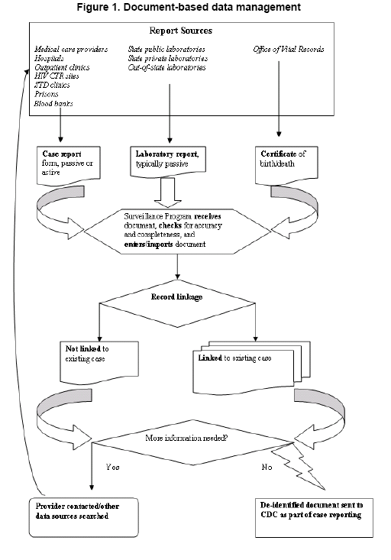
Notes:
Increased use of diagnostic laboratory testing and the growth of electronic reporting have led to an increased number of documents. Historically, consolidated information from all documents has been used to create a single case record for each HIV-infected person. CDC developed a document-based data management system to better track information received from HIV surveillance and to better monitor HIV disease progression. . Document-based surveillance requires retention of all documents received by the surveillance program that contain information on HIV cases. Other chapters of the TG describe the tasks and standards for processing these documents.

Slide 13
Electronic
laboratory
reports
Paper
laboratory
reports
Testing and
treatment
history
Case
Report
Forms
Incidence
document
Lab document
person view
Death document
Case Report Form
Document
Death
Certificate
Interstate
duplication
information
Notes:
In document-based data management, a predetermined algorithm selects the most appropriate values from incoming documents to create and update case records for analysis while still allowing for review of the overall case information.

Slide 14
Electronic
laboratory
reports
Person-based Dataset
one record per case
eHARS
unique ID
Electronic
case report
forms
Document-based Dataset
one record per document
can be many documents per case
Incidence
Forms
Notes:
Document-based data management allows information from all documents to be stored and retained electronically. Staff can refer not only to case report records, but also to original source documents.

Slide 15
Organization of Technical Guidance
    Main topic areas (see Table of Contents)
  Structural requirements
  Process standards
  Outcome measures
    Format allows for flexibility and ease of responsiveness as changes occur in methodology and as understanding of HIV disease continues to evolve
    .
Notes:
The technical guidance is divided into multiple main topic areas (such as reporting, pediatric surveillance, risk factor ascertainment….see Table of Contents page XX). Each main topic areais subdivided into structural requirements, process standards, and outcome measures. The format of the current surveillance policies and procedures allows for flexibility and ease of responsiveness as changes occur in methodology and as understanding of HIV disease continues to evolve

Slide 16
CSTE Position Statements
List of position statements drafted by CSTE that address surveillance of HIV infection can be found at the end of chapter
Notes:
The introduction to policies and procedures chapter includes list of position statements drafted by CSTE that address surveillance of HIV infection which can be found at the end of chapter

Slide 17
Technical Guidance for
HIV Surveillance Programs https://partner.cdc.gov/sites/NCHHSTP/HICSB/default.aspx
Notes:
This concludes my review of the Introduction to Policies and Procedures chapters. Once chapters have gone through the complete review process, they will be posted to HICSB’s Sharepoint drive which can be accessed at the url on the screen.

Slide 18
Questions
Notes:
Thank you for your attention. I will now take questions.

Slide 19
Thank you!
For more information please contact Centers for Disease Control and Prevention
1600 Clifton Road NE, Atlanta, GA 30333
Telephone: 1-800-CDC-INFO (232-4636)/TTY: 1-888-232-6348
E-mail: cdcinfo@cdc.gov Web: http://www.cdc.gov
The findings and conclusions in this report are those of the authors and do not necessarily represent the official position of the Centers for Disease Control and Prevention.
National Center for HIV/AIDS, Viral Hepatitis, STD, and TB Prevention
Place Division name here

