Slide 1
NIOSH Social Media in Action
Tanya Headley, MS
Health Communication Specialist, NIOSH
Mansi Das, MPH, MBA
Health Communication Specialist, NIOSH

Slide 2








Overview of NIOSH Social Media Efforts
NIOSH Website:
5.8M visits in 12mo.
MySpace:
700+ “fans
Facebook:
8000+ “likes”
NIOSH eNews:
43,000+ subscribers
Twitter: 10 “feeds”
150,000+ “followers”
NIOSH Science Blog:
25,000 subscribers
Flickr:
879 photos uploaded
YouTube:
66,000 upload views

Slide 3

NIOSH on Facebook

Slide 4
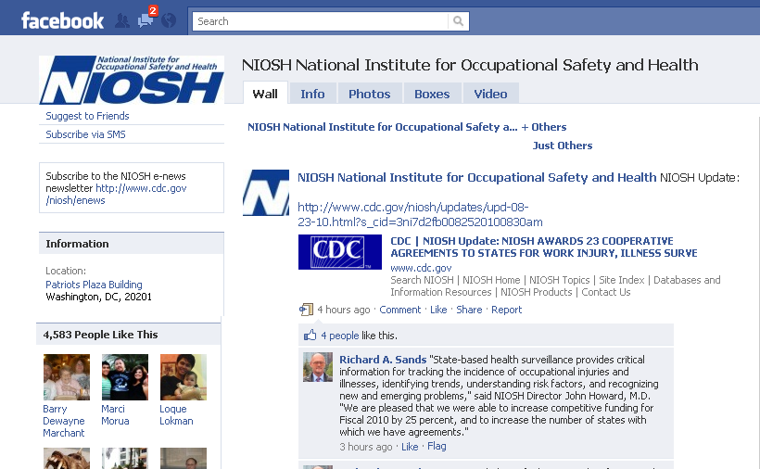
NIOSH on Facebook
10,200 user likes
5,300 average impressions (views) per post
7,000 average monthly active users

Slide 5

Facebook’s Practical Uses
Provide alternate content
Interact with fans/friends
Post applications, games, calculators
Portray “face” and “personality” of organization
Drive traffic to other channels
Announce events

Slide 6

NIOSH on Twitter

Slide 7
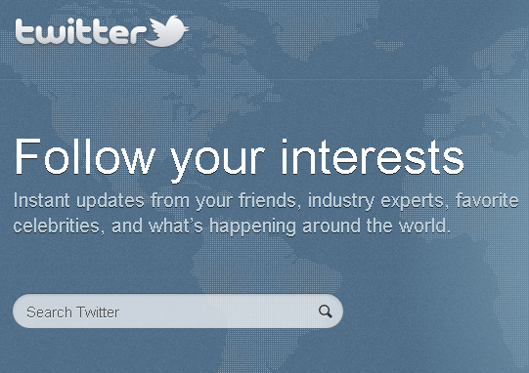
Twitter is…
A microblogging service
Limited to 140 characters
A one-to-many communication tool
A keyword generator
Twitter has…
300,000 new users every day
600 million daily searches on Twitter
More than a third of users access Twitter via their mobile phone

Slide 8
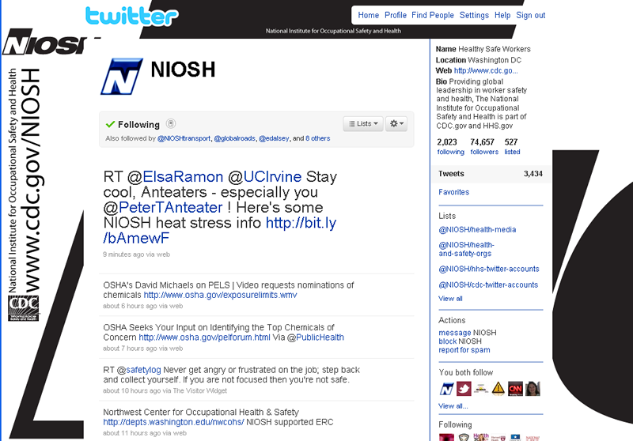
NIOSH on Twitter
146,000+ followers
6,600+ tweets
Hundreds of mentions and retweets
4,700 click-throughs

Slide 9
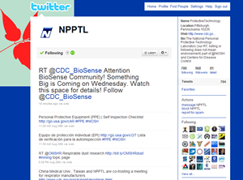
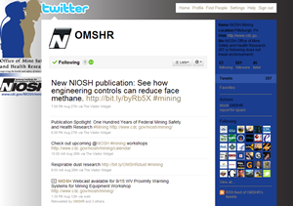
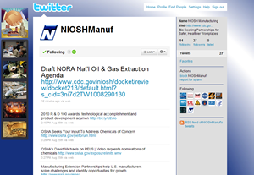
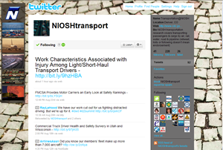
9 targeted feeds
@NIOSHConstruct
@NIOSHFACE
@NIOSHFishing
@NIOSHManuf
@NPPTL
@NIOSHNoise
@OMSHR
@NIOSHTransport
@NIOSH_FirRanges

Slide 10
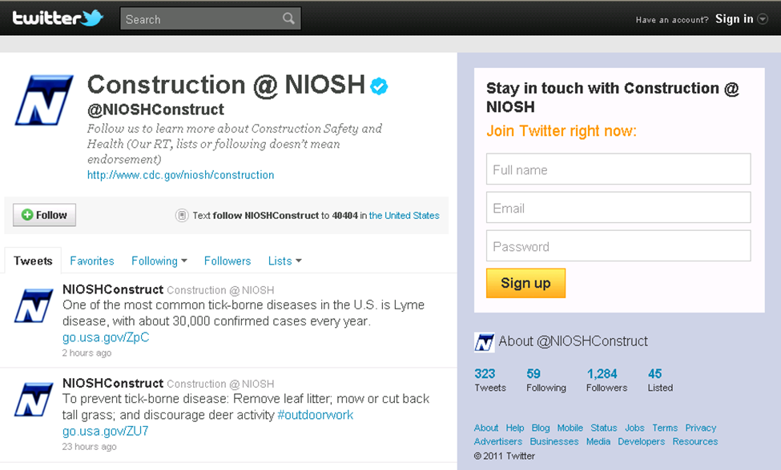
Case Study: @NIOSHConstruct

Slide 11
@NIOSHConstruct
Started in March 2010 as a trenching demo project
  600 followers
Revamped in April 2011 as Construction @ NIOSH in response to Sector Council
  3,245 followers (quadrupled in 7 months)
  928 tweets
  74 people/orgs we are following
  86 lists

Slide 12
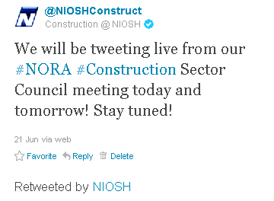
@NIOSHConstruct
5 managers in 3 locations for the Twitter account
  Each manager has a designated day to tweet
  Tweet log kept to stay abreast and record tweets
  Tweet 3-4 times per day
Live tweeting during meetings

Slide 13
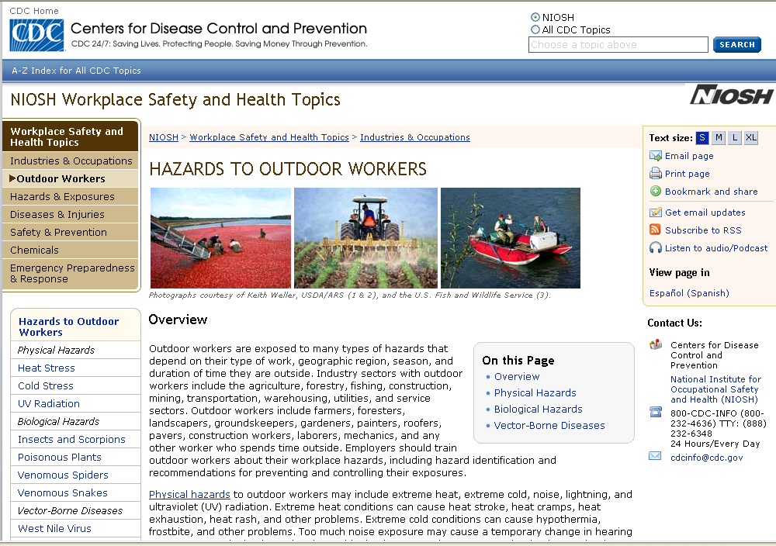
#outdoorwork Twitter Campaign
Piloted a Twitter campaign
  Construction work outdoors (June–September)
Coordinating with DOL/OSHA’s heat stress prevention campaign
Example:
  June 28, 2011
  5 tweets on UV radiation
  14 retweets
  525 click-throughs to the
  NIOSH radiation website

Slide 14
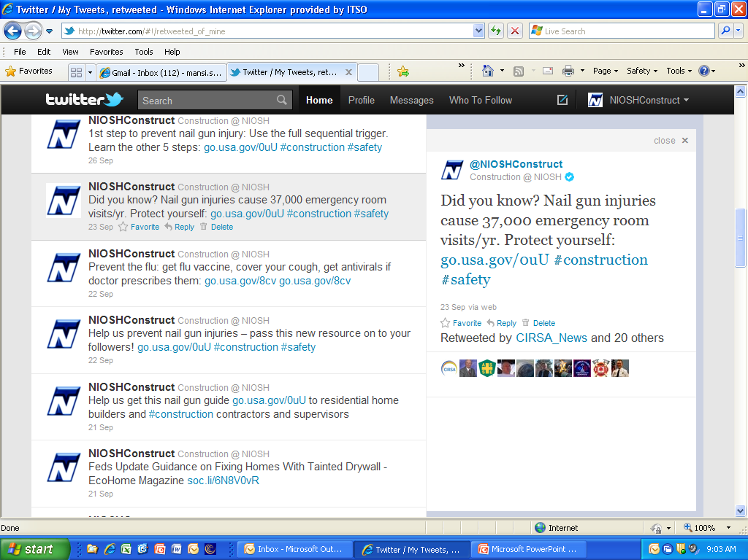
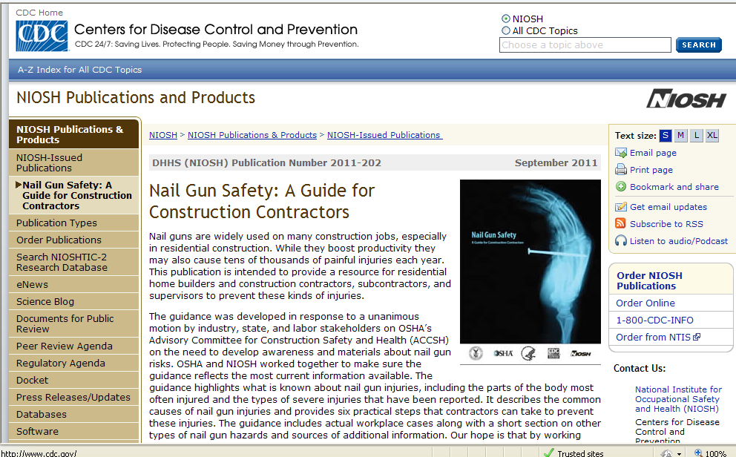
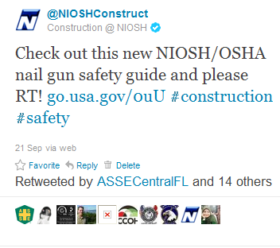
Nail Gun Safety Document
7 tweets
6 days
Same link
1,596 Click-throughs

Slide 15
Benefits
To NIOSH:
  More aware of weekly science and industry developments
  Worldwide reach
  Feedback/comments/engagement with end users
  Quick and easy dissemination
To audience:
  Information where they are, when they want it
  Feedback/comments/engagement with NIOSH

Slide 16
Challenges
Multiple audiences–sometimes info on research is of interest, other times not
Still learning how to communicate study results in accurate but short statements!
Unsure if many of our more media-traditional partners have switched over to following twitter–we may still need to rely on other vehicles to reach them
Lack of time to “follow” other groups

Slide 17
Lessons learned
Ask questions
  Tweets with questions were most often retweeted
Learn the lingo
  RT, #, @, link shorteners, #FF
Make sure click-through links are updated
Engage the sector council more to use for their purposes
Identify sources to get information
Build a log of stock tweets for slow days
Directly engage to build advocates and key informants

Slide 18
Best Practices

Slide 19
Best Practices
Share.
Listen.
Ask.
Respond.
Reward.
Demonstrate wider leadership and know-how.
Champion your stakeholders.
Establish the right voice.
Notes:
Share photos and behind the scenes info about your business. Even better, give a glimpse of developing projects and events. Users come to Twitter to get and share the latest, so give it to them!
Regularly monitor the comments about your company, brand, and products.
Ask questions of your followers to glean valuable insights and show that you are listening.
Respond to compliments and feedback in real time
Tweet updates about special offers, discounts and time-sensitive deals.
Reference articles and links about the bigger picture as it relates to your business.
Retweet and reply publicly to great tweets posted by your followers and customers.
Twitter users tend to prefer a direct, genuine, and of course, a likable tone from your business, but think about your voice as you Tweet. How do you want your business to appear to the Twitter community?

Slide 20
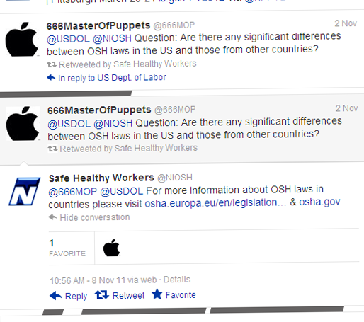
Respond to Questions & Interact
Always respond
NIOSH-Related
  Seek out subject matter expert at NIOSH
  Refer to topic page if no SME
    Non –NIOSH, OSH-related
      Find web page for related federal agency (OSHA, MSHA, etc).

Slide 21
Site/Content Management
Require clearance for new sites
Unique email addresses
Internal listing of all site managers
Only post/tweet cleared NIOSH material. Can “repost” partner materials.

Slide 22
Questions?

Slide 23
Thank You!

