Slide 1
The First Step: Conducting an Initial Assessment
CSTE webinar series
Implementing the Integrated Data Security and Confidentiality Guidelines for HIV, Viral Hepatitis, Sexually Transmitted Disease, and Tuberculosis Programs
April 18, 2013
2:30 – 3:45 pm ET

Slide 2
Webinar Agenda
Moderator: Vincent Fears, Program Consultant/Project Officer, Division of TB Elimination
Introduction and Welcome: Nathalie Roberts, Senior Advisor Program Integration in the NCHHSTP Office of the Director (PCSI)
Lead Presenter: Sam Costa, Deputy Branch Chief, QSDMB, DHAP NCHHSTP
State Grantee: Bridget Anderson, Director of the Bureau of HIV/AIDS Epidemiology, New York State Department of Health
City Grantee: Katherine Endress, Public Health Advisor, STI/HIV Division Chicago Department of Public Health
Questions and Discussion: presenters and participants

Slide 3
Webinar Housekeeping
Please note that today’s webinar is being recorded
  The presentation slides and a recording of the webinar will be available on the CSTE website’s webinar library at www.cste.org.
All phone lines have been placed on mute
There will be a question-and-answer period at the end of the webinar
  To ask a question, please use the Q&A box on the right side of your screen
Notes:
Please note that today’s webinar is being recorded. If you have any objections, you may disconnect at this time.
The presentation slides and a recording of the webinar will be available on the CSTE website at www.cste.org
Please also note that all phone lines have been placed on mute
Finally, there will be a question and answer session at the end of the webinar.
To ask a question, you may use the question and answer box on the right hand side of your screen. You may ask a question at any time during this webinar, but we will only be answering questions after the speakers’ presentations.

Slide 4
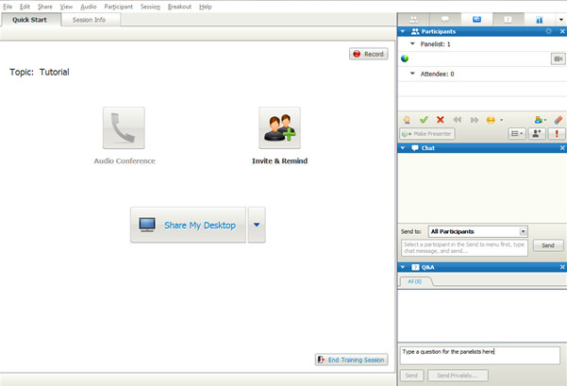
To Ask a Question
Click on the blue question mark tab on the top right panel of your screen
This will open the Q&A box on the bottom right panel on your screen
Type a question
Send it to All Panelists
Questions will be answered during the Q&A period
Notes:
Here are detailed instructions on how to ask a question during the webinar.
Click on the blue question mark tab on the top right panel on your screen.
This will open up the Q&A box on the bottom right panel of your screen.
Type a question and please be sure to send it to all panelists.
Questions will be answered during the Q&A period at the end of the webinar.
Thank you for your participation in the webinar today.

Slide 5
Webinar Agenda
Moderator: Vincent Fears, Program Consultant/Project Officer, Division of TB Elimination
Introduction and Welcome: Nathalie Roberts, Senior Advisor Program Integration in the NCHHSTP Office of the Director (PCSI)
Lead Presenter: Sam Costa, Deputy Branch Chief, QSDMB, DHAP NCHHSTP
State Grantee: Bridget Anderson, Director of the Bureau of HIV/AIDS Epidemiology, New York State Department of Health
City Grantee: Katherine Endress, Public Health Advisor, STI/HIV Division Chicago Department of Public Health
Questions and Discussion: presenters and participants

Slide 6
Integrated Data Security and Confidentiality Guidelines
The First Step: Conducting an Initial Assessment
Introduction and Welcome
Nathalie Roberts
Senior Advisor for Program Integration NCHHSTP
April 18, 2013
National Center for HIV/AIDS, Viral Hepatitis, STD & TB Prevention
Office of the Director

Slide 7
NCHHSTP Data Security and
Confidentiality Guidelines
NCHHSTP Guidelines released in 2011
Meant to help all of us protect the public health data that are the foundation of the country’s response to these infections
Standard protections help maintain public trust in public health programs
Foundation for data sharing and better service to patients and stronger surveillance programs
Allow data sharing with the confidence that the data will be protected from inadvertent release to unauthorized parties

Slide 8
First of Five Monthly Webinars in 2013
Intended to provide practical, hands-on tips, templates and dialogue
Covered areas - any program where PII is collected and/or maintained. Includes:
  HIV surveillance
  HIV prevention- Partner Services and Prevention with Positives programs
  STD surveillance and program
  Tuberculosis surveillance and case management
  Viral Hepatitis surveillance and case management

Slide 9
Intended to Foster Collaboration Between Programs
Whether your health department structure is integrated, siloed or somewhere in between if you receive NCHHSTP funding, these Guidelines apply to you
We encourage you to view these five webinars together across programs
Use this webinars as an opportunity to strengthen collaboration across programs and begin or continue the internal dialog needed for implementation

Slide 10
Future Webinar Topics
Developing Policies & Procedures; Conducting Periodic Assessments May 7, 2013, 12:30 – 1:45 EDT
Ensuring a Secure Physical & Electronic Environment; Annual Training and Certification - June 6, 2013, 2:00-3:15 EDT
Data Use and Sharing - July 2013
Handling Breaches- August 2013
Notes:
These topics cover the contents of the 2011 Guidelines and have been mentioned as areas where more guidance is needed, Dates for July and August to be determined

Slide 11
Thank you for attending and actively participating

Slide 12
Webinar Agenda
Moderator: Vincent Fears, Program Consultant/Project Officer, Division of TB Elimination
Introduction and Welcome: Nathalie Roberts, Senior Advisor Program Integration in the NCHHSTP Office of the Director (PCSI)
Lead Presenter: Sam Costa, Deputy Branch Chief, QSDMB, DHAP NCHHSTP
State Grantee: Bridget Anderson, Director of the Bureau of HIV/AIDS Epidemiology, New York State Department of Health
City Grantee: Katherine Endress, Public Health Advisor, STI/HIV Division Chicago Department of Public Health
Questions and Discussion: presenters and participants

Slide 13
Integrated Data Security and Confidentiality Guidelines
The First Step: Conducting an Initial Assessment
Sam Costa, MA
Deputy Chief, Quantitative Sciences & Data Management Branch
Division of HIV/AIDS Prevention
April 18, 2013
National Center for HIV/AIDS, Viral Hepatitis, STD, and TB Prevention
Division of HIV/AIDS Prevention

Slide 14
Integrated Guidelines- Why?
What is the reason for adopting so widely?
All public health data need to be protected; to share data across programs for public health action, all programs need to protect the information using the same standards
Public health providers and disease intervention specialists need to have complete information, especially where co-morbidity is high
To enhance successful collaborations, increase completeness of key data elements, improve the possibility of collaborative analyses, and enhance program efficiencies

Slide 15
Integrated Guidelines- Why?
Which programs do they apply to?
HIV surveillance
HIV prevention staff who handle PII (personally identifiable information):
  For example, partner services and prevention with positives
STI surveillance and program staff (DIS)
Tuberculosis surveillance and case management
Viral hepatitis prevention coordinators and surveillance

Slide 16
Do the Guidelines Apply to Anyone Else?
Yes!
Apply to those with whom you share PII data
  Local health departments and other public health partners who use the PII data collected under these guidelines. For example, it could apply to:
    Ryan White Programs
    ADDP/ADAP
    Care/Treatment partners

Slide 17
Overall Purpose for Conducting an Initial Assessment
Provide opportunity to evaluate practices across disease/program areas, whether formal polices exist or not
Identify weaknesses in current policy and practice
Identify barriers to compliance
Share experiences, lessons learned (good/bad)

Slide 18
Specific Purpose for Conducting an Initial Assessment
Identify activities specific programs conduct as part of their SOP that potentially conflict with what the Guidelines specify
That is a crucial step because it is often where compliance falters
Identify potential areas of conflict and brainstorm ways to meet needs of program operations and still comply with the guidelines

Slide 19
Approaches to Areas of Potential Conflict Between Practice and Guidelines
Define areas of difficulty
If you can’t comply with something in particular write down what you can do and start writing policy from there
Ask colleagues from other states how they approached it to share ideas (ask CDC, too!)
Remember the goals are to both protect persons’ information and to do public health

Slide 20
What is Personally Identifiable Information (PII)?
“Any information about an individual maintained by an agency, including (1) any information that can be used to distinguish or trace an individual’s identity, such as name, social security number, date and place of birth, mother’s maiden name, or biometric records; and (2) any other information that is linked or linkable to an individual, such as medical, educational, financial, and employment information.”
http://csrc.nist.gov/publications/

Slide 21
Example of Potential Conflict and Solutions - Faxing
  STI program needs to fax PII (see Appendix F)
    Create form that uses codes instead of disease names
    Minimize date elements to those absolutely required
    Program most commonly used fax numbers to decrease likelihood fax report will go to wrong # (NOT foolproof: example)
    Make sure fax machines are in a secure area
    If faxing individual case reports leave name off and call with name after faxing
    Be creative and collaborative- we all agree this is important. Not all programs have same program or business needs so how can we do our jobs and minimize risk of improper disclosure? —& don't forget fax machine probably has hard drive storage.

Slide 22
Examples of potential conflict and solutions -$$$
  Lack of funds to provide/improve physical security
    Do NOT say ”No way we can afford to do what HIV does!”
    Do NOT say “HIV way is the only way!”
    Get creative, don’t get a ‘tude
  Request permission to use funds from a better funded program to fund needs in other programs. For example:
    Buy locking file cabinets, privacy screens, cross-cutting shredder, etc.
    Install security door, put up cubicle walls in a clinic area to protect access to a computer needed to check a registry with names in it

Slide 23
Conducting an Initial Assessment- Step by Step
Guidelines include:
  Initial Assessment of Data Security and Confidentiality Protections (p 6)
  Appendix B (pp 43-44) includes a list of steps for conducting an initial assessment and guiding questions
Today we are not going to review those--next two slides just illustrate how presented.
We are providing you with practical suggestions for how to approach an initial assessment

Slide 24
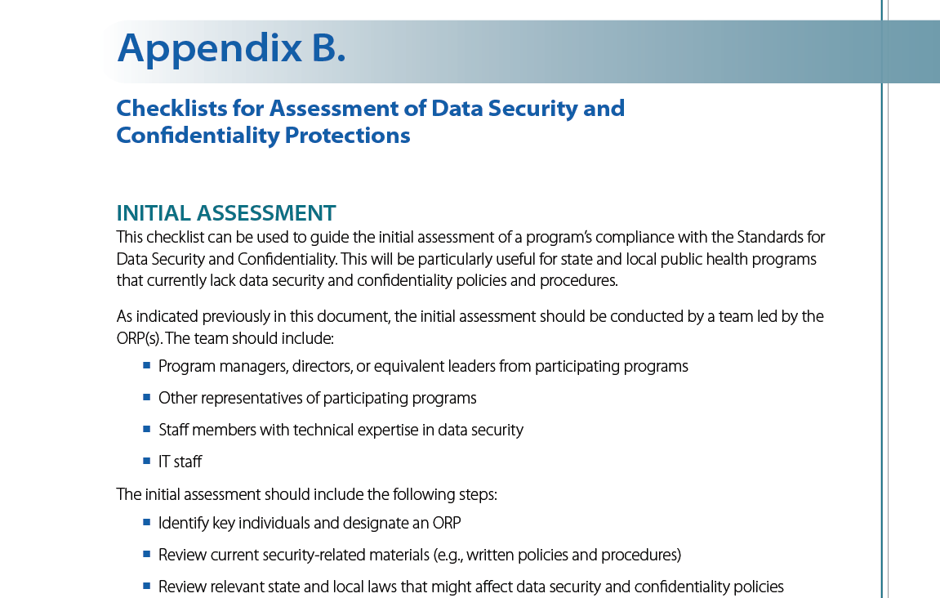

Slide 25
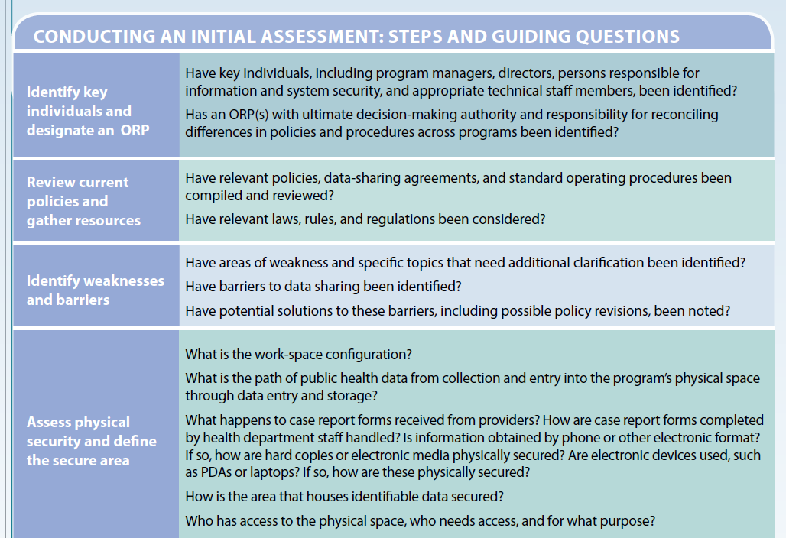

Slide 26
Same Policy, Same Access?
Does having all these disease areas follow the same policy mean that everyone has access to view & edit all the named data bases?
  No; minimum people and minimum access
Role-based access is the basis for written policy
All diseases need a written policy- it can be one policy or several – as long as they all comply with the Guidelines

Slide 27
Role-based Access
Policies and practices are related to employee role, not which disease they work with- keep this in mind when conducting initial assessment
Staff that have the same responsibilities and access to PII regardless of which disease they work with would have the same training .
  All field staff with same duties- same training
  All analysts with same duties- same training
Staff who do not use PII as part of their jobs but are in the same physical location (e.g., have cubicles in same room) as staff who work with PII also need the same training

Slide 28
Role-based Access, cont.
However, access to information such as disease specific data bases with PII should be based on “need to know” to perform one’s job
Staff should have access to the minimum information needed to perform their job
This protects staff as well as the personally identifying information

Slide 29
Role-based Access, cont.
Make a list of staff positions that need access to PII and evaluate their process for handling it
  It helps to make this list specific to roles and not individual people to communicate the message that “this isn’t about you”; it’s about what information a person in your role needs to access to perform the job

Slide 30
Is Access to PII Needed?
Theme is- if access is not needed to perform duties of the job then access to PII should be blocked. For example:
  If someone answers the phones and is located in a more public space then names do not need to be recorded
  Analysts get de-identified datasets for analysis, as there is no need for PII. For example, you can change DOB to age in analysis file to mask DOB.

Slide 31
Yes, but…….
However, do not overdo this theme
Think through with staff what they need to do their job
Remember to keep it role based and not personal
If a role needs access but does not need to edit data the people in that role can be given “Read Only” access with privacy screens as needed.

Slide 32
Suggested Approach
“Follow the information”
To see potential problems follow all the places the PII goes, both physically and electronically, to look for potential weak spots
Basic common sense but I started breaking S&C down that way when NY Times came to do a story on New Jersey’s named HIV reporting system—when it was still being debated in New York.
Notes:
NYT mentioned because a reporter & photographer certainly get your forced attention and help make you think of a pipeline and where there might be ‘leaks’.

Slide 33
Specifics of Physical Access to PII
We determined someone in your role needs access, now we ask where you work with PII
  Hard copy in the office/field?
  On your desktop in the office?
  On a laptop or tablet in the field?
  Phone conversations in the office/in the field?
  Do you talk to patients or just providers/labs or both?
  Do you work at home with PII?
Notes:
Follow information works here too—follow all potential paths & identify risks

Slide 34
How Does Mail Arrive?
How do paper forms with PII come into the office?
  Is mail placed in mail boxes? Who has access to the mail boxes? Are the mailboxes in an open room with access by people who have not had S&C training?
  Would it be more or less secure to put it on staff desks? This will vary based on the physical configuration- are staff in rooms with doors or in cubicles?
  Who sorts it? Who opens it?

Slide 35
How Are Files with PII Worked with and Maintained?
Does data entry have a secure location to work with case report forms and other documents with PII while entering?
Where are such documents stored?
  During the work day when staff leave their desks?
  Overnight and on weekends?
See Physical Security Standards for secure location discussion

Slide 36
How Are Phones Handled?
Central number? If so how are they answered by the attendant? Do they say HIV or STD or some other disease name?
Direct numbers? Are staff instructed how to answer the phone? Do they say HIV or STD or some other disease name?
Is voice mail line secure? If not does voice mail message say not to leave confidential information?
Where does phone bounce if no answer or caller presses 0? How does that person answer?

Slide 37
Moving from Physical Access to Electronic Access
Associated Security Issues

Slide 38
Follow the Info
Trace the various routes PII comes into, moves within and leaves the office
This includes physical and electronic paths
  At each point, who has/needs access?
  What is the risk of unnecessary sharing/release at each step?
Don’t forget about the hard drive in most copiers/printers/scanners/faxes today

Slide 39
Email?
Is email a secure way to communicate PII as long as information stays within your state/city system/firewall?
  No. Federal government email is “FOI-able”, & most jurisdictions have some type of “sunshine” laws governing open records, open meetings, etc.
  Email can be, and has been, accessed via Freedom of Information Act or similar requests. Even the publicity generated by challenges can be detrimental to public health---Perception is reality.

Slide 40
The Alphabet Soup of Electronic Security
What are the ways to make electronic transmission of PII more secure?
  VPN – Virtual Private Network
  SFTP – Secure File Transfer Protocol
  SDN – Secure Data Network (CDC only), soon to be Secure Access Management System (SAMS)
  PHIN messaging (or similar system)

Slide 41

Example of a Common Issue
STI/PS investigators need to know all infections a patient has before interview, but their computers are in area viewable by clients. HIV program is reluctant to give access to clinic staff working in public areas. Follow the information and suggest approaches/ideas to resolve.
Submit responses <= 250 characters
Poll will be open for 2 minutes

Slide 42
Example of a Common Issue
STI/PS investigators need to know all infections a patient has before interview, but their computers are in area viewable by clients. HIV program is reluctant to give access to clinic staff working in public areas. Follow the information and suggest approaches/ideas to resolve
  Possible approaches:
  Need access to eHARS or access to certain info in eHARS?
  “Read only” access to eHARS (or eHARS info)
  For off-site staff, calling HIV surveillance staff (or STD staff with access in office)
  Locate one secure computer to access info (data extract if not real-time eHARS access)
  Privacy screen on computer monitor
  Others?

Slide 43
Templates for Conducting an Initial Assessment [1]
Check lists
  S&C Guidelines Check List from Standards on pages 12-33
  Appendix B- Expanded: Integrates Steps and Guiding Questions
  LHD Cross Program S&C Review Monitoring Tool
  Medium Size Integrated Dept. Public Health S&C Assessment Tool
Notes:
Some of these will be discussed by our grantee presenters Bridget Anderson and Katie Endress following my presentation

Slide 44
Templates for Conducting an Initial Assessment [2]
Self-Administered Survey
  Virginia Self-Administered Review Tool for Data Analysts/List of topics covered by survey
Sample Report/Sample Scenario
  Medium Size Integrated Department of Public Health (MSIDOH) Security and Confidentiality Assessment Findings and Next Steps- Sample Report
  Sample scenario to use in training
Notes:
Some of these will be discussed by our grantee presenters Bridget Anderson and Katie Endress following my presentation

Slide 45
What Templates Would Help You?
We are still finalizing expanded checklist
If there are other particular templates that would help you do an assessment let us (CDC, CSTE) know. We cannot promise everything, but we can certainly try to help.

Slide 46
Template Timeline
The templates used in presentations should be available in the next day or two on the CSTE website.
As others are developed we will post links on PCSI site to CSTE
Also available on CSTE website: Webinar recordings & slide sets
Notes:
CSTE.org -->Trainings & Activities --> webinar library

Slide 47

  Resources (including links to CSTE site) available on the PCSI website: http://www.cdc.gov/nchhstp/programintegration/
  Post questions to pcsi@cdc.gov scosta@cdc.gov
For more information please contact Centers for Disease Control and Prevention
1600 Clifton Road NE, Atlanta, GA 30333
Telephone: 1-800-CDC-INFO (232-4636)/TTY: 1-888-232-6348
E-mail: cdcinfo@cdc.gov Web: http://www.cdc.gov
The findings and conclusions in this report are those of the authors and do not necessarily represent the official position of the Centers for Disease Control and Prevention.
National Center for HIV/AIDS, Viral Hepatitis, STD , and TB Prevention
Division of HIV/AIDS Prevention

Slide 48
Webinar Agenda
Moderator: Vincent Fears, Program Consultant/Project Officer, Division of TB Elimination
Introduction and Welcome: Nathalie Roberts, Senior Advisor Program Integration in the NCHHSTP Office of the Director (PCSI)
Lead Presenter: Sam Costa, Deputy Branch Chief, QSDMB, DHAP NCHHSTP
State Grantee: Bridget Anderson, Director of the Bureau of HIV/AIDS Epidemiology, New York State Department of Health
City Grantee: Katherine Endress, Public Health Advisor, STI/HIV Division Chicago Department of Public Health
Questions and Discussion: presenters and participants

Slide 49
Conducting a Security and Confidentiality Assessment:
The New York State Experience
Bridget J. Anderson, PhD
Bureau of HIV/AIDS Epidemiology
AIDS Institute
New York State Department of Health
Integrating Data Security and Confidentiality Guidelines for HIV, Viral Hepatitis, STD, and TB Programs: Conducting an Initial Assessment
April 18, 2013

Slide 50
Introduction
In 2011 NYS received short-term funding to assess the feasibility of implementing an early draft of the now released CDC NCHHSTP Data Security and Confidentiality Guidelines
An assessment tool was developed in conjunction with NYSDOH STD, TB, communicable disease and partner services colleagues
  The goal was to document the ability of STD, viral hepatitis, communicable disease, TB and partner services programs of the state and local health departments to meet the anticipated standards.
Notes:
In 2011 as part of the HIV Surveillance cooperative agreement, NYS was awarded short-term funding to assess the feasibility of implementing in NYS an early draft of the now released CDC National Center for HIV, Hepatitis, STD, TB Prevention’s (NCHHSTP) Data Security and Confidentiality Guidelines for HIV, Viral Hepatitis, Sexually Transmitted Disease, and Tuberculosis Programs: Standards to Facilitate Sharing and Use of Surveillance Data for Public Health Action.
The assessment was launched on 10 November with notification to the New York State Association of County Health Officials (NYSACHO) of the project and on 14 November to Commissioners or Public Health Directors across the state via USPS and blast email. Staff have commenced scheduling visits with an anticipated completion of mid December. Additionally, program areas have been contacted to inquire of their interest in receiving specific items, such as cross cut shredders, computer privacy screens and filing cabinet bar locks, to meet the anticipated standards.
The review of local and regional health department’s existing security and confidentiality procedures related to the surveillance of viral hepatitis, STD and TB was completed with 71 on site assessments and 4 conference calls. Data entry of the assessment tools is complete; data analysis and preparation of a summary report documenting the physical space configurations of local and regional health departments and their capacity to meet the standards is underway.

Slide 51
Introduction
The New York State Association of County Health Officials and the County Health Commissioners or Public Health Directors of the state were notified of the project via USPS and blast email
  The names of specific program area contacts for each local health department were confirmed as part of this communication.
  Enticement -- funding may allow the provision of a limited set of items to enhance the physical security of offices used in these program areas.
Notes:
In 2011 as part of the HIV Surveillance cooperative agreement, NYS was awarded short-term funding to assess the feasibility of implementing in NYS an early draft of the now released CDC National Center for HIV, Hepatitis, STD, TB Prevention’s (NCHHSTP) Data Security and Confidentiality Guidelines for HIV, Viral Hepatitis, Sexually Transmitted Disease, and Tuberculosis Programs: Standards to Facilitate Sharing and Use of Surveillance Data for Public Health Action.
The assessment was launched on 10 November with notification to the New York State Association of County Health Officials (NYSACHO) of the project and on 14 November to Commissioners or Public Health Directors across the state via USPS and blast email. Staff have commenced scheduling visits with an anticipated completion of mid December. Additionally, program areas have been contacted to inquire of their interest in receiving specific items, such as cross cut shredders, computer privacy screens and filing cabinet bar locks, to meet the anticipated standards.
The review of local and regional health department’s existing security and confidentiality procedures related to the surveillance of viral hepatitis, STD and TB was completed with 71 on site assessments and 4 conference calls. Data entry of the assessment tools is complete; data analysis and preparation of a summary report documenting the physical space configurations of local and regional health departments and their capacity to meet the standards is underway.

Slide 52
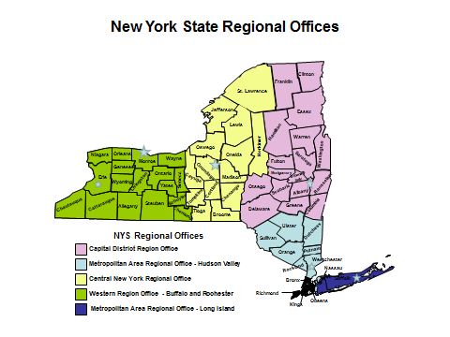
Cross-Program Security and Confidentiality Assessment
The tool was beta tested in the state STD program central office
The assessment was led by an HIV surveillance program retiree
Notes:
The tool (template included in the reference materials for this webinar) was organized around the NCHHSTP 5 standards to ensure security and confidentiality.
Program policies and responsibilities
Data collection and use
Data sharing and release
Physical security
Electronic data security
The tool was beta tested in the central office STD unit – a program with a long history of collaboration with HIV surveillance around HIV partner services and thus very attuned to the NCHHSTP level of standards.
The assessment team was lead by a recent HIV surveillance program retiree, who was well versed in the standards of security and confidentiality.
62 counties – the 5 counties/boroughs of NYC were not assessed.
The review of local and regional health department’s existing security and confidentiality procedures related to the surveillance of viral hepatitis, STD and TB and HIV-STD partner services was completed with 71 on site assessments and 4 conference calls.

Slide 53
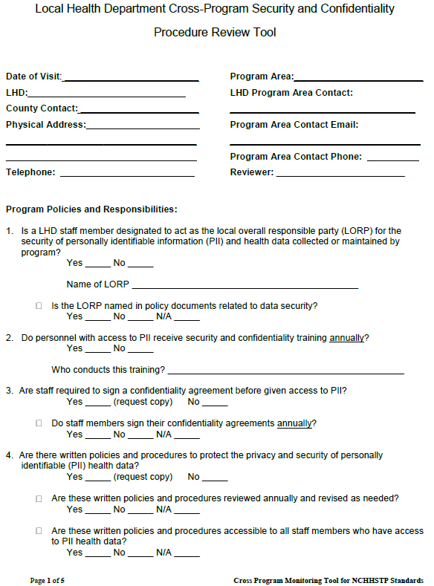
Cross-Program Security and Confidentiality Assessment
Notes:
The tool (template included in the reference materials for this webinar) was organized around the NCHHSTP 5 standards to ensure security and confidentiality.
Program policies and responsibilities
Data collection and use
Data sharing and release
Physical security
Electronic data security
The tool was beta tested in the central office STD unit – a program with a long history of collaboration with HIV surveillance around HIV partner services and thus very attuned to the NCHHSTP level of standards.
The assessment team was lead by a recent HIV surveillance program retiree, who was well versed in the standards of security and confidentiality.
62 counties – the 5 counties/boroughs of NYC were not assessed.
The review of local and regional health department’s existing security and confidentiality procedures related to the surveillance of viral hepatitis, STD and TB and HIV-STD partner services was completed with 71 on site assessments and 4 conference calls.

Slide 54
Time Frame and Process of Assessment
Two assessors traveled across the state to conduct the assessments using observational and interview techniques
  Mid-November to the end of December
  Where possible,
    multiple counties per day
    all county program offices separately
  Time constraints and local vacation schedules necessitated four telephone assessments
Dedicated administrative staff in Central Office helped with travel arrangements and performed data entry

Slide 55
Results of Assessment (1)
Assessments of 75 state or local health department STD, TB, communicable disease, immunization or HIV prevention program offices were conducted
Area Assessed
Area | Number | Percent
State - Central Office | 4 | 5.3
State - Regional Office | 6 | 8.0
Local/County Health Department Office (LHD) | 65 | 86.7
 | 75 | 100
Notes:
Most assessed offices were within the local or county health departments of the state.
For some counties, one office (and sometimes one person) was responsible for all disease program areas.
For the larger counties, the STD, TB, CD, immunization and HIV activities involve more staff and multiple office areas. These were assessed separately.

Slide 56
Results of Assessment (2)
Nearly all had a local overall party designated (LORP); however for half, the LORP is not explicitly named.
Virtually all require annual security and confidentiality training; though only 76% require an annual signed confidentiality attestation.
Most LHDs have written policies and procedures regarding the privacy and security of PII/health data; however nearly 5% reported no specific written policies.
All reported awareness of the definition of breaks in procedures and security breaches in confidentiality. However, there is unevenness in knowing what to do in follow up to a serious break or breach.
Notes:
The assessment documented that program areas were attuned the need to for security and confidentiality measures in order to protect personally identifiable information (PII); however some gaps exist.
97% of entities (73/75) had a staff member designated to act as the local overall responsible party (LORP) for the security of PII and health data collected or maintained by the program. However for about half of the entities, the LORP is not named in policy documents related to data security, but rather the LORP responsibilities are referenced to a specific position or title (i.e., Public Health Director, Privacy Security Officer).
Virtually all programs require staff with access to PII to receive annual security and confidentiality training, though only 76% (56/74) require an annual signed confidentiality attestation.
Most LHDs have written policies and procedures designed to protect the privacy and security of PII health data; however three (4.6%) LHDs reported no county health department specific written policies. All three were interested in developing written procedures and requested model procedures and or assistance with developing them.
All state, regional and LHDs reported staff awareness of the program’s definition of breaks in procedures and security breaches in confidentiality. However, there is unevenness in understanding the procedures to be taken in follow up to a serious break or breach. For example, six program areas reported not routinely reporting serious breaks or breaches in confidentiality to the LORP.

Slide 57
Results of Assessment (3)
While most program areas reported using locking filing cabinets, many stored filing cabinets in public areas or did not use double locking cabinets – defined as two locks on the actual cabinet.
Nearly 40% reported not destroying paper documents with PII/health information using a cross-cutting shredder.
All programs reported limiting the sharing of PII to those with a justifiable public health need; however, over half reported not restricting terms easily associated with HIV/Viral Hepatitis/STD/TB from data transmissions or coding PII/health information. Faxing of PII was common among the LHDs.
Program areas were diligent about protecting electronic data. However, some LHDs reported using email to transfer PII.
Notes:
Unevenness in physical security was also found:
When resources are available, staff are diligent about using the resources to secure their workstations and documents, including locking doors, file cabinets, and desks. While most program areas reported using locking filing cabinets, many either stored locked cabinets in public areas or did not have double locking cabinets.
The vast majority of programs reported limiting the sharing of PII to those with a justifiable public health need; however, over half (56%) reported that they do not restrict terms easily associated with HIV/Viral Hepatitis/STD/TB from data transmissions or code PII or health information to prevent inadvertent release (49.3%). All staff acknowledged that they are responsible for challenging those who are not authorized to access surveillance data or other documents containing patient information.
Staff are also diligent about protecting electronic data.. Most reported using the highly secure NYSDOH infrastructure, such as the NYSDOH supported password protected Electronic Clinical Laboratory Reporting System (ECLRS) or the Communicable Disease Electronic Surveillance System (CDESS), to send and receive lab and case reports. None of the programs reported the storage of confidential information on removable storage devices such as memory sticks or portable hard drives. However, some LHDs reported using secure email to transfer PII. Faxing of PII was common among the LHDs.

Slide 58
Lessons Learned:
The assessment documented that program areas are attuned the need to for security and confidentiality measures in order to protect PII and health information.
In particular, local health department program-wide and site-specific strengths and weaknesses were identified.
Results indicate that local health departments universally report concerns regarding the lack of dedicated funding for the enhancement of the physical security of their offices.

Slide 59
Successful Strategies:
Model documents and resources were requested:
  Sample restricted access signs
  Confidentiality and Security training materials
  Attestation of Confidentiality template
  Computer surplus and memory storage device destruction policies
  Sample data release policies
Using data gathered from the assessment, NYSDOH was able to mitigate many identified issues with the enhancement of physical security of office space:
  Cross-cutting shredders
  Bar locks to double lock filing cabinets
  Computer privacy screens
  White noise machines
  Door locks
  Installation of electronic security systems
Notes:
Fortunately, with the short term funding received by the HIV Surveillance Program, the
Using data gathered in the assessment, NYSDOH was able to mitigate many identified issues with the enhancement of
physical security of office space

Slide 60

Bridget J. Anderson, PhD bja03@health.state.ny.us
518-474-4284

Slide 61
Webinar Agenda
Moderator: Vincent Fears, Program Consultant/Project Officer, Division of TB Elimination
Introduction and Welcome: Nathalie Roberts, Senior Advisor Program Integration in the NCHHSTP Office of the Director (PCSI)
Lead Presenter: Sam Costa, Deputy Branch Chief, QSDMB, DHAP NCHHSTP
State Grantee: Bridget Anderson, Director of the Bureau of HIV/AIDS Epidemiology, New York State Department of Health
City Grantee: Katherine Endress, Public Health Advisor, STI/HIV Division Chicago Department of Public Health
Questions and Discussion: presenters and participants

Slide 62
Conducting a Security and Confidentiality Assessment of an STI/HIV Program:
The Chicago Experience
Katherine Endress, MPH
Public Health Advisor
Integrating Data Security and Confidentiality Guidelines for HIV, Viral Hepatitis, STD, and TB Programs: Conducting an Initial Assessment
April 18, 2013

Slide 63
Overview of CDPH STI/HIV Program
9 locations
  5 Specialty Clinics
  STI Surveillance & Syphilis Elimination Unit office
  3 Cook County facilities housing CDPH staff
Staff
  Epidemiologists
  Field Operations Managers
  Front Line Supervisors
  Clinic Disease Intervention Specialists (DIS)
  Surveillance DIS
  Data Entry Operators
  Syphilis Elimination Unit
  Adolescent Health

Slide 64
Purpose of Assessment
To ensure Clinic and Field Operations procedures are in compliance with the CDPH Confidentiality and Security Policy
To identify the following:
  Strengths, weaknesses, and recommendations to ensure compliance
  Training needs
  Staff who have access to confidential information
  Systems/databases containing patient information

Slide 65

Assessment Preparation
Why me?
  Familiarity with the program, clinics, staff, and staff roles and responsibilities
  Experience conducting clinic and field operations

Slide 66
Assessment Tool Development
CDC’s Data Security and Confidentiality Guidelines for HIV, Viral Hepatitis, STD, and TB Surveillance Programs: Standards to Facilitate Sharing and Use of Surveillance Data for Public Health Action
Chicago Department of Public Health, STI/HIV/AIDS Division, Confidentiality and Security Policy
Security and Confidentiality Requirement Checklist
  Security and Confidentiality Assessment Tool

Slide 67
Assessment Tool Development
Tool tailored for staff roles and responsibilities
  Each question was assigned to one or more of the following
    Clinic DIS
    Surveillance Staff
    Supervisors/Managers
    Epidemiologists
    All

Slide 68
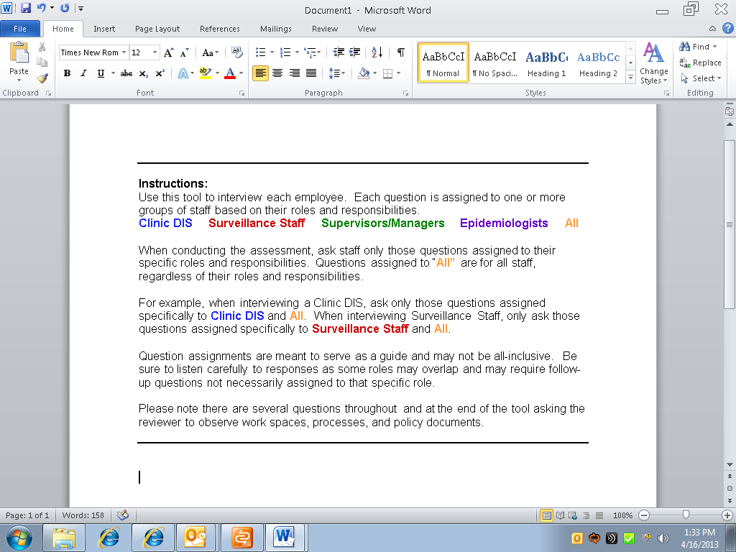

Slide 69
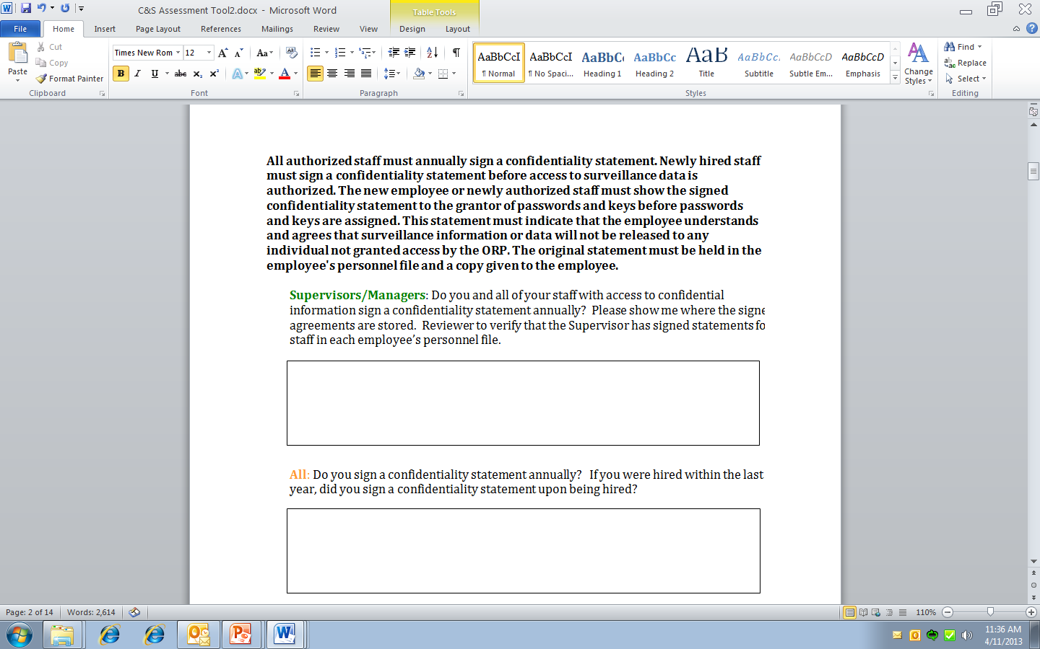

Slide 70
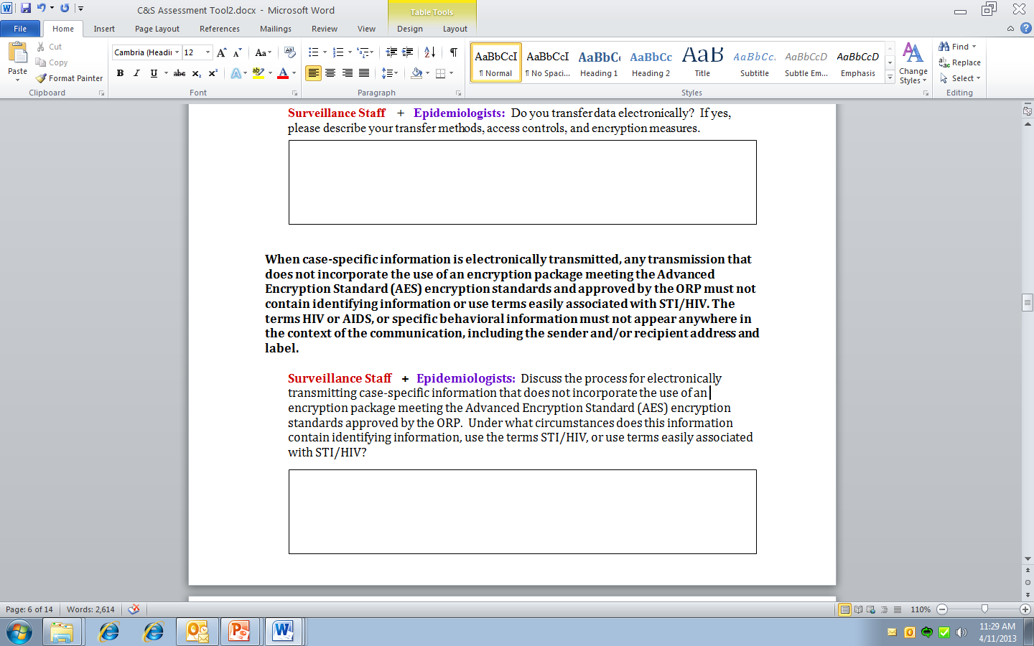

Slide 71
Tailored Tool
Benefits
  Saves time when meeting with staff and collecting data
  Allows for a more focused discussion
  Individuals appreciative = more cooperative
Challenges
  Development is time consuming on the front end
  Staff roles are not always clear cut
    Reviewer needs to listen closely to determine the need to address other areas

Slide 72
Conducting the Assessment
Schedule site visits
  Observe practices and work environments to ensure compliance
One-on-one interviews
  + Open, non-threatening environment
  -- Lack of discussion
Data entry and analysis
Develop recommendations for improvement
Document findings and recommendations
Implement recommendations for improvement, including trainings

Slide 73
Lessons Learned
Staff were very enthusiastic and cooperative
Staff recognized gaps in the existing protections and offered innovative recommendations for improvement
Staff recognized that required changes were beneficial and did not entail significant changes to current practices
Tailored approach results in greater cooperation
Different facilities have different issues
  Importance of visiting all locations and speaking with staff at all levels

Slide 74
Recommendations
Have someone familiar with the program conduct the assessment
Tailor the assessment tool to the various staff roles and responsibilities
Schedule site visits in advance
Speak with individuals one-on-one
Conduct focus groups
Follow the PHI

Slide 75

Questions?
For additional information please contact:
Katie Endress at dxn6@cdc.gov

Slide 76
Webinar Agenda
Moderator: Vincent Fears, Program Consultant/Project Officer, Division of TB Elimination
Introduction and Welcome: Nathalie Roberts, Senior Advisor Program Integration in the NCHHSTP Office of the Director (PCSI)
Lead Presenter: Sam Costa, Deputy Branch Chief, QSDMB, DHAP NCHHSTP
State Grantee: Bridget Anderson, Director of the Bureau of HIV/AIDS Epidemiology, New York State Department of Health
City Grantee: Katherine Endress, Public Health Advisor, STI/HIV Division Chicago Department of Public Health
Questions and Discussion: presenters and participants

Slide 77
To Ask a Question
Click on the blue question mark tab on the top right panel of your screen
This will open the Q&A box on the bottom right panel on your screen
Type a question
Send it to All Panelists
Questions will be answered during the Q&A period
Notes:
Here are detailed instructions on how to ask a question during the webinar.
Click on the blue question mark tab on the top right panel on your screen.
This will open up the Q&A box on the bottom right panel of your screen.
Type a question and please be sure to send it to all panelists.
Questions will be answered during the Q&A period at the end of the webinar.
Thank you for your participation in the webinar today.

Slide 78
Thank you for your participation!
Please complete the evaluation:
  https://www.research.net/s/SCwebinar1
The webinar recording and the slides will be available on the CSTE website’s webinar library: http://www.cste.org/?page=WebinarLibrary
Upcoming webinars in the series:
  May 7, 12:30 – 1:45 pm ET: Developing Policies & Procedures; Conducting Periodic Assessments
  June 6, 2:00 – 3:15 pm ET: Ensuring a Secure Physical & Electronic Environment; Annual Training/Certification
Notes:
Thank you for your participation in today’s webinar!
Your feedback is important to help improve future trainings. All information submitted will be kept confidential.
A recording of the webinar and the presentation slides will be available on the CSTE website under the Webinar Library.
The second webinar will be on May 7, 2013 from 12:30 to 1:45 pm ET and the main topics covered include developing policies and procedures and conducting periodic assessments.
The third webinar will be on June 6, 2013 from 2:00 to 3:15 pm ET and the main topics covered include ensuring a secure physical and electronic environment and annual training/certification.
We will share information on the upcoming webinars as the details are finalized.
Thank you!

